Slide 1
Quo vadis, EGI Clouds?
Michel Drescher
Technical Manager, EGI.eu

Slide 3
Where do we come from?
Where we are heading?

Slide 5
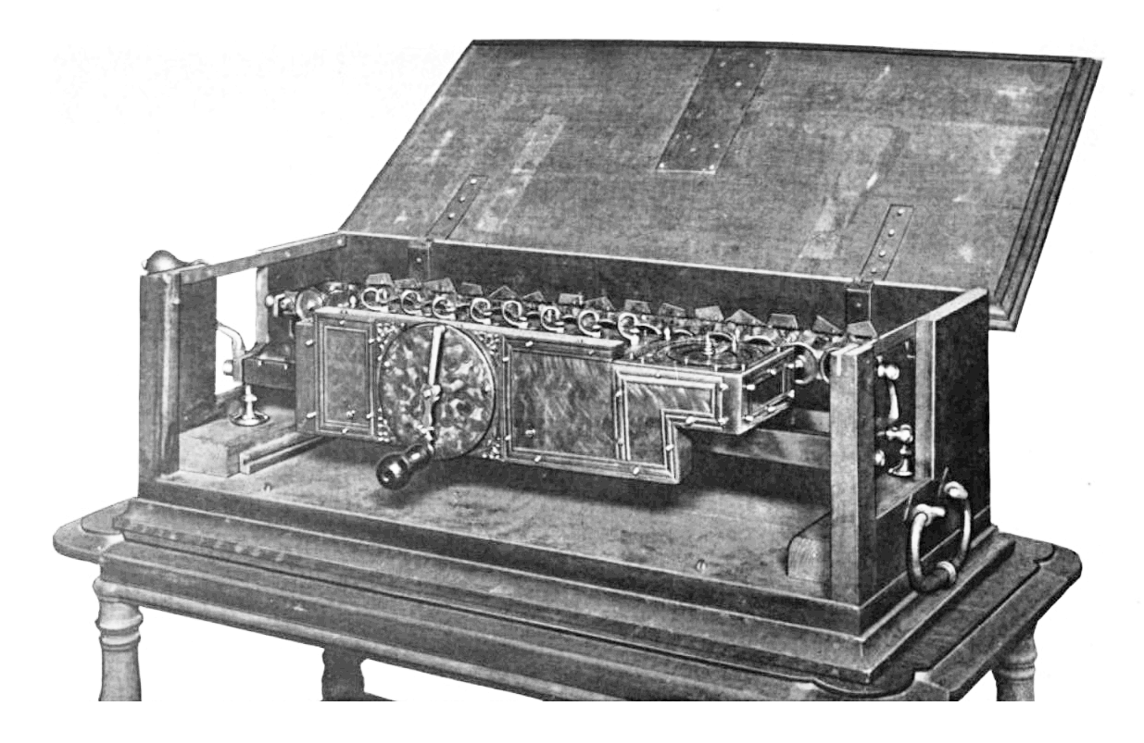
Where do we come from?
Leibnitz stepped reckoner, 1672

Slide 6
In the beginning …
EGEE was a homogenous project
Resources, Software & Users
EGEE served the “Heavy User Communities”
High-energy Physics / WLCG
Astrophysics
Earth Sciences
Life Sciences
… with one Grid middleware.
Notes:
EU “large flagship project” model
Include all that’s necessary
WLCG is by far the biggest community
Strong influence
Others tagged along as see fit

Slide 7
Why did this work out?
EGI
gLite UI, Portals, Workflows, …
Vertical Market
gLite
Infrastructure
Notes:
Heavy User Communities are
Batch Job driven
Vast amounts of data needs processing
Data is loosely coupled
High degree of parallel processing
Large overlap in requirements!
Efficient service to large communities with ONE vertical stack!

Slide 8
Does it scale?
EGI currently serves about 20,000 researchers

Slide 9
Scaling out the current model
EGI
UI layer
UI layer
UI layer
UI layer
Globus
UNICORE
gLite
Infrastructure
Notes:
Still same (physical) infrastructure
… with different Grid middlewares integrating with Batch Sub Systems
… Middleware access standards … JSDL vs. JDL vs Condor ClassAds
Manual deployment – much manual interference because:
Different architectures and languages
Different deployment models
Automation is limited
YAIM tried to solve that in gLite
Not even all gLite components supported YAIM
Political autonomy causes deployment tool fragmentation
Very different management interfaces
No common standard across all middlewares
Config file based → bad for automation!
Different traceability
Logging formats, infrastructure, detail, etc.

Slide 10
Does it scale?
Public sector: 2,000,000 researchers!
Notes:
Current 20k users are all but 1% of the potential market!
If 1% can create such an almost unmanageable diversity, how about 2 million?!?

Slide 11
We might have a problem…
?

Slide 12
Where are we heading?
HAL 9000

Slide 13
EGI Strategy for the ERA
“Three pillars supporting the EGI ecosystem”
Operational Infrastructure
Community & Coordination
VRE support
Notes:
Operational Infrastructure
Anything software being deployed in EGI
EGI stuff
Community stuff
Community & Coordination
Human Networks
Communications & Marketing
Policy & Strategy
EGI VRE support
UCST
TONC
UCB?

Slide 14
EGI Platform architecture
EGI VRE Support
EGI Collaboration Platform
“Tools & Services enabling cross-community collaboration”
Community
Platform
Community
Platform
Community
Platform
Community
Platform
EGI Cloud Infrastructure Platform
“A federated IaaS Cloud infrastructure”
Community & Coordination
EGI Core Infrastructure Platform
“Operational services necessary for the management of federated DCIs”
Physical Infrastructure
Notes:
Operational Infrastructure
Community & Coordination
Human Networks
NGI Int’l Liaisons
EGI Champions
Ops network
Virtual Teams & mini projects
Communications & Marketing
EGI Events & Workshops
Publications
NIL dispatches & Newsletters
Media, public relations, Social Media
Policy & Strategy
Strategic Analysis
Service Management
Business & Policy Development
Compendium
EGI VRE support
Community Platforms
UMD
Emerging platforms (UNICORE HPC, ARC, EGCF Globus, QCG, …)
UCST
TONC
UCB

Slide 15
EGI cloud computing!
Five characteristics of Cloud computing
[NIST SP 800-145, “A NIST definition of cloud computing”]
On-demand self-service
Broad network access
Resource pooling
Rapid elasticity
Measured service
Consistency through standards (EGI)
Notes:
On-demand self-service
Consumer provisions resources – unilaterally!
Does not require human interaction!
Broad network access
Remotely available
Uses standard access models (NOT STANDARDISED!)
Resource pooling
Multi-tenant resource
Often location-independent (not in EGI though)
Rapid elasticity
Grow and shrink resource consumption – often automated
Measured service
Self-explanatory – we account for it…

Slide 16
Core Infrastructure Platform
Pure infrastructure management
Other platforms required to integrate
Mix of central and distributed services
EGI Core Infrastructure Platform
Information
Discovery
(BDII)
Federated AAI
Monitoring
Accounting
Metrics
Visualisation
(gstat)
Service
Catalogue
(GOCDB)
Messaging

Slide 17
Cloud Infrastructure platform
EGI Cloud Infrastructure Platform
VM
Managemt.
Data
Managemt.
Information
Discovery
EGI Collaboration Platform
VM Image
Managemt.
Application Database
Cloud Management Stacks
(OpenStack, OpenNebula, …)
Image Metadata Marketplace
EGI Core Infrastructure Platform
Federated AAI
Central Service
Registry
Monitoring
Accounting
Image Repository

Slide 18
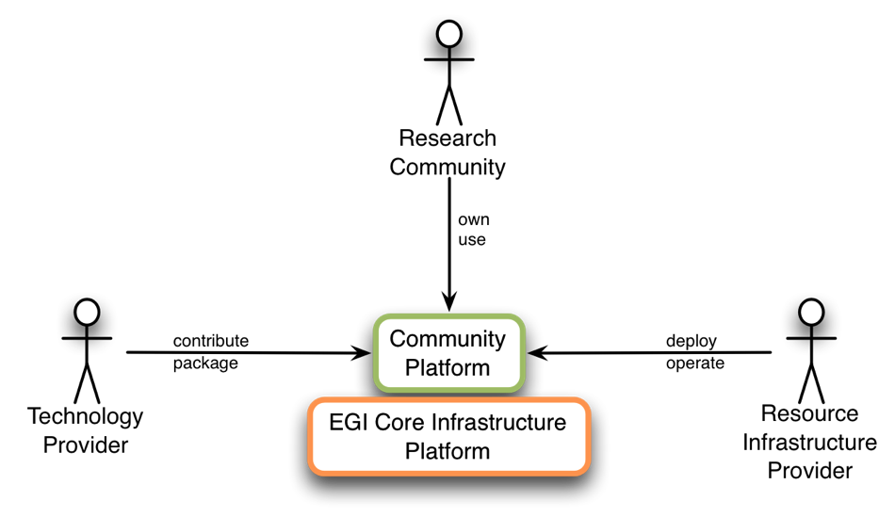
Platform stakeholders in EGI (1)

Slide 19
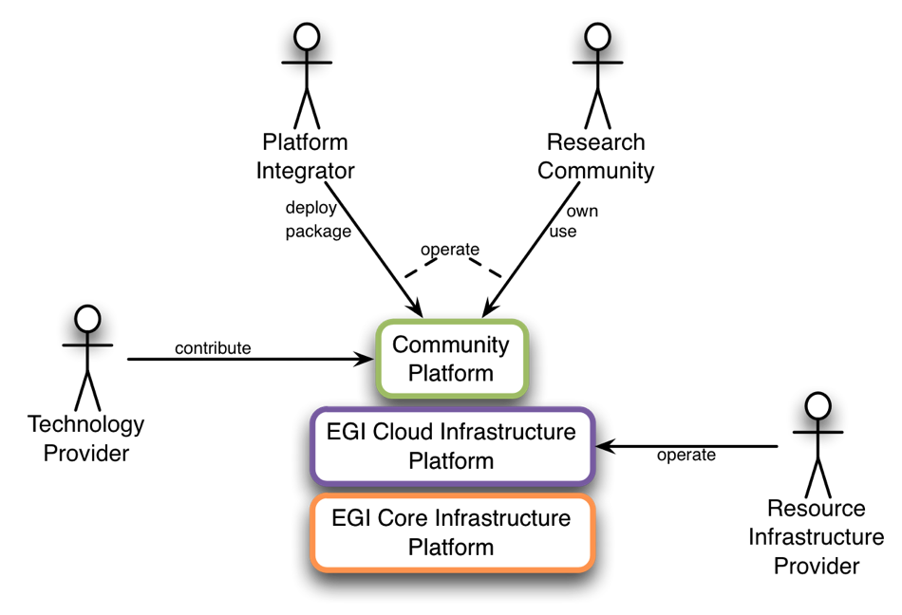
Platform stakeholders in EGI (2)

Slide 20
EGI cloud ecosystem
Gateways
Brokers
Configuration
Portals
Token pools
TONC
Load balancer
UCB
Domain
software
Registries
UCST
Federation Layer
OpenNebula
TCB
OpenStack
URT
Synnefo
WNoDeS
Operational Security
Physical Infrastructure

Slide 21
Summary
Self-service
Many-community
ecosystem
Support
&
Coordination
Federated EGI
Cloud Infrastructure platform

Slide 23
EGI cloud ecosystem
Technical Collaboration
Support services
Research
Communities
EGI Collaboration P.
Federation Layer
EGI
Technology
Providers
Resource Providers
Physical Infrastructure

Slide 24
EGI cloud computing!
Six characteristics of Cloud computing
[NIST SP 800-145, “A NIST definition of cloud computing”] + [EGI]
On-demand self-service
Broad network access
Resource pooling
Rapid elasticity
Measured service
Consistency through standards (EGI)
✔
✔
✔
✔
✔
✔

