Slide 1
EGI Online Storage
Vincenzo Spinoso, EGI, vincenzo.spinoso@egi.eu
Sep 2018

Slide 2
Online Storage
Allows you to store data in a reliable and high-quality environment and share it across distributed teams
Your data can be accessed through different standard protocols and can be replicated across different providers to increase fault-tolerance
Online Storage gives you complete control over the data you share and with whom

Slide 3
Online Storage vs Archive Storage
«Online»: the storage you access is exposed through an interface, and always available on demand for read and write operations, no matter the kind of interface it is.
It is different from the «Archive Storage»: for instance, where there underlying storage infrastructure takes some time to «prepare» for transfers (tapes are a a typical example of archive).

Slide 4
Online Storage: Interfaces
File storage: classical way of storing information based on a hierarchy of files and directories
File storage is exposed through SRM interfaces, WebDAV or other protocols
Users can do whatever is typically possible with files (read, write, copy, delete, list… ) and directories (create, delete… )
Object storage: information are not stored as files, but as objects, identified by name and (globally unique) ID
Block storage: this is an option typically usable in a VM, where you can attach and «mount» an external volume; the information on the volume is persistent and can be easily attached to alternative VMs if needed

Slide 5
Online Storage: Interfaces
Users
Object storage
File storage
CDMI
SWIFT
S3
SRM
WebDAV
POSIX
Block storage
Interfaces
Disks

Slide 6
Components (1): File Catalogues
File Catalogue
Structured representation of files in the storage.
It includes metadata, information on size, position in the disk, directories and tags.

Slide 7
Components (2): Storage Resource Management (SRM)
SRM is a standard/protocol that allows information interchange among clients and servers or two servers (3rd party copy)
SRM was written in hierarchical storage (disks and tapes), in order to allow executing complex storage calls within a single request (e.g., the client asks for a file, the file is transferred from tape to disk, then it is transferred)
Helpful with data back up and data recovery
X509 authentication is a requirement
Available on all EGI Resource Centres (it is required)
All SRM endpoints are discoverable in BDII and published in GOCDB

Slide 8
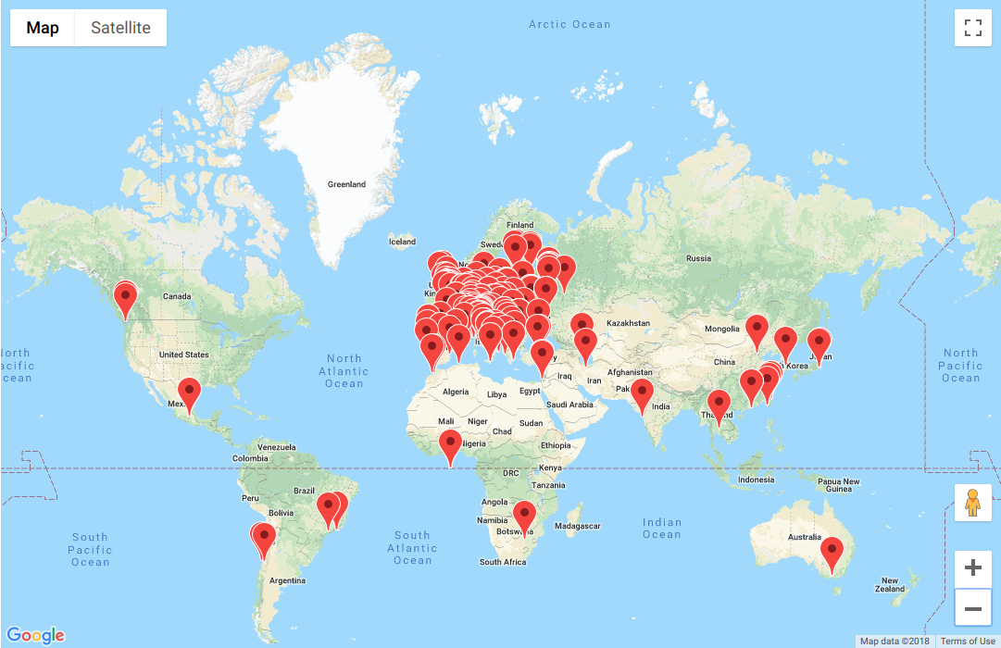
EGI Resource Centres
Every Resource Centre can provide one or more interfaces to storage
SRM endpoints can be discovered through an LDAP search on the TOP BDII, which is the EGI (dynamic) information system
SRM endpoints are published in GOCDB, the EGI configuration mnagement system, listing all the services in production on the EGI certified RCs https://goc.egi.eu/portal/
Every EGI user is affiliated to a Virtual Organization (VO) so that all users in the same VO can share their files (similar to the user/group Unix model)

Slide 9
Discovery Example
Using the BDII:
ldapsearch -x -H ldap://lcg-bdii.cern.ch:2170 -b o=grid GlueServiceType=SRM # all SRM endpoints
ldapsearch -x -H ldap://lcg-bdii.cern.ch:2170 -b o=grid GlueServiceType=SRM GlueServiceAccessControlBaseRule=VO:ops # all SRM endpoints serving the «ops» VO
Using the GOCDB (no information about the VOs!):
https://goc.egi.eu/portal → «Services» → set «ServiceType» = «SRM» and apply the filter:

Slide 10
SRM Servers and Client
There are different (interoperable) server implementations of the same SRM protocol, and different client user interfaces.
SRM server implementations, a.k.a. «Storage Resource Managers» or simply «SRM»
dCache https://www.dcache.org/
DPM http://lcgdm.web.cern.ch/dpm
StoRM https://italiangrid.github.io/storm/index.html

Slide 11
SRM Servers & Client
The different SRMs provide their own client implementation, which are usually interoperable
The best way to iteract with SRM is to use the GFAL clients https://dmc.web.cern.ch/projects/gfal-2/home which provide an abstraction layer on top of several storage protocols (dCap, GSIDCap, RFIO, XrootD, WebDAV, SRM). SRM is one of the protocols handled by GFAL.

Slide 12
Interacting with SRM using GFAL client
Authenticate using X509 VOMS-based authentication
voms-proxy-init --voms ops
Example

Slide 13
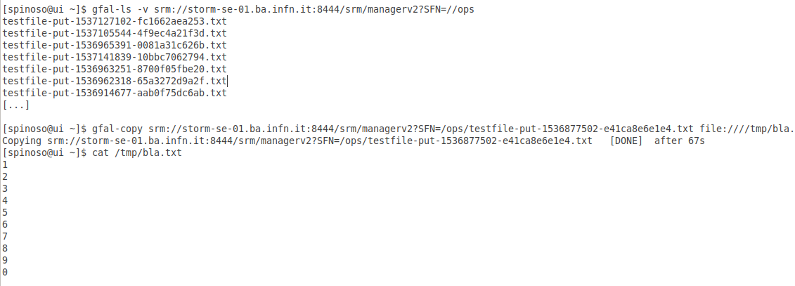
Interacting with SRM using GFAL client
List directory, get and cat (locally) a file
gfal-ls
Example

Slide 14
Interacting with SRM using GFAL client
Cat the same file remotely (i.e. without the need of getting it, but performing a remote POSIX open call)
gfal-cat
Example:

Slide 15
Interacting with SRM using GFAL client
Other GFAL commands
gfal
Example:

