Slide 1
Cloud services on the European e-Infrastructures
Giuseppe La Rocca, EGI Foundation
Lecce, 9-13 July 2018

Slide 2
EGI: Advanced Computing for Research

Slide 3
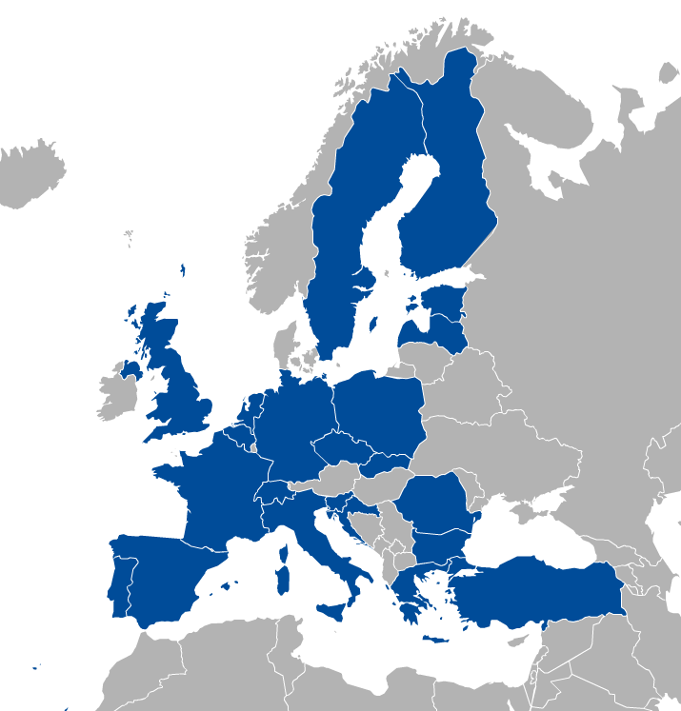
EGI: A federation of national e-Infrastructures
Established in 2010
EGI Foundation: Coordinator (Amsterdam, Science Park)
NGIs: National e-infrastructures (22 country + CERN)
Membership fees sustain the federation; Projects innovate (e.g. EOSC-hub)
Institutional representatives

Slide 4
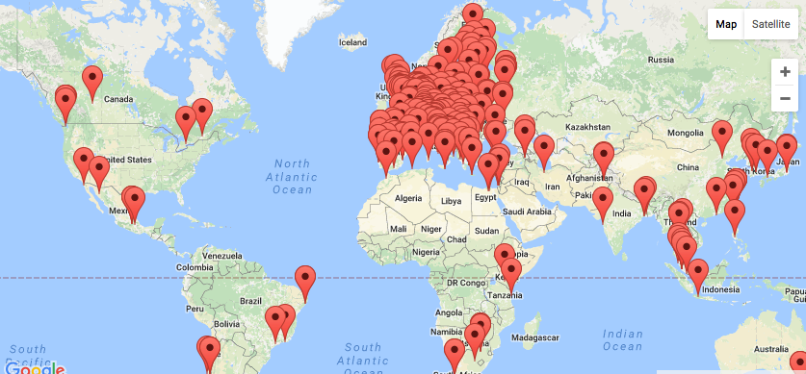
EGI Federation: Largest distributed compute e-Infrastructure of the world
EGI Foundation (Amsterdam)
260+ HTC providers
20 Cloud providers
730,000 CPU cores
650 PB storage
1.7 Million jobs/day
2.8 Billion CPU hours/year
240 Virtual Organisations
61,000+ users

Slide 5
EGI serves researchers and innovators
Size of individual groups
WLCG
ELI
CTA
ELIXIR
EPOS
BBMRI
INSTRUCT
CLARIN
EISCAT_3D
DARIAH
LOFAR
LifeWatch
ICOS
EMSO
CORBEL
…
VRE projects
OpenDreamKit
WeNMR
DRIHM
VERCE
MuG
AgINFRA
CMMST
LSGC
SuperSites Exploitation
Environmental sci.
neuGRID
…
PeachNote
CEBA Galaxy eLab
Semiconductor design
Main-belt comets
Quantum pysics studies
Virtual imaging (LS)
Bovine tuberculosis spread
Convergent evol. in genomes
Geography evolution
Seafloor seismic waves
3D liver maps with MRI
Metabolic rate modelling
Genome alignment
Tapeworms infection on fish
…
Agroknow
CloudEO
CloudSME
Ecohydros
gnubila
Sinergise
SixSq
TEISS
Terradue
Ubercloud
…
ESFRIs, FET flagships
Multinational communities, (e.g. H2020 projects)
Industry, SMEs
‘Long tail of science’

Slide 6
Used today in the lab sessions!!
The EGI Federated Cloud Infrastructure
20 resource centres
15 OpenStack
4 OpenNebula
1 Synnefo
5 centres under integration
2 centres expressed interest on joining

Slide 7
The EGI Federated Cloud usage
AoD
1.6M users
+500 users
12 SLAs
> 10 M CPU hours
> 500 K VMs
2 VREs
Piloting / testing VO
+80 users
*Data and figure extracted from accounting portal Apr 2017 – Apr 2018

Slide 8
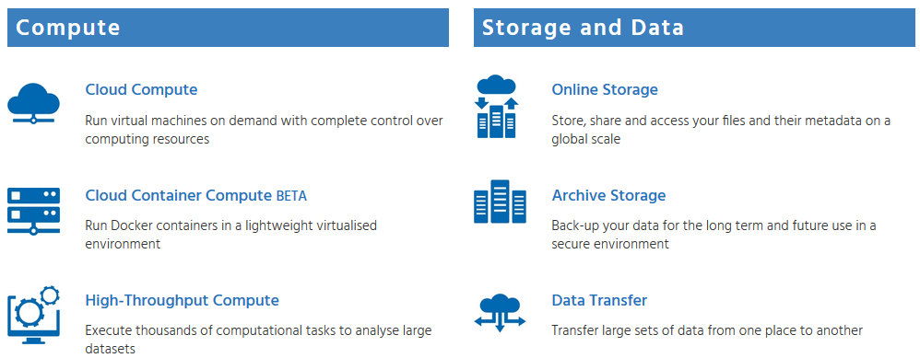
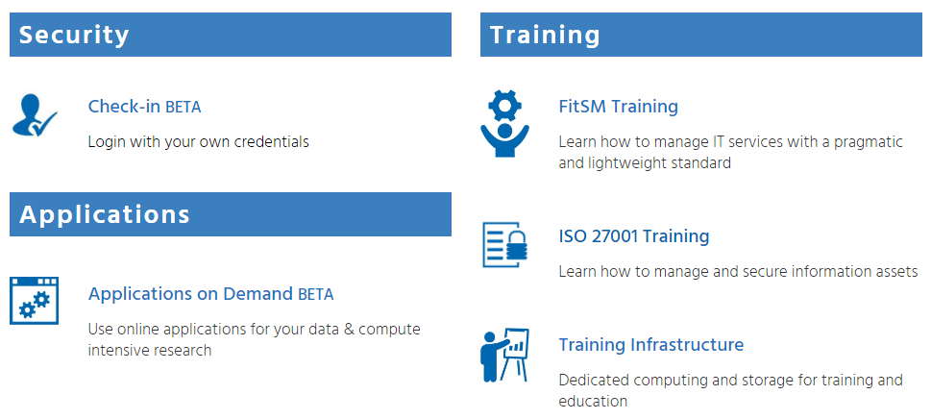
Used today in the lab sessions!!
The EGI Service Catalogue
www.egi.eu/services
Coming soon: - JupyterHub as a Service
Used today in the lab sessions!!

Slide 9
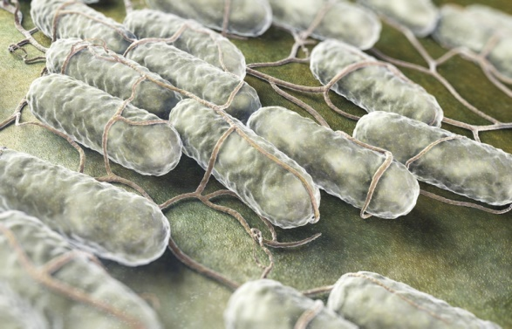
Powered by Cloud Compute
When a human cell meets Salmonella
K. Förstner, Univ. Würzburg, used Cloud Compute to run a pipeline for the analysis of sequencing data.
Nature (doi:10.1038/nature16547)
The EXTraS project
Implement four software pipelines to harvest data collected on-board ESA’s space observatory XMM-Newton.

Slide 10
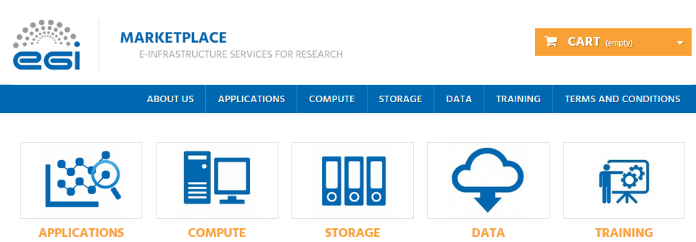
How to find the service ?
Login to the Marketplace https://marketplace.egi.eu
With his/her personal academic credentials, eduGAIN, social credentials or use the EGI SSO account
Configure the user’s account (only first time)

Slide 11
Thank you for your attention! support@egi.eu

