Slide 1
Abbreviations
EGI: European Grid Infrastructure
EGI.eu: European Grid Initiative organisation
EIRO: European International Research Organisation
ESFRI: European Strategy Forum on Research Infrastructures
HUC: Heavy User Community
NGI: National Grid Infrastructure/Initiative
RP: Resource infrastructure Provider
SSC: Specialised Support Centre
UMD: Unified Middleware Distribution
VO: Virtual Organisation
VRC: Virtual Research Community

Slide 2
EGI.eu Contacts
Director
director@egi.eu
Operations Team
operations@egi.eu
User Community Support Team
ucst@egi.eu
Strategy and Policy Team
policy@egi.eu
Marketing and Communications Team
press@egi.eu
Secretariat
contact@egi.eu

Slide 3
Contents
EGI Overview
Background to EGI
EGI-InSPIRE Project
EGI’s Supported Research Communities

Slide 4
EGI Overview

Slide 5
Vision
To support the digital European Research Area through a pan-European research infrastructure based on an open federation of reliable services that provide uniform access to national computing, storage and data resources.

Slide 6
Mission
To connect researchers from all disciplines with the reliable and innovative ICT services they need to undertake their collaborative world-class and world-spanning research
Core Values
Leadership | Openness
Reliability | Innovation

Slide 7
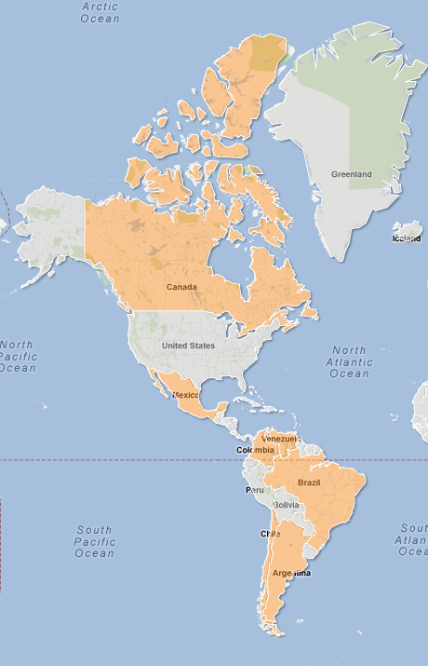
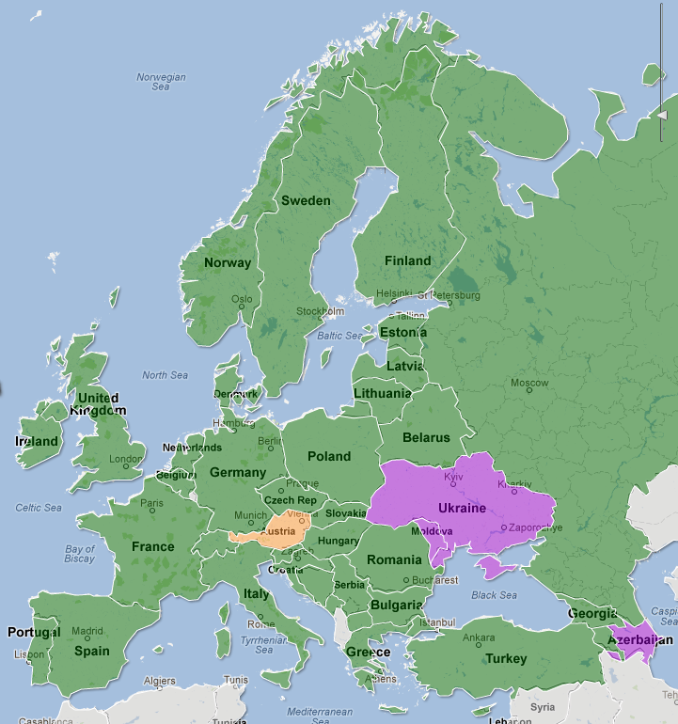
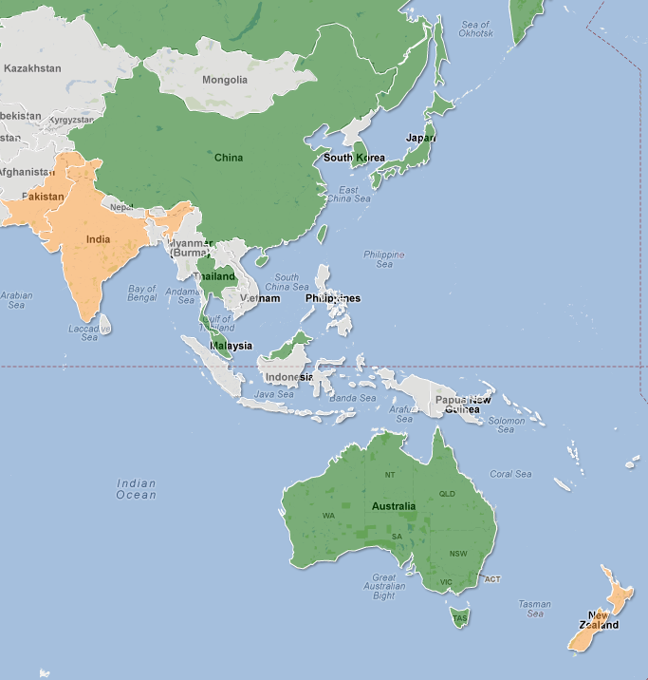
EGI Resource Infrastructure Providers - RPs (April 2012)

Slide 8
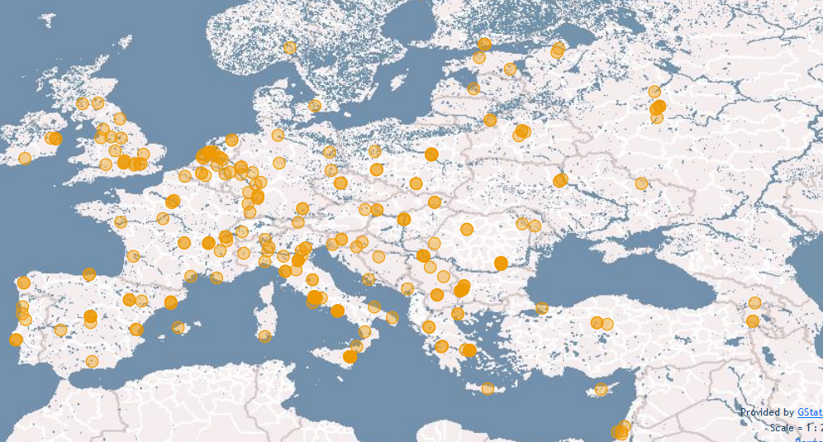
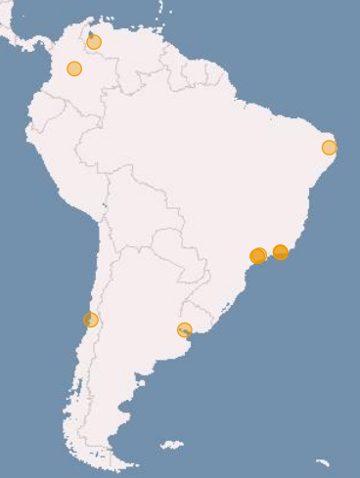
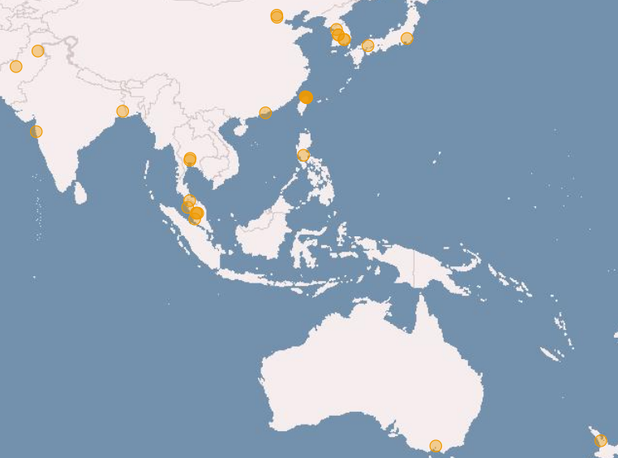
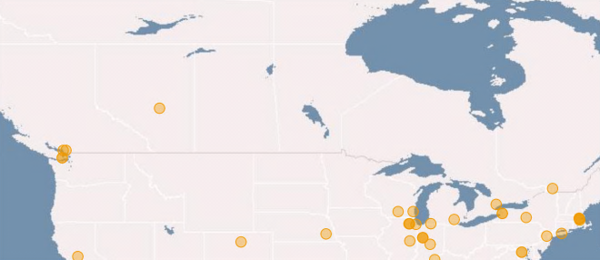
EGI Resource Centres (April 2012)

Slide 9
Metrics (April 2012)
Metrics |  |  | Value (Yearly increase)
Installed Capacity | Logical CPUs | EGI-InSPIRE and EGI Council members | 270,800 (+30.7% )
 |  | Including integrated RPs | 399,300
 | HEP-SPEC 06 | EGI-InSPIRE and EGI Council members and integrated RPs | 2.96 Million (+49.5% )
 | Storage | Disk (PB) | 139 PB (+31.4% )
 |  | Tape (PB) | 134.3 PB (+50%)
Resource Centres | EGI-InSPIRE and EGI Council members |  | 326
 | Including integrated RPs |  | 352
 | Supporting MPI |  | 90
Countries | EGI-InSPIRE and Council members |  | 42
 | Including integrated RPs |  | 54
Performance | Monthly Availability/Reliability |  | 94.50%/95.42%
Utilization | HEP-SPEC 06 Hours |  | 10.5 Billion (+52.91% )
 | Jobs |  | 492.5 Million Jobs /year 1.35 Million Jobs/day (+46.42%)

Slide 10
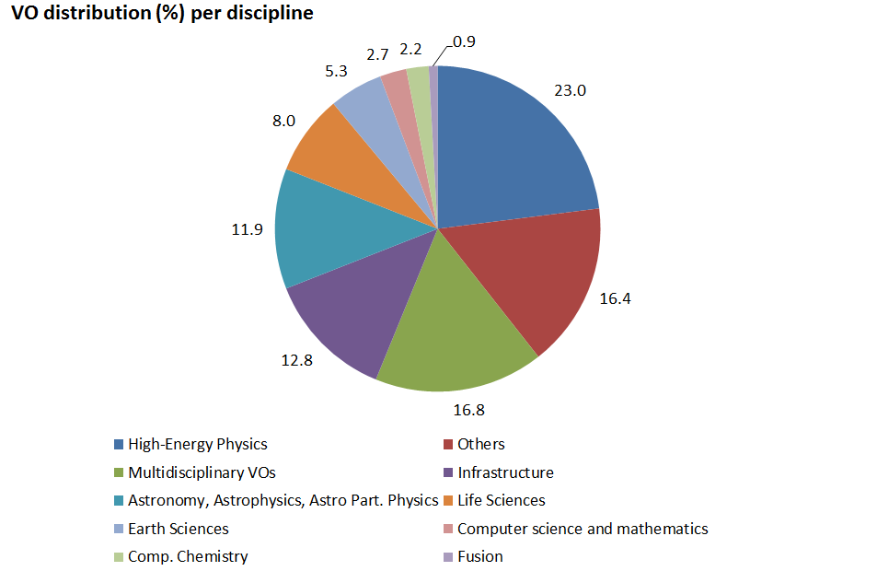
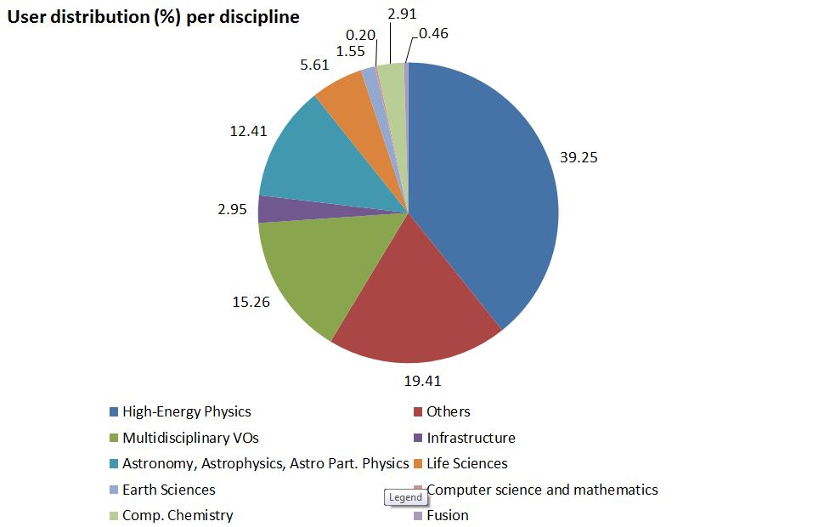
VO Statistics (April 2012)
Metrics | Value
Registered national and international VOs | 226 (3.20% )
Registered users | 20883 (14.30% )
Active VOs (High/Medium/Low) | 25/23/8
Supported Research Communities
Archeology
Astronomy
Astrophysics
Civil Protection
Comp. Chemistry
Earth Sciences
Finance
Fusion
Geophysics
High Energy Physics
Life Sciences
Multimedia
Material Sciences
…

Slide 11
EGI means Innovation
Deploy Technology Innovation
Distributed Computing continues to evolve
To include: Grids, Desktops, Virtualisation, Clouds, …
Enable Software Innovation
Provide reliable persistent technology platform
Tools built on gLite/UNICORE/ARC/Globus
Support Research Innovation
Infrastructure for data driven research
Support for international research (e.g. ESFRI)

Slide 12
Technology Innovation
Will come from outside EGI
Moving research technologies into production
Partnership with technology projects
EMI (European Middleware Initiative)
IGE (Initiative for Globus in Europe)
EDGI (European Desktop Grid Initiative)
StratusLab
VenusC
SAGA

Slide 13
Software Innovation
Will also come from outside EGI
EGI is a neutral platform for applications
EGI cannot support all services for all users
Every community needs something different
Foster innovation within different ‘sectors’
e.g. Digital Libraries
gCube from D4Science

Slide 14
Research Innovation
An infrastructure to support European Researchers
Within the EU27
Geographical Europe
Worldwide
Interoperability
Work with Virtual Research Communities
Groupings of aligned Virtual Organisations
Enable their community specific support activity:
Support, training, consultancy, requirements etc.
Notes:
Add 2 additional logos to consider the 2 MoUs signed during Py2

Slide 15
Learning from others
Grids have benefited from commoditisation
Hardware: HTC & HPC affordable to all
Networking: GBs can be moved over WAN
Software: Open source software comes of age
The impact of commodity virtualisation…
For transactional models →
The ‘Cloud’: A model based on compute not data
For large distributed data-oriented models →
The emergence of true ‘function shipping’?

Slide 16
Guiding Principles
Be a neutral resource provider
Any application, any domain, any technology
A platform for domain specific innovation & use
Integration of any compliant resource
End-user needs and technologies change
Allow VOs to deploy their own services
VOs will then need to manage their infrastructure
Give VOs the power to meet their own needs

Slide 17
Standards Needed Here!
Consensus
Openness
Balance
Transparency
Data Layer
Secure reliable data movement
Access to data resources
Virtualisation Layer
Span trust domains within agreed policies
Monitoring as important as lifecycle control
Service Layer
The services that go into the virtual machine
Avoid domain specific silos & promote reuse

Slide 18
EGI’s Strategic Focus
Community & Coordination
Community building through events
Community networking through the NGIs
Operational Infrastructure
Operate a European wide infrastructure
Offer its use to other research infrastructures
Build a federated cloud environment
Virtual Research Environments
Enable 3rd party integration & operation of VREs
http://go.egi.eu/EGI2020

Slide 19
Enabling Platforms
Core Infrastructure Platform
Used by EGI to run distributed services
Available for other Research Infrastructures
Collaborative Infrastructure Platform
Services to enable collaboration between
EGI and its supported Research Communities
Research Communities and each other
Cloud Infrastructure Platform
Prototype federation of distributed private clouds
Enable the deployment of VREs on demand

Slide 20
What will EGI do?
Continue with a secure reliable infrastructure
Integrated: gLite & ARC
Nearing Completion:
Globus, UNICORE, desktop grids
Support its user communities
Maintain user services & tools
Engage with structured (virtual) user communities
Encourage structuring in unstructured user communities
Defined representatives within EGI bodies
Engage with the ESFRI projects
Notes:
Added desktop grids

Slide 21
Summary
EGI.eu established in Amsterdam
Supported through EGI-InSPIRE project
EGI has transitioned from a federation of regional to national resource providers
EGI works with technology providers on an open standards based architecture
EGI is evolving to support the needs of its current and new research communities

Slide 22
Background to EGI

Slide 23
Why build a European Grid Infrastructure?

Slide 24
Infrastructure (Wikipedia)
Infrastructure is the basic physical and organisational structures needed for the operation of a society or enterprise, or the services and facilities necessary for an economy to function
EGI provides a service infrastructure that exposes and helps coordinate a resource infrastructure
The Enterprise is the European Research Area

Slide 25
What is a Grid?
A grid consists of distributed resources controlled by separate organisations that are systematically used securely by users external to that organisation
Resources can include:
Commodity or HPC clusters
Disk or tape storage
Instruments
Data Archives or Digital Libraries

Slide 26
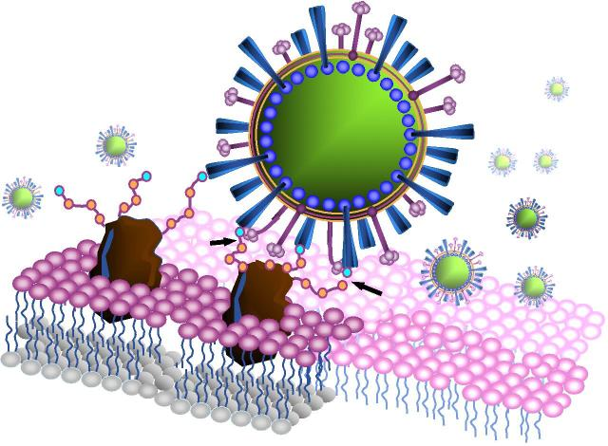
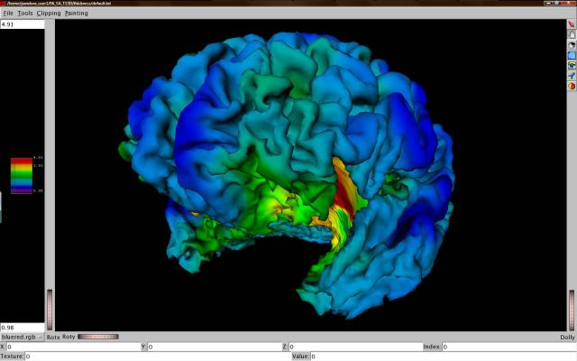
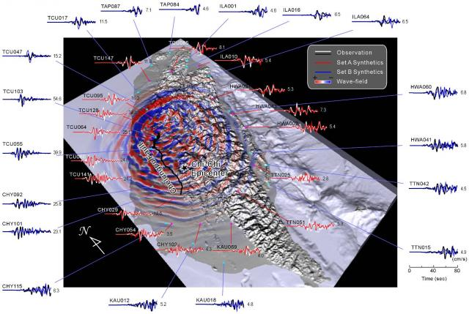
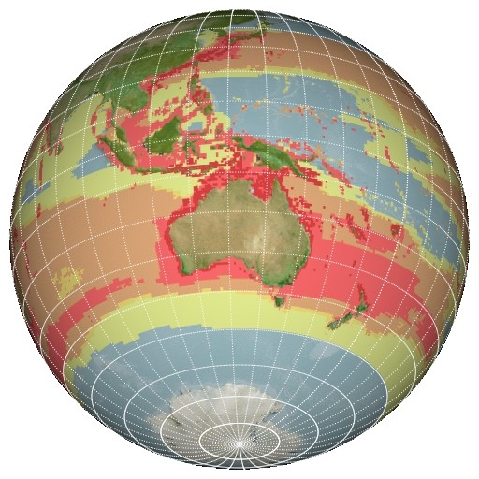
C21: Digital Research
Extracting Knowledge from the Data Deluge

Slide 27
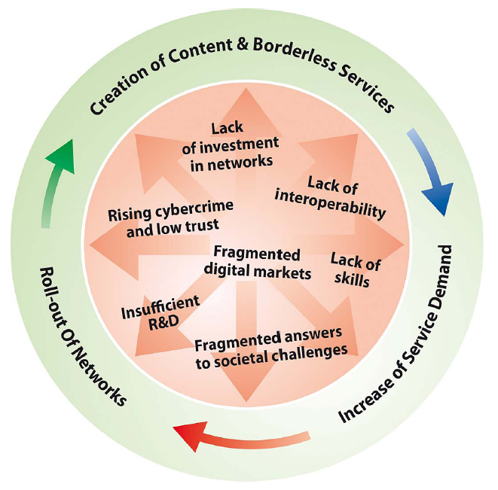
Digital Agenda for Europe
Borderless Services
Interoperability
Supporting Innovation
remove barriers to the free movement of knowledge
“Europe should also build its innovative advantage in key areas through reinforced e-Infrastructures (i.e. GEANT & EGI)”
Digital Agenda for Europe

Slide 28
What is EGI?

Slide 29
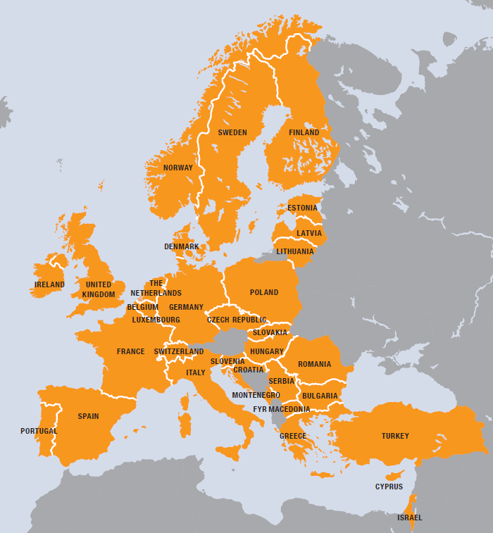
EGI
European
Over 35 countries
Grid
Secure sharing
Infrastructure
Computers
Data
Instruments
…. and beyond!!

Slide 30
EGI Collaboration
NGI
EIRO
NGI
NGI
EIRO
NGI
NGI
Virtual Research Community
Virtual Research Community
Virtual Research Community
EGI.eu
NGI: National Grid Initiative
EIRO: European Intergovernmental Research Organisation

Slide 31
What is EGI?
European Grid Infrastructure (EGI)
Federation of National Grid Infrastructures
Represented by EGI.eu (Dutch foundation)
National Grid Infrastructures (NGIs)
Sole national point of contact for ‘Grids‘
Integrates individual resource centres
Current Status:
35+ NGIs & 350+ resource centres
300,000 CPUs & 200PB+ storage

Slide 32
A Virtuous Service Cycle
National
Resource Providers
European Grid Infrastructure
Ecosystem
Used by Researchers
Gathering New Requirements
New Technology Assessed
Deployed Infrastructure Services
Current User Communities
MoUs & OLAs
MoUs
EGI.eu
MoUs & SLAs
New User Communities
Technology Providers

Slide 33
The EGI Model

Slide 34
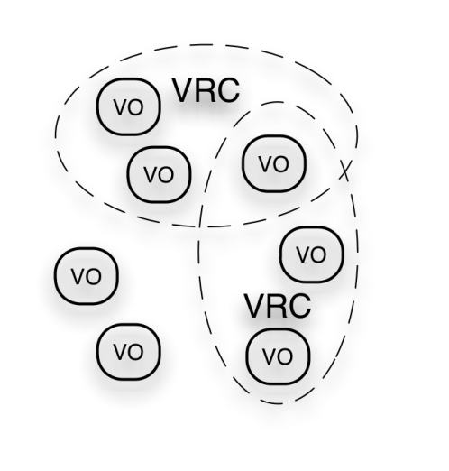
EGI Ecosystem
User Community
Policies + Funding
Requirements + Feedback
Services + Support
EGI-InSPIRE
SA3
Service & Resource Providers
Requirements + Feedback
NA2
Public Funding Bodies
Policies + Funding
Requirements + Feedback
European Commission
EGI.eu
Technology Providers
NA1
SA2
Open Source Providers
National Research Councils
Resource Infrastructure Providers
Strategic Feedback
SA1 & JRA1
Technology + Support
Commercial Providers
Policies + Funding

Slide 35
MoUs Structure Ecosystem
http://www.egi.eu/collaoboration/
Technology Providers
RPs
VRCs
Others
+ LoI with DARIAH & CLARIN,
and other informal collaborations

Slide 36
EGI Technical Governance
EGI Council
EGI.eu Executive Board
Terms of
Reference
(ToR)
Common
Process
(PDP)
Common
Glossary
(GCG)
Technology
TCB
Security
OMB
OTAG
Users
UCB
OAT
SPG
SCG
SVG/RAT
CSIRT
Operations
SVG/RAT
CSIRT
http://www.egi.eu/policy/groups/
http://go.egi.eu/policies_and_procedures

Slide 37
EGI.eu
Coordination for European Grid resources
Established February 8th 2010
Central policy & services needed to run a grid
Sustainable small coordinating organisation
Based in Amsterdam
Coordinating core (~20 people) in Amsterdam
Technical services from partners (~20 people)
EGI and EGI.eu: Supported by the EGI-InSPIRE project

Slide 38
EGI.eu Governance
EGI.eu established as non-profit foundation
Governance & ownership by its participants
Participants:
European NGIs
Associated participants:
Organisations aligned with EGI.eu’s objectives
EGI Council contains all participants
Votes linked to fees

Slide 39
EGI-InSPIRE Project

Slide 40
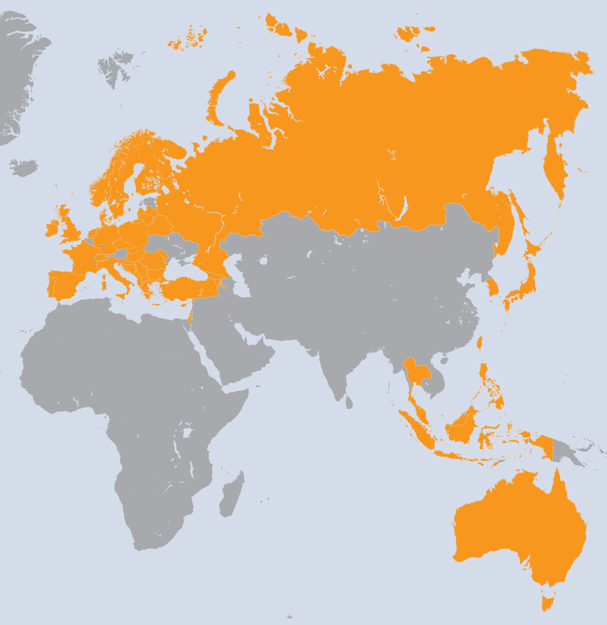
EGI-InSPIRE Project
Integrated Sustainable Pan-European Infrastructure for Researchers in Europe
A 4 year project with €25M EC contribution
Project cost €72M
Total Effort ~€330M
Effort: 9261PMs
Project Partners (50)
EGI.eu, 38 NGIs, 2 EIROs
Asia Pacific (9 partners)

Slide 41
Project Objectives
A sustainable production infrastructure
With resource providers around the worldwide
With new technologies as they mature
Support structured international research
Sustain current domain specific services
Attract new research communities (e.g. ESFRI)

Slide 42
Project Activities
NA1: Project & Consortium Management
Project Office and Quality Assurance
NA2: Community Engagement
Strategic and Policy Development
Marketing & Communication
Community Outreach
Technical Outreach to New Communities
NGI International Liaisons
SA3: Support for Heavy User Communities
Services & tools for all users of the infrastructure
Domain specific support for current heavy users

Slide 43
Project Activities
SA1: Operation of the production infrastructure
Infrastructure oversight and quality control
Operational security
Operational Tools, monitoring & accounting
Helpdesk & Support teams (NGI & centrally)
Validation and integration of new technology
SA2: Provisioning the Software Infrastructure
Definition of software coming from external projects
Validation of delivered software
Software repository and support tools
JRA1: Support for Operational Tools
Maintenance and Development
Support for new resources and their accounting

Slide 44
Engagement with the Research Community

Slide 45
User Support & Services
Support User Communities
Researchers in International Collaborations
National Research Collaborations through the NGI
Scale up from the single VO to a community
Provide core services to support users
Manage VOs, AppDB, Training Services
Support teams
EGI.eu User Community Support Team
NGI User Support Teams
NGI Operations Teams
Experts within user communities or projects

Slide 46
A Virtuous User Cycle
Aka: “the chicken and egg conundrum...
Design
Deliver
Discover
Feedback through VRCs in the User Community Board
Task Forces to drive detailed design
Where is the community?
How can I contribute?
- VRCs
Mailing lists
Workshops
Forums
Blogs
Projects
Sharing stories
Collaborating
Applications
Data collections
Requirements
Proposals
Projects
Success stories
How do I use these resources?
Integrated Services
Human
Technical
Infrastructure
Attend training courses
Utilise training material
Access data
Run applications on the grid

Slide 47
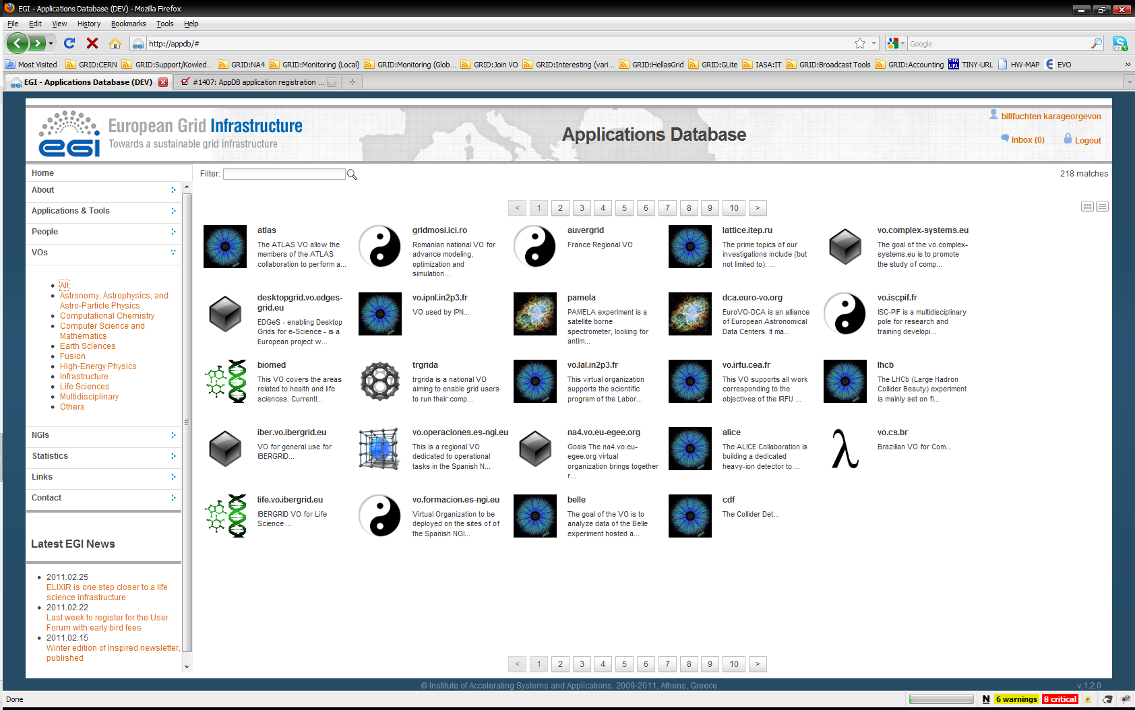
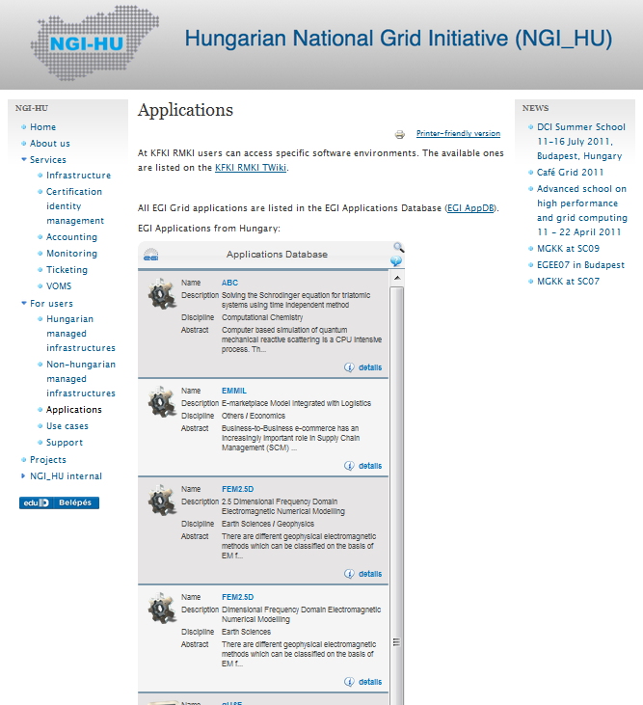
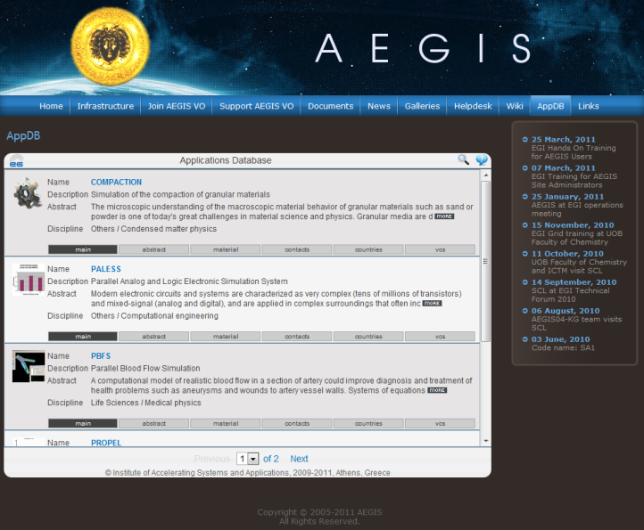
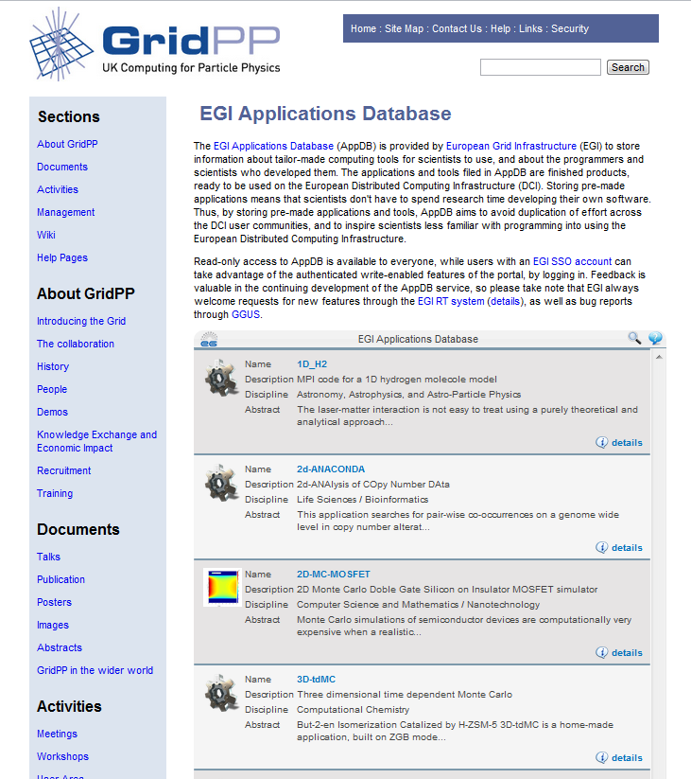
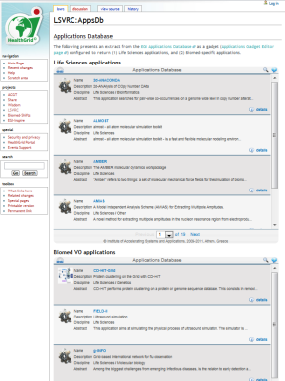
EGI Applications Database
Benefits:
Gives recognition to reusable scientific applications, application developer tools, portals, workflows, etc.
Gives recognition to application developers (people profiles)
Access through web page AND web gadget
Community features such as commenting, rateing, tag-based groupings
http://appdb.egi.eu

Slide 48
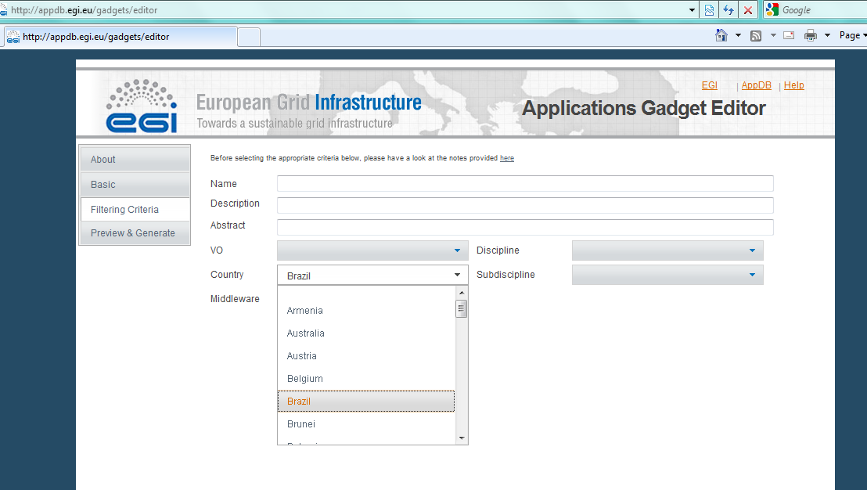
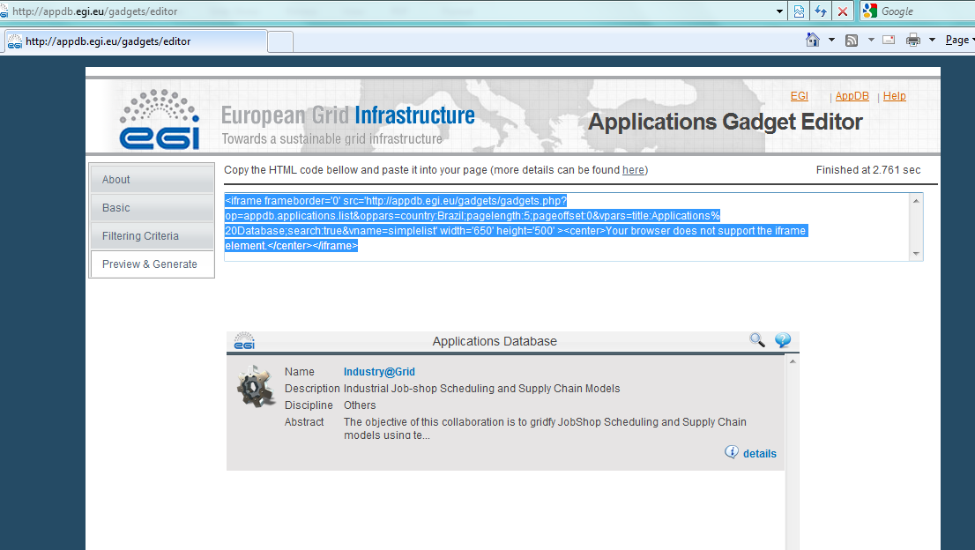
The AppDB gadget
Copy – paste this into your Website

Slide 49
Services for VOs
Activities
Consultancy and helpdesk for VO managers
Evaluation of VO management, monitor and accounting tools
Provision of VO support software for VRCs
VO-specific monitoring
Monitor only those sites that support you
Create and plug-in VO-specific probes
How to get involved?
Request support
Prepare and share reviews of VO tools
Offer local solutions for VOs through the group
NGI
NGI
VO
monitor
NGI
NGI
https://wiki.egi.eu/wiki/VO_Services

Slide 50
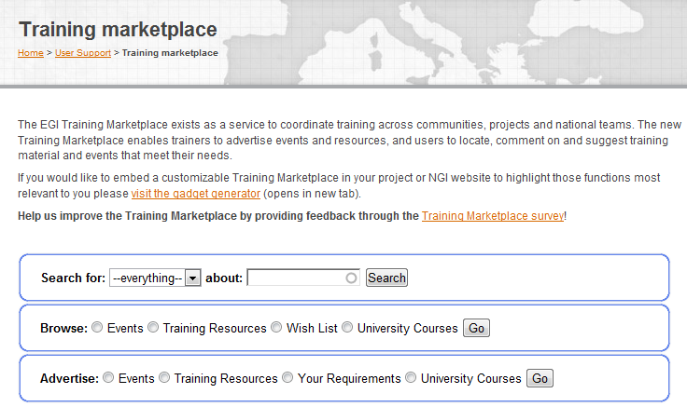
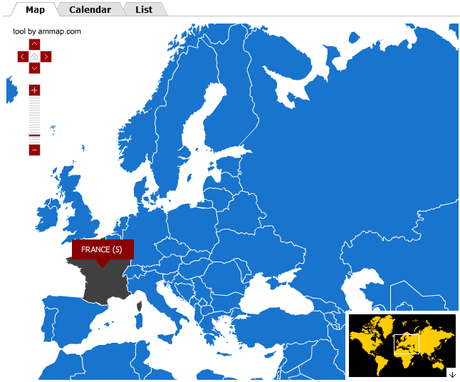
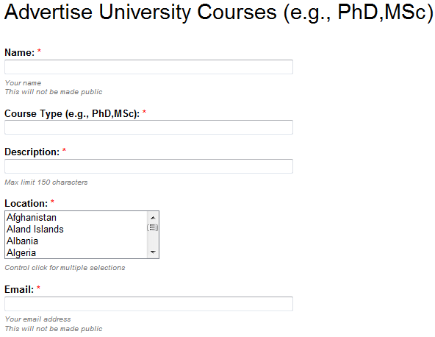
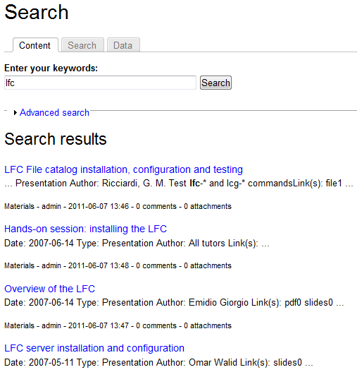
EGI Training Marketplace
Benefits:
Register & share
training events, expertise, services, materials, resources, online courses, university courses
Browse and search items
Community features such as commenting, rating
Access through web page and web gadget
http://training.egi.eu
http://training.egi.eu

Slide 51
Requirements Lifecycle
User Community Support Team of EGI.eu
User Community Board
Structured scientific communities
VOs
EGI Requirements Tracker
Input channels for community requirements
VRCs
Technology Coordination Board
Technology providers
projects
NGIs
events
Operations Management Board
Resource centres
EGI Helpdesk
NGIs & projects
http://go.egi.eu/requirements

Slide 52
Services for HUCs
Supporting major production computing
At an unprecedented scale – both quantitatively and qualitatively
Delivering common solutions across multiple communities
Identifying areas for future work
Broadening the use of grid technology and HUC services to related projects within the HUC domain
Especially unfunded Life Science & Earth Science projects
Developing a S.W.O.T. analysis of each HUC
Focus steps on the road to sustainability

Slide 53
Virtual Research Environments

Slide 54
Virtual Research Environments
Definitions:
Wikipedia (2011): A virtual research environment or virtual laboratory is an online system helping researchers collaborate
UK JISC (2004): VREs help researchers in all disciplines manage the increasingly complex range of tasks involved in carrying out research.
NeCTAR (Australian Research Cloud) (2011): Virtual Laboratories connect researchers to existing and new research facilities, data repositories and computational tools to streamline research workflows and enable new opportunities for research innovation
EGI’s role:
Support the simulation, data sharing and data analysis activities of innovative, collaborative VREs.
Enable 3rd party integration & operation of VREs

Slide 55
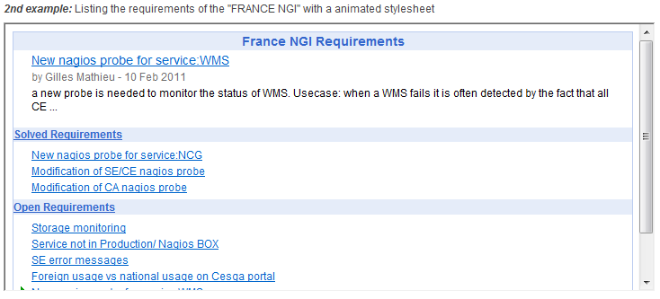
EGI Web Gadgets
The simplest way to reuse EGI services: embed EGI gadgets into your website
Benefits
Customisability
Reusability
Compatibility
Existing gadgets:
Application Database
Training Marketplace
Requirement Tracker
Use and develop gadgets & share them through EGI:
www.egi.eu/user-support/gadgets

Slide 56
VREs in EGI
Virtual Research Communities
Created by a communities such as WLCG, LSGC, WeNMR, etc.
Virtual Research Environment
EGI Collaboration platform
EGI Community Platform
VM
VM
DB
SW
EGI Infrastructure platform
VM
VM
Research facilities (e.g. detectors, sensor networks)
VM
DB
SW
EGI resources (clusters, storages,...)
Dedicated or shared resources/platforms (e.g. Clusters; EC2, PRACE, XSEDE)

Slide 57
Anatomy of a VRE
EGI support
Service access (Science gateways - portal, desktop and mobile)
EGI support
Service integration (workflows)
EGI support
Services (Applications & data)
Off-the-shelf and custom VM images
Domain specific and generic data repositories
Off-the-shelf and custom applications
EGI support

Slide 58
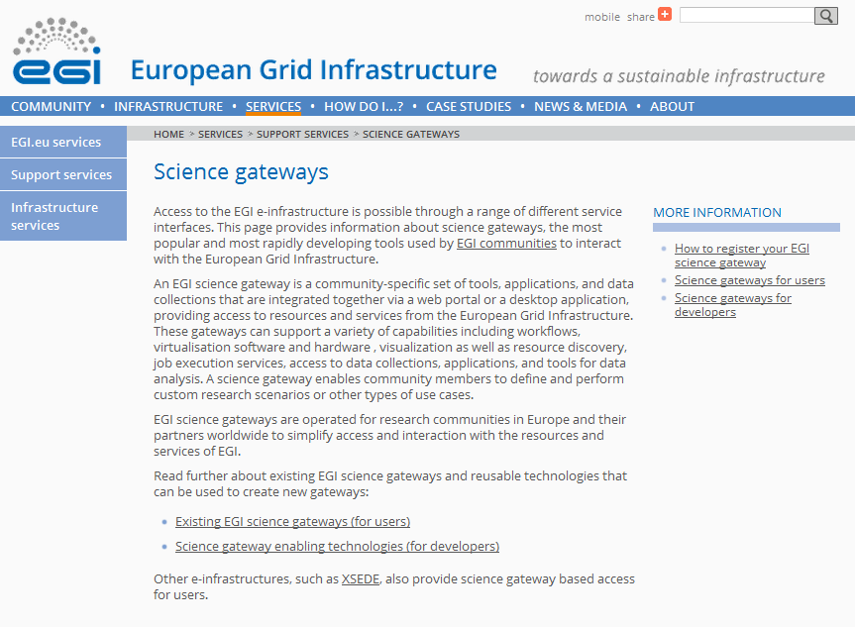
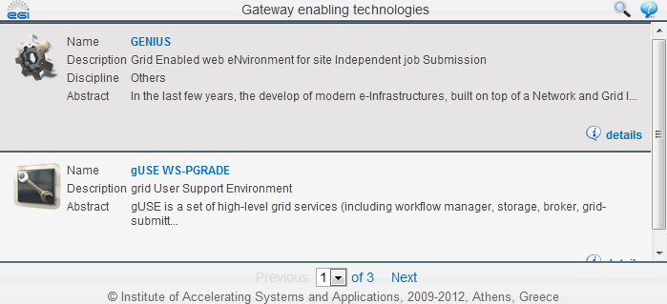
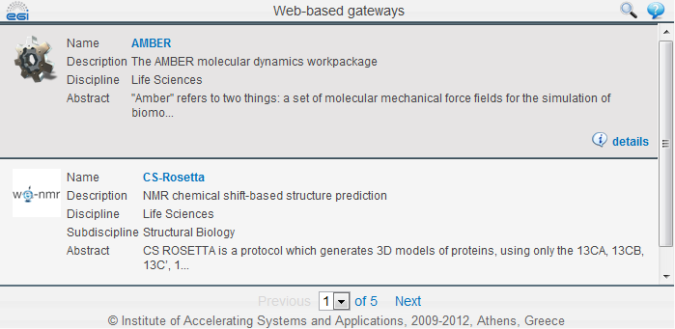
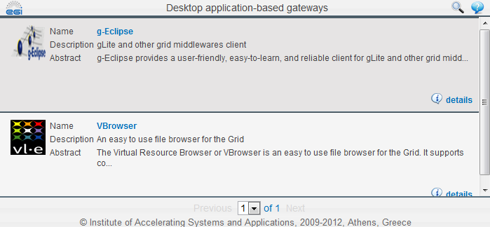
EGI support for ‘Service Access’ in VREs
Catalogue of existing solutions
http://go.egi.eu/sciencegateways
“How-to” documentation
Under development https://wiki.egi.eu/wiki/VT_Science_Gateway_Primer
Gateway components repository
SCI-BUS portlet repository will be used (see MoU)
Portal & gateway workshops
At EGI Forums
Hosted by NGIs
Within community events

Slide 59
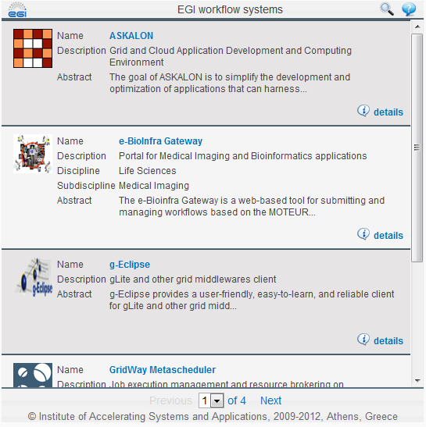
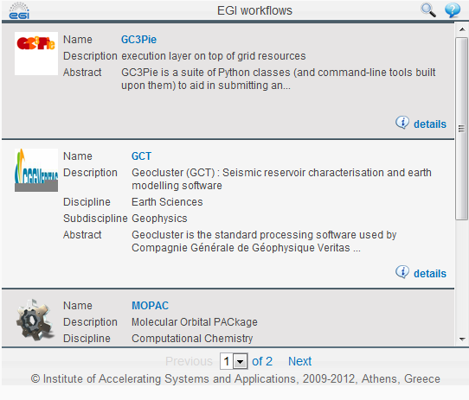
EGI support for ‘Service Integration’ for VREs
Catalogue of existing workflow tools and workflow applications
http://go.egi.eu/workflows
Collaboration with workflow system developers
SHIWA project; ER-Flow proposal, VOs and VRCs
Requirements, workshops (e.g. http://go.egi.eu/workflowworkshops)
Middleware API table: (to be finalised in EMI-2) https://wiki.egi.eu/wiki/Service_APIs

Slide 60
EGI support for VRE operation
Established & evolving processes from various EGI(-InSPIRE) stakeholders:
EGI Operations
EGI Technology
NGIs, VRCs, EGI.eu
Pojects (e.g. BioVel, Scalalife, ...)
But the EGI platform is about to change:
Services will run in Virtual Machines
EGI Strategic Plan; EGI Platform Roadmap
Developers & operators will need new support mechanisms:
VM image repository
VM information system
VM monitor with helpdesk integration
...
EGI Federated Cloud Task force → EGI Infrastructure platform
Join as user community!

Slide 61
Marketing, Communications & Events

Slide 62
Communications
Disseminate EGI’s activity within the project and worldwide through its regionally dispersed dissemination contacts.
Developed the EGI branding and content for the project and event websites.
Produced monthly Director’s Letters, 4 annual issues of the EGI Inspired newsletter
Published success stories in International Science Grid This Week, The Parliament, Public Service Review, PanEuropeanNetworks, HPCwire, HPCintheCloud, Datanami, HostingTecNews, clippings in Wired and Discovery News
Produced a range of general and community focused brochures and posters.
Since the project start, the EGI website has received over 100,000 unique visitors and over a 1million page views.
Redesigned website re-launched in March 2012 with increased functionality

Slide 63
Communications
Attended a range of international events, including eChallenges in Florence, SciTech in Brussels, International Symposium on Grid and Clouds in Taipei, SuperComputing11 in the US, European Geophysics Union in Vienna and International Supercomputing in Hamburg.
Hosted booths at the EGI’s events, including the Technical and Community Forums, and ran outreach campaigns that included printed materials, press releases, social media feeds and blogs.
NILs contributed events, websites, materials, publications, papers, translations, press releases and outreach to policy makers.

Slide 64
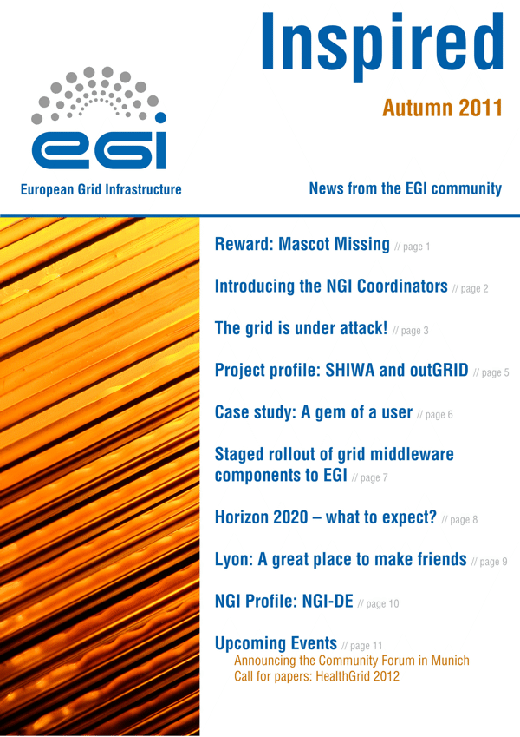
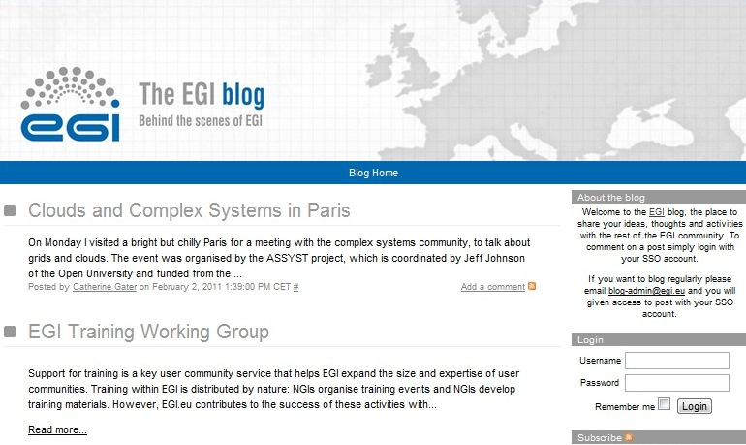
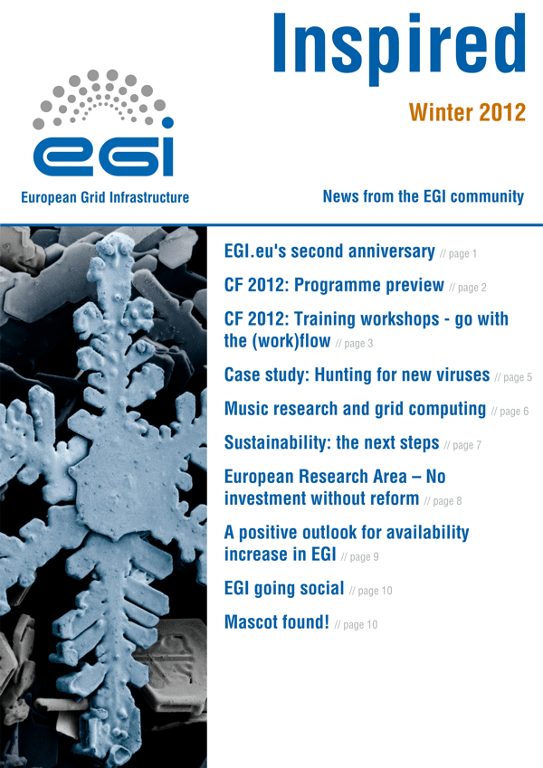
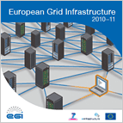
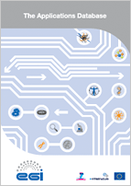
Communications
Website
Wiki
Blogs
Newsletters
Letters
Social Media
Posters
Brochures
Book of abstracts

Slide 65
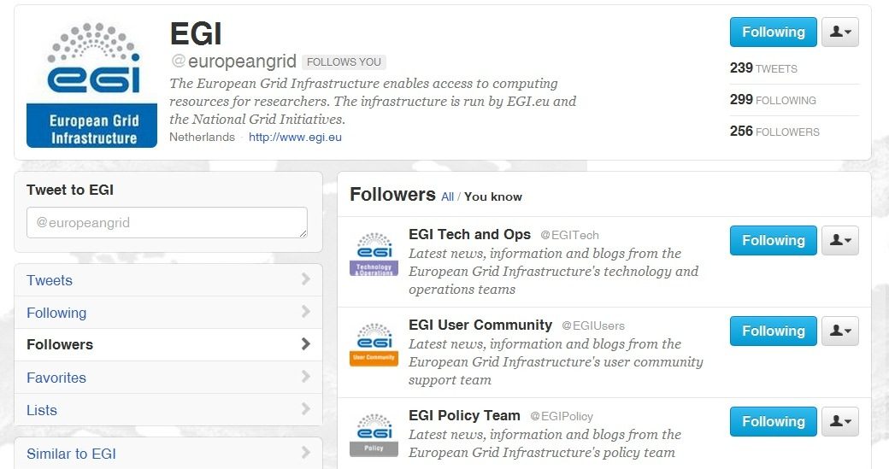
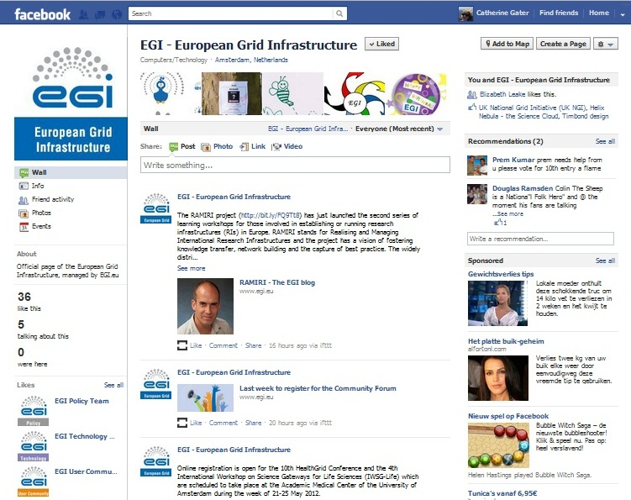
Website and social media
Website relaunched March 2012
Follow Tech & Ops, User Community, Policy and News social media feeds individually

Slide 66
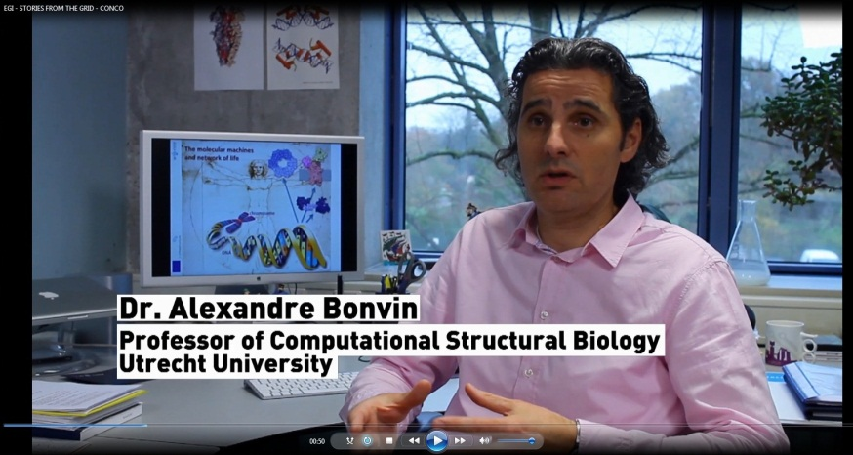
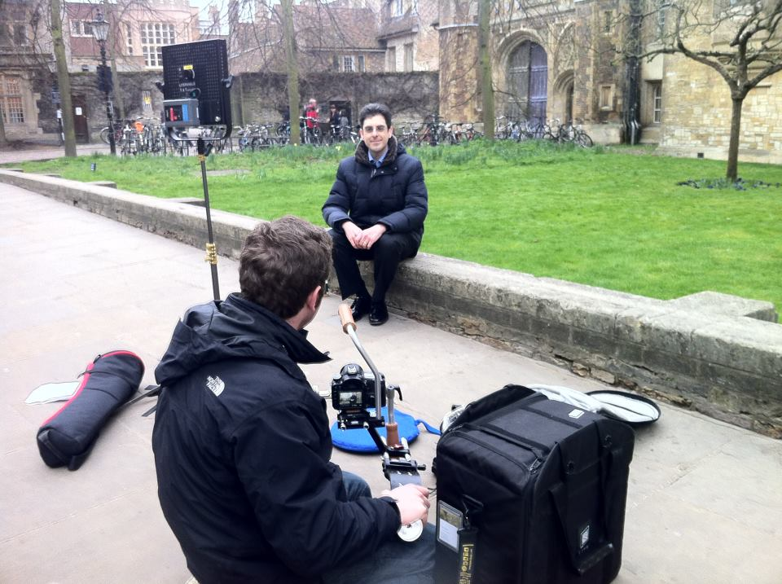
“Stories from the grid”
New series of YouTube videos launched: “Stories from the Grid”
Videos on WeNMR, Lost Sounds Orchestra, Top Quark grid research
More case studies on the website at http://www.egi.eu/results/success_stories/

Slide 67
EGI Technical Forum 2011
Held in Lyon, France, 19-23 September 2011, organised in partnership with the French NGI (part of CNRS, the local organisers) and the CC-IN2P3 computing centre.
Focused on the efforts to drive forward progress toward the adoption of a federated virtualised infrastructure for European researchers.
Co-located with the 9th e-Infrastructure Concertation Meeting, OGF31, Grid2011, the first French Grid Day and the first GlobusEUROPE event (organised by the IGE project). Other EU-funded projects such as SIENA also organised workshops.
655 participants registered for the forum, making it the best attended EGI event so far.
The sessions included 132 contributions.
The Technical Forum website (http://tf12.egi.eu) received almost 4,000 unique visitors, with about 35,000 page views.

Slide 68
EGI Community Forum 2012
Held in Munich, Germany, from 26-30 March, co-organised Munich Network Management.
The event showcased the services, technologies and tools available to scientific communities.
Held in conjunction with the 2nd EMI Technical Conference and co-located with the 2nd Annual European Globus Community Forum
421 registered for the event that featured 171 contributions.
The Community Forum website (http://cf12.egi.eu) was read by about 3,200 unique visitors, with about 20,000 page views.
The #cf2012 tag was mentioned in 403 Twitter posts; 221 photographs uploaded to Flickr; iPhone & android free apps downloaded by 154 users.

Slide 69
Technology Provisioning

Slide 70
Technology Environment
EGI Technology Roadmap
Technical environment & its evolution
Mainstream open-source components
Open to commercial components
Unified Middleware Distribution (UMD)
Components from within the EGI community
External technology provider: EMI, IGE, SAGA, …
Details contained in the EGI Technology Roadmap
To meet the unique needs of EGI users

Slide 71
Software Provisioning
Integrated processes for efficient software provisioning
External Technology Providers
Requirements
Software
Operations
Criteria
Definition
Criteria
Verification
Staged
Rollout
Production
Deployed Software
SU
Provisioning Infrastructure

Slide 72
Provisioning Workflow
Infrastructure for verifying UMD components
Technology Provider release schedules are monitored
Components are pulled in using a small tool
Criteria Verification organises and executes the verification work-plan
Staged Rollout exposes verified software in the production infrastructure
UMD release is assembled and published

Slide 73
Criteria Verification
Formal verification of software using the Quality Criteria library valid at that time
Publishes verification reports
Verification reports provides feedback to
Criteria definition
Technology Providers
Deployed Software Support Unit
UMD Release Notes

Slide 74
Provisioning Infrastructure
UMD Repository (http://repository.egi.eu/)
Frontend publishes release notes etc.
Temporary internal repositories for:
Verification & Staged Rollout
Permanent but volatile testing repositories
Public coherence points for volunteer testing
Composite repository for public UMD updates
Process management infrastructure
GGUS → External Technology Providers
RT → Internal Verification and StagedRollout

Slide 75
Deployed Software Support Unit
Second level support unit for middleware
Resolves issues with documentation, configuration
Provides workarounds for known issues
Develops and publishes best practices for popular components
Provides recommendations for Technology Providers via the TCB
Negotiates estimated delivery time for identified software problems

Slide 76
Technology Operation

Slide 77
EGI Resource Infrastructure
National Grid Initiative
Network
Peer Resource Infrastructure Provider
Resource Infrastructure
EGI.eu
Resource Infrastructure
Resource Centres
MoUs
Resource Centres
Integrated Resource Infrastructure Provider
Resource Infrastructure
Resource Centres
Resource Centres
Resource Centres
Resource Centres
Integrated: infrastructure operated by a non-EGI-InSPIRE partner but relying on EGI operational services (MoU)
Peer: infrastructure accessible to EGI users, but relying on own operational services

Slide 78
EGI Resource Providers and Operations Centres
27 National Operations Centres
Armenia, Belarus, Bosnia and Herzegovina, Bulgaria, Cyprus, Croatia, Czech Republic, Finland, France, FYR of Macedonia, Germany, Georgia, Greece, Hungary, Ireland, Israel, Italy, Moldova, Montenegro, Poland, Romania, Serbia, Slovakia, Slovenia, Switzerland, Turkey, United Kingdom
5 Federated Operations Centres (15 NGIs)
IberGrid (Portugal and Spain)
Italy (Italy and Austria)
The Netherlands Federation (Belgium and The Netherlands)
Russian Federation (Russia and Ukraine)
NDGF Federation (Denmark, Estonia, partly Finland, Latvia, Lithuania, Norway and Sweden)
1 EIRO: CERN
Integrated Operations Centres (22 countries)
Asia Pacific (Australia, China, India, Japan, Malaysia, New Zeeland, Pakistan, South Korea, Taiwan, Thailand)
IGALC (Argentina, Brazil, Chile, Venezuela)
Latin America (Brazil, Chile, Colombia, Mexico)
Canada (Canada, China)

Slide 79
Operational Tools
Develops and maintains operational tools
Regionalised for NGI deployment
Tool | Link | Partner
Operations Portal | https://operations-portal.egi.eu/ | CNRS
Service Availability Monitoring | Nagios and MyEGI portals fully regionalised at NGIs https://wiki.egi.eu/wiki/SAM_Instances | CERN/SRCE
Grid Configuration database (GOCDB) | https://goc.egi.eu/ | SFTC
EGI Helpdesk (GGUS) | http://helpdesk.egi.eu/ | KIT
Accounting Portal | http://accounting.egi.eu/ | FCTSG
Metrics Portal | http://metrics.egi.eu/ | FCTSG
Notes:
Removed link of old cic portal instance

Slide 80
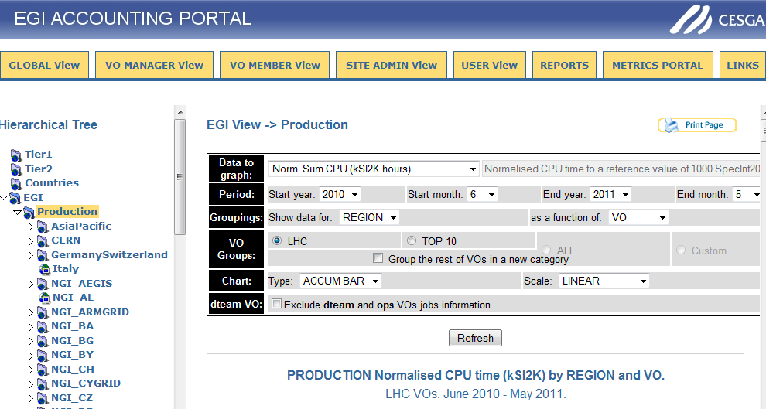
Ops Tools Screenshots

Slide 81
Operational Tool Developments
Message Broker Network Configuration to support tools and operations
Development of the Central Accounting Repository (clients provided by the EMI project)
Development of accounting systems needed for “new” resource types
Billing
Accounting of application usage
Accounting of data usage
Accounting of capacity and cloud computing usage

Slide 82
EGI’s Supported Research Communities

Slide 83
Grid Use Cases
These case studies show some of the advantages of using the grid:
allows world-wide multi-disciplinary collaboration;
integrate distributed resources into a single whole;
customised grid services to meet the unique demands of researchers;
reliable service for computation, data transfer and storage of large data sets;
reduced analysis time and analysis on-demand;
scientifically useful results are generated more quickly;
long term support;
sharing sensitive data securely among a trusted community;
allows member institutions to contribute computing power to the community;
generate data-intensive stimulations in a shorter amount of time;
reduce technical workload (by following grid standards), so scientists can concentrate more effort on the science
30/05/2011
Project Presentation - May 2011

Slide 84
Use Case: Large Hadron Collider
World’s largest particle accelerator
Supports 8,000 researchers
1 billion CPU hours in the last 12 months
15Pb of data created annually
Data ‘parked’ for later analysis

Slide 85
Use Case: Large Hadron Collider
Some advantages of using the grid:
allows worldwide mass collaboration with thousands of physicists;
customised grid services to meet the unique demands of the experiments;
large data storage facility;
physicists can access the data using their own computer locally.

Slide 86
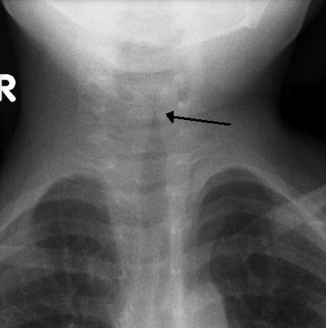
Use Case: New viruses
VIDISCA-454, new method to find new viruses from genetic material
Runs on grid computing thanks to customised workflows, allowing researchers to save time.
E.g. a test with 1444 samples produced 4,783,684 genetic sequences and was analysed in 14 hours. (Local server would need 17 days)
The method was used to identify a new type of coronavirus
Results published in Nature Medicine
Many children suffer from respiratory diseases caused by unknown viruses
http://go.egi.eu/virus

Slide 87
Use Case: The epigonion
The epigonion was the guitar of Ancient Greece – how did it sound?
Domenico Vincinanza recreated the sound of its 48 strings as digital files, using the grid-enabled ASTRA platform
It took him just a few hours - in a single core he would need a month.
The epigonion’s sounds can now be downloaded and played by any musician using a simple keyboard.
Stories from the Grid, episode 2
The Epigonion (video)
http://go.egi.eu/epigonion

Slide 88
Use Case: ITER
Investigating viability of fusion as a power source
Modelling and simulating the reactor
Used 1 million CPU hours in the last 12 months

Slide 89
Use Case: ITER
Some advantages of using the grid:
perform the intensive computations needed to test the feasibility of fusion power before building the reactor;
open to future development: dedicated project ‘EUPHORIA’ was set up to further push the limits of existing state-of-the-art computing resources.

Slide 90
Use Case: DECIDE
Diagnostic Enhancement of Confidence by an International Distributed Environment
Diagnostic tools for the medical community
Example: Their Statistical Parametric Mapping application can help doctors to diagnose Alzheimer’s disease in its early stages and track the progress of the symptoms over time

Slide 91
Use Case: DECIDE
Some advantages of using the grid:
a single European-wide master database of images stored on the grid for doctors to use;
can set up diagnostic tools with a dedicated grid infrastructure;
customisable: dedicated software to track progression of the disease over time;
sharing medical data securely.

Slide 92
Use Case: Earthquakes
Earthquakes are caused by seismic waves that propagate as ripples on a pond
By studying how seismic waves travel it’s possible to predict how a site will respond to an earthquake
The Finite-Difference (FD) method simulates wave propagation by solving differential equations
But building one accurate model means solving millions of equations!
Grid computing allows scientists to solve the equations in parallel, saving time and resources.
The concept was applied in Thessaloniki, Greece.
The model helps local authorities to prepare the regional response to earthquakes
Earthquakes are not predictable, but their effects can be mitigated by modelling and planning
http://go.egi.eu/thess

Slide 93
Use Case: CTA
The Cherenkov Telescope Array
Future ground-based high energy gamma-ray instrument
132 institutes in 25 countries
Using applications and grid technology provided by the European grid

Slide 94
Use Case: CTA
Some advantages of using the grid:
allows member institutions to contribute computing power to the CTA community;
generate data-intensive stimulations in a shorter amount of time;
reduce technical workload (by following grid standards), so scientists can concentrate more effort on the science.

