Slide 1
EOSC Services & Architecture: the EOSC-hub approach
Tiziana Ferrari, Project Coordinator, EGI Foundation
Dissemination level: Public

Slide 2
20 digital research infrastructures,
EGI, EUDAT CDI and INDIGO-DataCloud
jointly offering services, software and data
for advanced, data-driven research & innovation
The Hub:
a European contact point
to discover, access, use and reuse
resources for advanced data-driven research
100 partners
36 months
33 million Euro

Slide 3
Project contribution to the EOSC Challenges
EOSC Objectives | Actions
Increase the ability to exploit research data across scientific disciplines and between the public & private sector | > Publish, discover, access services and resources for all scientific disciplines, defined and adopt a service portfolio management process – activities and governance > Open to national, regional, pan-European providers, and supports different exploitation models (e.g. free at point of use, commercial) Joint Digital Innovation Hub https://eosc-hub.eu/digital-innovation-hub

Slide 4
Project contribution to the EOSC Challenges
EOSC Objectives | Actions
Increase interoperability, interconnect the existing and the new research digital infrastructures across Europe | > Provide thematic services integrated with European compute/data platforms for data exploitation > Initial set of rules of participation for service providers and users > Single sign on, integrated access and order through a service marketplace

Slide 5
Project contribution to the EOSC Challenges
EOSC Objectives | Actions
Support open science | Services to share and discover research artefacts (datasets, software, notebooks) and research artefacts sources A EOSC-hub & OpenAIRE collaboration

Slide 6
EOSC-hub Service catalogue
Arts and Humanities
Medical and Health Sciences
Physical Sciences
Earth Sciences
Biological Sciences
Data Lifecycle Management, Compute,
Scientific Applications
Research
Enabling
Services
The
Hub
Access
Enabling
Services
e.g. Marketplace, AAI
Accounting and Monitoring
Helpdesk, …
https://www.eosc-hub.eu/catalogue/

Slide 7
Another view on the services based on the Research Data Lifecycle
4
Access, Deposition & Sharing
Application DB (software & VM)
B2DROP (data)
B2Note (data)
B2SHARE (data)
DataHub
3
1
Data Management, Curation & Preservation
Federation Services
Discover & Reuse
B2HANDLE
B2SAFE
European Certified Trusted Repository
Federated AAI. monitoring, accounting
SLA and order Management
Security incident response and policies
Technical support & Training
B2FIND (data)
Marketplace (Services)
2
Processing & Analysis
Applications on Demand
Federated HTC & Cloud Compute IaaS & PaaS
Processing of sensitive data
Jupyter Notebook
Thematic data analytics
Scientific Workflow Management, Orchestration (DIRAC, PaaS Orchestrator)

Slide 8
Services by scientific domain
e-Infra
EGI Federation
EUDAT CDI
Humanities
Language and literature (CLARIN)
Arts (DARIAH)
Engineering
Environmental engineering (sea vessels, LNEC)
Civil Engineering (Disaster Mitigation)
Medical and Health Sciences
Biological Sciences (ELIXIR)
Structural biology (WeNMR)
Natural sciences
INDIGO-DataCloud
Physical Sciences
Astronomy (LOFAR)
Fusion (ITER)
High Energy Physics (CMS and VIRGO)
Space Science (EISCAT-3D)
Earth Science
EO Pillar
GEO
Climate Research (ENES)
Seismology (ORFEUS, EPOS)
Biological Sciences
Marine and freshwater biology (IFREMER)
Biodiversity conservation (LifeWatch)
Ecology (ICOS)

Slide 9
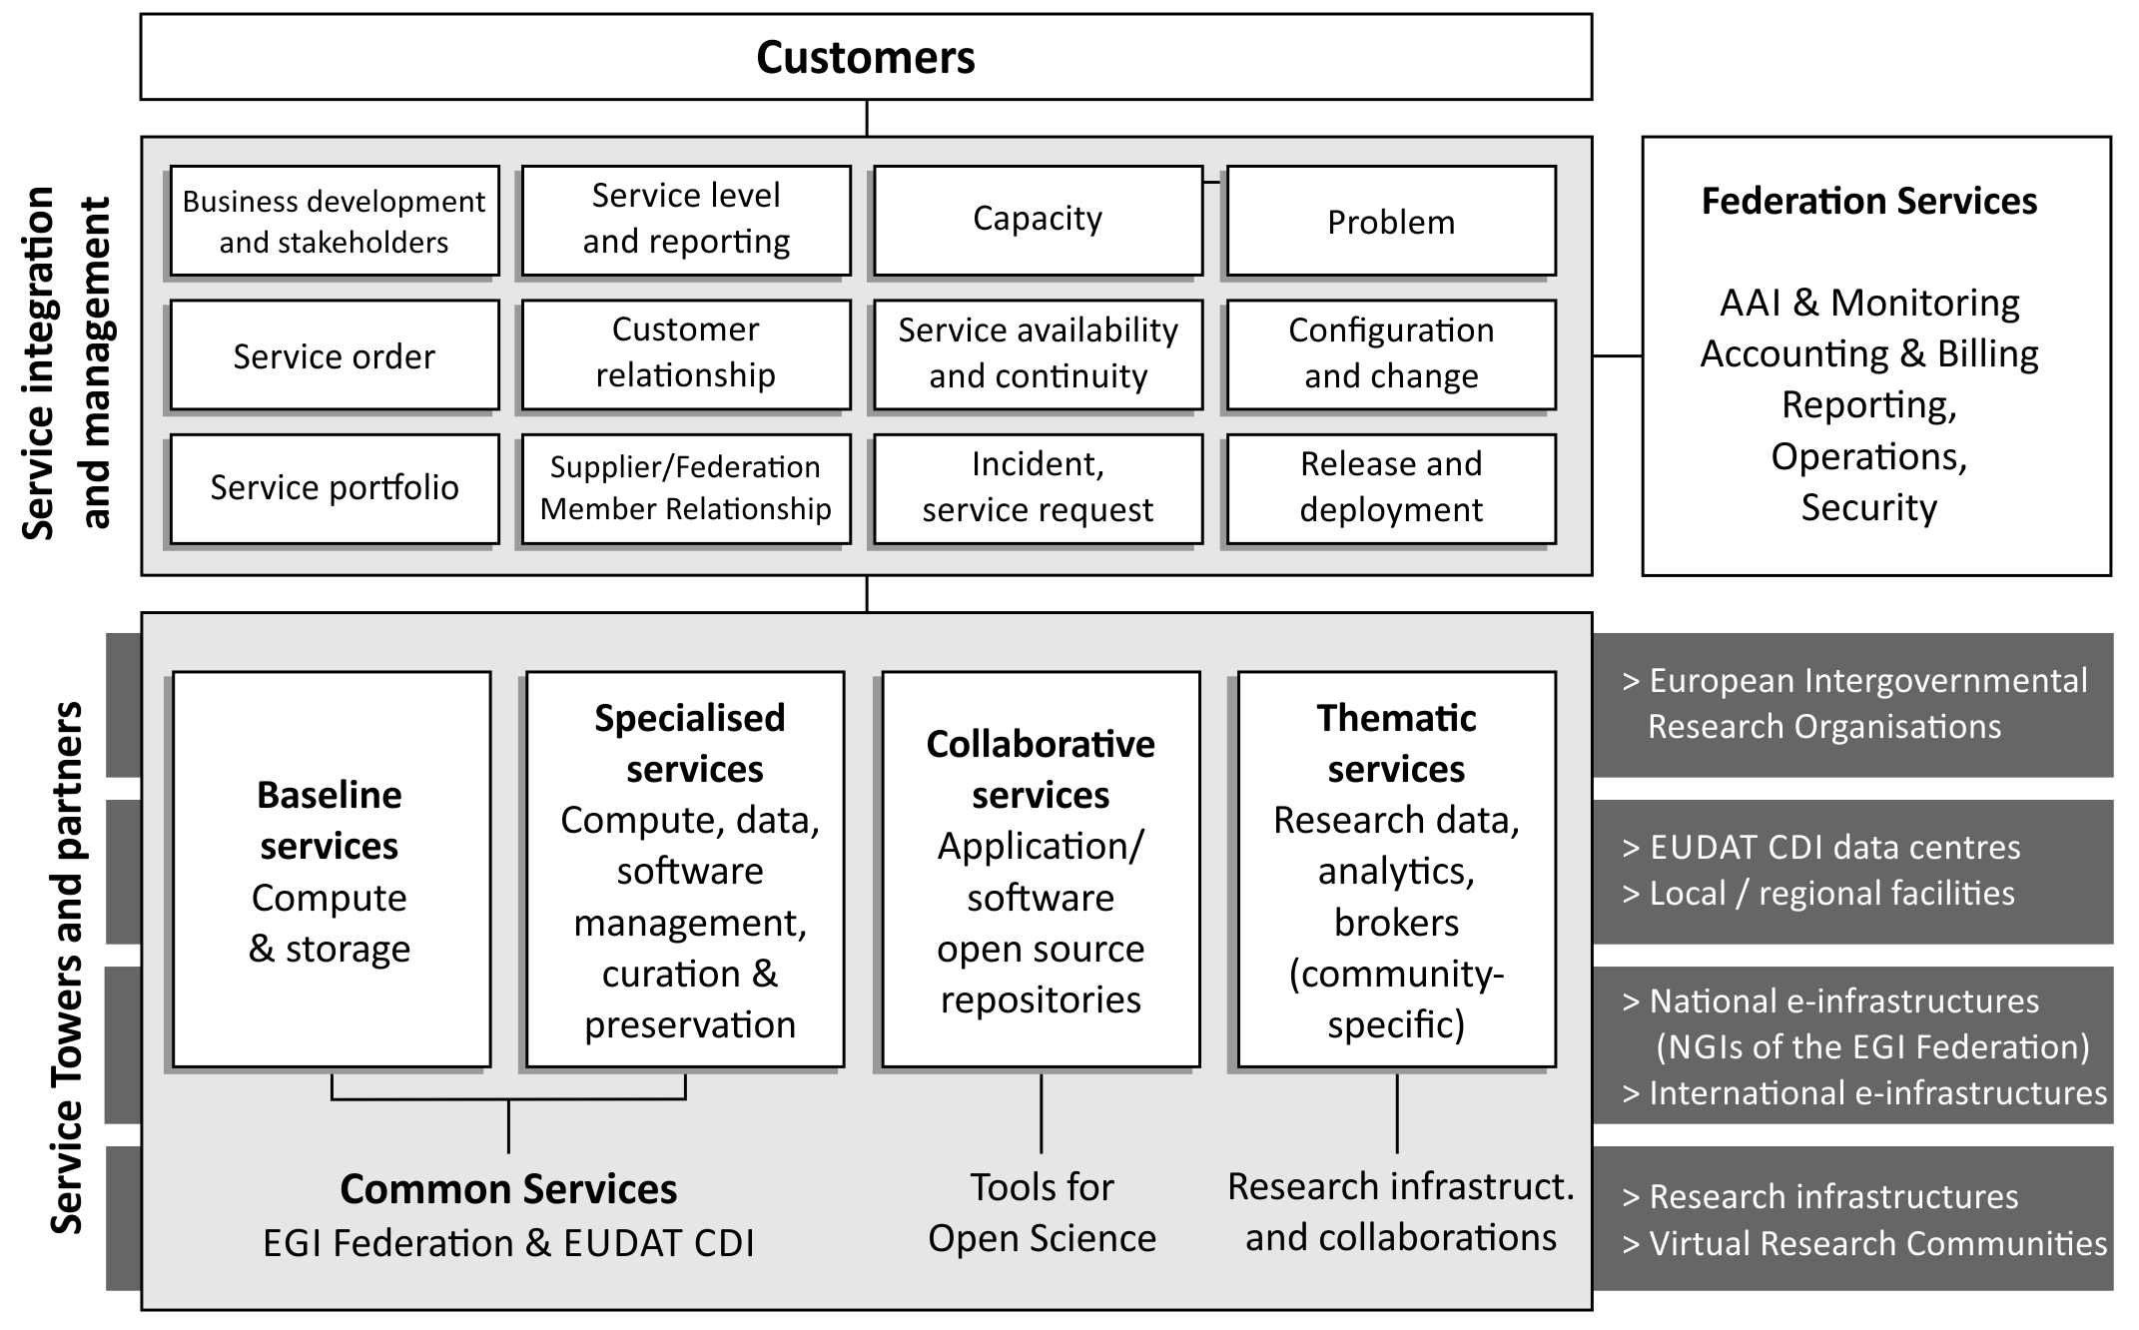

Slide 10
Contribution of Austria to EOSC-hub
For data & service interoperability

Slide 11
Coordination of Earth Observation programme
EOSC
Cloud IaaS
Platform Services
EO Data
Earth Observation Data Centre for Water Resources Monitoring Coordination of Earth Observation data and services integration
EO data
Platform services
Cloud IaaS
Collaboration with

Slide 12
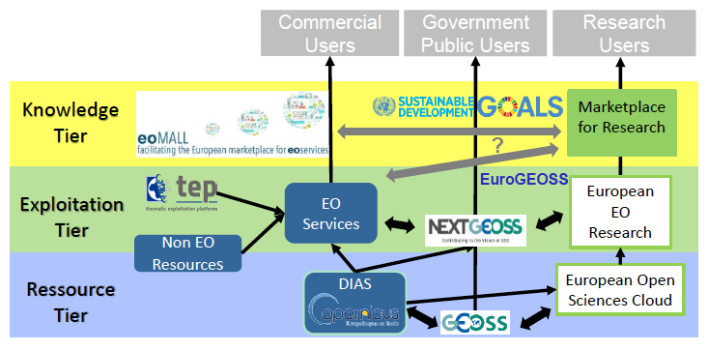
EOSC role in Earth Science
Credits: E. Pajot/EARSC

Slide 13
Datasets
(EODC) Metadata Catalogue Service, > 3.5 Million datasets, fully compliant with OGC standards
(Sinergise) Landsat-8 data
25 years of observations over Europe
Approximately 200,000 Landsat scenes
Sentinel series: Sentinel-1 GRD, Sentinel-2 L1C, Sentinel-2 L2A, Sentinel-3 OLCI, Sentinel-5P
1,018 * 600 MB Sentinel tiles are required to cover the entire Europe
Envisat MERIS data for the whole world and the full period of operation
MODiS (Moderate Resolution Imaging Spectroradiometer)
EOSC
Cloud IaaS
Platform Services
EO Data

Slide 14
Cloud Services
CloudFerro http://www.cloudferro.com/
EODC https://eodc.eu
GRNET and CESNET national research clouds https://www.egi.eu/services/cloud-compute/
EOSC
Cloud IaaS
Platform Services
EO Data

Slide 15
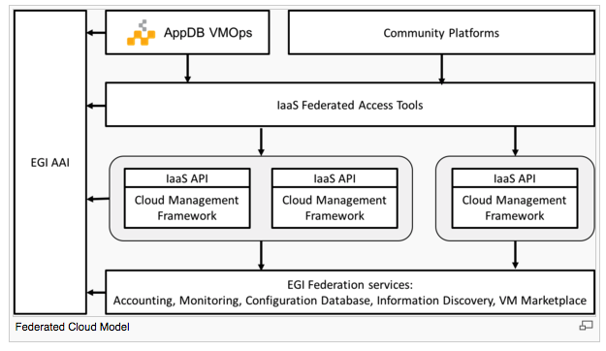
Federated Cloud Architecture

Slide 16
Platform Services
(TerraDue) Geohazards Thematic Exploitation Platform – TEP – web portal and OGC Open Search and OGC Web Map Service interfaces for data discovery and visualization by developers
(MEEO) Graphic User Interface portal, to support “human" interaction and OGC Open Search and OGC Web Coverage Service interfaces, to support data discovery and access by (web) developers
(EODC) Jupyter-Hub
(Rasdaman) Datacube Service
EOSC
Cloud IaaS
Platform Services
EO Data

Slide 17
Contribution to openEO
openEO (http://openeo.org/)
An open API to connect R, python, javascript and other clients (application layer) to big Earth observation cloud back-ends in a simple and unified way

Slide 18
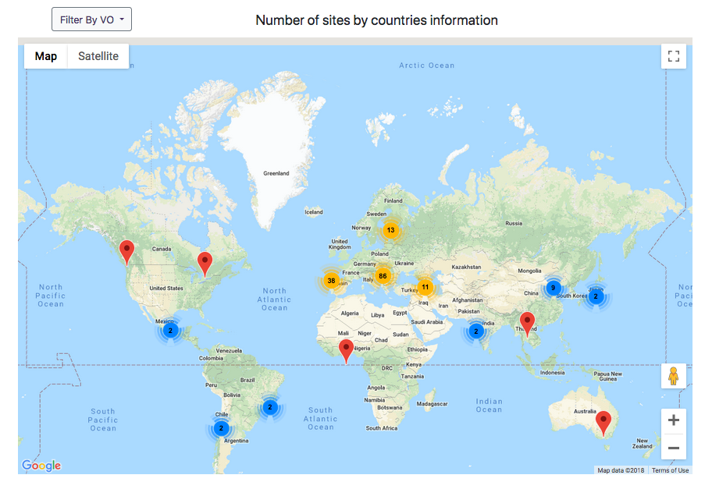
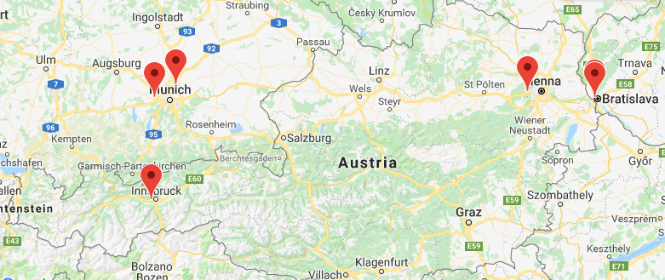
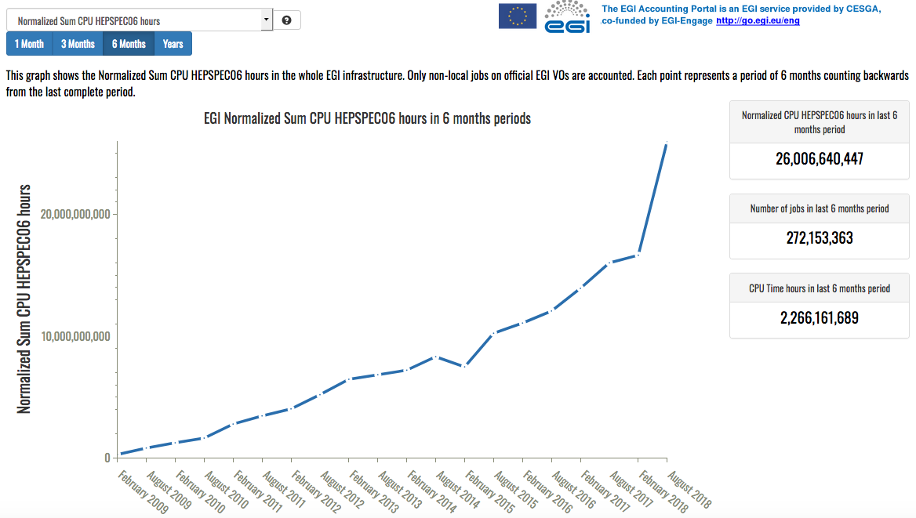
Austrian contribution to computing through the EGI Federation
970,600 computing cores, 356 PB disk & 380 PB tape storage
Austrian participation to EGI Federation/HTC Compute: Institute of High Energy Physics, Austrian Academy of Sciences and University of Innsbruck

Slide 19
EOSC-hub is a Commons
Openness by design

Slide 20
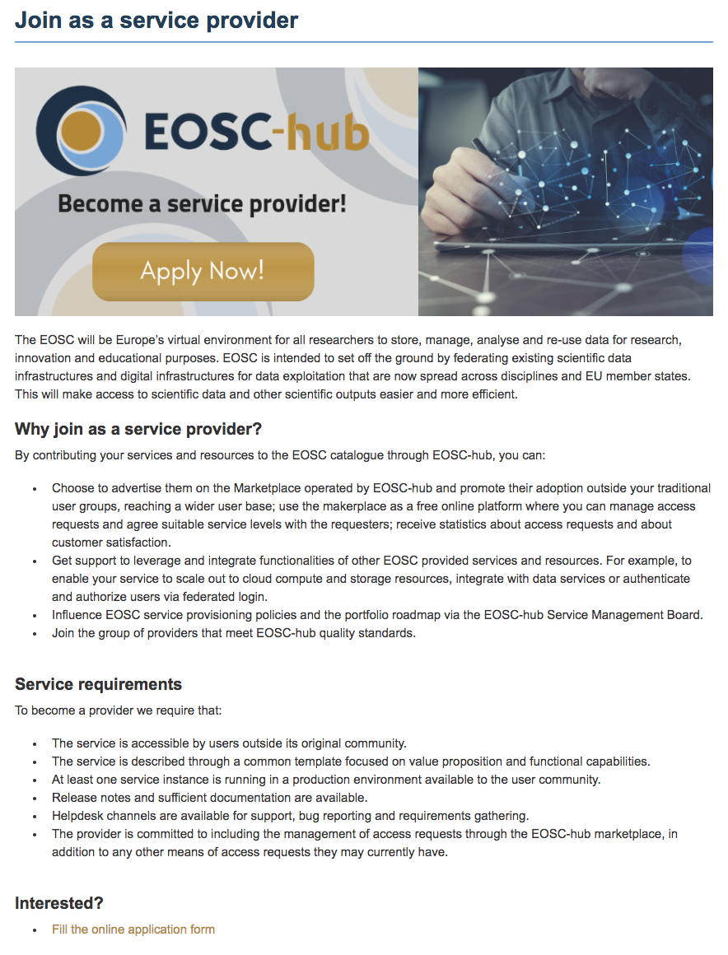
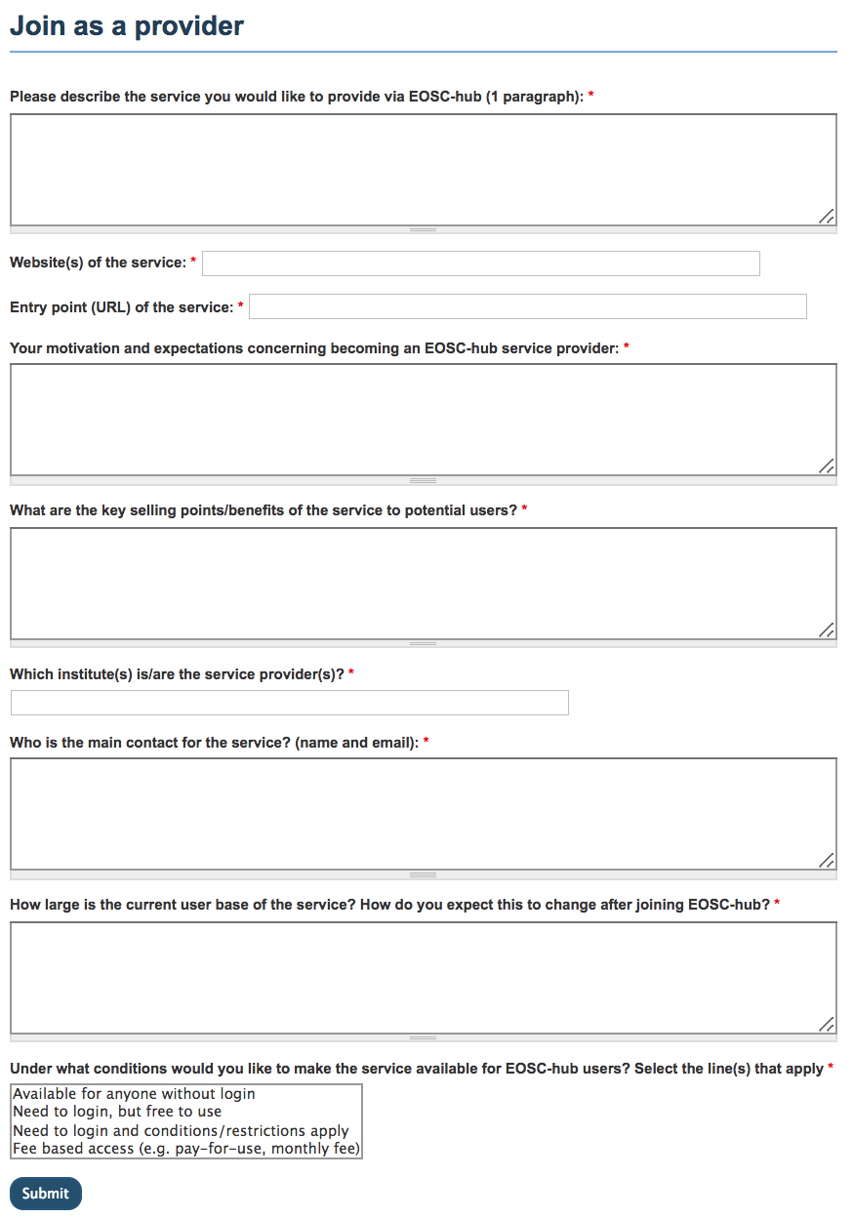
Become a provider
https://www.eosc-hub.eu/join-as-service-provider

Slide 21
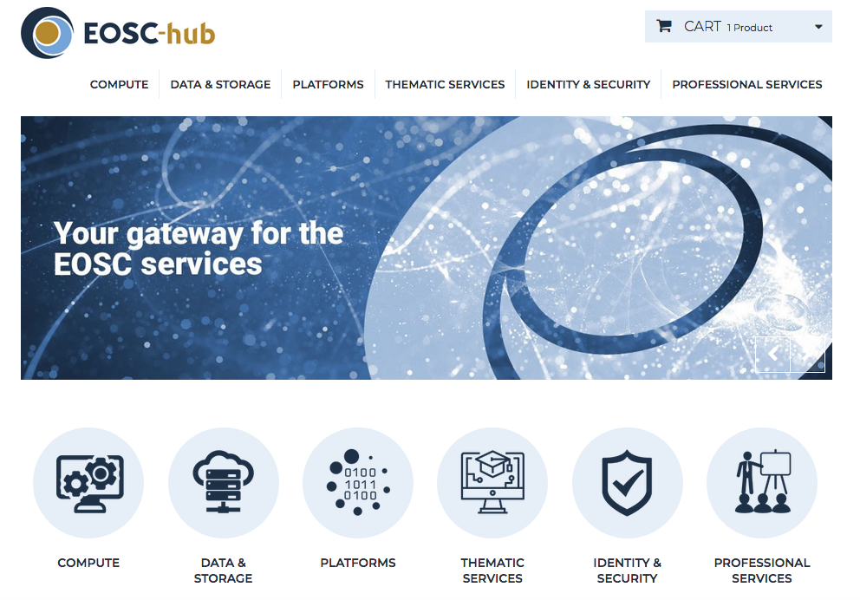
EOSC-hub Marketplace http://marketplace.eosc-hub.eu/
From 23 Nov the Marketplace
will become a component of
the EOSC Portal
A platform where services can be:
Promoted
Discovered
Ordered
Accessed
3-steps process for users
Authentication & registration
Product discovery and specification
Ordering and request processing

Slide 22
Summary
EOSC-hub started in Jan 2018 with an initial set of service selected
Thematic services were selected via an open call mechanism
Most of these services are already available for use
National infrastructures providing services for the support of the data lifecycle are necessary pillars of EOSC
Collaboration among national and international providers is key to the success of EOSC

