Slide 1
Requirements management in EGI
ucst@egi.eu
Slides are collected from various sources in EGI

Slide 2
Overview
Processes
EGI Ecosystem
Requirements process
User Community Board
Technology Community Board process
Requirements tools (tracking and submitting)
Requirements system
Wiki pages
Web gadgets

Slide 3
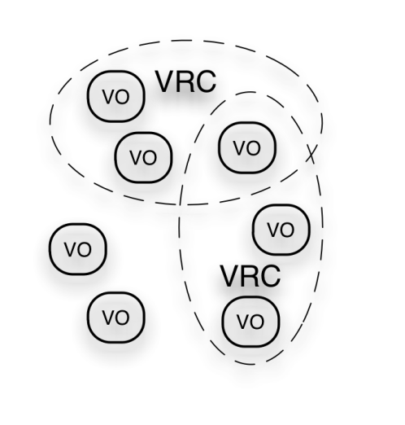
EGI Ecosystem
User Community
Project 1: SHIWA
Project 3: CLARIN
TRANSfoRm
Policies + Funding
Project 2: BioVel
Project X: ...
Project X: ...
Project X: ...
Requirements + Feedback
Services + Support
EGI-InSPIRE
Service & Resource Providers
Requirements + Feedback
Public Funding Bodies
Policies + Funding
Requirements + Feedback
European Commission
EGI.eu
Technology Providers
Currently:
EMI
IGE
SAGA
National Research Councils
Resource Infrastructure Providers
Strategic Feedback
Technology + Support
Policies + Funding

Slide 4
The EGI requirement gathering and tracking process
User Community Board
(UCB)
Structured scientific communities
User Community Support Team of EGI.eu
VOs
Channels for User & community requirements
EGI Requirements Tracker
VRCs
Technology Coordination Board
(TCB)
Technology providers
projects
NGIs
events
Operations Management Board
(OMB)
Resource
centres
EGI Helpdesk
Submit your requirements
Browse requirements
Offer solution to requirements:
http://go.egi.eu/requirements
NGIs & projects

Slide 5
User Community Board
Develops the strategy and defines the priorities for the human and technical user community support services provided by EGI
Monthly meetings (https://www.egi.eu/indico/categoryDisplay.py?categId=21)
Representatives of EGI VRCs and Heavy User Communities http://www.egi.eu/user-support/vrc_gateways:
Structural Biology and NMR
High Energy Physics
Digital Research Infrastructure for the Arts and Humanities
Research Infrastructure for Language Resources
Life Sciences
Earth Science
Computational Chemistry and Material Science
Fusion
The study of e-Science
Astronomy and Astrophysics
Hydrometeorology

Slide 6
TCB process
User Comm- unity Board
User
More details:
TCB requirements management process document

Slide 7
Requirements tools
Requirements tracker (RT) native interface
RT Dashboards lists only your requirements
Wiki pages and RT gadgets: not part of requirements tracker.

Slide 8
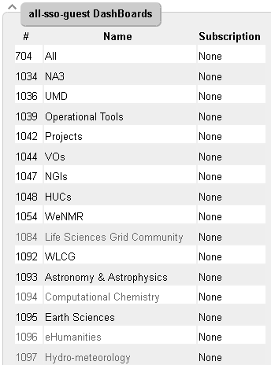
RT dashboards
Requirements tracker (RT) native
web interface with
pre-defined dashboards
http://go.egi.eu/requirements
Notes:
Change url to getting_help homepage
Color codes shows the current status of the requirement inside the process of requirements

Slide 9
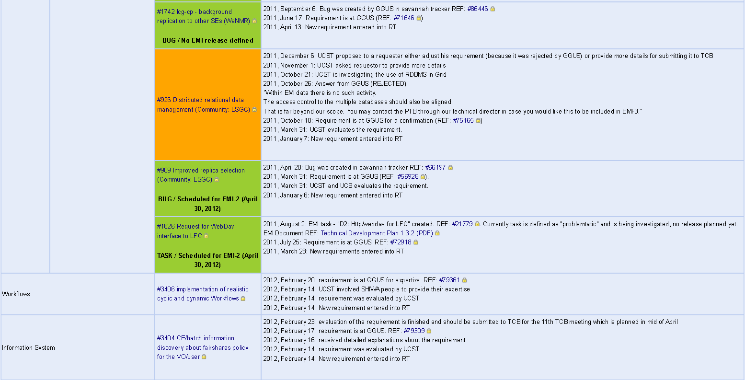
List of user community requirements
Detailed view of currently open user requirements
Accessible from http://go.egi.eu/requirements

Slide 10
User community requirements (solved)
Quarterly statistics about solved and created requirements
Accessible from http://go.egi.eu/requirements page
Notes:
Should popup in previous slide

Slide 11
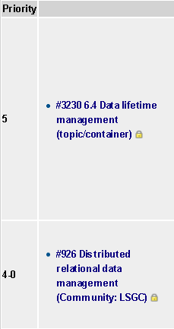
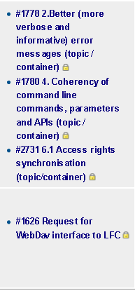
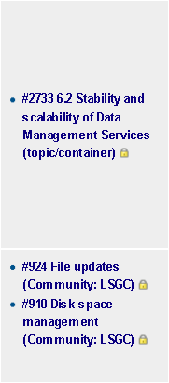
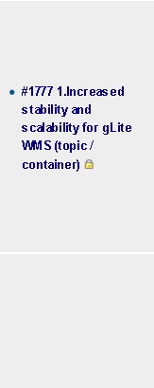
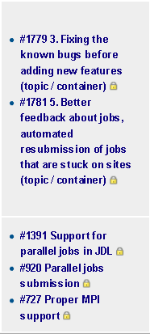
TCB catalog of requirements
Submitted
Endorsed
Assessed
Planned
Delivered
Accessible from http://go.egi.eu/requirements

Slide 12
Requirements web gadgets
What you can do with requirements web gadgets?
Embed Your requirements into Your website.
You can list your requirements e.g. per VRC, per VO, per NGI.
You can submit requirements through the gadget
Examples and information about how to request is accessible at http://go.egi.eu/requirements

Slide 13
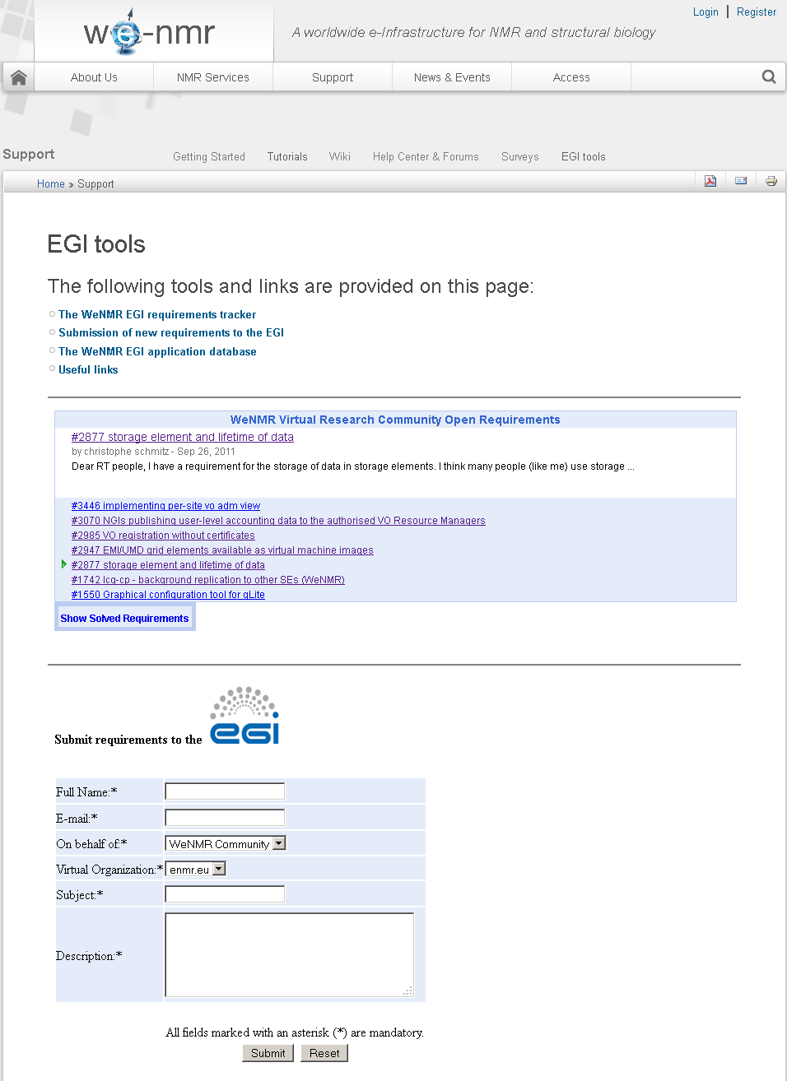
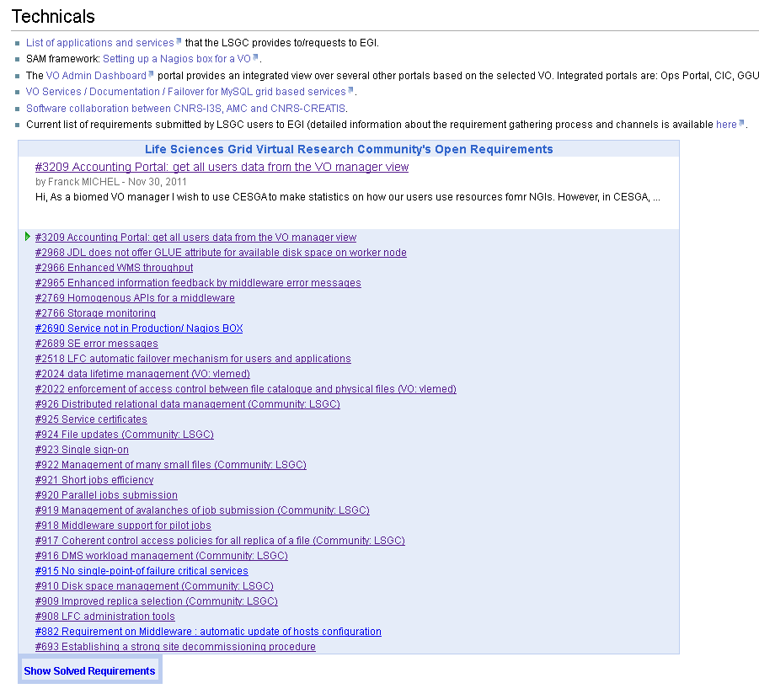
Web gadgets in use
WeNMR Grid Community Life Sciences Grid Community
/

Slide 14
Questions? Contact us:
ucst@egi.eu

