Slide 1
EGI: advanced computing for research
in Europe… and beyond!
Gergely Sipos
Customer and Technical Outreach Manager EGI Foundation
MSO4SC workshop
24 May 2017, Budapest
www.egi.eu
Permalink to slides: https://documents.egi.eu/document/3119
The EGI-Engage project is co-funded by the European Union (EU) Horizon 2020 program under grant number 654142

Slide 2
Outline
Mission and infrastructure
Members & partners
Our services
Resource allocation and access
Examples
EOSC
Next steps

Slide 3
EGI: Advanced Computing for Research
Notes:
A globally distributed ICT infrastructure that federates the digital capabilities, resources and expertise of national and international research communities in Europe and worldwide.
EGI has delivered unprecedented data analysis capabilities to more than 48,000 researchers from many disciplines and is now committed to bring innovation to the private sector.

Slide 4
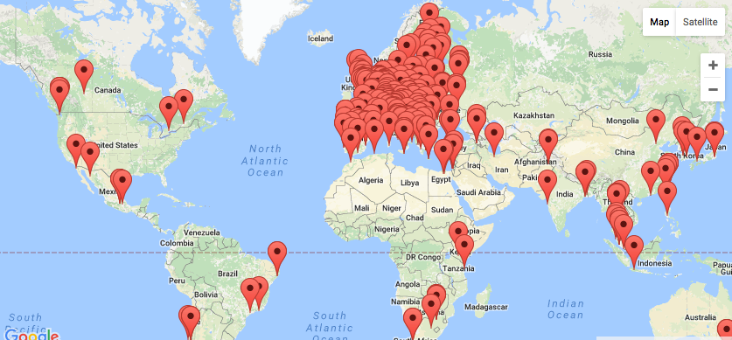
EGI Federation The largest distributed compute e-Infrastructure worldwide
EGI Foundation (Amsterdam)
23 Cloud providers,
300+ HTC providers
15 types of services
1.7 Million jobs/day
2.6 Billion CPU hours/year
>48 000 users

Slide 5
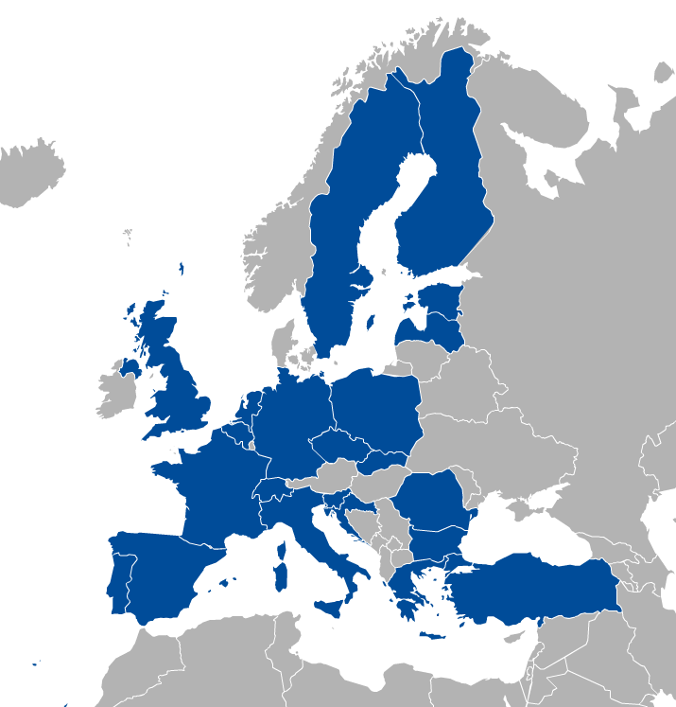
EGI Membership
Major national e-Infrastructures: 22 NGIs
EIROs: CERN and EMBL-EBI
EGI Foundation
(ERICs)
www.egi.eu/about/egi-foundation/

Slide 6
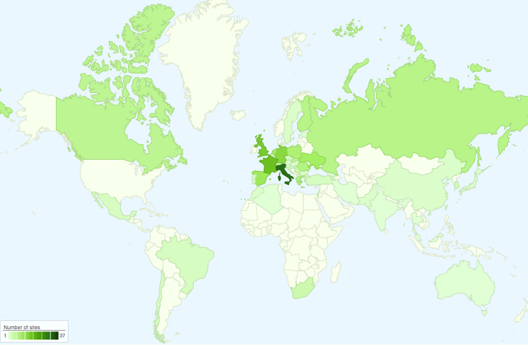
International Partnerships
Canada
China Inst. Of HEP
Chinese Academy
of Sciences
USA
India Centre for
Development of
Advanced Comp.
Africa and Arabia
Council for Scientific and
Industrial Research, South Africa
Asia Pacific Region
Academia Sinica
at Taiwan
Latin America
Universida de Federal do
Rio de Janeiro
Ukraine
Ukrainian National
Grid

Slide 7
EGI Service Catalogue
Compute
High-Throughput Compute
Execute thousands of computational tasks to analyse large datasets
→ Aka. ‘Grid computing’
Cloud Compute
Run virtual machines on demand with complete control over computing resources
Cloud Container Compute
Run Docker containers in a lightweight virtualised environment
Storage and Data
Online Storage
Store, share and access your files and their metadata on a global scale
Archive Storage
Back-up your data for the long term and future use in a secure environment
Data Transfer
Transfer large sets of data from one place to another
Training
FitSM training
Learn how to manage IT services with a pragmatic and lightweight standard
Training infrastructure
Dedicated computing and storage for training and education

Slide 8
EGI Service Catalogue
with New Developments
Compute
Security
Attribute management
High-Throughput Compute
Execute thousands of computational tasks to analyse large datasets
→ Aka. ‘Grid computing’
Manage community membership and expose trusted information about users
CheckIn
Cloud Compute
Run virtual machines on demand with complete control over computing resources
Handle transparent Single Sign-On from multiple, heterogeneous identity providers
Cloud Container Compute
Run Docker containers in a lightweight virtualised environment
Storage and Data
Open Data Platform (based on OneData)
Online Storage
Store, share and access your files and their metadata on a global scale
Share, discover, and process data federated from different sources
Archive Storage
Back-up your data for the long term and future use in a secure environment
DataHub
Access key scientific datasets scalably
Data Transfer
Transfer large sets of data from one place to another
Content Distribution
Deliver data in the most efficient way
Training
Operations
Configurations database
FitSM training
Learn how to manage IT services with a pragmatic and lightweight standard
Manage the configuration information of federated e­-infrastructure assets and their functional relations
Service monitoring
Training infrastructure
Dedicated computing and storage for training and education
Monitor a wide range of services across your infrastructures

Slide 9
EGI serves researchers and innovators
Size of individual groups
WLCG
ELI
CTA
ELIXIR
EPOS
EISCAT_3D
BBMRI
CLARIN
LOFAR
EMSO
LifeWatch
ICOS
EMSO
CORBEL
ENVRIplus
…
VRE projects
OpenDreamKit
WeNMR
DRIHM
VERCE
MuG
AgINFRA
CMMST
LSGC
SuperSites Exploitation
Environmental sci.
neuGRID
…
PeachNote
CEBA Galaxy eLab
Semiconductor design
Main-belt comets
Quantum pysics studies
Virtual imaging (LS)
Bovine tuberculosis spread
Convergent evol. in genomes
Geography evolution
Seafloor seismic waves
3D liver maps with MRI
Metabolic rate modelling
Genome alignment
Tapeworms infection on fish
…
Agroknow
CloudEO
CloudSME
Ecohydros
gnubila
Sinergise
SixSq
TEISS
Terradue
Ubercloud
…
ESFRIs, FET flagships
Multinational communities, (e.g. H2020 projects)
Industry, SMEs
‘Long tail of science’

Slide 10
Access to resources: Virtual Organisations (VOs)
VO 1 (site a, b, c)
VO 2 (site x, y, z, b)
Generic VOs – such as fedcloud.egi.eu → Test VOs, “incubator” for new users
Community/discipline-specific VOs – e.g. Chipster, Highthroughtputseq, EISCAT, etc.
Training VO = training.egi.eu → Running hands on training in the cloud (about any software!)
Browse and search VOs at http://operations-portal.egi.eu/vo/search

Slide 11
Resource allocation to Virtual Organisations (VOs)
Type, number, size, cost, availability, etc.
Applic. provider
Service requirements
Conditions
Storage provider
Cloud provider
Project/Community representing the VO
Negotiator
Grid provider
Service Level Agreement
Operation Level Agreement
Training
Support
Satisfaction review (every 3/6/12 months)
Performance reports
Notes:
SLA is an agreement on intentions to collaborate and support research.
OLA captures conditions, such as: What type of service? How much capacity? Location of service? Free or pay-for-use? How much availability and reliability? Response time for user/operational requests? ‘Human services’, such as consultancy and training? Etc.

Slide 12
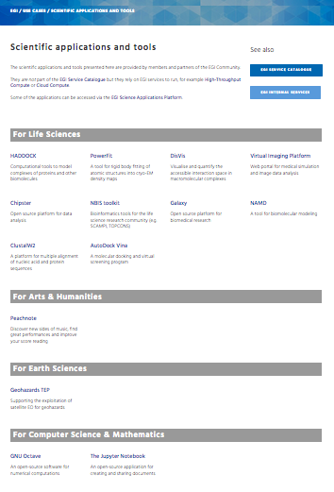
Thematic services from EGI partners
https://www.egi.eu/use-cases/scientific-applications-tools/

Slide 13
Example: Powered by High-Throughput Compute
http://haddock.science.uu.nl/enmr/services/HADDOCK2.2/
HADDOCK
A web portal offering tools for structural biologists
Used to model the structure of proteins and other molecules.
So far, HADDOCK processed + 130,000 submissions from over 7,500 scientists.
Read more...

Slide 14
Example: Powered by Federated Cloud
Analysis software contains over 300 analysis tools for NGS, microarray, proteomics and sequence data.
Bioinformaticians
Clouds of the Chipster Virtual Organisation
VM
Block storage
Chipster portal
VM
Cloud calls (CMD/API)
VM
Appliances Marketplace (AppDB)
VM
Block storage
Update VM image
Virtual Appliances of the Chipster VO
Chipster VM
Push VM image
VM
Chipster developer (CSC, Finland)
VM
Read more...
Notes:
Remark: The Virtual Appliances Catalogue does not store physically the VMs. It stores only references and metadata about the VMs. The VMs are physically stored elsewhere – e.g. third party HTTP server, EGI Repository

Slide 15
Example: Powered by Operations, Security, Cloud
“A distributed infrastructure for life science information”
EGI CheckIn integrated with the ELIXIR AAI IdP Proxy
EGI Operations tools are used to federate ELIXIR Clouds
ELIXIR users are empowered to access:
Configurations database: site admins can register and manage infrastructure resources (cloud and storage)
Cloud: application developers can register Virtual Appliances for publishing; Bioscientists can browse and instantiate software on nearest cloud.
Adding DataHub functionality to replicate reference datasets to clouds
Read more...

Slide 16
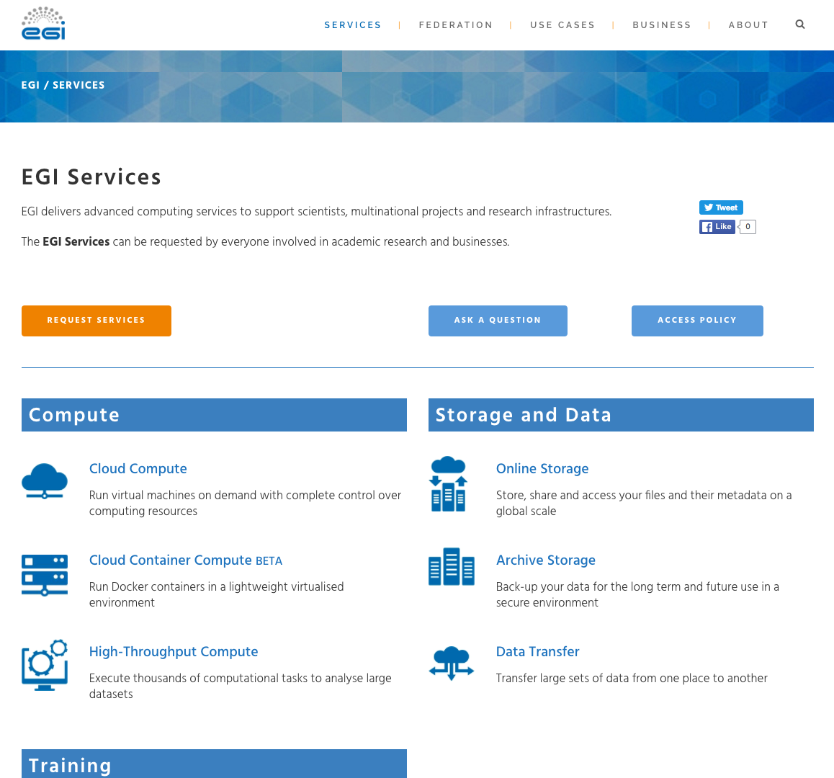
Request
Ask question
Access policy

Slide 17
EOSC
“The European Open Science Cloud (EOSC) is a vision for a federated, globally accessible, multidisciplinary environment where researchers, innovators, companies and citizens can publish, find, use and reuse each other's data, tools, publications and other outputs for research, innovation and educational purposes.”
Credits: Open Science Policy Platform EOSC wg
EOSCpilot project: 2017-2018 (2y)
Call for ‘demonstrators’ every 6 months
EOSC-hub project: 2018-2020 (3y)
Under evaluation in EINFRA12-2017(a) H2020 call
Joint proposal of EGI, EUDAT, INDIGO-DataCloud, several Research Infras.

Slide 18
Thank you!
Get in touch!
support@egi.eu
EGI Foundation • Science Park 140 • 1098 XG Amsterdam •
The Netherlands
+31 (0)20 89 32 007 • egi.eu

