Slide 1
EGI: Linking digital resources across Europe for European science and innovation
Steven Newhouse
EGI.eu Director

Slide 2
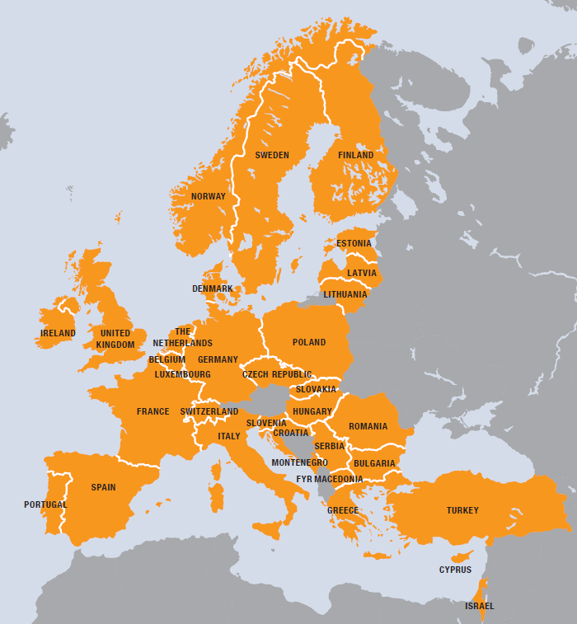
EGI
European
Over 35 countries
Grid
Secure sharing
Infrastructure
Computers
Cloud
Data
Instruments
…. and others

Slide 3
A moment of reflection…
The legacy from the Romans
Sanitation
Medicine
Education
Irrigation
Public health
Roads
Freshwater system
Baths
Public order
What is
Infrastructure?

Slide 4
What is
Digital
Research
Infrastructure?

Slide 5
1990: 1st Generation

Slide 6
1998: 2nd Generation
No centralised control
Open standards & protocols
Non-trivial quantities of service

Slide 7
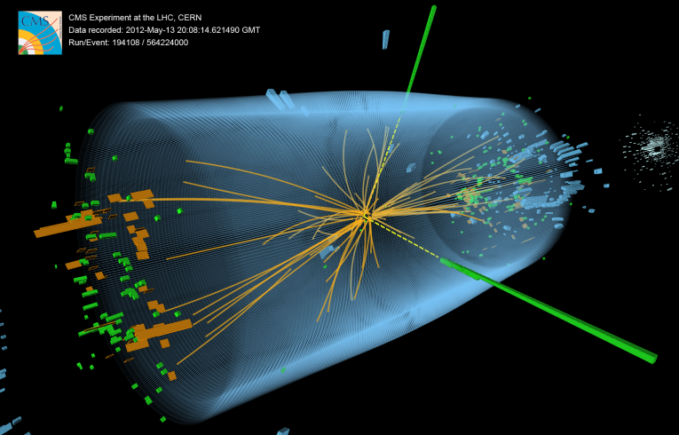
Geneva, 4th July 2012

Slide 8
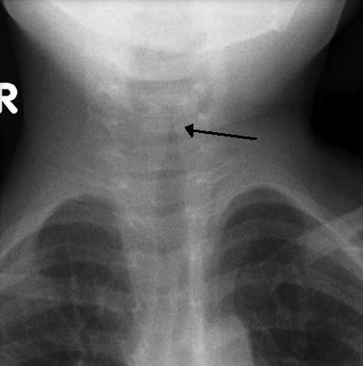
Analysing New Viruses
VIDISCA-454, new method to find new viruses from genetic material
Runs EGI using customised workflows, allowing researchers to save time.
Analysis done in 14 hours not 17 days
The method was used to identify a new type of coronavirus
Results published in Nature Medicine
Many children suffer from respiratory diseases caused by unknown viruses
http://go.egi.eu/virus

Slide 9
Fusion Reactor Modeling
Investigating viability of fusion as a power source
Modeling and simulating the reactor
Used 1 million CPU hours in the last 12 months

Slide 10
Tackling Alzheimers
Diagnostic Enhancement of Confidence by an International Distributed Environment
Diagnostic tools for the medical community sharing medical data securely
Allow doctors to diagnose Alzheimer’s disease in its early stages and track the progress of the symptoms over time

Slide 11
Cherenkov Telescope Array
Future ground-based high energy gamma-ray instrument
Integrate resources 132 institutes in 25 countries
Using applications and grid technology provided by EGI
Rapidly run data-intensive stimulations to explore design

Slide 12
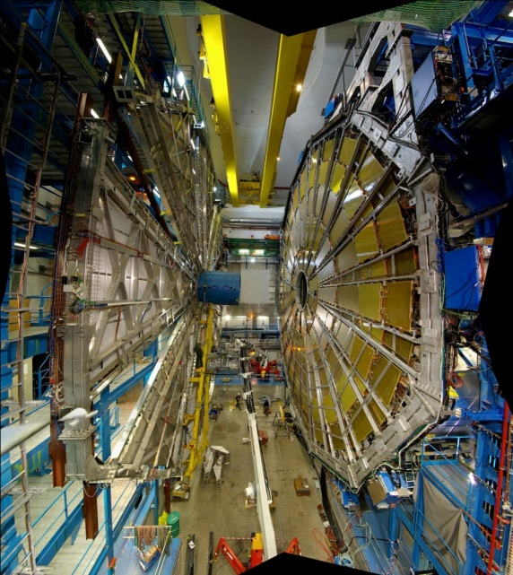
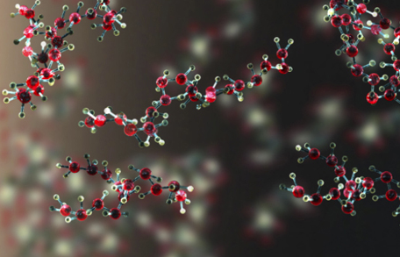
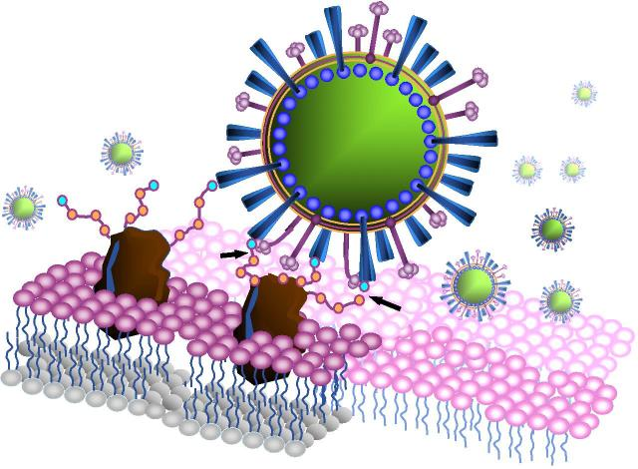
Accelerating Digital Research
Extracting Knowledge from a Deluge of Data
Medicine & Life Science
Genomes $5K & 24hrs
Scans & X-Rays, etc.
Mobile medical monitors
Structural Biology & Modeling
Requires a digital infrastructure to share services and tools personalised to individual research communities
High-Energy Physics
Large Hadron Collider: World’s largest particle accelerator
Supports 8,000 researchers
1 billion CPU hours in the last 12 months
15Pb of data created annually
Health-care
Diagnostic tools for the medical community
E.g.: to diagnose Alzheimer’s disease in its early stages and track the progress of the symptoms over time
See: http://www.egi.eu/case-studies/

Slide 13
2020: 3rd Generation
Sustainable Digital Research Infrastructure
Baseline activity supported by consumers
Project based funding for new innovation
Integrated e-Infrastructure Service Delivery
Across networking, HPC, clouds, grids, …
Driven by the needs of the researchers
Public and private sector demand & suppliers
Supporting European Research Infrastructures
For example, ELIXIR, SKA, …

Slide 14
The History of EGI
2001-2004 EDG Proof of Concept
2010-2014 EGI-InSPIRE Transition towards a sustainable infrastructure
2004-2010 EGEE-I/II/III From prototype to production
2007-2009 EGI Design Study Sustainability Model

Slide 15
EGI’s Vision for 2020
To support the digital European Research Area through a pan-European research infrastructure based on an open federation of reliable services that provide uniform access to national computing, storage and data resources.
EGI 2020 Strategy:
http://go.egi.eu/EGI2020
Virtual Research Environments
Operational Infrastructure
Community & Coordination

Slide 16
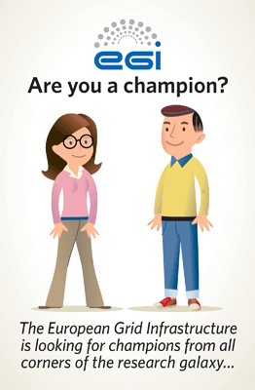
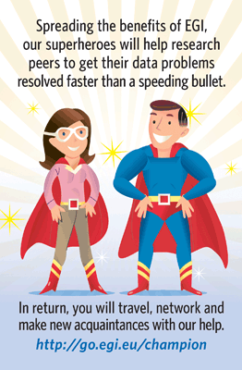
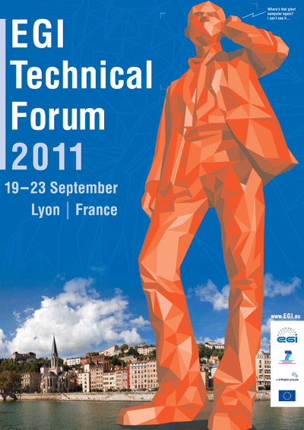
Community & Coordination
NGI International Liaisons
Human network of national contact points
Virtual Teams
Link national experts across Europe
EGI Champions
Expert researchers using EGI communicate to peers

Slide 17
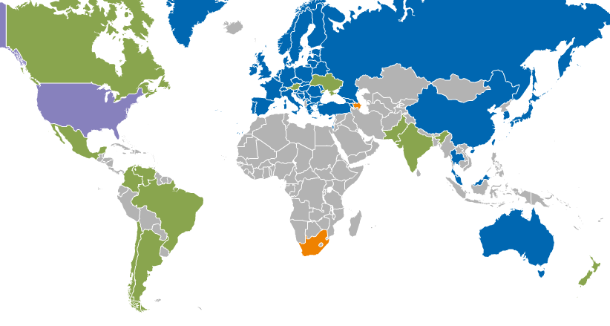
Operational Infrastructure
Registered Users: 21714 VOs: 233
LCPUs: 470,000 Disk: 143PB Tape: 138PB
Jobs: 1.62 million/day
Resource Centres | EGI-InSPIRE & EGI Council members | 319
 | Including integrated RPs | 351
Countries | EGI-InSPIRE & EGI Council members | 42
 | Including integrated RPs | 54
Integrated EGI-InSPIRE Partners and EGI Council Members
External Resource Providers (integrated)
Internal/External Resource Providers (being integrated)
Peer Resource Providers

Slide 18
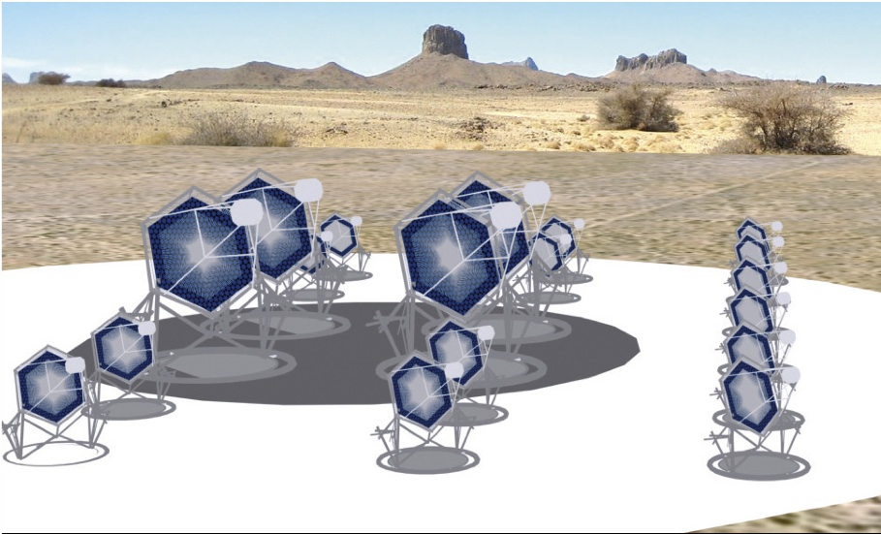
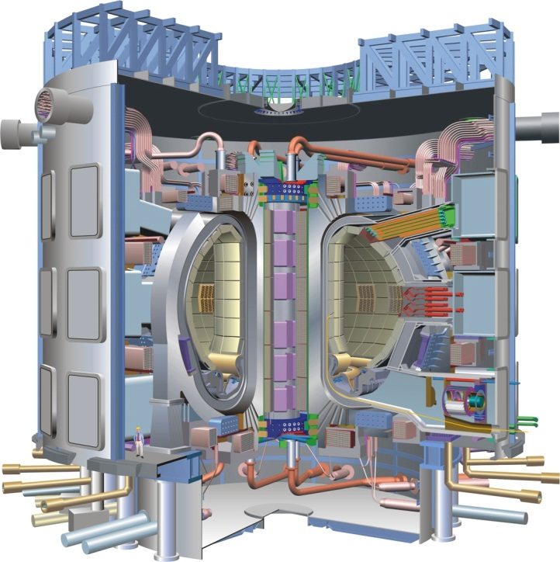
Virtual Research Environments
A VRE encompasses
Site services for a community or communities
Services run for a single community
Shared Services run for all communities
More control & responsibility to researchers
Dynamic deployment of services to meet their needs

Slide 19
EGI.eu
Coordination for European Grid resources
Established 8 February 2010
Central policy & services needed to run EGI
Sustainable small coordinating organisation
Based in Amsterdam
Coordinating core (25 people) in Amsterdam
Technical services from partners (~20 FTEs)
Governed by a Council with national reps.
EGI and EGI.eu: Supported by the EGI-InSPIRE project

Slide 20
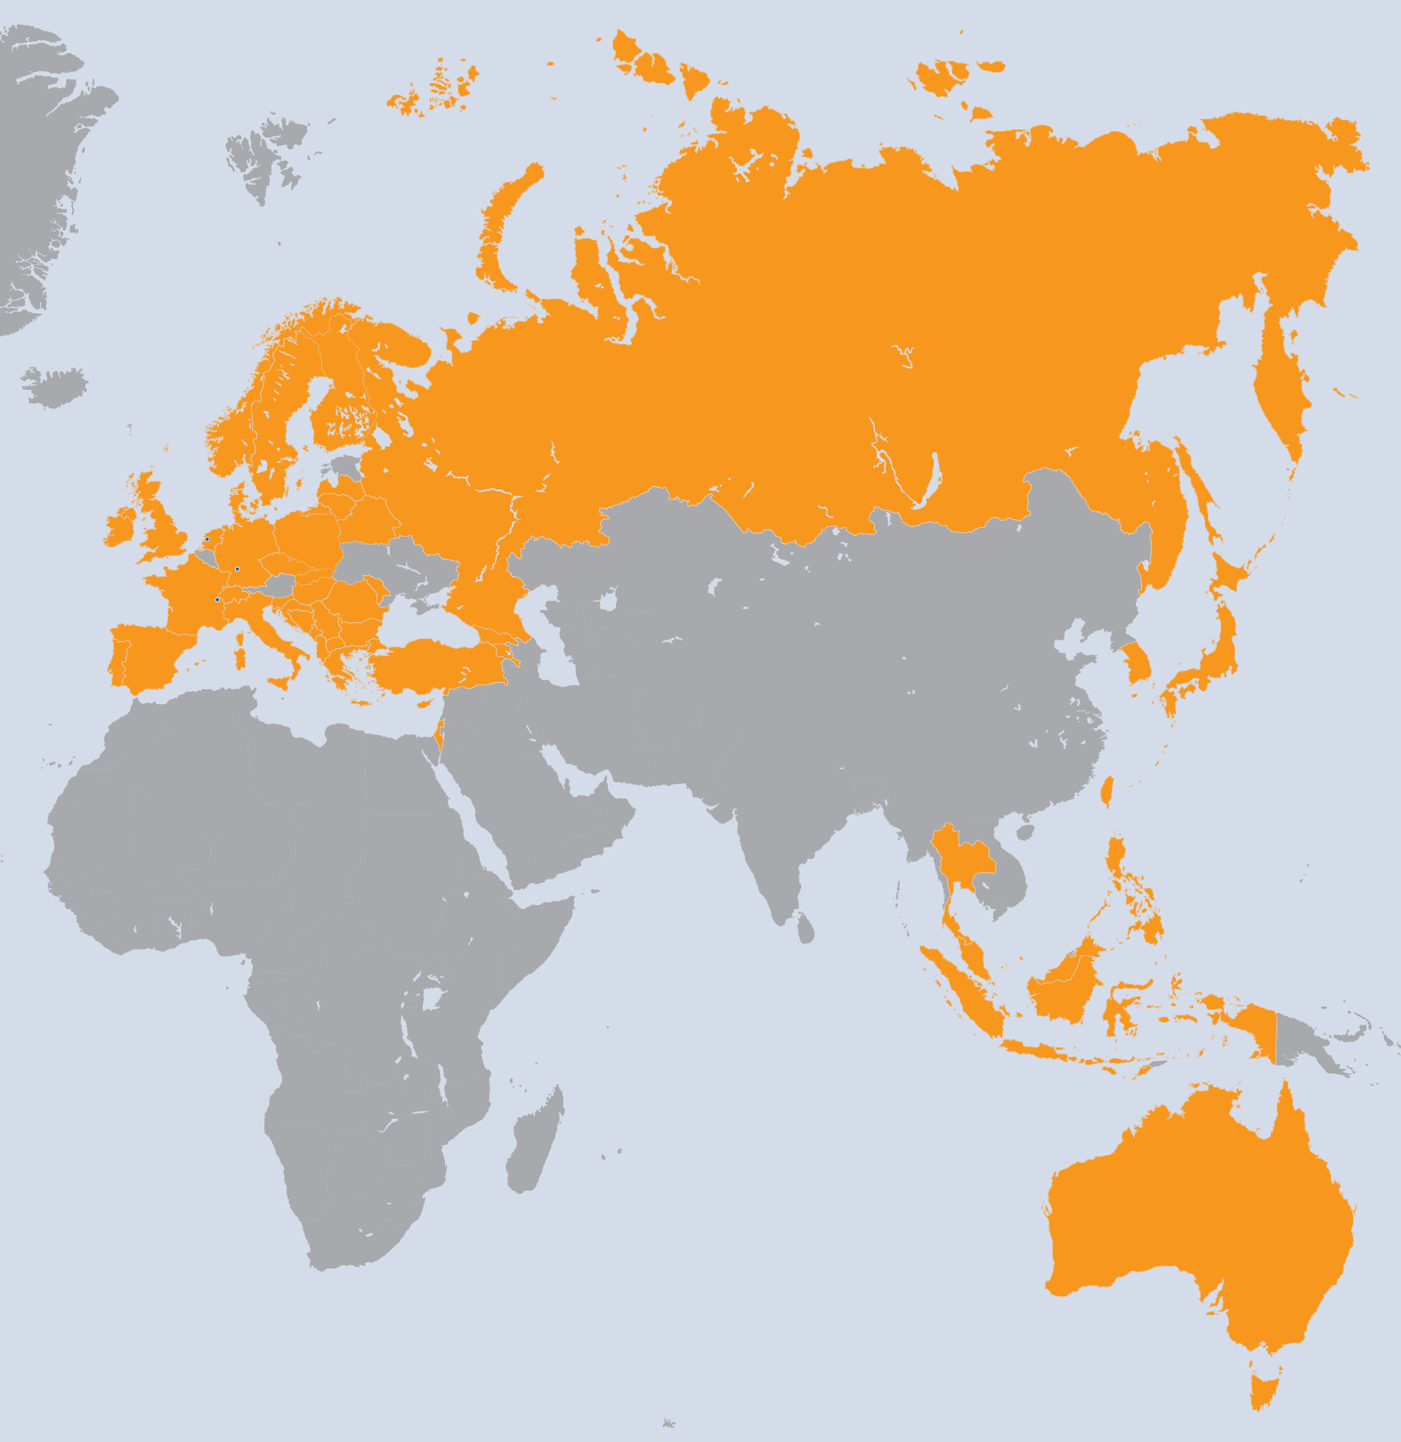
EGI-InSPIRE Project
Integrated Sustainable Pan-European Infrastructure for Researchers in Europe
A 4-year project with
€25M EC contribution
Project cost €72M
Total Effort ~€330M
Effort: 9261PMs
Project Partners (50)
EGI.eu, 38 NGIs, 2 EIROs
Asia Pacific (9 unfunded partners)

Slide 21
A vehicle for Innovation
Deploying Technology Innovation
Distributed Computing continues to evolve
To include: Grids, Desktops, Virtualisation, Clouds, …
Enabling Software Innovation
Provide reliable persistent technology platform
Build on community & external open source tools
Supporting Research Innovation in Europe
Infrastructure for data driven research
Support for international research (e.g. ESFRI)

Slide 22
EGI, EC and Europe 2020
EU2020
Digital Agenda for Europe
Innovation Union
Digital Agenda for Europe
Building a single digital market for research
Stimulate competitiveness and interoperability
Improves efficient use of national resources
Innovation Union
Enabling the digital European Research Area (ERA) for 1.5M+ publicly funded researchers
Development & mobility of our human capital
Removing barriers to the free movement of knowledge
Enable worldwide collaboration
“Europe should also build its innovative advantage in key areas through reinforced e-Infrastructures (i.e. GEANT & EGI)”

Slide 23
Horizon 2020
Funding innovation in Europe 2014-2020
Effectively the 8th Framework Programme
Establishing the ‘Innovation Union’
EC flagship initiative
European Research Infrastructures
Driving the creation of innovation in Europe
Underpinned by e-Infrastructures
Supporting multiple research communities

Slide 24
Disruptive Technologies
The Cloud has changed IT provision
User focused
Service oriented
On demand
Underlying technology is virtualisation
Greater flexibility
Better utilisation
Commoditised

Slide 25
EGI’s Federated Cloud
Community driven testbed activity
61 individuals, 23 institutions, 13 countries, 6 research communities
Current Status
8 Resource Providers running:
OpenNebula, OpenStack & local solutions
2 standard Cloud Management interfaces:
OCCI and CDMI
4 services: Information System, Marketplace, Monitoring and Accounting

Slide 26
The European Cloud
Individual communities get the environments they require
A cloud for EU researchers
Public & commercial resources
Complement EC investment in innovation with commercial expertise
Community Services
Community Services
Community specific
service platforms
EGI.eu Coordination
Globus
Core Software & Support
gLite
ARC
Globus
UNICORE
Community Platform
dCache
Federated Virtual Machine Managers
NGI
NGI
NGI
EIRO
Commercial
Commercial

Slide 27
The Future of DRI
Digital research is here to stay
The European Research Area is one example
Adoption and dependence increasing
1st: Web
2nd: Compute (HTC & HPC)
3rd: Integrated Compute & Data Services
Integrated Digital Research Infrastructure
Operation & support across all technologies

Slide 28
Summary
After a decade the system works well
Scaled up with increasing use & users
An active & engaged community
Consensus based policy & procedures
Sustainability for decades to come
EC funds innovation and structuring
Stakeholders fund the operation they benefit from
By growing the number and diversity of end-users

Slide 29
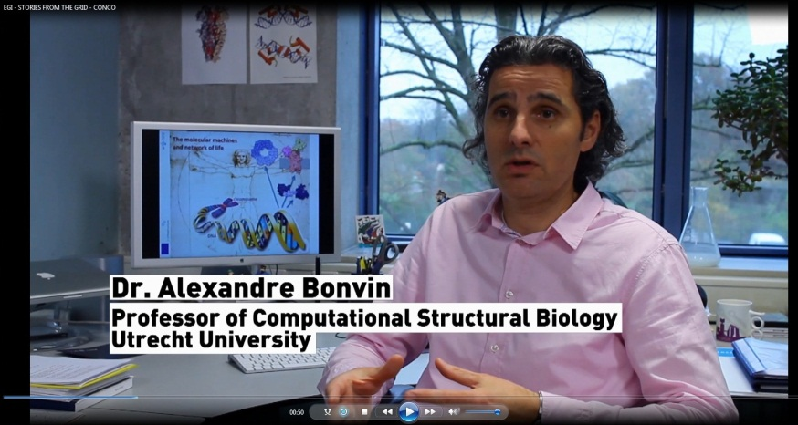
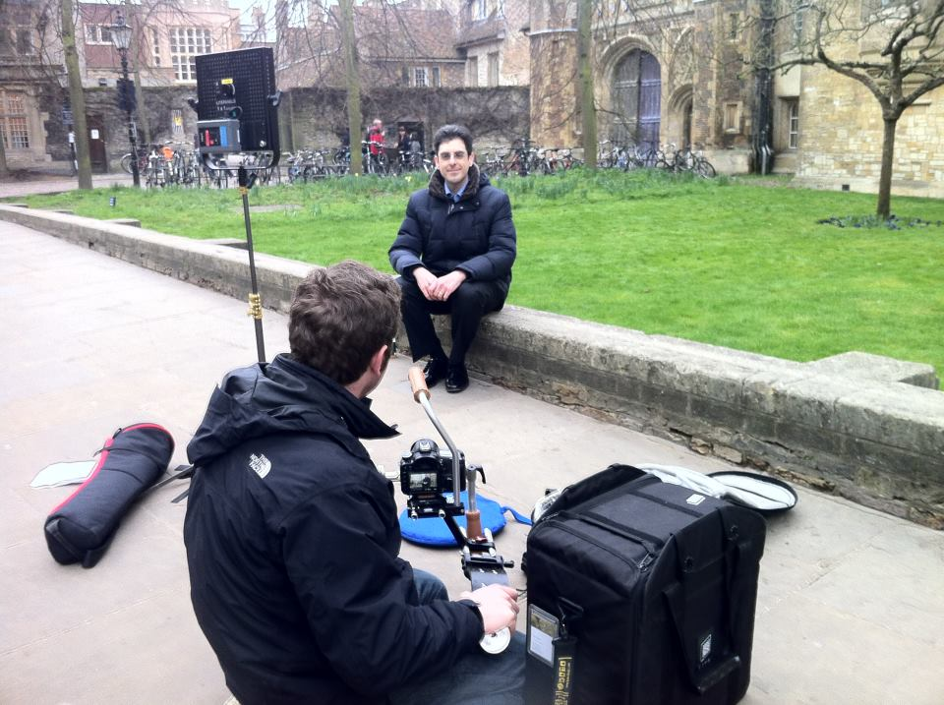
“Stories from the grid”
Visit booth #6
YouTube videos: “Stories from the Grid”
Structural biology (WeNMR project)
Lost Sounds Orchestra
Top Quark in High Energy Physics
See http://www.egi.eu/case-studies/

Slide 30
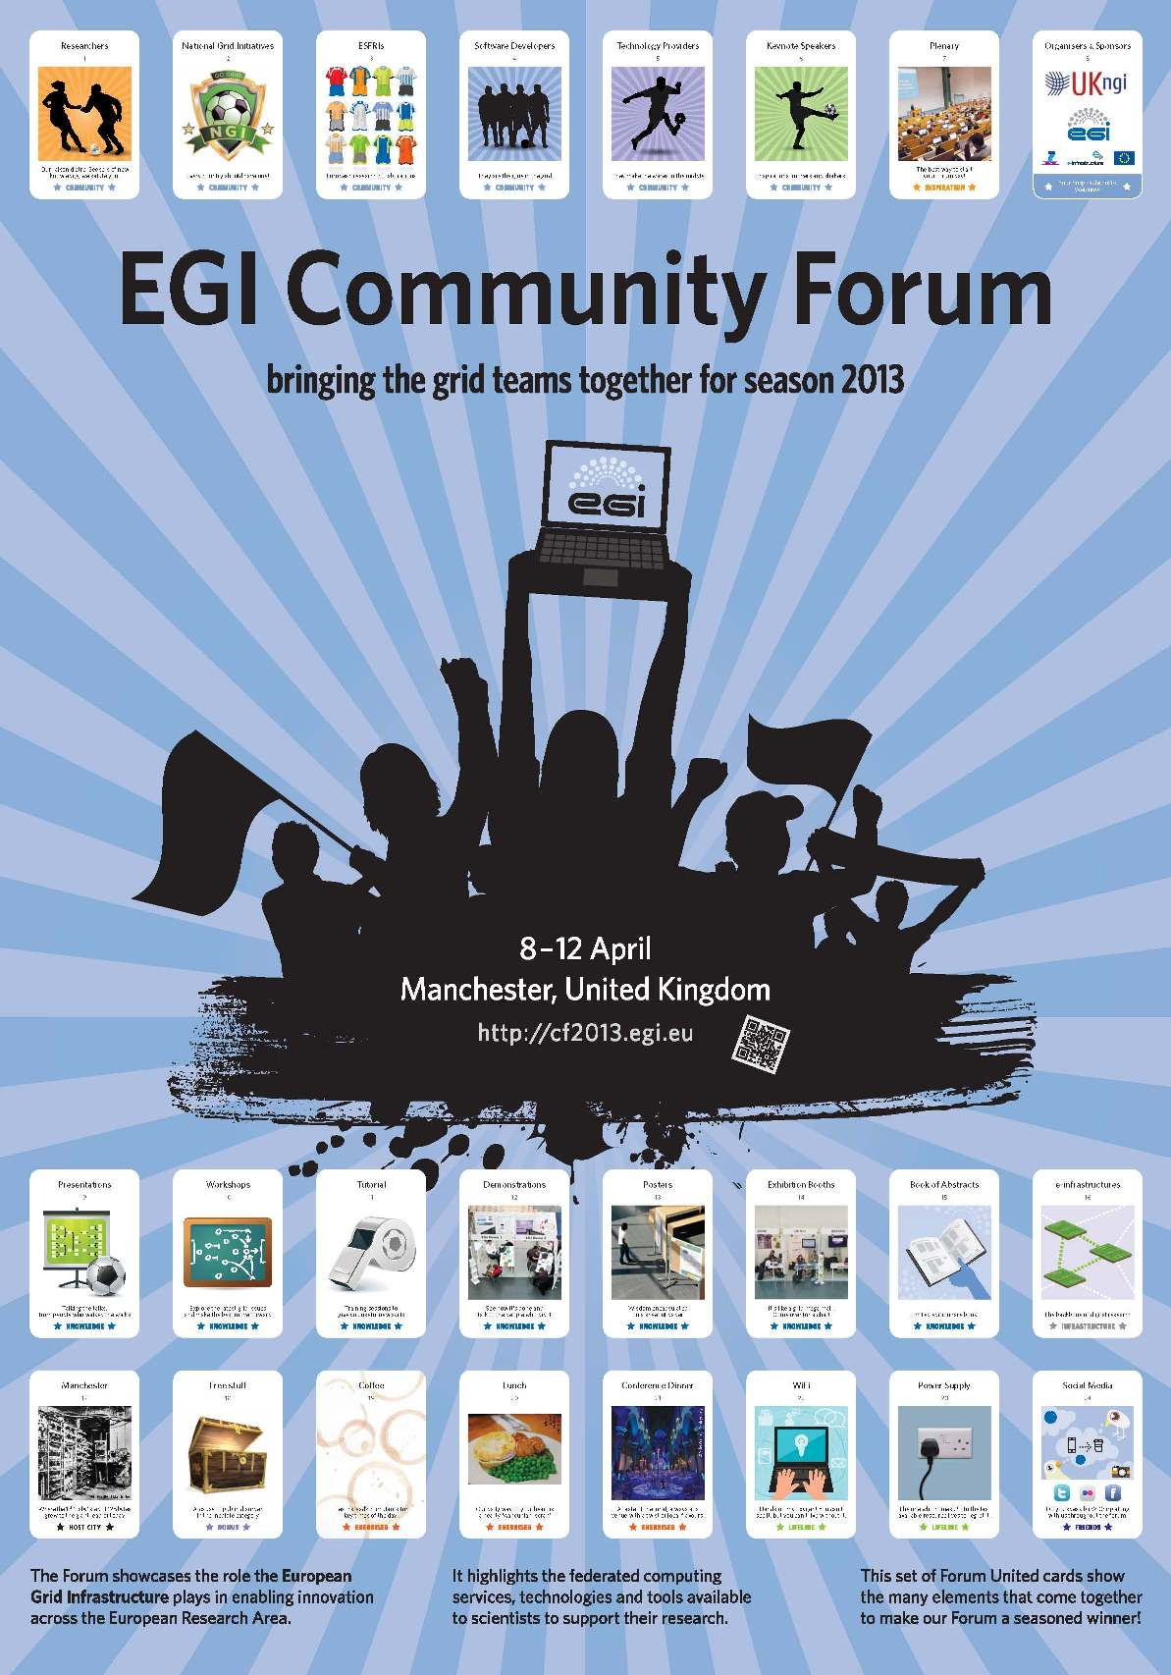
Conclusions
Focus on:
Community & Coordination
Operational Infrastructure
Virtual Research Environments
Sustainability
10 year not a 2 year view
More at www.egi.eu
Contact: director@egi.eu
EGI Strategy: http://go.egi.eu/EGI2020

