Slide 1
EGI: advanced computing for research
in Europe… and beyond!
Gergely Sipos
Customer and Technical Outreach Manager EGI Foundation
PEARC’17
July 2017, New Orleans
www.egi.eu
The EGI-Engage project is co-funded by the European Union (EU) Horizon 2020 program under grant number 654142

Slide 2
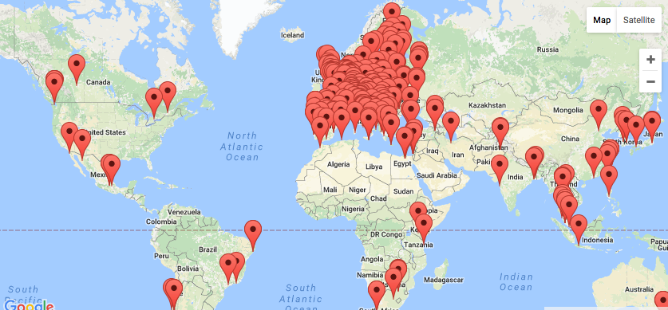
The EGI federated infrastructure
EGI Foundation (Amsterdam)
300+ HTC providers
23 Cloud providers
23 members (NGIs and CERN)
650k CPU cores
285 PB online storage
2.6 Billion CPU hours/year
240 Virtual Organisations
>48 000 users

Slide 3
EGI Service Catalogue
Compute
High-Throughput Compute
Execute thousands of computational tasks to analyse large datasets
→ Aka. ‘Grid computing’
Cloud Compute
Run virtual machines on demand with complete control over computing resources
Cloud Container Compute
Run Docker containers in a lightweight virtualised environment
Storage and Data
Online Storage
Store, share and access your files and their metadata on a global scale
Archive Storage
Back-up your data for the long term and future use in a secure environment
Data Transfer
Transfer large sets of data from one place to another
Training
FitSM training
Learn how to manage IT services with a pragmatic and lightweight standard
Training infrastructure
Dedicated computing and storage for training and education

Slide 4
EGI serves researchers and innovators
Size of individual groups
WLCG
ELI
CTA
ELIXIR
EPOS
EISCAT_3D
BBMRI
CLARIN
LOFAR
EMSO
LifeWatch
ICOS
EMSO
CORBEL
ENVRIplus
…
Support by ‘Competence Centres’
VRE projects
OpenDreamKit
WeNMR
DRIHM
VERCE
MuG
AgINFRA
CMMST
LSGC
SuperSites Exploitation
Environmental sci.
neuGRID
…
PeachNote
CEBA Galaxy eLab
Semiconductor design
Main-belt comets
Quantum pysics studies
Virtual imaging (LS)
Bovine tuberculosis spread
Convergent evol. in genomes
Geography evolution
Seafloor seismic waves
3D liver maps with MRI
Metabolic rate modelling
Genome alignment
Tapeworms infection on fish
…
Agroknow
CloudEO
CloudSME
Ecohydros
gnubila
Sinergise
SixSq
TEISS
Terradue
Ubercloud
…
Research infrastructures
Multinational communities, (e.g. H2020 projects)
Industry, SMEs
‘Long tail of science’

Slide 5
Allocating resources to communities
Type, number, size, cost, availability, etc.
Applic. provider
Service requirements
Conditions
Storage provider
Cloud provider
Project/Community representing the VO
Negotiator
Grid provider
Service Level Agreement
Operation Level Agreement
Training
Support
Satisfaction review (every 3/6/12 months)
Performance reports
Notes:
SLA is an agreement on intentions to collaborate and support research.
OLA captures conditions, such as: What type of service? How much capacity? Location of service? Free or pay-for-use? How much availability and reliability? Response time for user/operational requests? ‘Human services’, such as consultancy and training? Etc.

Slide 6
Applications On Demand service Serving the long tail of science
http://access.egi.eu
For Application Developers
Integrate applications into science gateways
For Researchers
Use applications from the catalogue
App. 1
…
App. K
App. 1
…
App. L
Science gateway 1
Science gateway 2
Cloud, HTC, storage sites
User Registration Portal (URP)
Usage stats
EGI Accounting system
For providers
Receive credits via acknowledgements
Users
ApScience gateway 3
Science gateway X
For HTC/cloud/storage providers
Integrate resources
Identity vetting
Approve,suspend users
Scientific publications
App. 1
…
App. M
App. 1
…
App. N
For support teams
Direct contact with the long tail
Support teams
Usage stats

Slide 7
Thank you!
support@egi.eu
EGI Foundation • Science Park 140 • 1098 XG Amsterdam •
The Netherlands
+31 (0)20 89 32 007 • egi.eu

