Slide 1
EGI-InSPIRE Project Presentation
Steven Newhouse
Project Director, EGI.eu

Slide 2
Abbreviations
VO: Virtual Organisation
EIRO: European International Research Organisation
ESFRI: European Strategy Forum on Research Infrastructures
NGI: National Grid Infrastructure/Initiative
VRC: Virtual Research Community
SSC: Specialised Support Centre

Slide 3
Why build a European Grid Infrastructure?

Slide 4
Infrastructure (Wikipedia)
Infrastructure is the basic physical and organisational structures needed for the operation of a society or enterprise, or the services and facilities necessary for an economy to function
The Enterprise is the European Research Area

Slide 5
What is a Grid?
A grid consists of distributed resources controlled by separate organisations that be systematically used securely by users external to that organisation
Resources can include:
Commodity or HPC clusters
Disk or tape storage
Instruments
Data Archives or Digital Libraries

Slide 6
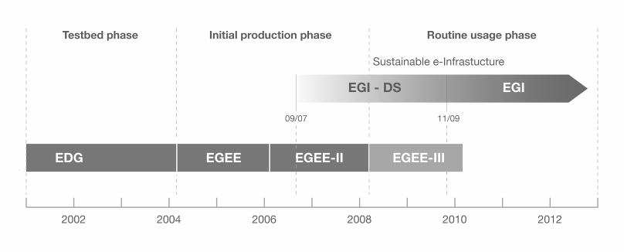
European Grid Infrastructure
European Data Grid (EDG)
Explore concepts in a testbed
Enabling Grid for E-sciencE (EGEE)
Moving from prototype to production
European Grid Infrastructure (EGI)
Routine usage of a sustainable e-infrastructure

Slide 7
Growing Capacity & Scope

Slide 8
The EGI Model

Slide 9
EGI
Collaboration
Research
Community
Research
Community
Research
Community
N
G
I
Research
Community
Research
Community
N
G
I
E
I
R
O
N
G
I
N
G
I
E
I
R
O
EGI.eu

Slide 10
EGI.eu
Coordination for European Grid resources
Established February 8th 2010
Central policy & services needed to run a grid
Sustainable small coordinating organisation
Governance & ownership by its participants
EGI Council votes linked to fees
Resources from within its participants
Located in Amsterdam with approx. 40 staff
Coordinating core (~20 people) in Amsterdam
EGI and EGI.eu supported by EGI-InSPIRE project

Slide 11
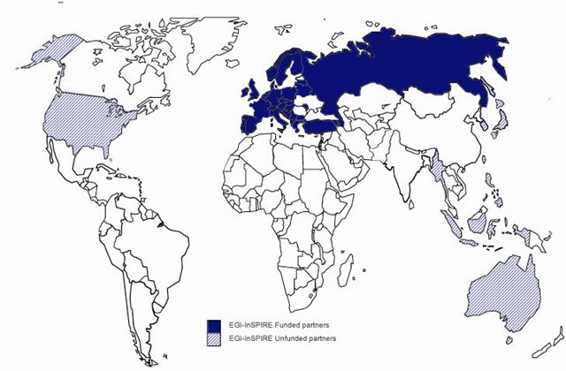
The EGI-InSPIRE Project
Integrated Sustainable Pan-European Infrastructure for Researchers in Europe
A 4 year project with €25M EC contribution
Project cost €72M
Total Effort ~€330M
Effort: 9261PMs
Funded
Un-Funded
Project Partners (51)
EGI.eu, 40 NGIs, 2 EIROs
Asia Pacific (8 partners)

Slide 12
EGI-InSPIRE Project Objectives
Continue towards a sustainable production infrastructure
With infrastructure providers in Europe and around the world
With new DCI technologies as they mature
Provide support to current structured international research communities
Sustain current domain specific services
Attract new user communities (e.g. ESFRI)

Slide 13
EGI-InSPIRE Project Activities
NA1: Project & Consortium Management
Project Office and Quality Assurance
NA2: External Relations
Policy Development and Dissemination
Community Building Events
NA3: User Community Coordination
EGI.eu and NGI support teams
Supporting Technical Services for Virtual Research Communities
JRA1: Support for Operational Tools
Maintenance and Development
Support for new resources and their accounting

Slide 14
EGI-InSPIRE Project Activities
SA1: Reliable Operation of the production infrastructure
Monitoring, accounting, operational security
Helpdesk & NGI Support teams
Validation of new technology & operational tools
SA2: Provisioning the Software Infrastructure
Definition of software coming from external projects
Validation of delivered software
Software repository and support tools
SA3: Support for Heavy User Communities
Services & tools for all users of the infrastructure
Domain specific support for current heavy users

Slide 15
What WILL EGI do?

Slide 16
EGI means Innovation
Deploy Technology Innovation
Distributed Computing continues to evolve
To include: Grids, Desktops, Virtualisation, Clouds, …
Enable Software Innovation
Provide reliable persistent technology platform
Tools built on gLite/UNICORE/ARC/Globus
Support Research Innovation
Infrastructure for data driven research
Support for international research (e.g. ESFRI)

Slide 17
User Support & Services
Support User Communities
Researchers in International Collaborations
National Research Collaborations through the NGI
Scale up from the single VO to a community
Provide a federated Helpdesk linking:
Discipline specific support (e.g. Bio Apps)
National Grid Infrastructures
Generic services (e.g. Training)
Provide core services to support users
Manage VOs, Application DB, Training DB

Slide 18
Other Activities
Dissemination
With NGIs, VRCs, SSCs and other projects
Support for Heavy User Communities
General & community specific services
Events
Two Annual meetings: Users & Technology
Technology Assessment and Integration
Liaison with software providers
Definition and verification of requirements

Slide 19
Technology Innovation
Will come from outside EGI
Moving research technologies into production
Partnership with technology projects
EMI (European Middleware Initiative)
IGE (Initiative for Globus in Europe)
EDGI (European Desktop Grid Initiative)
StratusLab
VenusC

Slide 20
Software Innovation
Will also come from outside EGI
EGI is a neutral platform for applications
EGI cannot support all services in its core
Every community needs something different
Foster innovation within different ‘sectors’
Digital Libraries
gCube from D4Science

Slide 21
Research Innovation
An infrastructure to support European Researchers
Within the EU27
Geographical Europe
Interoperability worldwide for collaboration
Work with Virtual Research Communities
Groupings of aligned Virtual Organisations
Enable their community specific support activity:
Support, training, consultancy, requirements etc.

Slide 22
Future Plans

Slide 23
What will EGI do?
Continue with a secure reliable infrastructure
Integrate resources based on gLite, UNICORE, ARC, Globus, ...
Continue the transition to national structures
Support its user communities
Maintain user services & tools
Engage with structured (virtual) user communities
Encourage structuring in unstructured user communities
Defined representatives within EGI bodies
Engage with the ESFRI projects

Slide 24
Be a Neutral Infrastructure
Consider IP network providers
Supports traffic from different communities
Customised solutions within a generic framework
Standards drive integrated deployment
And for sustainable e-Infrastructures?
Any application, any domain, any technology
A platform for domain specific innovation & use
Integration of any compliant resource

Slide 25
In the Future…
Improve the efficiency of the infrastructure
The jobs, users & data will continue to increase
Effectiveness of the resources needs to match
User input into upper middleware layers
VOs decide what services are deployed where
VOs manage their own deployed infrastructure
Empower the VOs to meet their own needs
Flexibility and responsibility

Slide 26
Can we learn from others?
Grids have benefited from commoditisation
Hardware: HTC & HPC affordable to all
Networking: GBs can be moved over WAN
Software: Open source software comes of age
Impacts of commodity virtualisation…
For transactional models →
The ‘Cloud’: A model based on compute not data
For large distributed data-oriented models →
The emergence of true ‘function shipping’?

Slide 27
A need for Standards
Consensus
Openness
Balance
Transparency
Data Layer
Secure reliable data movement
Access to data resources
Virtualisation Layer
Span trust domains within agreed policies
Monitoring as important as lifecycle control
Service Layer
The services that go into the virtual machine
Avoid domain specific silos & promote reuse

Slide 28
Summary
EGEE:
Demonstrated a production e-infrastructure
EGI:
Provide a sustainable production e-infrastructure
EGI.eu established in Amsterdam
Supported transition through EGI-InSPIRE
Contact: director@egi.eu

