Slide 1
EGI Data Transfer Service
Training Material
Yin Chen, Baptiste Grenier
EGI Foundation

Slide 2
Overview

Slide 3
Overview: Service Features
Description: Allows to move any type of data files from one place to another within a specified Virtual Organization (VO)
Features:
Ideal to move large amounts of files or very large files
Has mechanisms to ensure automatic retry in case of failure
The transfers are monitored, managed and optimised
Can be integrated by higher level services, e.g., DIRAC, Rucio, Science Gateways
A WebFTS frontend is provided, allowing graphical interface without a Command Line Interface (CLI)

Slide 4
Overview: Technology
The service is based on FTS3
FTS3 was developed to distribute LHC data across Worldwide LHC Computing Grid (WLCG)
FTS3 is a low level multi-protocol data movement service, responsible for reliable bulk transfer of files from one site to another
FTS3 can be also used to monitor and log transfer jobs
Access to FTS3 can use Command Line Tool, REST API, or WebFTS
WebFTS is a an autonomous web application that interacts with FTS3 via REST
Documentation:
FTS3: http://fts3-docs.web.cern.ch/fts3-docs/
WebFTS: http://fts3-docs.web.cern.ch/fts3-docs/docs/webfts.html

Slide 5
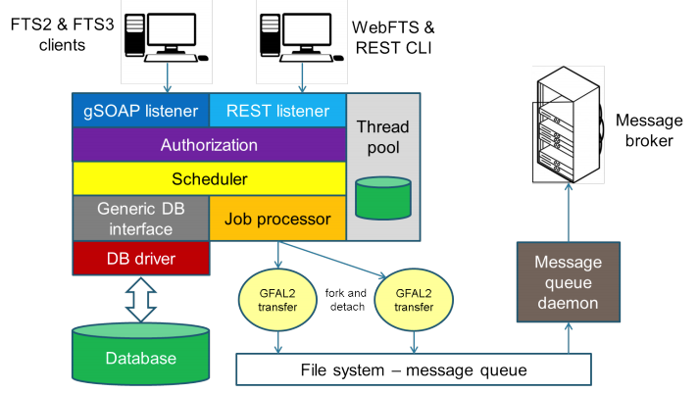
FTS3 Architecture
Figure is from ‘FTS3: New Data Movement Service For WLCG’, A A Ayllon et al 2014, J. Phys.: Conf. Ser. 513 032081

Slide 6
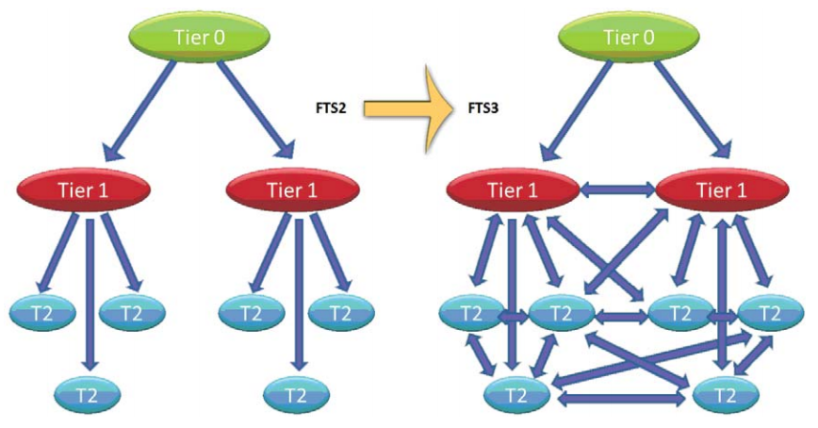
FTS3 approach: adaptive optimisation
The FTS3 auto-tuning algorithm and channel-less model allows moving from a structured topology to a full-mesh for networks links and storage elements without any configuration and, optimising transfers based on information retrieved from the database
Figure is from ‘FTS3: New Data Movement Service For WLCG’, A A Ayllon et al 2014, J. Phys.: Conf. Ser. 513 032081

Slide 7
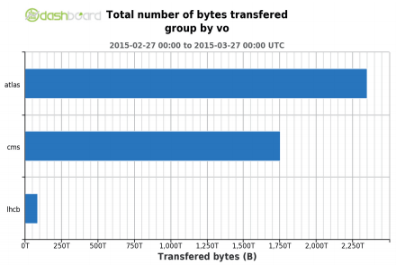
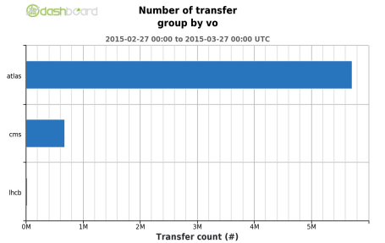
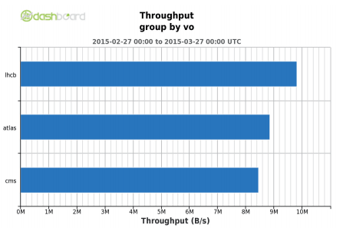
FTS3 performance
The figures shows CERN Production FTS3 instances with 9 virtual machines
A single FTS3 instance is capable of scheduling more than 4PB in 28 days, distributed across more than 6 million transfers
Figure is from ‘FTS3 on the web’, A A Ayllon et al., Poster presentation, 21st CHEP2015,
https://indico.cern.ch/event/304944/contributions/1672726/

Slide 8
Overview: Service Provision
The EGI Data Transfer service is supported by two providers: CERN and STFC/UKRI
CERN provides the following access instances
FTS3 instance at: https://fts3-public.cern.ch:8446/ : is deployed as a load-balanced alias across a number of machines
WebFTS instance: https://webfts.cern.ch/
STFC/UKRI provides the following access instance:
FTS3: https://lcgfts3.gridpp.rl.ac.uk:8446/
This is provided as a HA Proxy load-based alias across a pool of servers
Technology supports and help desk can be found at:
https://wiki.egi.eu/wiki/GGUS:EGI_Data_Transfer_Service_FAQ

Slide 9
WebFTS: HowTo

Slide 10
What is WebFTS
https://webfts.cern.ch/
Web based tool to transfer files between grid/cloud storages
Additional Features
Check-summing and file overwriting
Possibility to resubmit transfer jobs or only-failed files transfers.
Storage Endpoints Auto-completion
For endpoints published on the BDII (EGI and WLCG Information System)

Slide 11
WebFTS Architecture
BROWSER
WEBFTS.js
REST API
REST API
FTS3
GFAL2
DAVIX
GSIFTP
DROPBOX
…

Slide 12
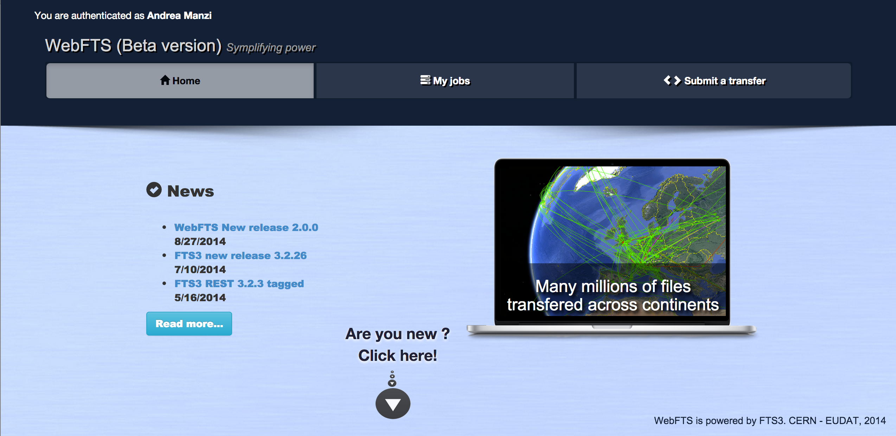
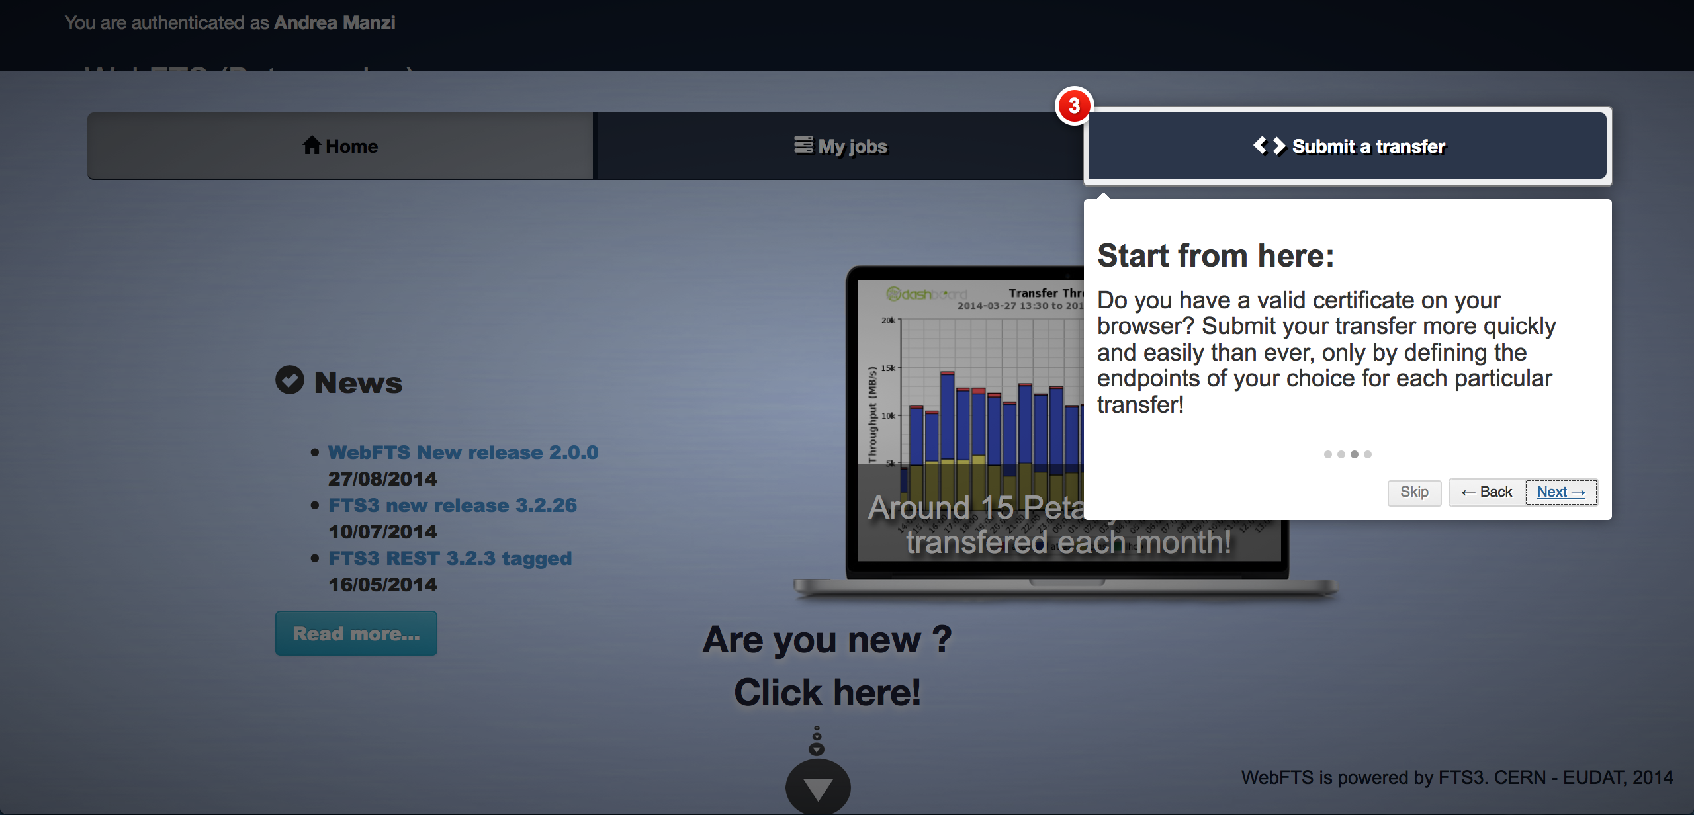
Landing Page and Guided-tour
https://webfts.cern.ch/

Slide 13
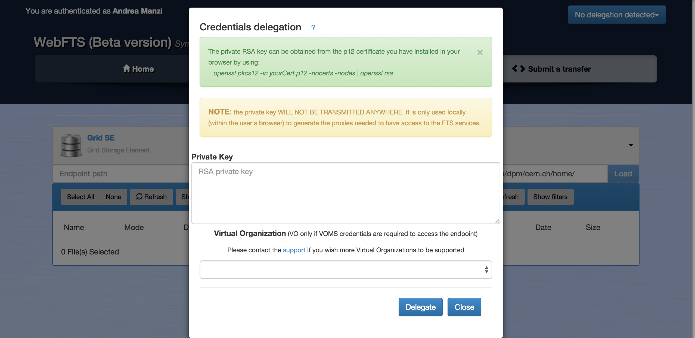
Credential Delegation
ZERO SENSITIVE INFORMATION IS TRANSMITTED

Slide 14
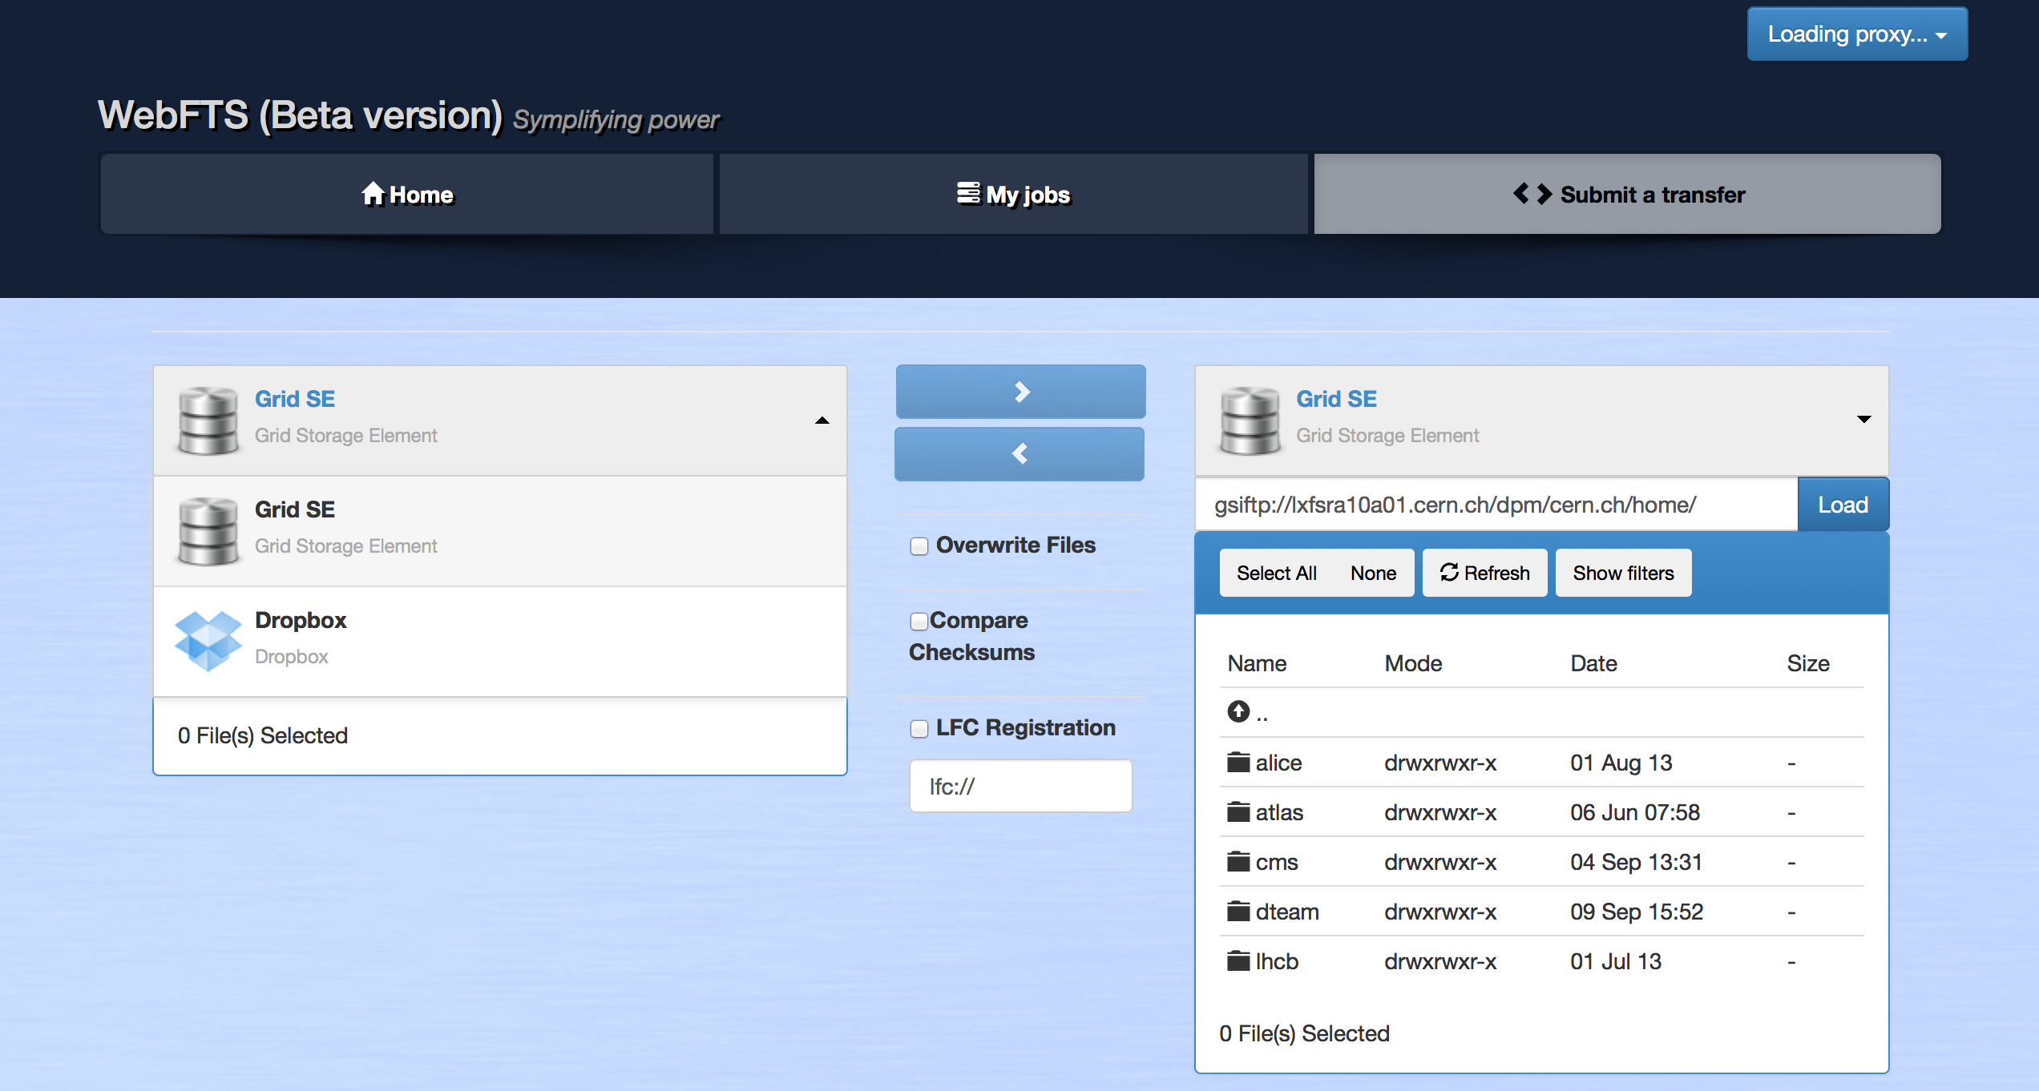
Transfer Interface

Slide 15
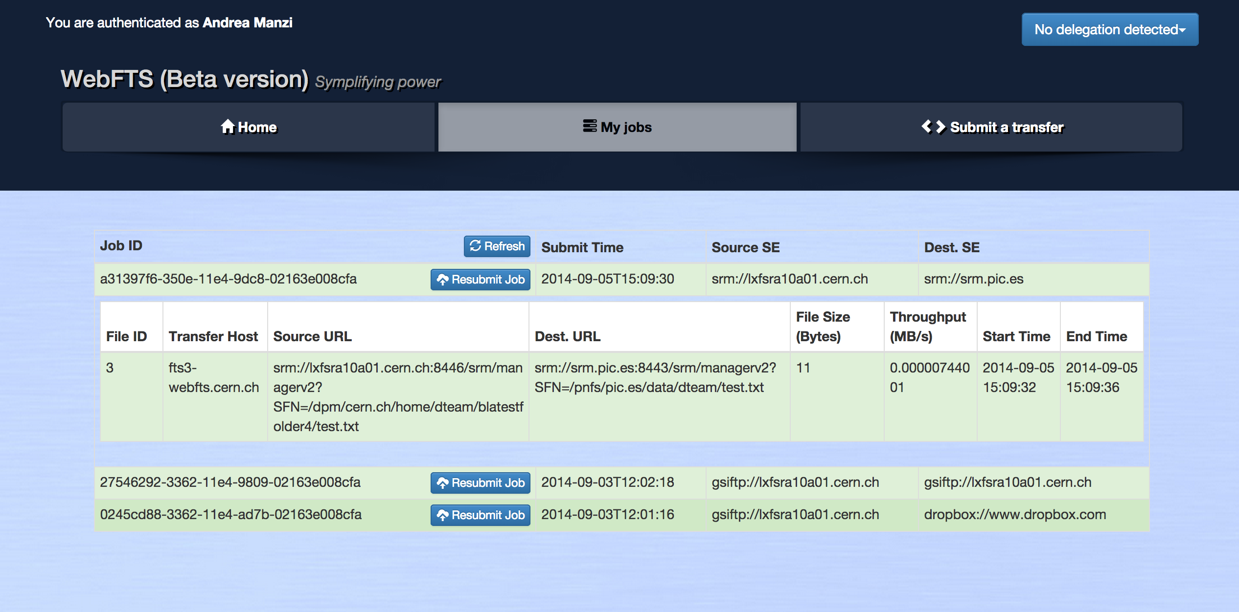
Job Status Interface

Slide 16
Security
Simpler access while keeping the same level of security
X509
Transparent delegation of credentials
Avoid storing or transferring any sensitive data
Open access to all source code
All sensitive information is used within the browser and forgotten
Delegation is needed to let WebFTS access the grid on users behalf
Users make private key available to browser
Not available via browser API
VOMS extensions acquired by the service on users behalf
Why it’s important
Gives the users a service which can access the grid for them, from a browser, with full VOMS credentials

Slide 17
Get Started

Slide 18
Get Started
A user can order the service at
EGI Marketplace
eInfraCentral Platform
Pre-requests:
User should already have a valid Certificate. Otherwise, Get a user certificate
Support for new VOs must be explicitly requested as they need to be configured in WebFTS and on the FTS cluster nodes (voms files)
Requested VO should have storage attached
For users:
User guide for command Line Tools: http://fts3-docs.web.cern.ch/fts3-docs/docs/cli.html
User guide for REST API: http://fts3-docs.web.cern.ch/fts3-docs/fts-rest/docs/index.html
User guide for WebFTS: http://fts3-docs.web.cern.ch/fts3-docs/docs/webfts.html
Information about technology supports and the help desk: https://wiki.egi.eu/wiki/GGUS:EGI_Data_Transfer_Service_FAQ
Service Wiki: https://wiki.egi.eu/wiki/EGI_Data_Transfer#Get_Starts

