Slide 1
EGI for big data experimentation
Tiziana Ferrari
EGI.eu Technical Director
Tiziana.Ferrari@egi.eu

Slide 2
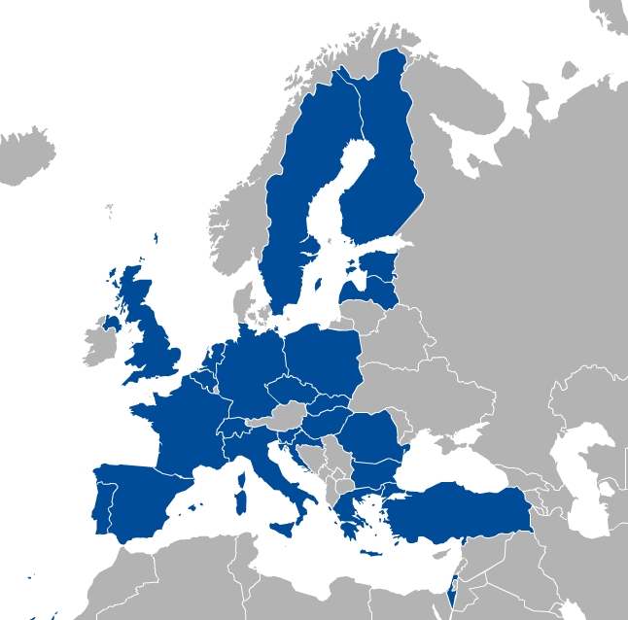
About EGI
European infrastructure for distributed advanced computing
26 funding organization in Europe, 24 countries, CERN and EBI
Participation open to research and commercial organizations
Shared interest in
Providing access to distributed datasets and the computing capabilities needed to transform data into a service
Sustainable
Infrastructure (storage and computing): national funding agencies
Federation services and R&D: European projects
Access to services: free at point of use and/or pay for use
EGI.eu in Amsterdam
EGI for big data experimentation
Notes:
E-Infrastructures are geographically distributed computing resources and data storage facilities linked by high-performance networks. They allow scientists to share information securely, analyse data efficiently and collaborate with colleagues worldwide. They are an essential part of modern scientific research and a driver for economic growth.
EGI was established in 2010 building on over a decade of investment by national governments and the European Commission. EGI is a European-wide federation of national computing and data storage resources. Its aim is to support cutting-edge research, innovation and knowledge transfer in Europe. EGI federates resources from various resource centres, mainly from research insitututes and universities. These centres provide computer clusters, storage servers, applications and human support services for secure access and sharing. EGI provides these services to European researchers and their international collaborators.
EGI is coordinated by EGI.eu, a not-for-profit foundation based in Amsterdam and owned by EGI’s participants, the National Grid Infrastructures (NGIs).

Slide 3
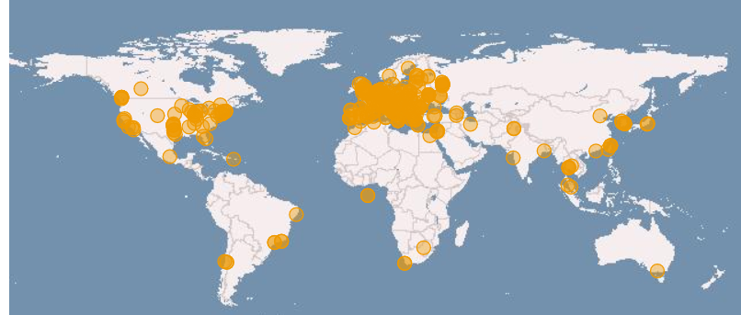
EGI infrastructure today
620,000 CPU Cores
500 PB of storage
21 Cloud providers
350 data centres
40,000 users
+2,000 research papers

Slide 4
EGI Cloud Federation http://go.egi.eu/fedcloud
Production operations since May 2014
Currently:
21 providers from 14 NGIs
6.000 cores in total
700k VMs, 9M CPUh in last 12 months

Slide 5
EGI Federated Cloud Architecture
IaaS
Capabilities
Uniform interfaces and behaviour
Share & endorse VM images
EGI Cloud Service Providers
Cloud Management Framework
Replicate
VM images
Federation Integration
EGI AppDB
EGI Core Platform
VM Image Catalogue
Operation-Level Federator Services
EGI for big data experimentation

Slide 6
Transforming federated datasets into service
Publish open datasets and link them to tools and publications as the output of analysis tasks run in EGI
Preservation services are offered during the entire data lifecycle
Data as a Service: host data collections replicas and make them discoverable and sharable to bring computation next to the data and tools
Analyze data that is hosted by external data preservation infrastructures, share data analytics software and applications

Slide 7
What EGI can provide
A sustainable environment where
both researchers and SMEs can test innovative services and product ideas based on open data and business data
Large scale infrastructure
Various providers ISO 27k certified
exchange, linking and re-use, as well as to integrate data assets from multiple sectors: working with various research infrastructures and their datasets (environment, biodiversity, earth observation, art and humanities, biobanks, life science etc.)
knowledge and technologies can be shared: we provide tools and software for cross-border data and application portability
Can handle large, complex and realistic data sets of the order of hundreds of TBs, we federated 500 PB of storage world wide
In operations since 2004
Experience in running and operating a European network of competence centres and participating to the EDISON project developing and promoting a data scientist model curricula

Slide 8
The EGI Distributed Competence Centre
Federated services
BBMRI
ELIXIR
EPOS
MoBRAIN/ INSTRUCT
EISCAT-3D
DARIAH
LifeWatch
Environment (disaster mitigation)

Slide 9
Contact address: projects@mailman.egi.eu

