Slide 1
Status Update
Status Update, GA 08 Oct 2018
Credits: J. Reetz, D. Scardaci, WP Managers
Dissemination level: Confidential
Disclosing Party: Activity Management Board
Recipient Party: General Assembly

Slide 2
Outline2

Slide 3
20 digital research infrastructures,
EGI, EUDAT CDI and INDIGO-DataCloud
jointly offering services, software and data
for advanced, data-driven research & innovation
The Hub:
a European contact point
to discover, access, use and reuse
resources for advanced data-driven research
→ contact@mailman.eosc-hub.eu
100 partners
36 months
33 million Euro

Slide 4
Service catalogue
Arts and Humanities
Medical and Health Sciences
Physical Sciences
Earth Sciences
Biological Sciences
Data Lifecycle Management, Compute,
Scientific Applications
Research
Enabling
Services
The
Hub
Access
Enabling
Services
e.g. Marketplace, AAI
Accounting and Monitoring
Helpdesk, …
https://www.eosc-hub.eu/catalogue/

Slide 5
EOSC-hub Mission
The project will create EOSC Hub:
a federated integration and management system for EOSC
From the consortium AND from external contributors
Services
Processes and policies
Federated operations
Federation services
Data
Applications & tools
Baseline services (storage, compute, connectivity)…
Training, consultants
Marketplace
AAI
Accounting
Monitoring
…
Usage according to Principles of engagement
Lightweight certification of providers
SLA negotiation
Customer Relationship Management
…
Security regulations,
Compliance to standards,
Terms of use,
FAIR implementation guidelines
…
10/8/2018
Based on FitSM
5

Slide 6
What does the Hub provide?
Contact point for researchers and innovators to discover, access, use and reuse a broad spectrum of resources for advanced data-driven research
Catalogue of resources and services
Humanities, Engineering, Medical and Health Sciences, Natural Sciences
Corpus of policies, processes and federation services (community-defined)
Principles of engagement and EOSC “core” services
Quality assurance reviews
Manage end-to-end service level management performance
Competence Centres and a Joint Digital Innovation Hub
Specialized Technical support, training

Slide 7
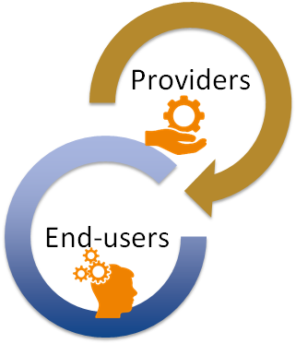
Value proposition
Publish and promote services and resources
Defined Hub policies (general & community-specific)
FAIR best practices, access and usage policies, interoperability, standards
General service management processes with the providers
Tools for federated service management
Accounting, monitoring, federated AAI, registries
Incident and support management, customer relationship and order management, SLA management, IT security management, …
Using institutional credentials for access
Discover and compare services
Access services and resources and get support
Order extended capacities
Order service upgrades

Slide 8
Shaping the EOSC
The EOSC-hub contribution: Jan-Sep 2018

Slide 9
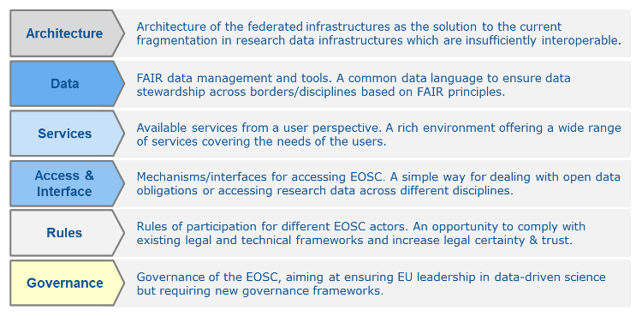
Action lines
Architecture | Provides a framework to manage services sourced from a number of service providers. The project plays the role of service integrator.
Data | Through the EOSC-hub Marketplace, provides a discovery and access channel to FAIR-accredited datasets

Slide 10
Action lines
Services | Contributes to the definition of a participatory and lightweight service portfolio management process in collaboration with the participating service providers.
 | Engages with the demand and supply side of the EOSC, and will co-develop and operate a marketplace as one entry point to EOSC

Slide 11
Action lines
Access & Interface | Engagement with the demand and supply side of the EOSC; Co-development
Rules of Participation | Collaborates with partners and external projects/initiatives to establish and maintain a corpus of policies that is attractive and provides value for both service providers and service users.

Slide 12
Shaping the EOSC:
The EOSC Service Management System
Processes and procedures to onboard, operate and offer EOSC services

Slide 13
EOSC Service Management System
Framework to manage services sourced from a number of service providers
Processes and procedures to onboard, operate and offer EOSC services
Progress in all 12 process definitions and implementations
Supplier Portfolio Management | Configuration Management | Capacity Management
Service Level Management | Change Management | Information Security Management
Customer Relationship Management | Release and Deployment Management | Incident and Service Request Management
Supplier Relationship Management | Service Availability and Continuity Mgmt | Problem Management
Setting up of Service Management Board (SMB)
Management/governance body for all Service Providers of EOSC-hub
Forum for discussion of service provisioning matters: security, upgrades, operational problems etc.
Validation of operational aspects
Definition and maintenance of service provisioning policies

Slide 14
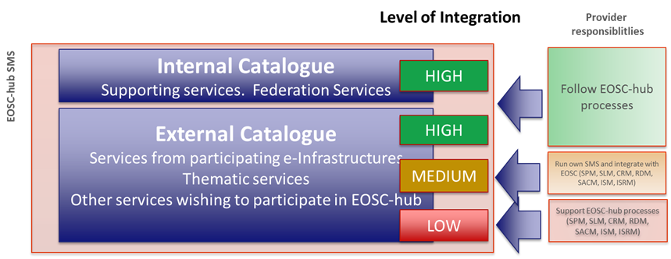
Contribution to Rules of Participation (RoP)
Collaboration with partners and external projects/initiatives to establish and maintain a corpus of policies that is attractive and provides value for both service providers and service users.
Task Force set-up and working on defining the RoP
Collaboration with the 2nd HLEG EOSC and other EOSC projects (EOSC-pilot, eInfraCentral, OpenAIRE Advance, etc.)
Ongoing: definition of appropriate procedures to assess the conformance of the services to the RoP and to the FAIR principles
Defined operational requirements to join the service catalogue
Ongoing:
Legal and policy requirements
Technical requirements

Slide 15
Shaping the EOSC:
EOSC-hub contribution to the EOSC Portal

Slide 16
The EOSC Portal initiative of the EC
The EOSC Portal is a European-level entry point to all services and resources needed by European researchers to perform science in a collaborative, open and cost efficient way: publish → discover → access
EOSC objectives | What EOSC Portal does
Increase the ability to exploit research data: data can be used as widely as possible, across scientific disciplines and between the public and the private sector | > Publish, discover, access services and resources for all scientific disciplines > Open to national, regional, pan-European providers, and supports different exploitation models (e.g. free at point of use, commercial) > Provide interoperable generic and thematic services for data exploitation
Increase interoperability, interconnect the existing and the new research digital infrastructures across Europe, remove fragmentation | > Provide thematic services integrated with European compute/data platforms for data exploitation > Single sign on, integrated access and order
Support open science | > Research artefacts sharing and discovery: services to share and discover research artefacts (publications, datasets, software, workflows etc.), research artefacts data sources (publication repositories, publishers, data archives, software archives, etc.), and others

Slide 17
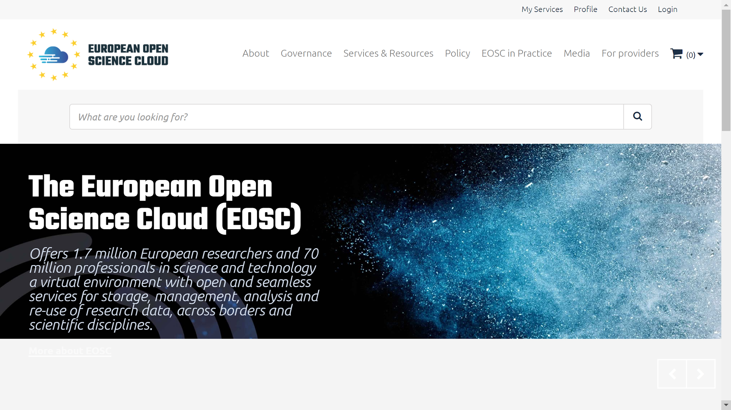
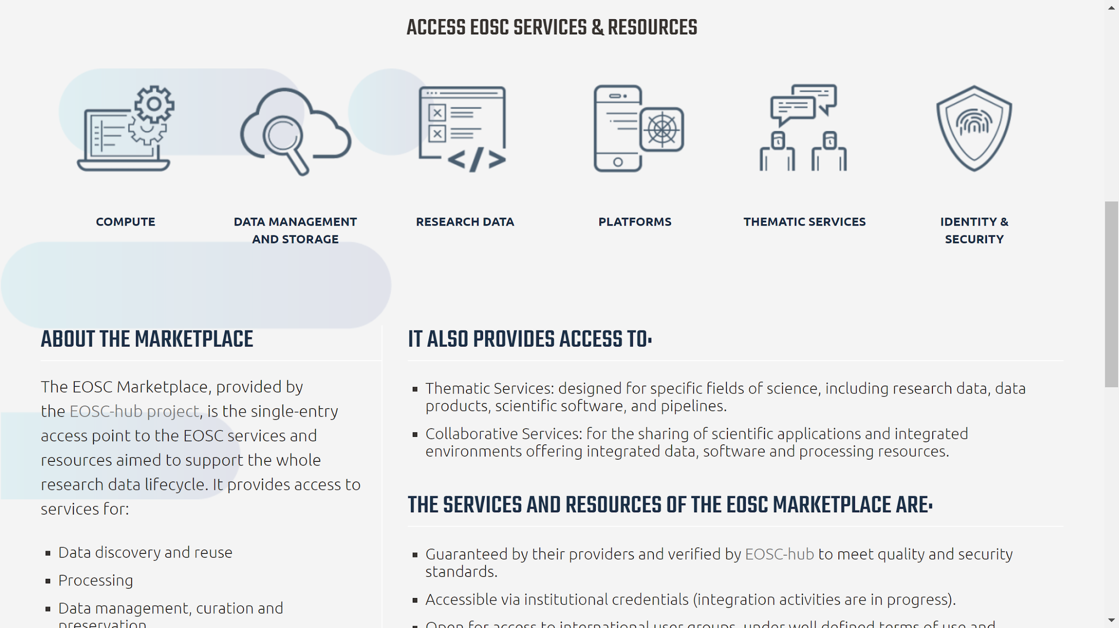
Contribution to the EOSC Portal launch
Major contribution to design and content development
Provisioning of website and white label EOSC AAI and Marketplace (“EOSC” branded) for access to TRL 8-9 services
Contribution of use cases for the launch event
Preparation of the launch event
Vienna, 23 Nov 2018

Slide 18
The EOSC Marketplace as key component of the EOSC portal
Added values for service providers and end-users
Service providers | End-users
Publish, share and advertise services & resources, promote the adoption outside the traditional user groups | Discover a set of scientific outputs, applications, research data exploitation/discovery platforms, data management, compute services
Reach out to a wider international user base of researchers and innovators | Get complete, harmonized information on access policies, maturity level, standard compliance
Get a free online platform to manage service requests, interact with users, provide support, agree the most suitable service levels. | Smoother authentication/authorization process with own credentials for authentication
Allow users to authenticate with their own credentials to access your services and resources and get support to enable this. | Choose and access multiple resources and services according to the user’s needs by placing orders
Contribute to the definition and maintenance of EOSC service provisioning policies and the portfolio roadmap. | Provide feedback about services and information about needs → service roadmap
Receive a label that identifies validated services & resources

Slide 19
Shaping the EOSC
Engaging with and boarding of service providers

Slide 20
Boarding of service providers Creating a catalogue of services as part of EOSC
First version of the EOSC service portfolio defined
External service portfolio:
Research Enabling services: Customer-facing services that are offered via the EOSC Hub
Internal service portfolio:
Access Enabling serving: Supporting services needed to operate the EOSC Hub
Draft of the service portfolio management process defined
Templates, Procedures, Tools to on board, validate and update services
49 services
Engagement activities to to open up the Hub to external providers
First Virtual Access report on access provisioning in preparation
Marketplace Launch in November as additional promotion and service delivery channel

Slide 21
Boarding of service providers Research Enabling Services – Thematic Services
Domain specific services for end-users
They benefit from the single access hub and the supporting services provided by the EOSC-hub project
Helpdesk, standard access workflow, single sign-on, …
They can be discovered along with other services in a consistent fashion through the Marketplace
9 Thematic Services in the portfolio
5 Already operational
WeNMR | VA Metrics
 | New users in 9 months: from 1750 to 2273 (+401%)
 | Number of user runs submitted to portals in 9 months: from 13800 to 36179 (+162%)
 | Job submitted: 5034534
 | Consumed CPU time: 15685748 hours
 | Reached countries: 96
Dynamic On Demand Analysis Service
EO PILLAR

Slide 22
Engaging with service providers Research Enabling Services – Competence Centers
Use cases | CCs | Services
Application and data platform | EISCAT_3D ICOS-eLTER | DIRAC B2Stage, B2Share B2Safe | EOSC-hub AAI Fed.Cloud Containers Storage (online, archive)
Data and application replication ‘backbone’ | ELIXIR EPOS- Orfeus | FTS, B2Stage Kubernetes Life sc. & EPOS AAI
User workflows over distributed data and compute | Fusion Astronomy Disaster Mit. | DODAS OneData Jupyter
Incubators for early adopter research communities
Technical support
Architecture planning:
Sharing plans and technology experiences
Tech-talks with project experts
Area-specific consultancy web-meetups
Storage; AAI; Cloud-Containers-Orchestration
Formal description of the requirements
Cross-infrastructure integration
Guided by community requirements:
Integration between Common and Domain Specific services
Integration between Common services
E.g.: Check-in and DIRAC (EISCAT_3D CC), Check-in and EBI Embassy OpenStack cloud (ELIXIR CC), EGI Jupyter and B2Drop (EPOS-ORFEUS CC)
Service providers invited to join the Service Portfolio after successful integration

Slide 23
Engaging with service providers Business sector & the Joint digital innovation hub
Business pilots success stories to further develop European economic innovation capacity
Objective: Create partnerships with SMEs/industry, innovation clusters, accelerators and investors that stimulate innovation
Result | Impact
EOSC Digital Innovation Hub | 6 SME collaborations (https://www.eosc-hub.eu/digital-industry-hub) Engaging with EC DIH Working Group and finalizing the application for the DIH catalogues
MoUs | Mind the Byte (SME Drug discovery); Kings Distributed Systems (SME interested in providing CPU capacity and offering a token/credit system); UberCloud (broker services to facilitate engagement with SMEs for establishing new pilots); Politecnico di Milano/Engineering (DIH business models, platform adoption)
Collaborations | BDVA (iSpaces); Acellera and Evotec (SMEs Drug Discovery); Sunbay (new external request); XSEDE (industry programme experience and knowledge sharing collaboration)

Slide 24
Engaging with service providers Other Service Providers
EOSC-hub engages with the demand and supply side of the EOSC
26 communities engaged
Joint sessions with ESFRI clusters, EOSCpilot Scientific Demonstrators and H2020 e-infrastructure projects at EOSC-hub Week
Joint workshops under finalisation with ESFRI clusters (CORBEL, ASTERICS, ENVRI, etc.)
Form to collect expression of interests on becoming an EOSC provider
https://eosc-hub.eu/join-as-service-provider
Result | Impact and KPI
Training events and resources | Train people in research and academic organisations preventing lack of skilled and specialized infrastructure operators 16 events, 538 trained people

Slide 25
Shaping the EOSC:
EOSC-hub Technical architecture as a contribution to the EOSC
Technical Coordination & Technical Architecture

Slide 26
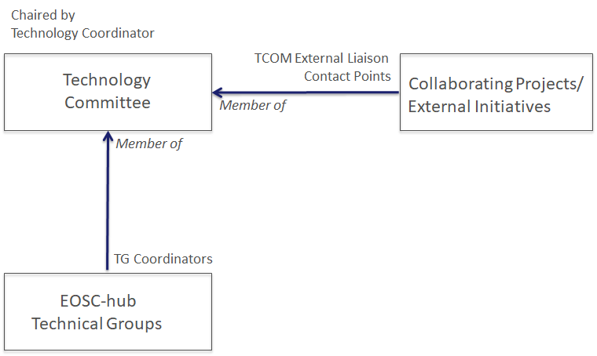
Technical coordination
Technical committee (TCOM) appointed and operational
Technical roadmap
Contribution to open source community projects and standards bodies
Compliance to standards and security of the service in the catalogue
Coordinating with external initiatives and projects
12 Technical areas identified
A technical group per area
Involving representatives of all services and
products of the area
Technical Areas
Data Platforms for Processing | Software Release and SQA
Data Publishing and Open Data | Federation Tools
Data Preservation/Curation/Prov. | PaaS Solutions
Metadata Management and Data Discovery | Workflow management and user interfaces and Data analytics
HTC/HPC Compute | Security
Cloud Compute | AAI

Slide 27
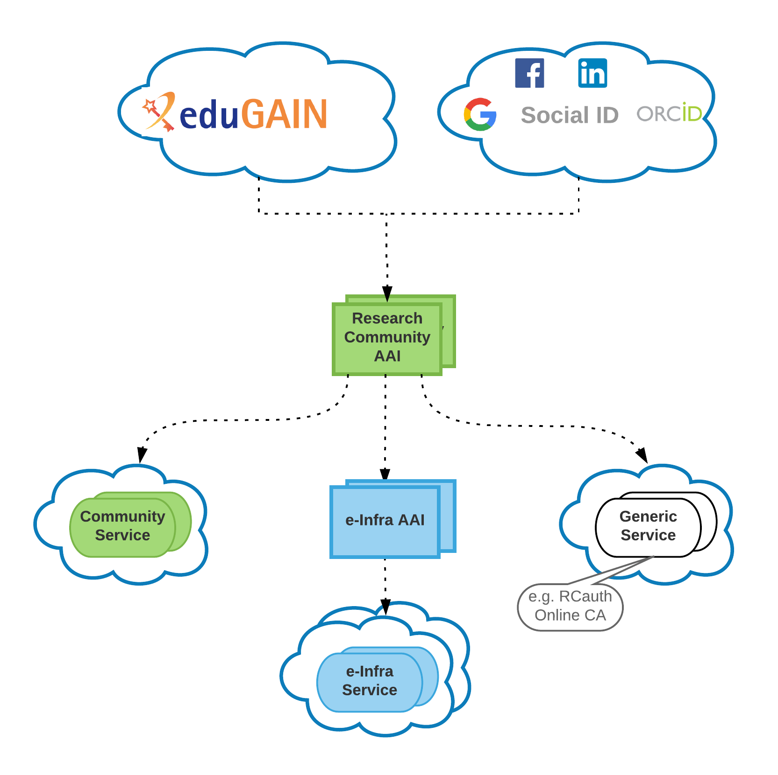
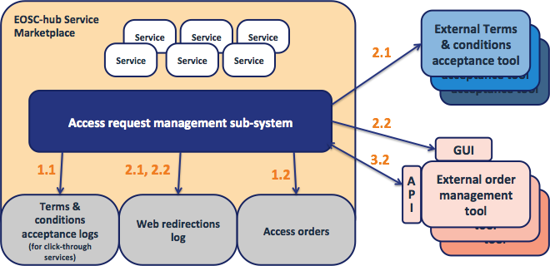
Highlights
EOSC-hub AAI architecture defined
EGI Check-in / EUDAT B2ACCESS interoperability achieved
Accounting
EUDAT and EGI accounting data integrated in the one repo, design of the EOSC-hub accounting portal
Monitoring: First prototype of the unified monitoring system
Unified EOSC-hub Helpdesk available in Nov 2018
Working on integration between EGI, EUDAT and INDIGO common services
B2FIND, B2DROP, EGI Cloud Compute, INDIGO Orchestrator, etc
Setup of testbeds
EOSC-hub AAI
EOSC Marketplace - Distributed order mgmt

Slide 28
Shaping the EOSC
Communication, Dissemination and Training

Slide 29
Communication and Dissemination
Joint EOSC-hub/OpenAIRE communication/stakeholder engagement activities
Joint communication plan in place
2 joint case studies (www.eosc-hub.eu/collaborations/openaire-advance)
Joint webinar & session at DI4R 2018 on national initiatives (with GEANT, PRACE, RDA)
Joint exhibition booth at ICT2018 (4-6 Dec 2018, Vienna)
EOSC-hub Supported events:
First EOSC-hub week, 16-20 Apr 2018, Malaga – over 170 stakeholders engaged
DI4R2018, 9-11 Oct, Lisbon – over 20 EOSC-hub contributions & sessions! (> 370 participants)
EOSC Launch and ICT 2018 with joint exhibition booth (4-6 Dec 2018, Vienna)
EOSC-hub Week 2019, 9-12 April 2019
EOSC-hub website in place (www.eosc-hub.eu)
Integrated with the EOSC-hub service catalogue (www.eosc-hub.eu/catalogue)
Equipped with dedicated areas for DIH and Competence Centers

Slide 30
Training
Training programme and online services for training
Training Catalogue (under testing), Training programme for the first project year
Training infrastructure up & running
OLAs with resource providers in place till 12/2020 (reviewed every year)
Online tools and services for supporting training are available
Training the trainers event on Tue 23 Oct: introduce the material to trainers
Training events
Scheduling and planning of 7 training events on Data Management Plans
4 FitSM foundation level trainings
~60 formally certified in FitSM
Webinars “Lightweight Service Management for Research Infrastructures: FitSM Approach”
CORBEL (6 Feb) (~50 participants) and ENVRI+ (20 Mar) (~15 participants)
Trainings on infrastructure and common services (~70 participants)
Doman-specific training to data providers and data scientists (~120 participants)

