Slide 1
EGI-InSPIRE Project Presentation
Steven Newhouse
Project Director, EGI.eu

Slide 2
Abbreviations
EGI: European Grid Infrastructure
EGI.eu: European Grid Initiative organisation
EIRO: European International Research Organisation
ESFRI: European Strategy Forum on Research Infrastructures
HUC: Heavy User Community
NGI: National Grid Infrastructure/Initiative
RP: Resource infrastructure Provider
SSC: Specialised Support Centre
UMD: Unified Middleware Distribution
VO: Virtual Organisation
VRC: Virtual Research Community

Slide 3
Why build a European Grid Infrastructure?

Slide 4
Infrastructure (Wikipedia)
Infrastructure is the basic physical and organisational structures needed for the operation of a society or enterprise, or the services and facilities necessary for an economy to function
EGI provides a service infrastructure that exposes and helps coordinate a resource infrastructure
The Enterprise is the European Research Area

Slide 5
What is a Grid?
A grid consists of distributed resources controlled by separate organisations that be systematically used securely by users external to that organisation
Resources can include:
Commodity or HPC clusters
Disk or tape storage
Instruments
Data Archives or Digital Libraries

Slide 6
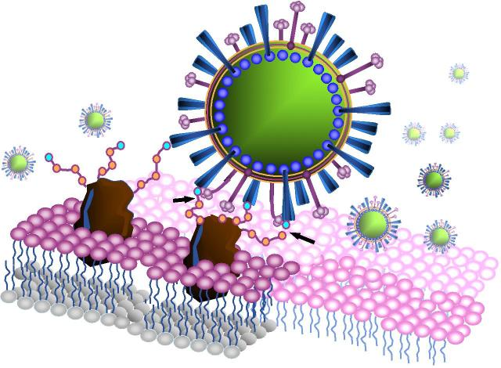
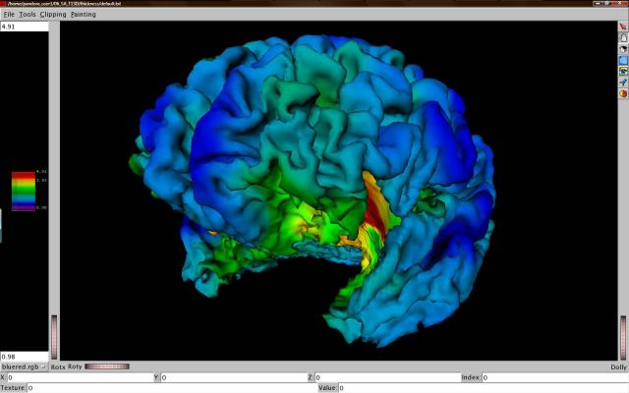
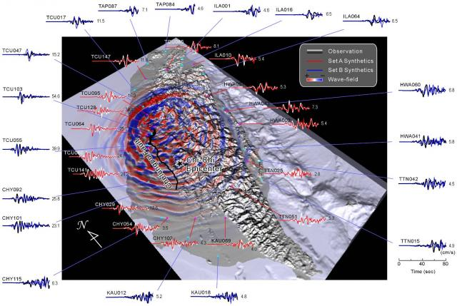
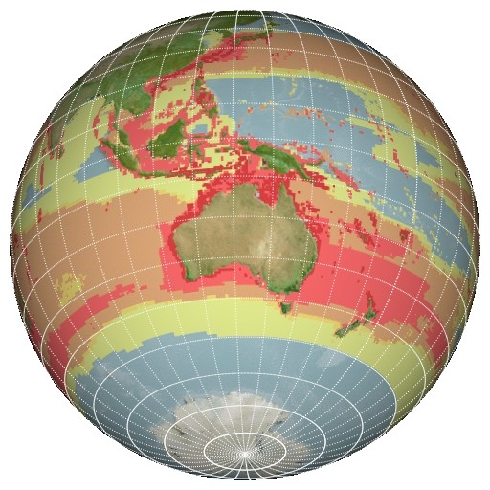
C21: Digital Research
Extracting Knowledge from the Data Deluge

Slide 7
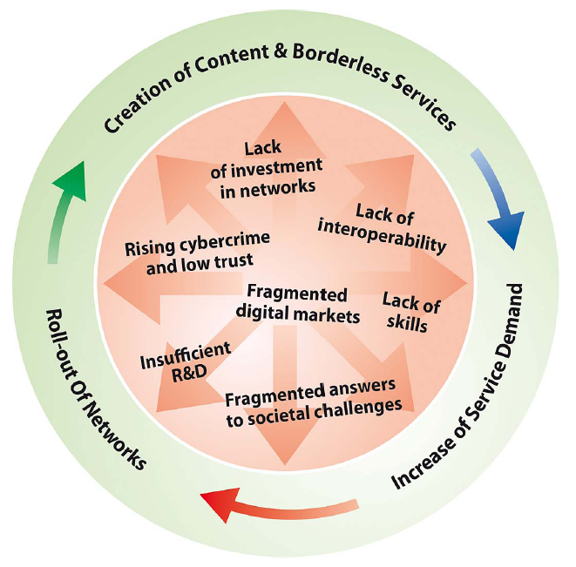
Digital Agenda for Europe
Borderless Services
Interoperability
Supporting Innovation
remove barriers to the free movement of knowledge
“Europe should also build its innovative advantage in key areas through reinforced e-Infrastructures (i.e. GEANT & EGI)”
Digital Agenda for Europe

Slide 8
The EGI Model

Slide 9
EGI
Collaboration
Research
Community
N
G
I
N
G
I
N
G
I
E
I
R
O
Research
Community
E
I
R
O
Research
Community
N
G
I
NGI: National Grid Initiative
EIRO: European Intergovernmental Research Organisation (e.g. CERN, EMBL, ESA, …)
EGI.eu

Slide 10
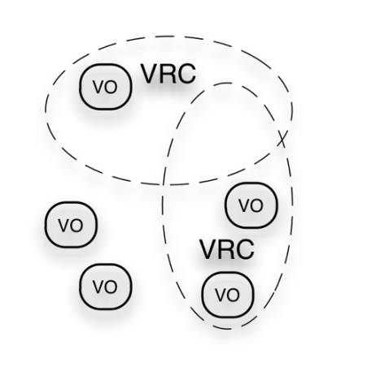
EGI Ecosystem
User Community
Policies + Funding
Services + Support
Requirements + Feedback
Service & Resource Providers
Requirements + Feedback
Public Funding Bodies
Policies + Funding
Technology Providers
European Commission
EGI.eu
Requirements + Feedback
Open Source Providers
National Research Councils
Resource Infrastructure Providers
Strategic Feedback
Technology + Support
Commercial Providers
Policies + Funding

Slide 11
A Virtuous Service Cycle
National
Resource Providers
European Grid Infrastructure
Ecosystem
Used by Researchers
Gathering New Requirements
New Technology Assessed
Deployed Infrastructure Services
Current User Communities
MoUs & OLAs
MoUs
EGI.eu
MoUs & SLAs
New User Communities
Technology Providers

Slide 12
MoUs Structure Ecosystem
http://www.egi.eu/collaoboration/
Technology Provider
RP
VRC
Project
+ more to come
DC-NET, DARIAH, CLARIN, …

Slide 13
EGI.eu
Coordination for European Grid resources
Established February 8th 2010
Central policy & services needed to run a grid
Sustainable small coordinating organisation
Based in Amsterdam
Coordinating core (~20 people) in Amsterdam
Technical services from partners (~20 people)
EGI and EGI.eu: Supported by the EGI-InSPIRE project

Slide 14
EGI.eu Governance
EGI.eu established as non-profit foundation
Governance & ownership by its participants
Participants:
European NGIs
Associated participants:
Organisations aligned with EGI.eu’s objectives
EGI Council contains all participants
Votes linked to fees

Slide 15
EGI Technical Governance
EGI Council
EGI.eu Executive Board
Terms of
Reference
(ToR)
Common
Process
(PDP)
Common
Glossary
(GCG)
Technology
TCB
Security
OMB
OTAG
Users
UCB
USAG
OAT
SPG
SCG
SVG/RAT
CSIRT
Operations
SVG/RAT
CSIRT
http://www.egi.eu/policy/groups/
http://go.egi.eu/policies_and_procedures

Slide 16
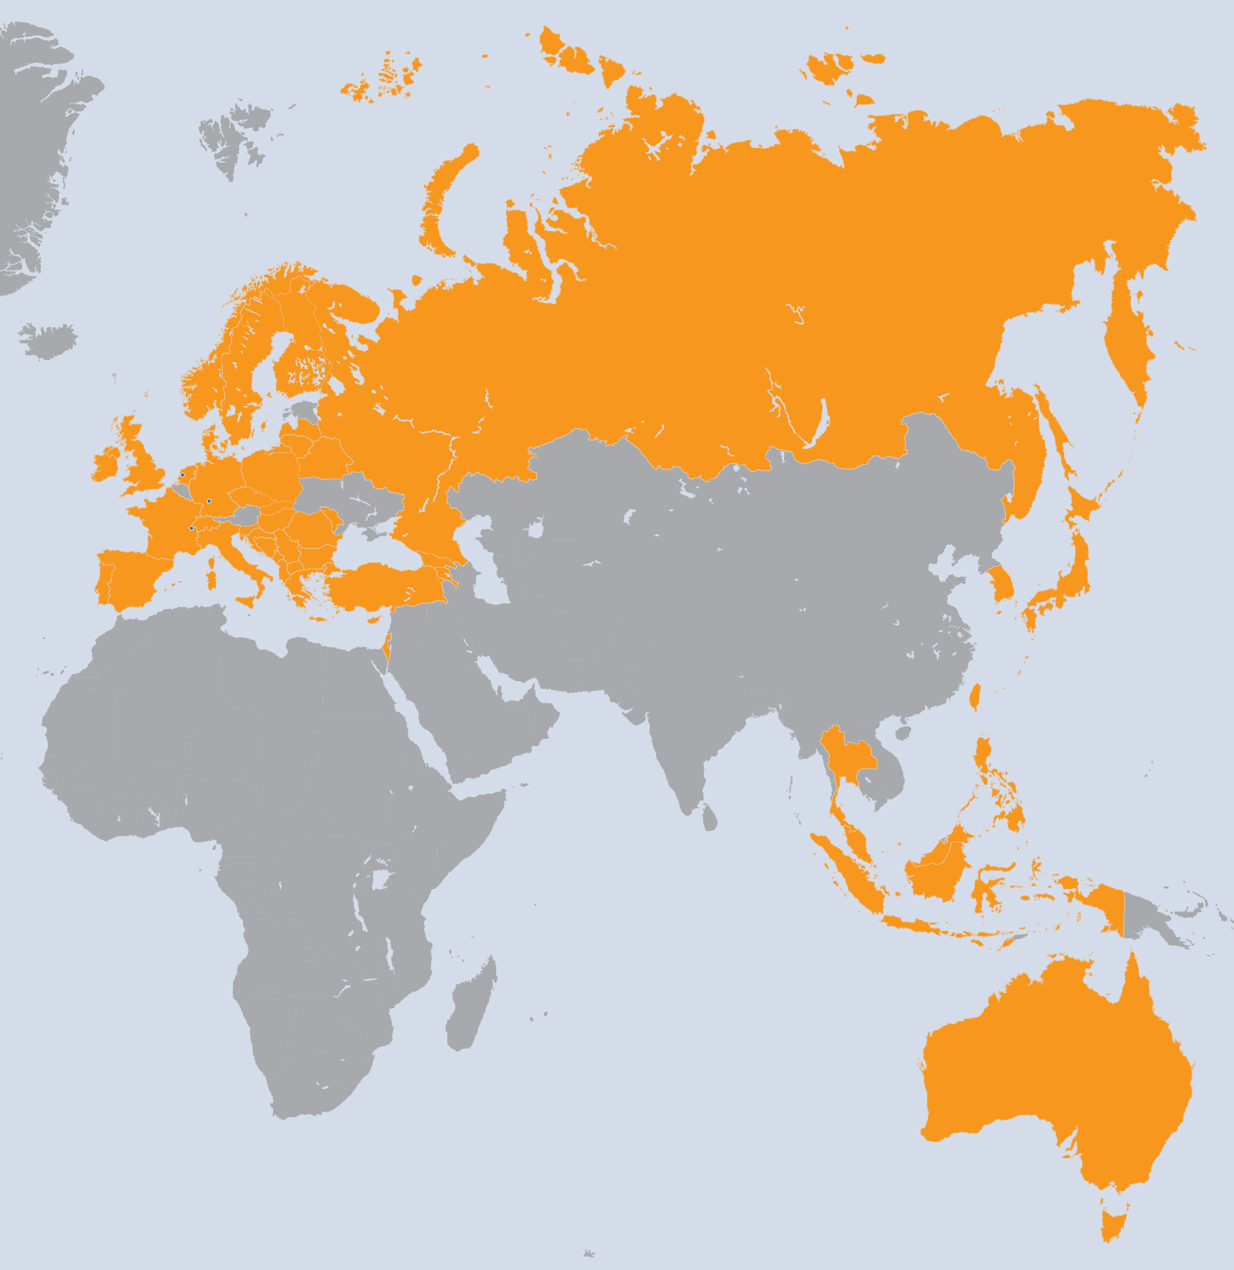
EGI-InSPIRE Project
Integrated Sustainable Pan-European Infrastructure for Researchers in Europe
A 4 year project with €25M EC contribution
Project cost €72M
Total Effort ~€330M
Effort: 9261PMs
Project Partners (50)
EGI.eu, 38 NGIs, 2 EIROs
Asia Pacific (9 partners)

Slide 17
Project Objectives
A sustainable production infrastructure
Resource providers in Europe and worldwide
With new technologies as they mature
Support structured international research
Sustain current domain specific services
Attract new user communities (e.g. ESFRI)

Slide 18
Project Activities
NA1: Project & Consortium Management
Project Office and Quality Assurance
NA2: External Relations
Policy Development and Dissemination
Community Building Events
NA3: User Community Coordination
EGI.eu and NGI support teams
Supporting Technical Services for Virtual Research Communities
JRA1: Support for Operational Tools
Maintenance and Development
Support for new resources and their accounting

Slide 19
Project Activities
SA1: Operation of the production infrastructure
Infrastructure oversight and quality control
Operational security
Operational Tools, monitoring & accounting
Helpdesk & Support teams (NGI & centrally)
Validation and integration of new technology
SA2: Provisioning the Software Infrastructure
Definition of software coming from external projects
Validation of delivered software
Software repository and support tools
SA3: Support for Heavy User Communities
Services & tools for all users of the infrastructure
Domain specific support for current heavy users

Slide 20
What does EGI do?

Slide 21
User Support & Services
Support User Communities
Researchers in International Collaborations
National Research Collaborations through the NGI
Scale up from the single VO to a community
Provide core services to support users
Manage VOs, AppDB, Training Services
Support teams
EGI.eu User Community Support Team
NGI User Support Teams
NGI Operations Teams
Experts within user communities or projects

Slide 22
A Virtuous User Cycle
Aka: “the chicken and egg conundrum...
Design
Deliver
Discover
Feedback through VRCs in the User Community Board
User Services Advisory Group to drive detailed design
Where is the community?
How can I contribute?
- VRCs
Mailing lists
Workshops
Forums
Blogs
Projects
Sharing stories
Collaborating
Applications
Data collections
Requirements
Proposals
Projects
Success stories
How do I use these resources?
Integrated Services
Human
Technical
Infrastructure
Attend training courses
Utilise training material
Access data
Run applications on the grid

Slide 23
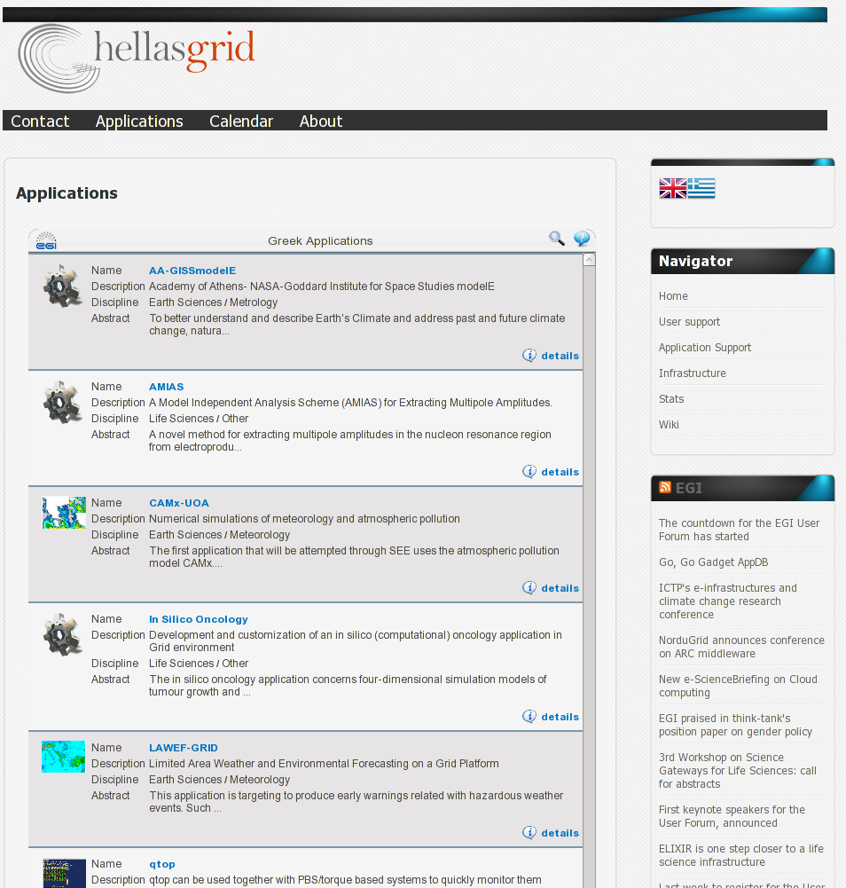
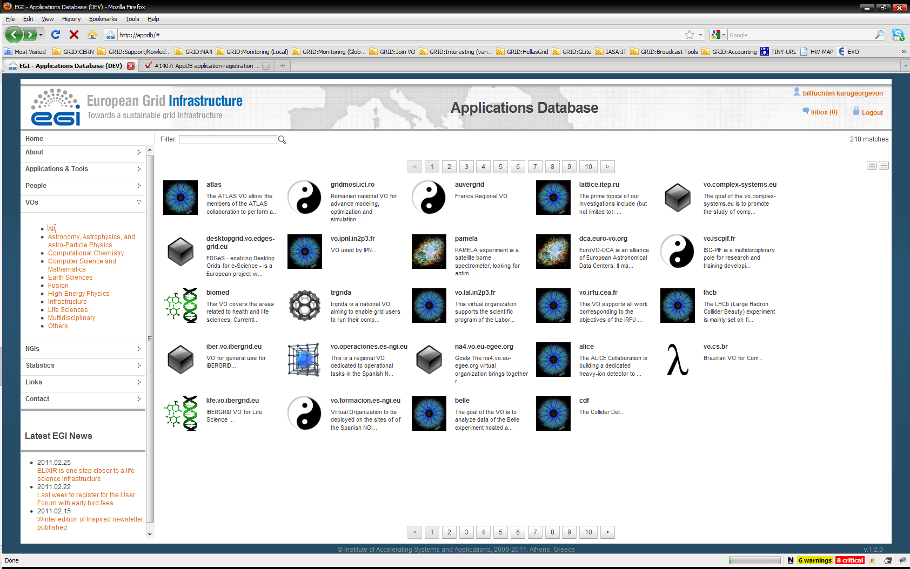
EGI Application Database
To give recognition to reusable applications
To give recognition for application developers
How to get involved
Register applications
Reuse applications
Integrate AppDB through its gadget into any Webpage!
http://appdb.egi.eu

Slide 24
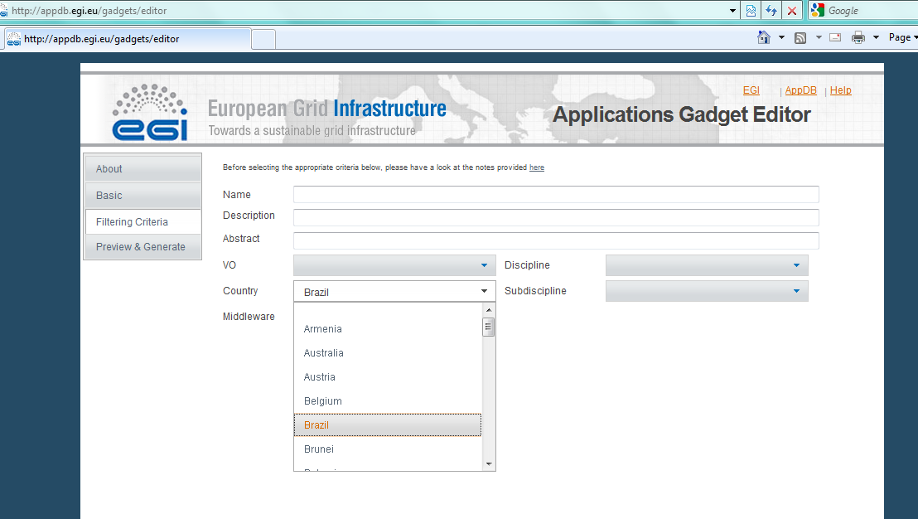
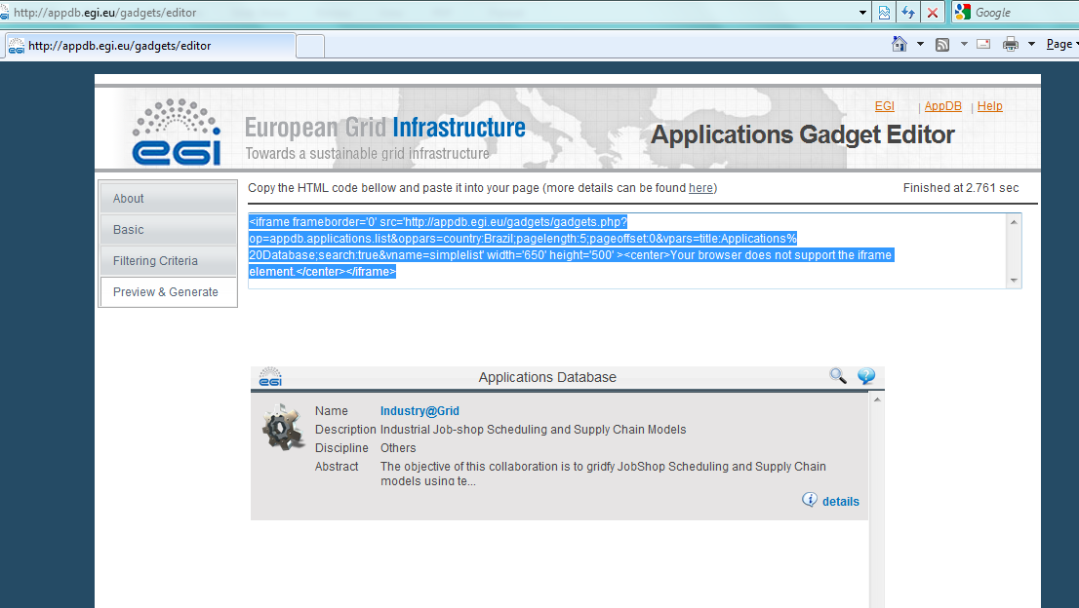
The AppDB gadget
Copy – paste this into your Website

Slide 25
Services for VOs
Activities
Consultancy and helpdesk for VO managers
Evaluation of VO management, monitor and accounting tools
Provision of VO support software for VRCs
VO-specific monitoring
Monitor only those sites that support you
Create and plug-in VO-specific probes
How to get involved?
Request support
Prepare and share reviews of VO tools
Offer local solutions for VOs through the group
NGI
NGI
VO
monitor
NGI
NGI
https://wiki.egi.eu/wiki/VO_Services

Slide 26
Training Marketplace
Integration of…
Training event calendar
Digital library (of training materials)
Service offering and requesting form
Plus: community contributed evaluation and reviews
How to get involved?
Register training events
Use, reuse and share training materials
Offer training-related services (infrastructure, VO, CA, ...)
Contribute training-requirements
Delegate representative to EGI Training Working Group
http://training.egi.eu

Slide 27
Requirements Lifecycle
UCST and EGI-InSPIRE developers
NGIs and VRCs
USAG, OTAG
HUCs
ESFRIs
1) 2) 3)
EIROs
EEF
Input Channels for User and Operations requirements
EGI Requirements Tracker
TCB
External technology providers
UCB OMB
VRCs
EMI
IGE
SAGA,
...
NGIs and
Resource Centers
EGI Helpdesk (GGUS system)
USAG: User Services Advisory Group
OTAG: Operational Services Advisory Group
UCB: User Community Board
TCB: Technology Coordination Board

Slide 28
Software Provisioning
Integrated processes for efficient software provisioning
External Technology Providers
Requirements
Software
Operations
Criteria
Definition
Criteria
Verification
Staged
Rollout
Production
DMSU
Provisioning Infrastructure

Slide 29
Technology Environment
EGI Technology Roadmap
Technical environment & its evolution
Mainstream open-source components
Open to commercial components
Unified Middleware Distribution (UMD)
Components from within the EGI community
External technology provider: EMI, IGE, SAGA, …
Details contained in the UMD Roadmap
To meet the unique needs of EGI users

Slide 30
Provisioning Workflow
Infrastructure for verifying UMD components
Technology Provider triggers the process
Criteria Verification organises and executes the verification workplan
StagedRollout exposes verified software in the production infrastructure
UMD release is assembled and published

Slide 31
Quality Criteria Definition
Comprehensive library of Quality Criteria
Defines EGI’s minimum acceptance level of any delivered software
Library with defined lifetime, and version
Liaising with Technology Providers for
Proactive Quality Assurance
Quality Criteria Review and improvement
Timely preparation for software changes

Slide 32
Criteria Verification
Formal verification of software using the Quality Criteria library valid at that time
Publishes verification reports
Verification reports provides feedback to
Criteria definition
Technology Providers
StagedRollout
Deployed Middleware Support Unit (DMSU)
UMD Release Notes

Slide 33
Provisioning Infrastructure
UMD Repository (http://repository.egi.eu/)
Frontend publishes release notes etc.
Temporary internal repositories for:
Verification & StagedRollout
Composite repository for public UMD updates
Process management infrastructure
GGUS → External Technology Providers
RT → Internal Verification and StagedRollout

Slide 34
Deployed Middleware Support Unit
Second level support unit for middleware
Resolves issues with documentation, configuration
Provides workarounds for known issues
Develops and publishes best practices for popular components
Provides recommendations for Technology Providers via the TCB

Slide 35
Services for HUCs
Supporting major production computing
At an unprecedented scale – both quantitatively and qualitatively
Delivering common solutions across multiple communities
Identifying areas for future work
Broadening the use of grid technology and HUC services to related projects within the HUC domain
Especially unfunded Life Science & Earth Science projects
Developing a S.W.A.T. analysis of each HUC
Focus steps on the road to sustainability

Slide 36
EGI Resource Infrastructure
National Grid Initiative
Network
Peer Resource Infrastructure Provider
Resource Infrastructure
EGI.eu
Resource Infrastructure
Resource Centres
MoUs
Resource Centres
Integrated Resource Infrastructure Provider
Resource Infrastructure
Resource Centres
Resource Centres
Resource Centres
Resource Centres
Integrated: infrastructure operated by a non-EGI-InSPIRE partner but relying on EGI operational services (MoU)
Peer: infrastructure accessible to EGI users, but relying on own operational services

Slide 37
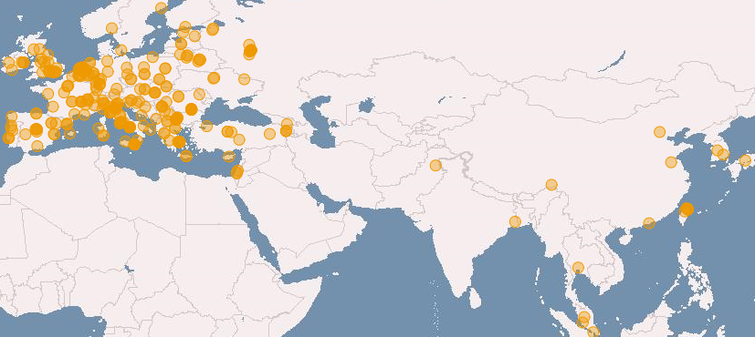
European Grid Infrastructure (April 2011 and yearly increase)
Logical CPUs (cores)
239,840 EGI (+24.9%)
338,895 All
102 PB disk and 89 PB tape
Resource Centres
338 EGI
345 All (+6.8 %)
96 supporting MPI (+6.8%)
Countries (+11.5%)
51 EGI
57 All (+18.75)

Slide 38
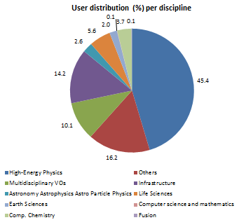
EGI Usage (April 2011)
Average usage 2010-2011 vs 2009-2010
27.8M jobs/month, 91,.000 jobs/month (+82%)
74.8M CPU wall clock hours/month (+35%)
2.8M jobs/month for non-HEP users (+47%)
Year to Year Increase
18,271 End-users (+47%)
219 VOs (+17.7%)
~30 high activity VOs (no change)
User Communities
Archeology
Astronomy
Astrophysics
Civil Protection
Comp. Chemistry
Earth Sciences
Finance
Fusion
Geophysics
High Energy Physics
Life Sciences
Multimedia
Material Sciences
…
Notes:
Tiziana: Updated Image

Slide 39
EGI Resource Providers and Operations Centres 1/2
22 National Operations Centres
Armenia, Belarus, Bosnia and Herzegovina, Bulgaria, Cyprus, Croatia, Czech Republic, France, FYR of Macedonia, Germany, Georgia, Greece, Hungary, Israel, Italy, Montenegro, Poland, Romania, Serbia, Slovakia, Slovenia and Turkey
5 Federated Operations Centres (16 NGIs)
IberGrid (Portugal and Spain)
The Netherlands Federation (Belgium and The Netherlands)
Russian Federation (Russia and Ukraine)
NDGF Federation (Austria, Denmark, Estonia, Finland, Latvia, Lithuania, Norway and Sweden)
United Kingdom/Ireland Federation

Slide 40
EGI Resource Providers and Operations Centres 2/2
1 EIRO Operations Centre: CERN
4 Non-European Operations Centres
Asia Pacific Federation: Australia, China, India, Japan, Malaysia, Philippines, South Korea, Taiwan and Thailand
Canada Federation: Canada and China
GISELA Consortium (IGALC Federation): Argentina, Brazil, and Venezuela
Latin America: Brazil, Chile, Colombia and Mexico

Slide 41
Operational Tools
Develops and maintains operational tools
Regionalised for NGI deployment
Tool | Link | Partner
Operations Portal | https://operations-portal.egi.eu/ The old CIC portal | CNRS
Service Availability Monitoring | Nagios and MyEGI portals fully regionalised at NGIs https://wiki.egi.eu/wiki/SAM_Instances | CERN/SRCE
Grid Configuration database (GOCDB) | https://goc.egi.eu/ | SFTC
EGI Helpdesk (GGUS) | http://helpdesk.egi.eu/ | KIT
Accounting Portal | http://accounting.egi.eu/ | FCTSG
Metrics Portal | http://metrics.egi.eu/ | FCTSG

Slide 42
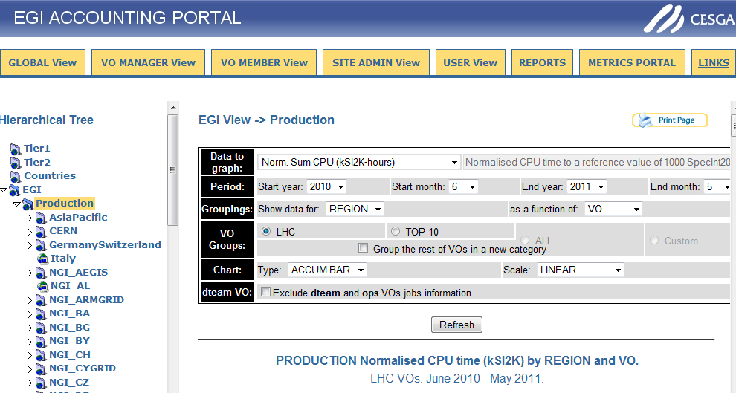
Ops Tools Screenshots

Slide 43
Operational Tool Developments
Message Broker Network Configuration to support tools and operations
Development of the Central Accounting Repository (clients provided by the EMI project)
Development of accounting systems needed for “new” resource types
Billing
Accounting of application usage
Accounting of data usage
Accounting of capacity and cloud computing usage

Slide 44
Dissemination
Disseminate EGI’s activity within the project and worldwide through its regionally dispersed dissemination contacts.
Developed the EGI branding and content for the project and event websites.
Produced 12 monthly Director’s Letters, 4 issues of the EGI Inspired newsletter, published success stories in International Science Grid This Week and Public Service Review.
Produced a range of brochures and posters.
EGI website received over 30,000 visitors in its first year, around 365,000 page views.
Attended a range of international events, including ISC2010 in Germany, ICT 2010 in Brussels, eChallenges in Warsaw, SciTech in Brussels, ISGC in Taipei, and SC10 in the US.
Hosted booths at the EGI Technical and User Forums, and ran outreach campaigns that included printed materials, press releases, social media feeds and blogs.
NGIs in the International task contributed events, websites, materials, publications, papers, translations, press releases and outreach to policy makers.

Slide 45
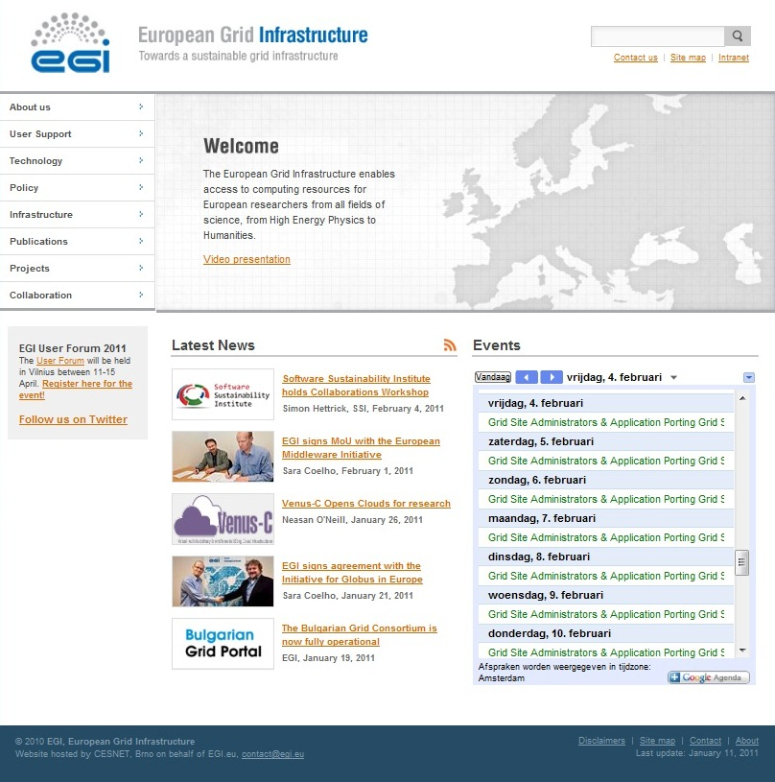
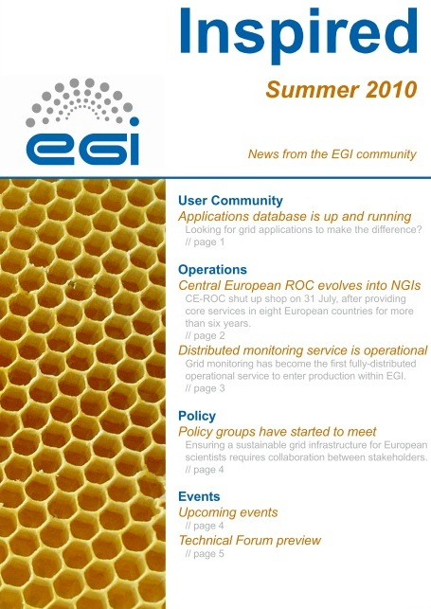
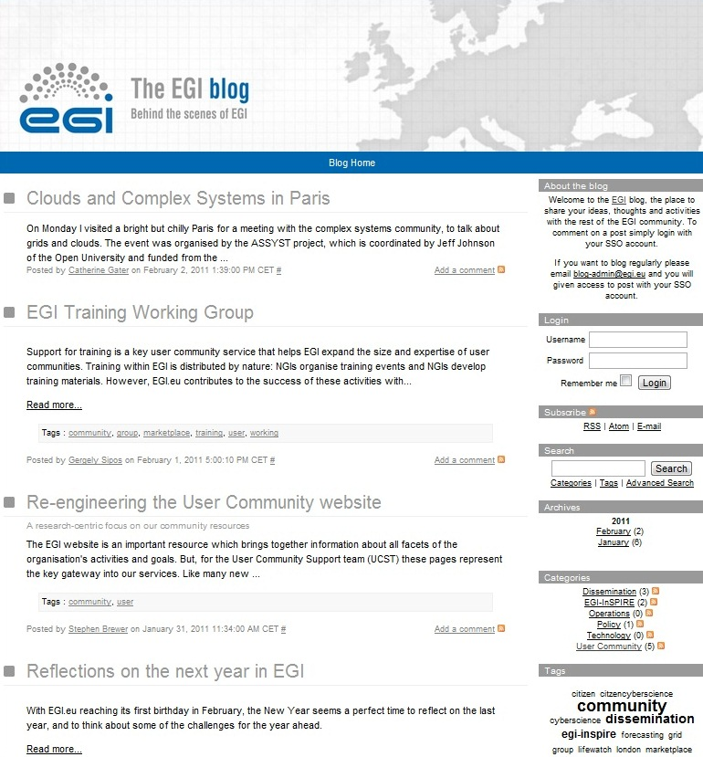
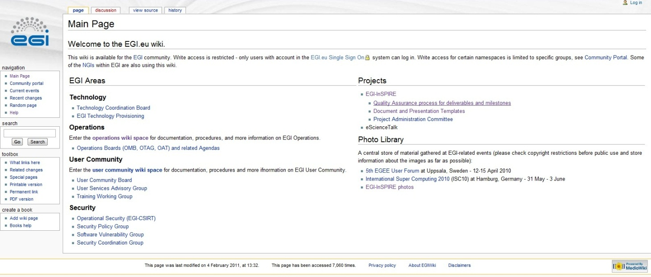
Communications
Website
Wiki
Blogs
Newsletters
Letters
Social Media

Slide 46
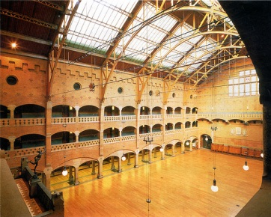
EGI Technical Forum 2010
Held in Amsterdam at the Beurs van Berlage,14 - 17 September 2010 in partnership with the BiG Grid project, and attracted 570 delegates.
First major event for the EGI community and brought together European distributed computing projects and their collaborators in academia and businesses.
Aimed to establish collaborations between the new and the current European DCI projects to meet the needs and requirements of the research community.
Included 290 contributions in the form of presentations, demos, posters and workshops.
22% of delegates used the iPhone application, 28% used Twitter, 10% Flickr, 25% YouTube, 8% the GLOBAL webcast of the plenaries and 28% read the GridCast blog.
Two press releases were issued leading to 27 press cuttings, including HPCwire, iSGTW, ZDNet, Yahoo News, ITnews in Australia, Science Business and Environment & Energy Management.
GridCast team from e-ScienceTalk produced 26 posts on the blog and 6 videos on YouTube.

Slide 47
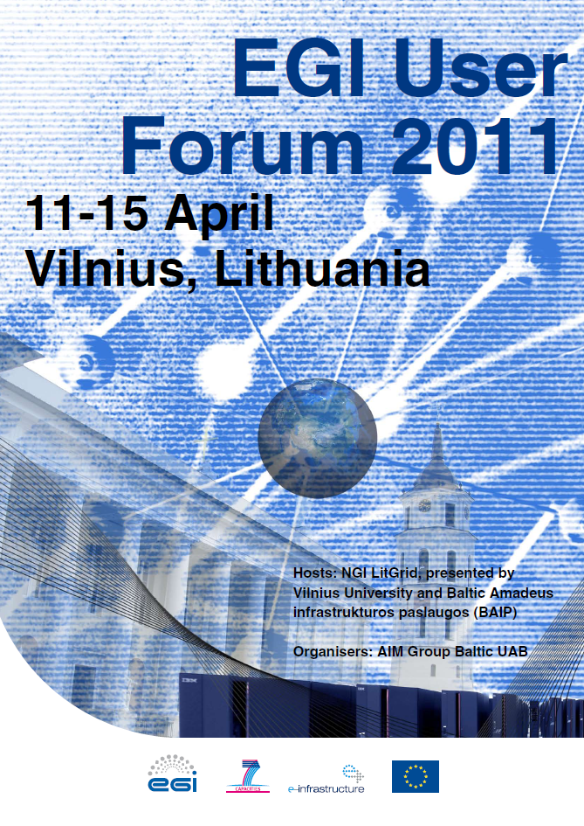
EGI User Forum 2011
Organised by EGI.eu, Vilnius University and LITNET in Vilnius, Lithuania, 11-14 April 2011, with the support of the European Middleware Initiative (EMI) and local secretariat BAIP.
Held at the Radisson Blu Lietuva in Vilnius, Lithuania, showcasing the diversity of the EGI user community, attended by 427 delegates.
Programme included networking and opportunities to ‘meet the EMI experts’.
Featured 196 contributions, 173 speakers and 34 session conveners.
Over 250 images on Flickr, 30 posts on the GridCast blog, including 14 videos and slide shows. Over 2,600 unique visitors visited the main event website, representing 20,000 page views.
Press articles appeared in HPCWire, the SSI blog, the GÉANT newsletter and iSGTW.
Book of Abstracts published for distribution at the event.

Slide 48
EGI means Innovation
Deploy Technology Innovation
Distributed Computing continues to evolve
To include: Grids, Desktops, Virtualisation, Clouds, …
Enable Software Innovation
Provide reliable persistent technology platform
Tools built on gLite/UNICORE/ARC/Globus
Support Research Innovation
Infrastructure for data driven research
Support for international research (e.g. ESFRI)

Slide 49
Technology Innovation
Will come from outside EGI
Moving research technologies into production
Partnership with technology projects
EMI (European Middleware Initiative)
IGE (Initiative for Globus in Europe)
EDGI (European Desktop Grid Initiative)
StratusLab
VenusC
SAGA

Slide 50
Software Innovation
Will also come from outside EGI
EGI is a neutral platform for applications
EGI cannot support all services for all users
Every community needs something different
Foster innovation within different ‘sectors’
e.g. Digital Libraries
gCube from D4Science

Slide 51
Research Innovation
An infrastructure to support European Researchers
Within the EU27
Geographical Europe
Interoperability worldwide for collaboration
Work with Virtual Research Communities
Groupings of aligned Virtual Organisations
Enable their community specific support activity:
Support, training, consultancy, requirements etc.

Slide 52
Grid Use Cases

Slide 53
Grid Use Cases
These case studies show some of the advantages of using the grid:
allows world-wide multi-disciplinary collaboration;
integrate distributed resources into a single whole;
customised grid services to meet the unique demands of researchers;
reliable service for computation, data transfer and storage of large data sets;
reduced analysis time and analysis on-demand;
scientifically useful results are generated more quickly;
long term support;
sharing sensitive data securely among a trusted community;
allows member institutions to contribute computing power to the community;
generate data-intensive stimulations in a shorter amount of time;
reduce technical workload (by following grid standards), so scientists can concentrate more effort on the science
30/05/2011
Project Presentation - May 2011

Slide 54
Use Case: Large Hadron Collider
World’s largest particle accelerator
Supports 8,000 researchers
1 billion CPU hours in the last 12 months
15Pb of data created annually

Slide 55
Use Case: Large Hadron Collider
Some advantages of using the grid:
allows worldwide mass collaboration with thousands of physicists;
customised grid services to meet the unique demands of the experiments;
large data storage facility;
physicists can access the data using their own computer locally.

Slide 56
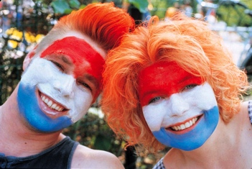
Use Case: GoNL
Mapping the genome of the Netherlands
Plan to sequence the genomes of 750 Dutch people
Currently 30Tb of data
Will generate 20 times that amount

Slide 57
Use Case: GoNL
Some advantages of using the grid:
analysis time reduced by 80%;
on-demand analysis – can be carried out as and when researchers need it;
provide development and support to help researchers get the most out of using the grid.

Slide 58
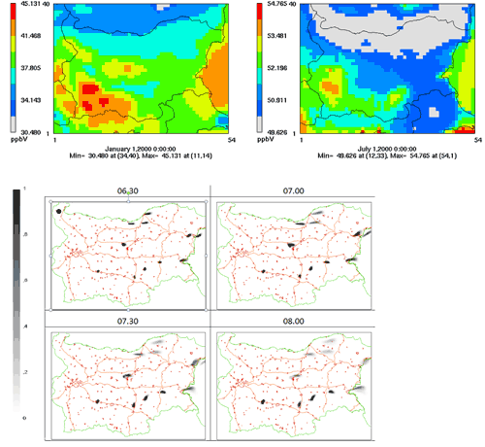
Use Case: Environmental Modelling
Bulgarian researchers have ported three applications to the grid
Study the impact of climate change on air quality
Model atmospheric composition
Investigate emergency responses to the release of harmful substances into the atmosphere

Slide 59
Use Case: Environmental Modelling
Some advantages of using the grid:
improved response times and decreased failure rate, so scientifically useful results are generated more quickly;
reliable service for computation, data transfer and storage of large sets of data;
using existing software with standard protocol means a quicker start-up time and compatibility between resource providers.

Slide 60
Use Case: ASTRA
Ancient instruments Sound/Timbre Reconstruction Application
Has recreated 4 instruments so far
Held concerts using these instruments

Slide 61
Use Case: ASTRA
Some advantages of using the grid:
can meet high demand for network and computing requirements;
high reliability;
allow multi-disciplinary collaboration between researchers, musicians and historians;
longevity: ASTRA running since 2006.

Slide 62
Use Case: ITER
Investigating viability of fusion as a power source
Modelling and simulating the reactor
Used 1 million CPU hours in the last 12 months

Slide 63
Use Case: ITER
Some advantages of using the grid:
perform the intensive computations needed to test the feasibility of fusion power before building the reactor;
open to future development: dedicated project ‘EUPHORIA’ was set up to further push the limits of existing state-of-the-art computing resources.

Slide 64
Use Case: DECIDE
Diagnostic Enhancement of Confidence by an International Distributed Environment
Diagnostic tools for the medical community
Example: Their Statistical Parametric Mapping application can help doctors to diagnose Alzheimer’s disease in its early stages and track the progress of the symptoms over time

Slide 65
Use Case: DECIDE
Some advantages of using the grid:
a single European-wide master database of images stored on the grid for doctors to use;
can set up diagnostic tools with a dedicated grid infrastructure;
customisable: dedicated software to track progression of the disease over time;
sharing medical data securely.

Slide 66
Use Case: CTA
The Cherenkov Telescope Array
Future ground-based high energy gamma-ray instrument
132 institutes in 25 countries
Using applications and grid technology provided by the European grid

Slide 67
Use Case: CTA
Some advantages of using the grid:
allows member institutions to contribute computing power to the CTA community;
generate data-intensive stimulations in a shorter amount of time;
reduce technical workload (by following grid standards), so scientists can concentrate more effort on the science.

Slide 68
Future Plans

Slide 69
Learning from others
Grids have benefited from commoditisation
Hardware: HTC & HPC affordable to all
Networking: GBs can be moved over WAN
Software: Open source software comes of age
The impact of commodity virtualisation…
For transactional models →
The ‘Cloud’: A model based on compute not data
For large distributed data-oriented models →
The emergence of true ‘function shipping’?

Slide 70
Guiding Principles
Be a neutral resource provider
Any application, any domain, any technology
A platform for domain specific innovation & use
Integration of any compliant resource
End-user needs and technologies change
Allow VOs to deploy their own services
VOs will then need to manage their infrastructure
Give VOs the power to meet their own needs

Slide 71
Standards Needed Here!
Consensus
Openness
Balance
Transparency
Data Layer
Secure reliable data movement
Access to data resources
Virtualisation Layer
Span trust domains within agreed policies
Monitoring as important as lifecycle control
Service Layer
The services that go into the virtual machine
Avoid domain specific silos & promote reuse

Slide 72
What will EGI do?
Continue with a secure reliable infrastructure
Integrated: gLite & ARC
Underway: Globus & UNICORE
Support its user communities
Maintain user services & tools
Engage with structured (virtual) user communities
Encourage structuring in unstructured user communities
Defined representatives within EGI bodies
Engage with the ESFRI projects

Slide 73
Summary
EGI.eu established in Amsterdam
Supported through EGI-InSPIRE project
EGI has transitioned from a federation of regional to national resource providers
EGI will with technology providers to have a standards based open architecture
EGI will evolve to support the needs of its current and new user communities

Slide 74
Contacts
EGI.eu Director
director@egi.eu
EGI.eu Operations Team
operations@egi.eu
EGI.eu User Community Support Team
ucst@egi.eu
EGI.eu Policy Team
policy@egi.eu
EGI.eu Dissemination Team
press@egi.eu
EGI.eu Secretariat
contact@egi.eu

