Slide 1
Abbreviations
EGI: European Grid Infrastructure
EGI.eu: European Grid Initiative organisation
EIRO: European International Research Organisation
ESFRI: European Strategy Forum on Research Infrastructures
HUC: Heavy User Community
NGI: National Grid Infrastructure/Initiative
RP: Resource infrastructure Provider
SSC: Specialised Support Centre
UMD: Unified Middleware Distribution
VO: Virtual Organisation
VRC: Virtual Research Community

Slide 2
EGI.eu Contacts
Director
director@egi.eu
Operations Team
operations@egi.eu
User Community Support Team
ucst@egi.eu
Strategy and Policy Team
policy@egi.eu
Marketing and Communications Team
press@egi.eu
Secretariat
contact@egi.eu

Slide 3
Contents
An Introduction to EGI: Background and Overview
EGI-InSPIRE : Supported Activity and Achievements
EGI’s Platform Model
Core, Cloud, Community & Collaboration
EGI’s Services & Solution Portfolio
Federated Infrastructure Operations
Federated High-Throughput Data Analysis
Federated Infrastructure as a Service Cloud
Community Networks and Support
Community Driven Innovation
EGI’s Supported Research Communities
Use cases and more from 7 research communities

Slide 4
An Introduction to the European Grid Infrastructure
Background and Overview

Slide 5
Vision
To support the digital European Research Area through a pan-European research infrastructure based on an open federation of reliable services that provide uniform access to national computing, storage and data resources.

Slide 6
Mission
To connect researchers from all disciplines with the reliable and innovative ICT services they need to undertake their collaborative world-class and world-spanning research
Core Values
Leadership | Openness
Reliability | Innovation

Slide 7
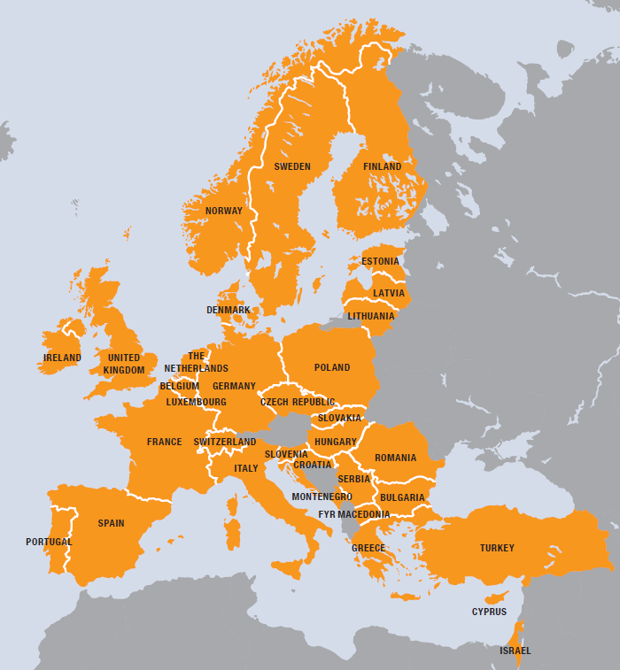
EGI
European
Over 35 countries
Grid
Secure sharing
Infrastructure
Computers
Cloud
Data
Instruments
…. and others

Slide 8
EGI.eu
Coordination for European Grid resources
Established February 8th 2010
Central policy & services needed to run a grid
Sustainable small coordinating organisation
Based in Amsterdam
Coordinating core (~25 people) in Amsterdam
Technical services from partners (~20 people)
EGI and EGI.eu: Supported by the EGI-InSPIRE project

Slide 9
EGI.eu Governance
EGI.eu established as non-profit foundation
Governance & ownership by its participants
Participants:
European NGIs
Associated participants:
Organisations aligned with EGI.eu’s objectives
EGI Council contains all participants
Votes linked to fees

Slide 10
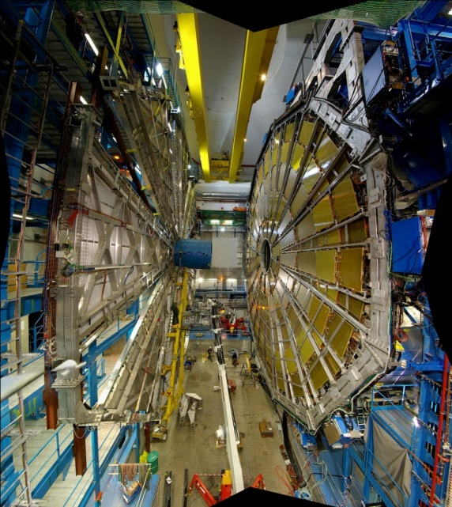
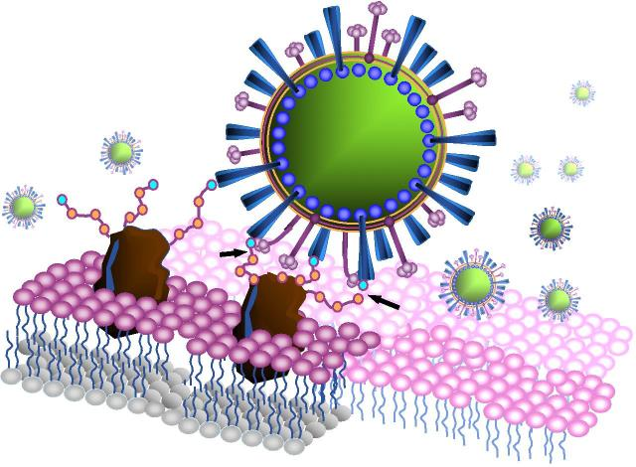
Research Communities
Extracting Knowledge from the Data Deluge
Requires a digital research infrastructure to share services and tools personalised to individual research communities
High-Energy Physics
Large Hadron Collider: World’s largest particle accelerator
Supports 8,000 researchers
1 billion CPU hours in the last 12 months
15PB of data created annually
Health-care
Diagnostic tools for the medical community
E.g.: to diagnose Alzheimer’s disease in its early stages and track the progress of the symptoms over time
Life Science
Structural Biology: provide data analysis
Structural Modeling: tools for NMR and SAXS techniques
See: http://www.egi.eu/case-studies/

Slide 11
EGI’s Vision for 2020
To support the digital European Research Area through a pan-European research infrastructure based on an open federation of reliable services that provide uniform access to national computing, storage and data resources.
EGI 2020 Strategy:
http://go.egi.eu/EGI2020
Virtual Research Environments
Operational Infrastructure
Community & Coordination

Slide 12
EGI-InSPIRE
Supported Activity and Achievements

Slide 13
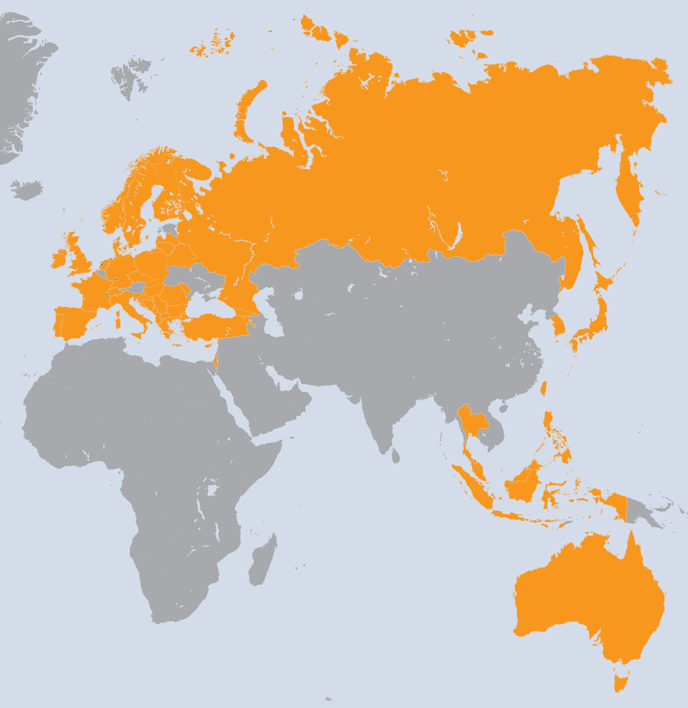
EGI-InSPIRE Project
Integrated Sustainable Pan-European Infrastructure for Researchers in Europe
A 4 year project with €25M EC contribution
Project cost €72M
Total Effort ~€330M
Effort: 9261PMs
Project Partners (50)
EGI.eu, 38 NGIs, 2 EIROs
Asia Pacific (9 partners)

Slide 14
Project Objectives
A sustainable production infrastructure
With resource providers around the worldwide
With new technologies as they mature
Support structured international research
Sustain current domain specific services
Attract new research communities (e.g. ESFRI)

Slide 15
Project Activities
NA1: Project & Consortium Management
Project Office and Quality Assurance
NA2: Community Engagement
Strategic and Policy Development
Marketing & Communication
Community Outreach
Technical Outreach to New Communities
NGI International Liaisons

Slide 16
Project Activities
SA1: Operation of the production infrastructure
Infrastructure oversight and quality control
Operational security
Operational Tools, monitoring & accounting
Helpdesk & Support teams (NGI & centrally)
Validation and integration of new technology
JRA1: Support for Operational Tools
Maintenance and Development
Support for new resources and their accounting

Slide 17
Project Activities
SA2: Provisioning the Software Infrastructure
Managing external software delivery
Validation of delivered software
Software repository and support tools
SA4: Accelerating EGI’s Strategic Objectives
Mini-projects bringing innovation into production

Slide 18
EGI’s Current Priorities
Sustaining EGI’s production infrastructure
Governance, financial and technical issues
Providing Core & Basic Operational Services
Developing EGI’s human networks
Providing training, material & travel support
Engagement with research communities
Bring co-developed services into production
Developing EGI’s production infrastructure
Increasing scale, flexibility and scope

Slide 19
EGI’s Human Networks
Identifying the individuals in the Network
By both position and selection
Communication within the Network
Broadcast material for consumption and/or relaying
Social networking and discussion forums
Webinars to support development & training
Using the Network
Supporting EGI at meetings & events
Provide travel, registration & subsistence support

Slide 20
Exploiting our Expertise
Human networks provide domain experts
Operations, User Support, Technology
Policy, Communications, Science Disciplines
Used to tackle community issues
New capabilities, new applications, …
Assemble into small focused teams
Virtual Teams: Unfunded investigative reports
Mini-Projects: Funded developments

Slide 21
VTs: Bring Experts Together
Reports with recommendations
Scientific Gateway Primer
Scientific Discipline Classification
Scientific Publications Repository
New Capabilities
GPGPU Requirements within EGI
Inter NGI Usage reporting
New Communities
ELIXIR and EGI
Cherenkov Telescope Array

Slide 22
Funded Mini-Projects
Virtual Research Environments
Massive Open Online Course Development
Evaluation of LifeRay Modules
Building and Using Operational Cloud Infrastructure
OCCI support for arbitrary Cloud Management Frameworks
CDMI Support in Cloud Management Frameworks
Dynamic Deployment for OCCI Compliant Clouds
Automatic Deployment and Execution of Applications Using Clouds
Transforming Research Platforms to Exploit Cloud Capabilities
Operational Tools
VO Administration Portal
A new approach to computing Availability and Reliability Reports
GOCDB Scoping Extensions and Management Interface
Automating applying for and allocating federated resources

Slide 23
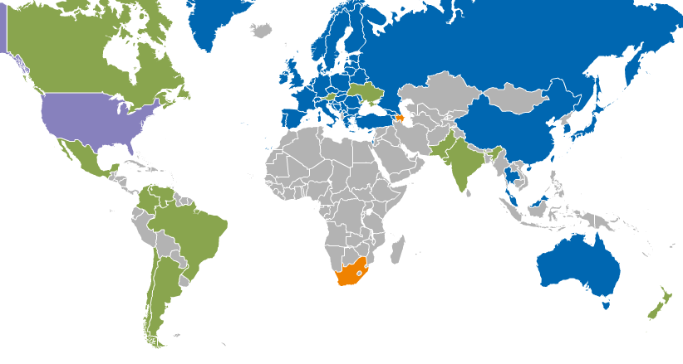
Operational Infrastructure
Registered Users: 22,197 VOs: 237
LCPUs: 361,300 Disk: 235PB Tape: 176PB
Jobs: 1.44 million/day
Resource Centres | EGI-InSPIRE & EGI Council members | 319
 | Including integrated RPs | 347
Countries | EGI-InSPIRE & EGI Council members | 42
 | Including integrated RPs | 53
Integrated EGI-InSPIRE Partners and EGI Council Members
External Resource Providers (integrated)
Internal/External Resource Providers (being integrated)
Peer Resource Providers

Slide 24
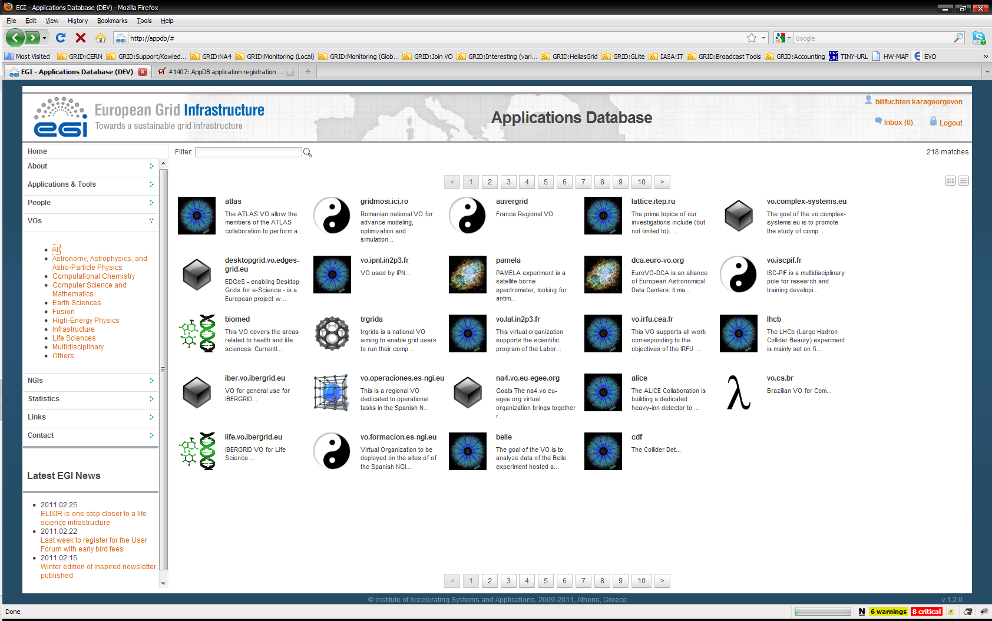
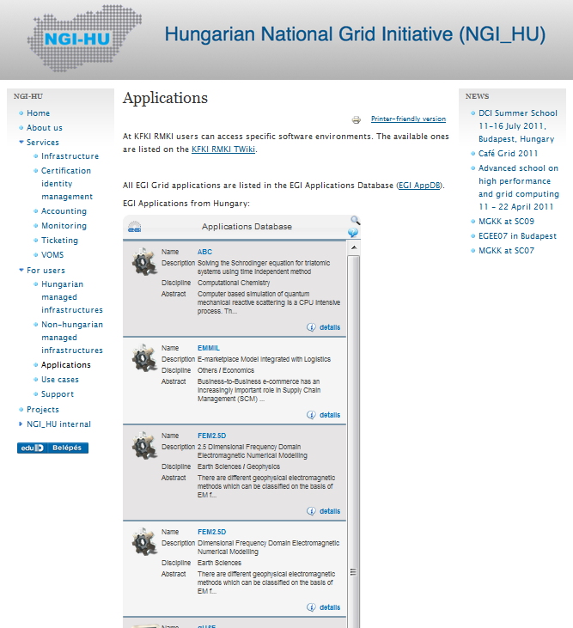
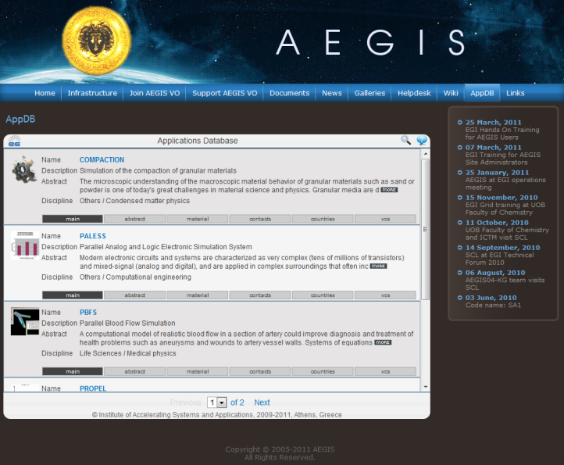
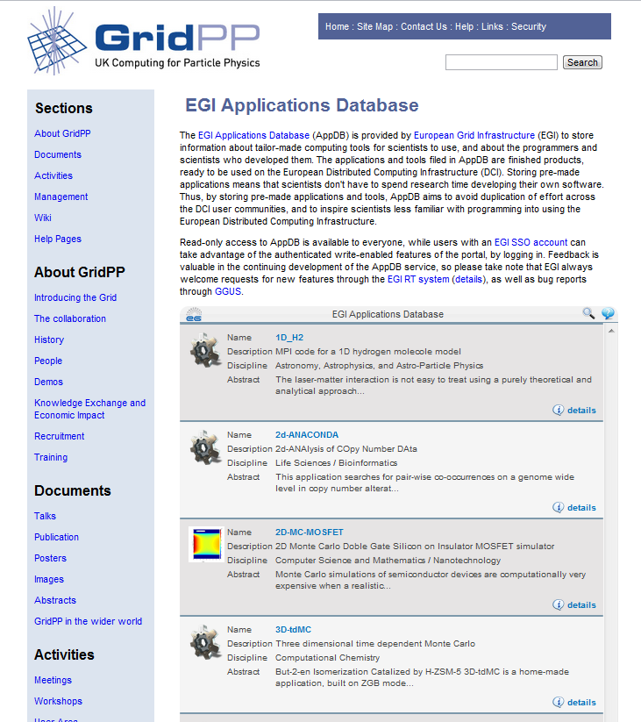
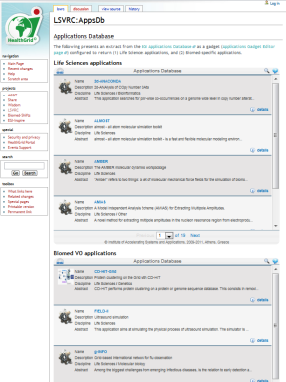
EGI Applications Database
Benefits:
Gives recognition to reusable scientific applications, application developer tools, portals, workflows, etc.
Gives recognition to application developers (people profiles)
Access through web page AND web gadget
Community features such as commenting, rateing, tag-based groupings
http://appdb.egi.eu

Slide 25
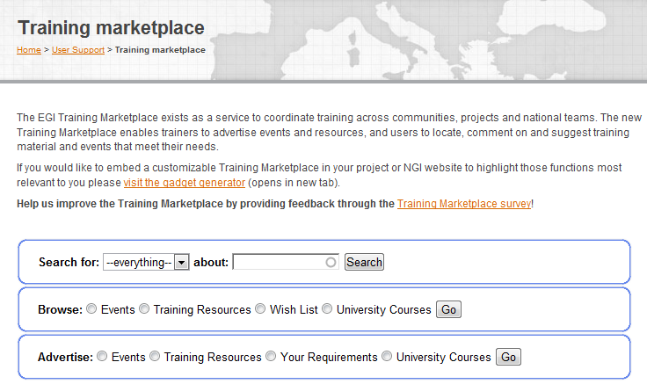
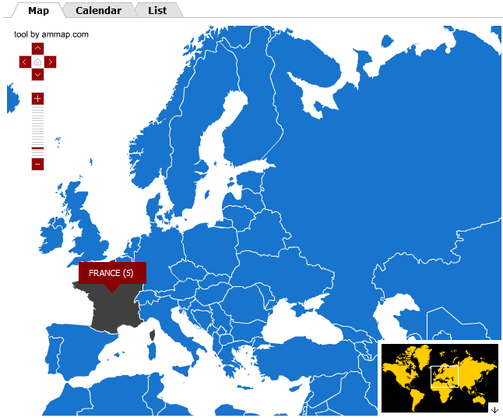
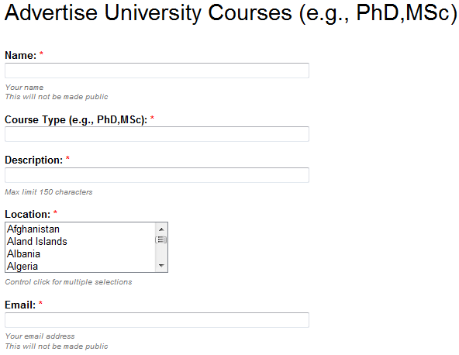
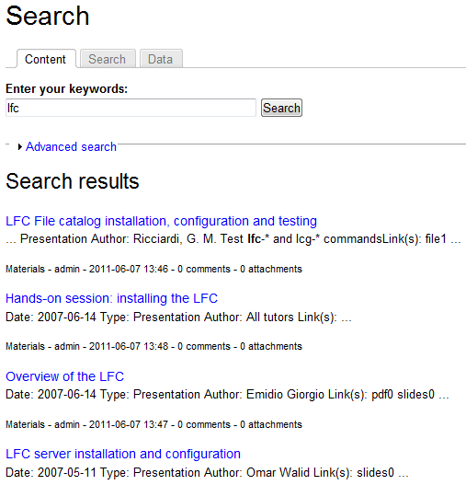
EGI Training Marketplace
Benefits:
Register & share
training events, expertise, services, materials, resources, online courses, university courses
Browse and search items
Community features such as commenting, rating
Access through web page and web gadget
http://training.egi.eu
http://training.egi.eu

Slide 26
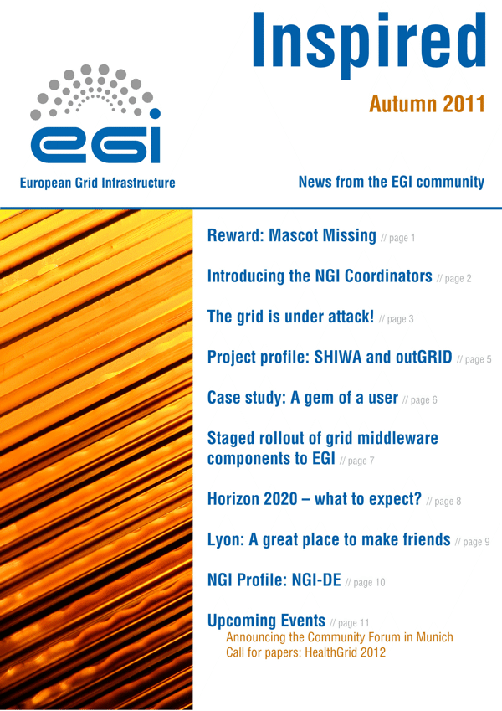
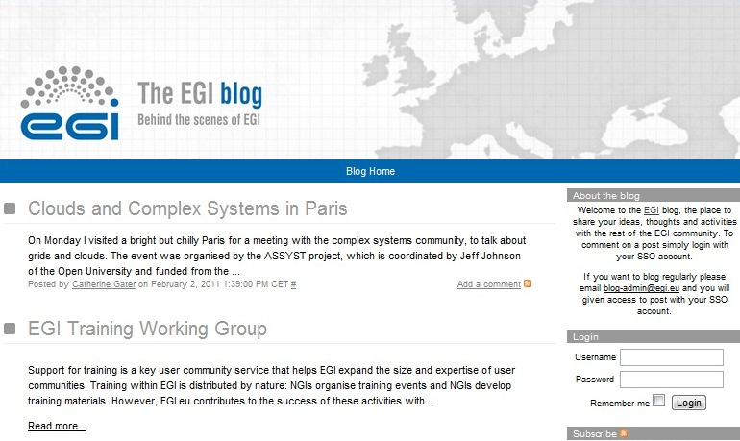
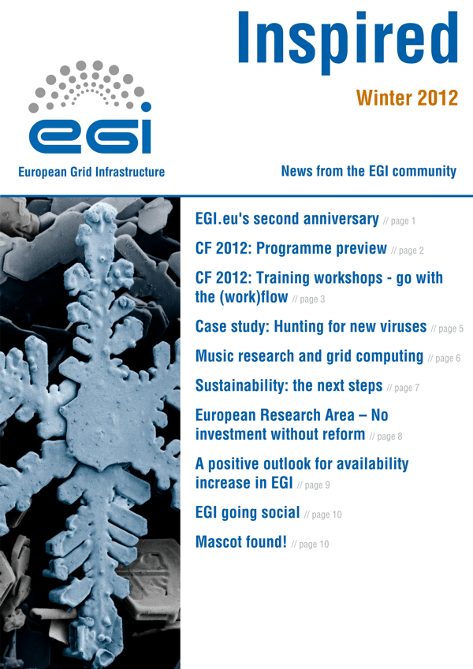
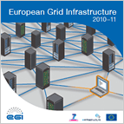
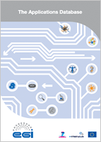
Communications
Website
Wiki
Blogs
Newsletters
Letters
Social Media
Posters
Brochures
Book of abstracts

Slide 27
EGI’s Platforms

Slide 28
The EGI Platform Model
What is a platform?
“offers the developer an undertaking that code will run consistently”
Built upon a defined set of services/APIs/…
EGI needs platforms to provide a focus:
What it offers (i.e. capability or solution)
Who it is offered too (i.e. consumer)
How it is delivered (i.e. service portfolio)

Slide 29
EGI’s Platforms for H2020
ERA needs an open ecosystem of VREs & services
EGI Collaboration Platform
“Tools & Services enabling cross-community collaboration”
Community
Platform
(VRE)
Integrated Community
Platform (VRE)
Integrated Community
Platform
(VRE)
EGI Cloud Infrastructure Platform
“A federated IaaS Cloud infrastructure”
EGI Core Infrastructure Platform
“Operational services necessary for the management of federated DCIs”

Slide 30
EGI’s Core Infrastructure
The services that federate and integrate the functional services deployed in the production infrastructure
EGI Core Infrastructure Platform
Information
Discovery
(BDII)
Federated AAI
Monitoring
Accounting
Metrics
Visualisation
(gstat)
Service
Catalogue
(GOCDB)
Messaging
Operations Portal
For e-Infrastructures, Research Infrastructures & Community Platforms

Slide 31
EGI’s Cloud Infrastructure
Enable an open ecosystem of services
EGI Collaboration Platform
EGI Cloud Infrastructure Platform
VM
Mgmt
Storage
Mgmt
Information
Image Repository
Cloud Management Stacks
(OpenStack, OpenNebula, …)
Image Metadata Marketplace
EGI Core Infrastructure Platform
Federated AAI
Central Service
Registry
Monitoring
Accounting

Slide 32
Community Platforms (CPs)
Integrated with the Core Infrastructure
Deployed directly at cooperating sites
Limited number due to local effort required
Cloud Platform is a CP assembled by EGI
Can use the Cloud Infrastructure
Deploy on any Cloud enabled site
Effort from the deployer and not the site
CPs assembled by anyone
May be integrated with the Core Infrastructure

Slide 33
EGI’s Collaboration Platform
Shared services for all communities
People/Social Services
Technical/Infrastructure Services
Customisable VRE encompasses:
Services to access local resources
Community Platform deployed across a community
Services run for a single community
Community Platform with a few instances
Shared Services run for all communities
From the EGI Collaboration Platform

Slide 34
EGI’s Services & Solutions Portfolios

Slide 35
Service Providers vs. Service Consumers
EGI Partnership
Researchers
Service
Research Infrastructures
Resource Centres
Resource Provider
International Research Collaborations
Product/
Service
Technology Providers
NGIs/EIROs
National Research Collaborations
EGI.eu
Individual Researcher
… and what does EGI.eu do?
How can e-infrastructures help me solve my research problems?
What does EGI do?
What about NGIs and resource centres?

Slide 36
Sustaining EGI Services
Service Portfolio
Activity within EGI
Service Providers
Resource
infrastructure
Providers
Resource
infrastructure
Providers
Resource
infrastructure
Providers
Resource
infrastructure
Providers
EGI.eu
Researchers
Technologists

Slide 37
From Process to Solution
EGI Solution
Portfolio
user
EGI.eu
Service
Portfolio
NGI/RP/RC
Service
Portfolios
solution
user-facing
services
supporting
services
process
document
record
EGI.eu
NGI/RP/RC

Slide 38
EGI Service Portfolio
EGI.eu Service Portfolio
Services provided ‘centrally’ for all
Operated by EGI.eu and partners
Technical & human coordination services
Resource infrastructure Provider Portfolio
Technical & human coordination services
Ensures services from Resource Centres
Resource Centres provide EGI’s resources

Slide 39
EGI.eu Service Portfolio
Coordination
Consulting and Support
Marketing and Outreach
Software and Services
Project and Programme Management
Operations Coordination
Technology Coordination
Security Coordination
Specialised Consultancy
Strategy and Policy Decision Support
Policy Development
Technical Consultancy and Support
Helpdesk Support
Marketing
Outreach
Federated Operations
Applications Database
Training Marketplace
Repository of Validated Software
http://www.egi.eu/services/

Slide 40
NGI/Resource Centre Service Portfolio
Core Platform
HTC Platform
Cloud Platform
Information Service
Grid Compute
Cloud Compute
VO Membership Management
Grid Storage
Data Management
Cloud Storage
Workflow Manager
Service Hosting
http://www.egi.eu/services/
work in progress

Slide 41
EGI Solutions Portfolio
Federated Infrastructure Operations
Federated High-Throughput Data Analysis
Federated Infrastructure as a Service Cloud
Community Networks and Support
Community Driven Innovations

Slide 42
Federated Infrastructure Operations

Slide 43
Target Groups, Problems, Pains
Target Groups | Research Infrastructures Resource infrastructure Providers
Need | Services for the local operation of their own infrastructure Want to participate in a federated service provision Remote access by one or more research communities
Problems | Pains
Monitoring, accounting, technical support solutions from individual providers are not integrated | Lack of interoperation and harmonization requires substantial coordination effort and duplication of services
Small resource providers do not have enough expertise and effort to increase the quality of their service delivery | Lack of expertise and resources

Slide 44
EGI Solution
Technologies, processes and people for standard operation of heterogeneous infrastructures from multiple independent resource providers with lightweight central coordination
EGI Services needed to build the solution
EGI.eu | Operations Coordination, Technology Coordination, Security Coordination, Helpdesk Support, Technical consultancy and support, Federated operations
NGIs Resource Providers | Operations Coordination, Security Coordination, Helpdesk Support, Federated operations

Slide 45
Services for Federated Operations
Core Infrastructure Platform
Processes
Accounting, Monitoring, Helpdesk, Configuration DB, Operations Portal, Security tools, Information discovery, Messaging
Operations and User community coord., Security coord., Integration coord., Service Management
Federated Operations
Documentation, policies, procedures, best practices, data (accounting, monitoring, service level reports)
Support, Training, Collaborative tools, working groups and task forces
Information
People

Slide 46
Value Proposition
Enabling cost efficient operations in a federated environment while retaining responsibility of local operations
Problems | Pain Relievers
Monitoring, accounting, technical support solutions from individual providers are not integrated | Core Infrastructure Platform based on standards, common interfaces and protocols, communication, planning and coordination
Small resource providers do not have enough expertise and effort to increase the quality of their service delivery | Provide federated service management best practices, cost-effective sharing of services (support, processes, policies, activities), community expertise & re-use of tools/output from public funded projects

Slide 47
Strategic Impact & Sustainability
What is the strategic impact of providing this solution?
EGI2020
Open uniform operation of a European scale infrastructure comprising locally deployed, domain specific services
Sharing of resources at local, national and European level
EU2020
Enabling the European Research Area
How this solution can be sustained?
Community funds: For operations, maintenance and infrastructure coordination
Projects: For technical innovation
In-kind contributions: Provide software consultancy
Notes:
European Union 10 year growth strategy – implementation of an open space for knowledge and growth by enabling integration and empowering international research collaboration

Slide 48
Federated High-Throughput Data Analysis

Slide 49
Target Groups, Problems, Pains
Target Groups | Research Communities
Need | Analyse or produce a large datasets through the execution of large ensembles of (hundreds to thousands) loosely coupled computational tasks possibly combined with parallel ones
Problems | Pains
Researchers may have access to local resources, but they are not integrated with national, regional or international resources | Remote resources have different access interfaces It requires substantial effort and skill to integrate and use them together for their science
Managing a huge amount of data within a collaboration is time consuming and prone to error | Lack of capabilities and resources to manage data in a collaborative and distributed environment
Researchers do not have access to enough local capacity for their needs | Lack of resources to undertake their science

Slide 50
EGI Solution
Pan-European federated high-throughput data analysis infrastructure composed of independent resource centres
EGI Services needed to build the solution
EGI.eu | Operations coordination, technology coordination, security coordination, helpdesk support, technical consultancy and support, federated operations, repository of validated software
NGIs Resource Providers Resource Centres | Grid compute, grid storage, workflow management, VO membership management, information service, data management

Slide 51
Value Proposition
Easy access to shared computing and data services from independent resource providers where to provision owned resources or access unused ones in a uniform way and preventing single vendor lock-in while optimising utilisation
Problems | Pain Relievers
Researchers may have access to local resources, but they are not integrated with national, regional or international resources | Open standards based and open source middleware for uniform interfaces to heterogeneous resources Workflow management tools Virtual Research Environments
Managing a huge amount of data within a collaboration is time consuming and prone to error | Data management and transfer tools that support VO-based authentication and authorisation
Researchers do not have access to enough local capacity for their needs | Opportunistic access to unused capacity in a shared infrastructure

Slide 52
Strategic Impact & Sustainability
What is the strategic impact of providing this solution?
EGI2020
VREs: provides large scale high-throughput data analysis platform for research communities to build their own VREs upon
EU2020
Pooling of resources together across Member States
Enabling the European Research Area
How this solution can be sustained?
Coordination: Membership fees from resource providers
Resources: Research community contribution or publicly-funded
Software: In-kind contribution from technology providers or research communities, EC project funding for innovation
Notes:
European Union 10 year growth strategy – implementation of an open space for knowledge and growth by enabling integration and empowering international research collaboration

Slide 53
Federated Infrastructure as a Service Cloud

Slide 54
Target Groups, Problems, Pains
Target Groups | Public and Private Sector Researchers with data analysis needs
Need | Deploy domain-specific IT services to manage access to research data and its analysis
Problems | Pains
Researchers do not want to learn how to use generic e-infrastructures to do their science but want to use their personalised services deployed by people within their own community who they trust | In current HTC-based Grid, it is not possible to delegate deployment and management of user-level services to research communities
Some communities application design models are not compatible with current e-infrastructures | The design of the current infrastructure can limit the configuration of different applications and therefore the communities that can be supported
Applications are released as virtual machine images to simplify maintenance and deployment | Cannot use traditional HTC-based Grids and leverage public investments on e-Infrastructures

Slide 55
EGI Solution
Standards based federation of IaaS clouds: A set of independent cloud services presented to prospective users as a coherent single system utilising a common standards profile allowing multiple provider services and capacity bursting
EGI Services needed to build the solution
EGI.eu | Operations coordination, technology coordination, security coordination, helpdesk support, technical consultancy and support, federated operations, repository of validated software
NGIs Resource Providers Resource Centres | Cloud compute, cloud storage, VO membership management, information service
Notes:
Solution Name (short, simple, understandable)
Description of the solution - what is it?
What services from the EGI Service Portfolio help support this solution?

Slide 56
Value Proposition
A single cloud system, providing resources targeted at the research community, able to scale to user requirements, and incorporating multiple different providers to give resilience and prevent single vendor lock-in
Problems | Pain Relievers
Researchers do not want to learn how to use generic e-infrastructures to do their science but want to use their personalised services deployed by people within their own community who they trust | Clouds isolate everyday users from the underlying infrastructure Allow community experts to provision and manage deployed resources
Some community’s application design models are not compatible with current e-infrastructures | The underlying use of virtualisation allows flexibility in the configuration of deployed services across and within providers
Applications are released as virtual machine images to simplify maintenance and deployment; compute models different than HTC | Provides a common cloud system where new and legacy applications deployed as virtual machines Virtual machines can be easily provisioned by user communities

Slide 57
Strategic Impact & Sustainability
What is the strategic impact of providing this solution?
EGI2020
Expands the resource provider to commercial of all sizes if they support open and recognized standards
Support broader communities beyond traditional users of distributed computing technologies
EU2020
Pooling of resources together across Member States
Enabling the European Research Area
Support the single digital market and cloud strategy
How this solution can be sustained?
Direct Charging: Providers add resources through the Federated Cloud making use of core services, thereby accessing new consumers markets
User Project: Pay per use model for provisioning of service instances targeted to communities connected to their resources

Slide 58
Community Networks and Support

Slide 59
Target Groups, Problems, Pains
Target Groups | National and International Research Collaborations
Need | To find the best solution for their data-intensive compute requirements
Problems | Pains
User groups may potentially benefit from EGI, but are unaware of its existence | They are struggling with their work and would like to be informed/supported
EGI users span different countries and disciplines and are often unaware of each other’s activities | Difficult to find suitable peers or reusable solutions
Difficult to find proper channels for expressing requirements in a multi-domain infrastructure | Lack of clarity on communication channels

Slide 60
EGI Solution
Establish and manage thematic open community networks
EGI services needed to build the solution
EGI.eu | Technical Consultancy and Support, Marketing, Outreach, Application Database, Training Marketplace
NGIs Resource Providers Resource Centres | Marketing, Outreach
Notes:
Solution Name (short, simple, understandable)
Description of the solution - what is it?
What services from the EGI Service Portfolio help support this solution?

Slide 61
Value Proposition
Definitive, user-friendly and engaging support and information; establishing and building a network of contacts with those solving the same problems
Problems | Pain Relievers
User groups may potentially benefit from EGI, but are unaware of its existence | Champions program to spread knowledge through domain experts
EGI users span different countries and disciplines and are often unaware of each other’s activities | Easy access to relevant scientific publications Community events to network with people working in related areas
Difficult to find proper channels for expressing requirements in a multi-domain infrastructure | Defined channels and procedures to gather and prioritise requirements in a transparent way

Slide 62
Strategic Impact & Sustainability
What is the strategic impact of providing this solution?
EGI2020:
Community building and Coordination/NGI International Liaisons and Champions: build and strengthen a grassroots infrastructure for community engagement, technical outreach and communication.
Operations Infrastructure/Researchers and Champions: promote use cases of individual researchers and research communities accessing and analysing remote data, and community events where new requirements can be gathered.
Operations Infrastructure/NGI Operations and technical squads: sharing technical expertise.
Virtual Research Environments/Researchers and Champions: collect requirements and feedback from researchers through case studies, events and social media.
EC2020: Contribution to skills development and the free-flow of knowledge; open access to research outputs
How this solution can be sustained?
Community funding: Event organisation, Champions, Collaboration agreements, CRM
Project funding: Materials, copywriting, web content, events attendance
Notes:
European Union 10 year growth strategy – implementation of an open space for knowledge and growth by enabling integration and empowering international research collaboration

Slide 63
Community-driven Innovation

Slide 64
Target Groups, Problems, Pains
Target Groups | Research Collaborations and their individuals
Need | Access the work of like minded specialists internationally Innovate their digital research workflow
Problems | Pains
Researchers have difficulty in defining the technical requirements for solutions that will support their research | Ideas on how to innovate their work through EGI, but lacking the skills to implement them
Short term collaborations to solve complex problems need easy access to knowledge and supporting processes and collaboration tools | High set up cost for the short-term collaborations slow down innovation
Technical solutions developed in isolation divert effort from research | Waste of resource when minimal effort could re-use other solutions

Slide 65
EGI Solution
Provide an EGI focal point through whom international teams and projects can be formed with relevant experts in order to develop technical solutions to support research
EGI services needed to build the solution
EGI.eu | Project and Programme Management (Project Management expertise, Collaboration tools) Technical Consultancy and Support (User Community Coordination, Requirements gathering and analysis, Coordination of application porting) Outreach (Coordination of events, Champions support, Collaboration)
NGIs Resource Providers Resource Centres | Consultancy and Support
Notes:
Solution Name (short, simple, understandable)
Description of the solution - what is it?
What services from the EGI Service Portfolio help support this solution?

Slide 66
Value Proposition
Facilitating innovation through on-demand access to experts supported by management tools provided centrally
Problems | Pain Relievers
Researchers have difficulty in defining the technical requirements for solutions that will support their research | Channel for accessing experts that can adapt existing tools and applications to meet specific needs
Short term collaborations to solve complex problems need easy access to knowledge and supporting processes and collaboration tools | Centrally-provided collaboration tools and streamlined best practices on how to set up and manage virtual teams, access to knowledge base
Technical solutions developed in isolation divert effort from research | Existing solutions can be adapted/re-used for the community by the community

Slide 67
Strategic Impact & Sustainability
What is the strategic impact of providing this solution?
EGI2020
Community and Coordination: Communities of researchers with shared needs emerge and solutions are relevant to larger groups (to enable more effective research)
Virtual Research Environments: Technical solutions support larger groups of researchers working in VREs.
How this solution can be sustained?
Innovation Funding: Funding to support innovation across the human networks within virtual teams & mini-projects
Coordination Funding: Provide the central support to facilitate productive short-term virtual teams or mini-projects
Notes:
European Union 10 year growth strategy – implementation of an open space for knowledge and growth by enabling integration and empowering international research collaboration

Slide 68
Researcher Profiles and EGI solutions

Slide 69
EGI Services for Research Communities
Services by our Community Networks
Individual researchers
Use services
Facility for HTC data analysis
Create services
Research collaborations
European-wide IaaS
Identifying and tackling Community Issues
Operate services
Research infrastructures
Federated Infrastructure Operations
...
Research infrastructure clusters

Slide 70
#1 Federated Infrastructure Operations for MAPPER
Community helpdesk
Users
EGI Helpdesk/GGUS
Specialized support
Technology provider
Virtual Research Environment support
User Community
Operations support
Resource infrastructure Provider (NGIs)
Specialized support
(Technology provider)
Specialized support
Technology provider
Specialized support
Technology provider
Specialized support
(Technology provider)
Specialized support
Technology provider
Specialized support
Technology provider

Slide 71
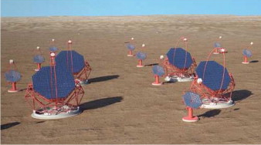
#2 EU High Throughput Data Analysis for CTA
CTA science gateway
App. porting tools
Applications
Authentiation,
Authorization
App. 1
App. 2
...
Support services
Computation
CTA resources
EGI HTC and data facilities

Slide 72
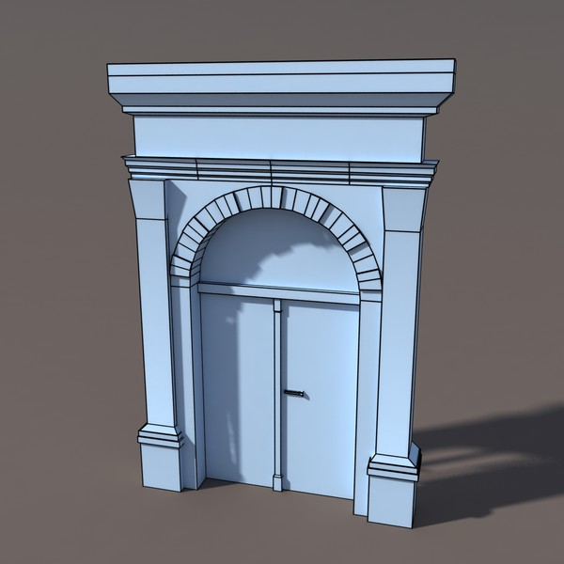
#3 EU Federated IaaS Cloud for CLARIN and BNCWeb
1st line infrastructure
2nd line Community support
Resource Discovery Service
Federated Cloud
SSO
Community Tools as Virtual Machines in Marketplace
Linguistic Datasets and corpa

Slide 73
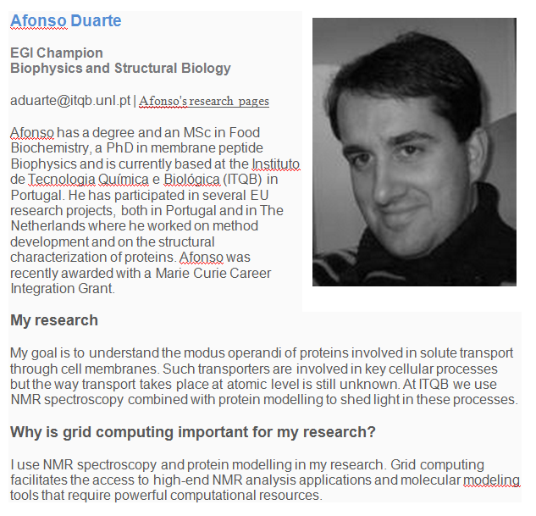
#4 Community Networks and Support The Champions Program
Feedback to EGI on application and services for biophysicsts
AppDB, brochure
Promote EGI at events
e.g. 9th European Biophysics Congress
Contribution to the EGI Massive Open Online Course mini-project
Liaison with Human Brain Project Flagship in Portugal

Slide 74
#5 Community-driven Innovation Virtual Team Projects - Examples
Activity | Discipline
EGI-EUDAT-PRACE pilots | Earthquake and seismology (VERCE); Life sciences (VPH)
EISCAT_3D and EURO-ARGO study cases | Environmental sciences (ESFRI cluster)
EGI-DRIHM collaboration | Hydrometeorology
NGI-ELIXIR collaboration | Life sciences (ESFRI)
Technology study for CTA | Astrophysics (ESFRI)
Towards a CMMST VRC | Chemistry, Molecular & Material Sciences
Speech on the Grid | Speech processing
Biodiversity and Environment (B & E) Community | Biodiversity and Environmental sciences
Fire and Smoke simulation | Fire and smoke simulation
MPI in EGI | Multi-disciplinary
GPGPU in EGI | Multi-disciplinary

Slide 75
EGI’s Supported Research Communities

Slide 76
Grid Use Cases
These case studies show some of the advantages of using the grid:
allows world-wide multi-disciplinary collaboration;
integrate distributed resources into a single whole;
customised grid services to meet the unique demands of researchers;
reliable service for computation, data transfer and storage of large data sets;
reduced analysis time and analysis on-demand;
scientifically useful results are generated more quickly;
long term support;
sharing sensitive data securely among a trusted community;
allows member institutions to contribute computing power to the community;
generate data-intensive stimulations in a shorter amount of time;
reduce technical workload (by following grid standards), so scientists can concentrate more effort on the science
30/05/2011

Slide 77
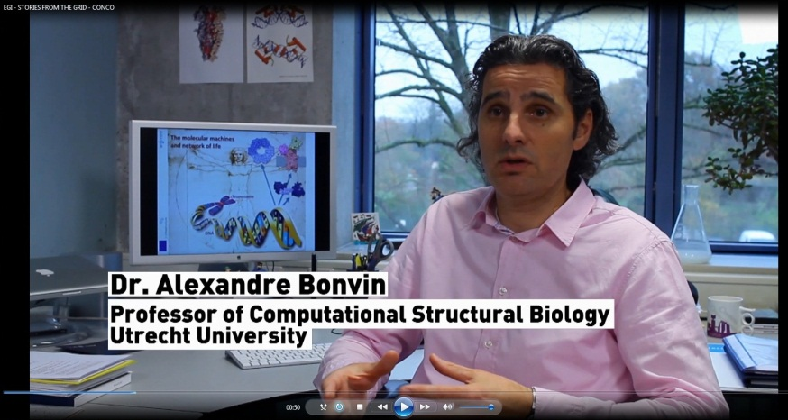
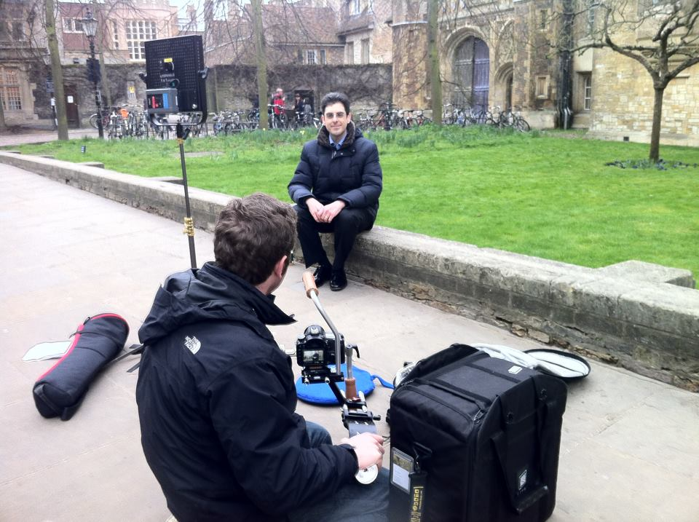
“Stories from the grid”
Short videos on WeNMR, Lost Sounds Orchestra, Top Quark grid research
http://www.youtube.com/playlist?list=PLBF22AA505DC625FE
More case studies on the website at http://www.egi.eu/results/success_stories/

Slide 78
Use Case: Large Hadron Collider
World’s largest particle accelerator
Supports 8,000 researchers
1 billion CPU hours in the last 12 months
15Pb of data created annually
Data ‘parked’ for later analysis

Slide 79
Use Case: Large Hadron Collider
Some advantages of using the grid:
allows worldwide mass collaboration with thousands of physicists;
customised grid services to meet the unique demands of the experiments;
large data storage facility;
physicists can access the data using their own computer locally.

Slide 80
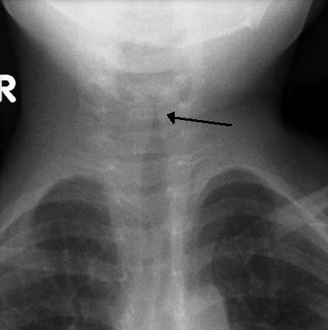
Use Case: New viruses
VIDISCA-454, new method to find new viruses from genetic material
Runs on grid computing thanks to customised workflows, allowing researchers to save time.
E.g. a test with 1444 samples produced 4,783,684 genetic sequences and was analysed in 14 hours. (Local server would need 17 days)
The method was used to identify a new type of coronavirus
Results published in Nature Medicine
Many children suffer from respiratory diseases caused by unknown viruses
http://go.egi.eu/virus

Slide 81
Use Case: The epigonion
The epigonion was the guitar of Ancient Greece – how did it sound?
Domenico Vincinanza recreated the sound of its 48 strings as digital files, using the grid-enabled ASTRA platform
It took him just a few hours - in a single core he would need a month.
The epigonion’s sounds can now be downloaded and played by any musician using a simple keyboard.
Stories from the Grid, episode 2
The Epigonion (video)
http://go.egi.eu/epigonion

Slide 82
Use Case: ITER
Investigating viability of fusion as a power source
Modelling and simulating the reactor
Used 1 million CPU hours in the last 12 months

Slide 83
Use Case: ITER
Some advantages of using the grid:
perform the intensive computations needed to test the feasibility of fusion power before building the reactor;
open to future development: dedicated project ‘EUPHORIA’ was set up to further push the limits of existing state-of-the-art computing resources.

Slide 84
Use Case: DECIDE
Diagnostic Enhancement of Confidence by an International Distributed Environment
Diagnostic tools for the medical community
Example: Their Statistical Parametric Mapping application can help doctors to diagnose Alzheimer’s disease in its early stages and track the progress of the symptoms over time

Slide 85
Use Case: DECIDE
Some advantages of using the grid:
a single European-wide master database of images stored on the grid for doctors to use;
can set up diagnostic tools with a dedicated grid infrastructure;
customisable: dedicated software to track progression of the disease over time;
sharing medical data securely.

Slide 86
Use Case: Earthquakes
Earthquakes are caused by seismic waves that propagate as ripples on a pond
By studying how seismic waves travel it’s possible to predict how a site will respond to an earthquake
The Finite-Difference (FD) method simulates wave propagation by solving differential equations
But building one accurate model means solving millions of equations!
Grid computing allows scientists to solve the equations in parallel, saving time and resources.
The concept was applied in Thessaloniki, Greece.
The model helps local authorities to prepare the regional response to earthquakes
Earthquakes are not predictable, but their effects can be mitigated by modelling and planning
http://go.egi.eu/thess

Slide 87
Use Case: CTA
The Cherenkov Telescope Array
Future ground-based high energy gamma-ray instrument
132 institutes in 25 countries
Using applications and grid technology provided by the European grid

Slide 88
Use Case: CTA
Some advantages of using the grid:
allows member institutions to contribute computing power to the CTA community;
generate data-intensive stimulations in a shorter amount of time;
reduce technical workload (by following grid standards), so scientists can concentrate more effort on the science.

