Slide 1
EC/NSF Collaborations: European Grid Infrastructure
Steven Newhouse
Project Director, EGI.eu

Slide 2
Agenda
What is EGI?
The European Context
Future Challenges
Collaborations

Slide 3
What is EGI?
European:
Focus on meeting the needs of European Researchers
Their key need is to collaborate internationally
Grid:
Federation of shared resources
Supportive of the collaborative social network
Infrastructure:
Physical and organisational structures
Services and facilities for an economy to function

Slide 4
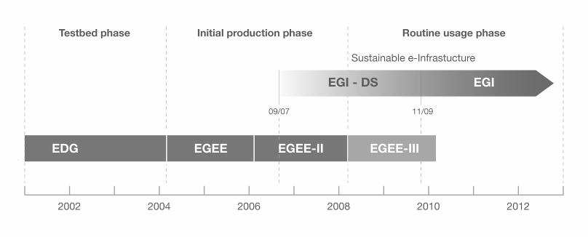
European Grid Infrastructure
European Data Grid (EDG)
Explore concepts in a testbed
Enabling Grid for E-sciencE (EGEE)
Moving from prototype to production
European Grid Infrastructure (EGI)
Routine usage of a sustainable e-infrastructure

Slide 5
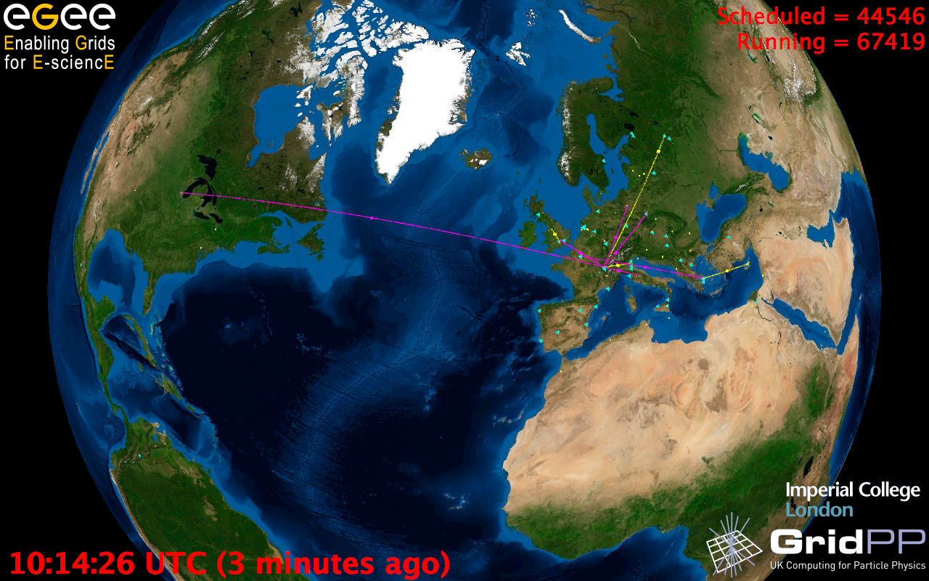
European Grid Infrastructure
Status April 2010 (yearly increase)
10000 users: +5%
243020 LCPUs (cores): +75%
40PB disk: +60%
61PB tape: +56%
15 million jobs/month: +10%
317 sites: +18%
52 countries: +8%
175 VOs: +8%
29 active VOs: +32%

Slide 6
EGI
Collaboration
Research
Community
Research
Community
Research
Community
N
G
I
Research
Community
Research
Community
N
G
I
E
I
R
O
N
G
I
N
G
I
E
I
R
O
EGI.eu

Slide 7
EGI.eu
Coordination for European Grid resources
Established February 8th 2010
Central policy & services needed to run a grid
Sustainable small coordinating organisation
Based in Amsterdam
Coordinating core (~20 people) in Amsterdam
Technical services from partners (~20 people)
EGI and EGI.eu supported by EGI-InSPIRE project

Slide 8
EGI.eu Governance
EGI.eu established as non-profit foundation
Governance & ownership by its participants
Participants:
European NGIs
Associated participants:
Other groups willing to agree with EGI.eu objectives
EGI Council contains all participants
Votes linked to fees

Slide 9
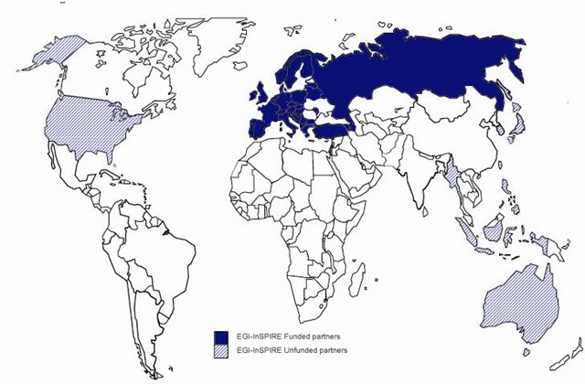
The EGI-InSPIRE Project
Integrated Sustainable Pan-European Infrastructure for Researchers in Europe
A 4 year project with €25M EC contribution
Project cost €72M
Total Effort ~€330M
Effort: 9261PMs
Funded
Un-Funded
Project Partners (51)
EGI.eu, 40 NGIs, 2 EIROs
Asia Pacific (8 partners)

Slide 10
European e-Infrastructure
Applications
Networking
Resources
Desktops
HTC Grids
HPC Grids
Petascale
HPC
EGI
EGEE
PRACE
Virtualised Resources

Slide 11
European e-Infrastructure Forum
HTC:
HPC:
Networking:
Data…?

Slide 12
The DCI Projects

Slide 13
The DCI Projects
Project | EDGI | EGI-InSPIRE | EMI | IGE | StratusLab | VENUS-C
Start Date | 01/06/2010 | 01/05/2010 | 01/05/2010 | 01/10/2010 | 01/06/2010 | 01/06/2010
Duration (months) | 24 | 48 | 36 | 30 | 24 | 24
Total Budget | 2,436,000 € | 72,000,000 € | 23,000,000 € | 3,693,000 € | 3,137,221 € | 8,803,046 €
Funding from the EC | 2,150,000 € | 25,000,000 € | 12,000,000 € | 2,350,000 € | 2,300,000 € | 4,500,000 €
Total effort in person-month | 281 | 9241 | 1115 | 277 | 340 | 639

Slide 14
DCI Taxonomy
EGI-InSPIRE
Operational
Infrastructure
Venus-C
EDGI
StratusLab
Users
IGE
EMI
Technology
Resources

Slide 15
Barriers to Adoption
Sustainability of e-Infrastructures has not been clear
Advances in ICT have matched data analysis needs
Computation beyond the desktop is still very hard
Service offerings do not match needs of new users
Value (and cost) need to be exposed to stakeholders
For multi-year projects this is a risk – addressed by EGI
ESFRI and related projects will push these boundaries
Virtualisation and new computing models simplify task
Must deliver a flexible federated production infrastructure
Service based infrastructure compare public & commercial

Slide 16
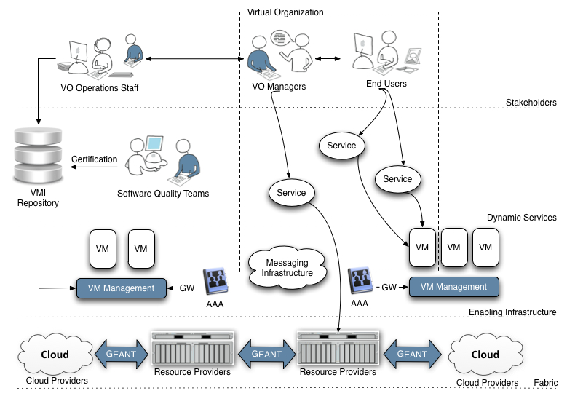
A Virtualised Future?

Slide 17
Collaborations
Virtualised Production Infrastructure
Exploration of clouds: FutureGrid & Magellen
User driven integration & interoperation
With OSG to support WLCG and others?
XD: Shared communities and resources?
Software and standards
Reduce duplication through greater exchange
Training:
To support expansion need trained staff

Slide 18
Summary
EGEE:
Demonstrated a production e-infrastructure
EGI:
Provide a sustainable production e-infrastructure
EGI.eu established in Amsterdam
Supported transition through EGI-InSPIRE
Contact: director@egi.eu

