Slide 1
e-ScienceTalk: Supporting Grid and High Performance Computing Reporting across Europe
GA No. 260733
1 September 2010 – 31 May 2013
Catherine Gater
e-ScienceTalk Project Coordinator
www.e-sciencetalk.eu

Slide 2
Aims of e-ScienceTalk
To build on the significant achievements of GridTalk in bringing the success stories of Europe’s e-Infrastructure to its audiences.
The key challenges are to work with the new DCI ecosystem, maintain and enhance the quality of the existing outputs, while reaching out to new disciplines and regions.
Project dates: 1 Sep 2010 – 31 May 2013

Slide 3
Partners
EGI.eu coordinates the pan-European distributed computing network, the European Grid Infrastructure, and leads the dissemination task
Queen Mary, University of London coordinates dissemination for GridPP, the UK Grid for Particle Physics and managed press and PR and event co-ordination for EGEE-III
APO is a web design business based in Bellegarde, France. It has worked previously on grid multimedia communication, including the GridCafé website
Imperial College is active in e-Science and created the 3-D graphical grid display tool, the Real Time Monitor
CERN is heavily involved in grid dissemination and coordinated all three phases of EGEE, including leading the outreach activity

Slide 4
Question #1
What is e-Science??
E-Science (or eScience) is computationally intensive science that is carried out in highly distributed network environments, or science that uses immense data sets that require grid computing (Wikipedia)
e-Science is the basis around which science is working to achieve new discoveries and advancement to improve areas ranging from medicine to dentistry. E-Science is the tool that offers scientists a scope to store, interpret, analyse and network their data to other work groups. e-Science will play a major role in every facet of scientific research. (www.escience-grid.org.uk)

Slide 5
Audiences
Influential policy makers in European science, government and business
European scientists in a position to develop or exploit grid computing
The general public in Europe and worldwide
New audience is university students and final year high school students, the future users of the infrastructure

Slide 6
New areas
Cover the broader e-Infrastructure eg volunteer, cloud, high performance computing and the network layer
Work with projects from a wider geographical area, including Asia, Latin America and Africa
Analyse the reach and impact of longer running products, such as iSGTW and GridCafé and explore sustainability beyond the lifetime of the project for all products
Explore new Web 2.0 technologies such as social media sites and interactive visual environments

Slide 7
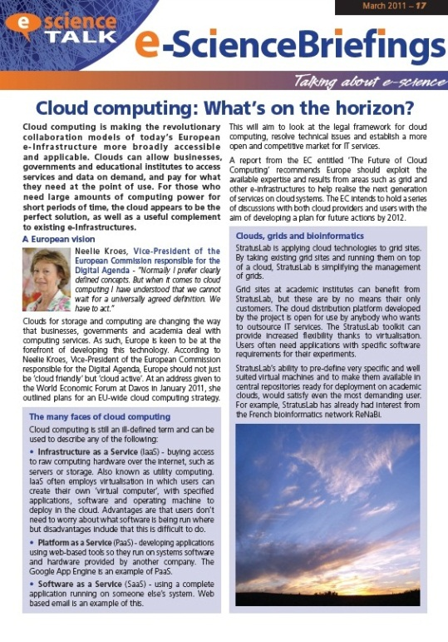
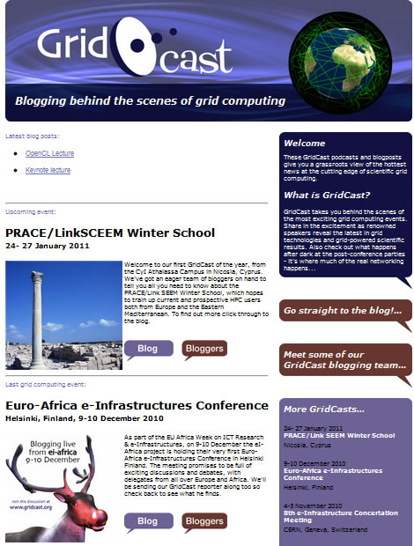
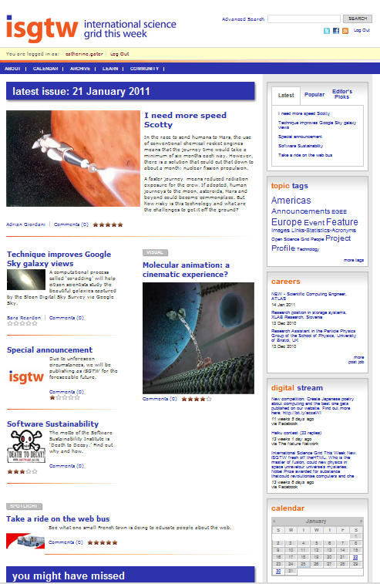
Reaching the audiences
Policy makers
Business
General public
Scientists
Research community
Developers
Delegates
Scientists
Policy makers
Funding agencies
Journalists

Slide 8
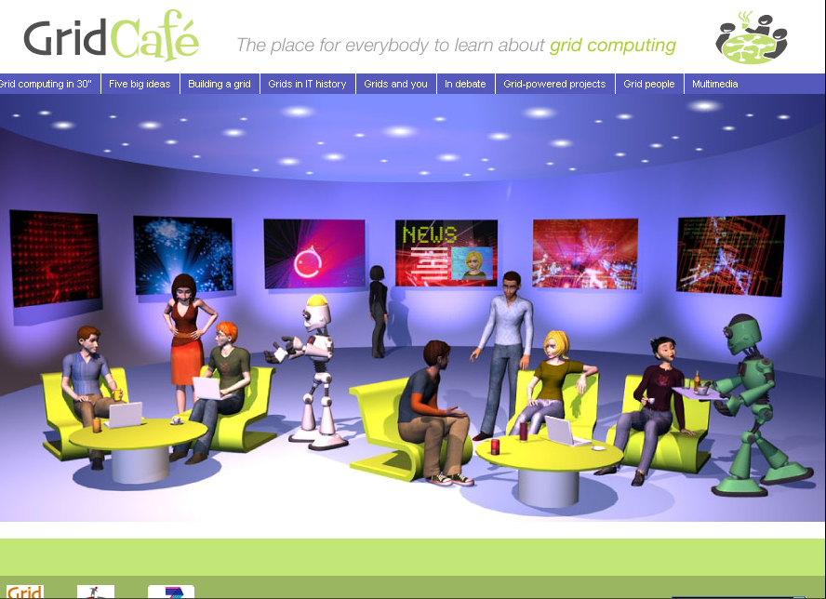
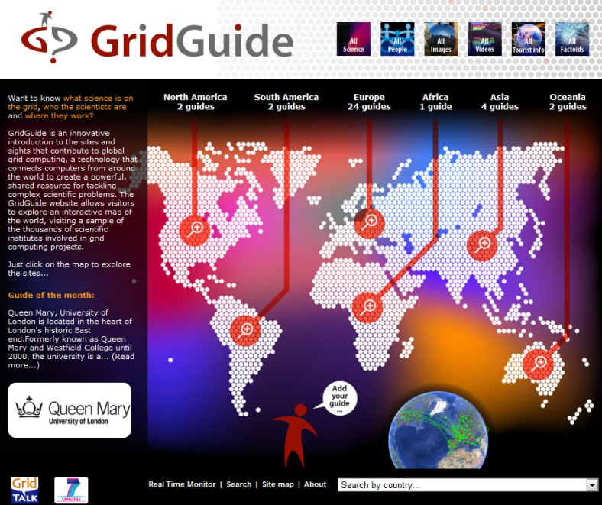
Reaching the audiences
General public
Students
Educators
Projects
General public
Research community
Policy makers
Projects

Slide 9
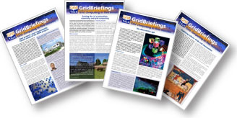
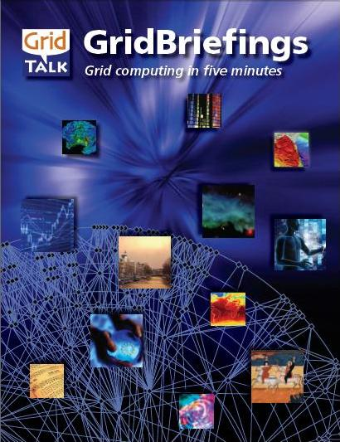
Policy
Reporting targeted at policy makers in government and businesses
Expand the audience and distribution lists for these outside Europe
Assess the impact of long running products and explore options for sustainability
Attend events in order to influence policy makers and distribute GridBriefings
Lead the e-concertation meetings in the e-Infrastructure area, maximising media impact

Slide 10
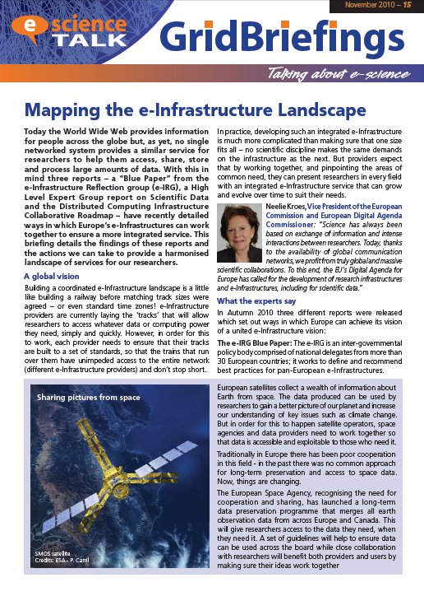
e-ScienceBriefings
Aimed at policy makers in governments, parliaments, science and business, plus scientists and public
Four page GridBriefings:
Cloud computing
Supercomputing
European Grid Infrastructure
Women in ICT etc
Innovative means of engaging policy makers
http://www.e-sciencetalk.org/briefings.php

Slide 11
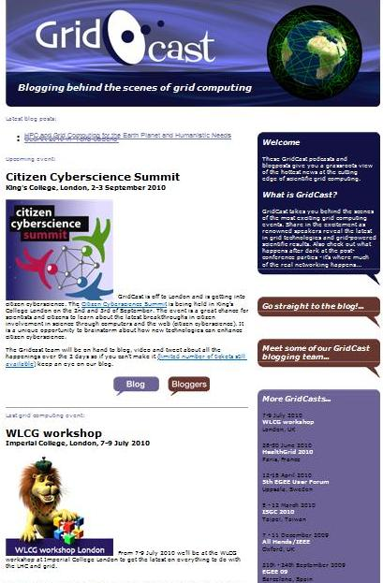
GridCast
Update the GridCast website and market it widely to the e-Infrastructure community and beyond
Users and developers blog at e-science conferences and events
Recent events include ICT2010, EGITF2010, eChallenges, EU-Africa ICT
Videocasts of demos and interviews
700 blog posts, 120 podcasts, slideshows, competitions, tours
www.gridcast.org
http://twitter.com/e_scitalk

Slide 12
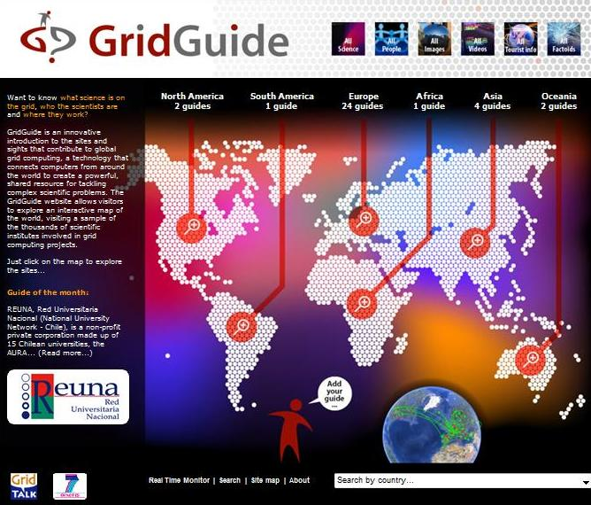
GridGuide
Expand the GridGuide to cover more sites and develop further interactivity with the Real Time Monitor
Shows the human face to the grid. Features interviews with scientists, articles from grid sites, news and images
Launched March 2009
Real Time Monitor shows traffic on the grid running in real time
34 site guides in Europe, US, South Africa, Asia and South America

Slide 13
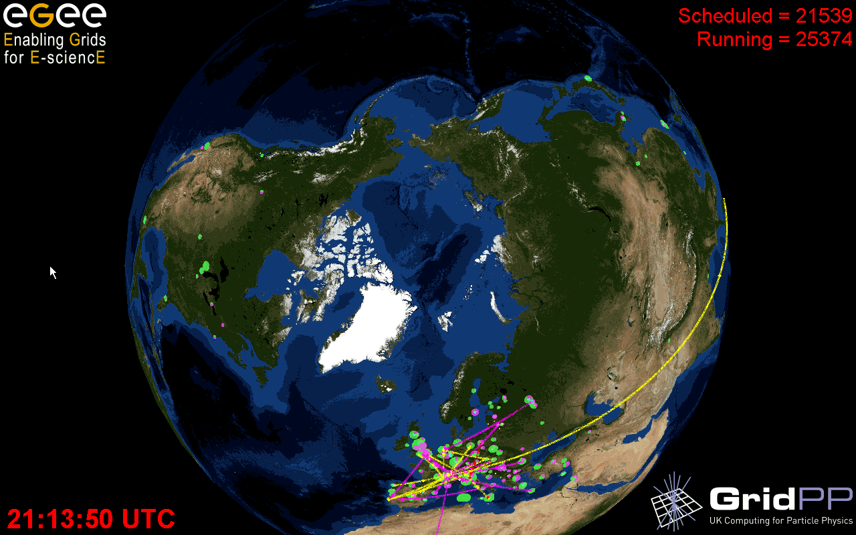
Real Time Monitor

Slide 14
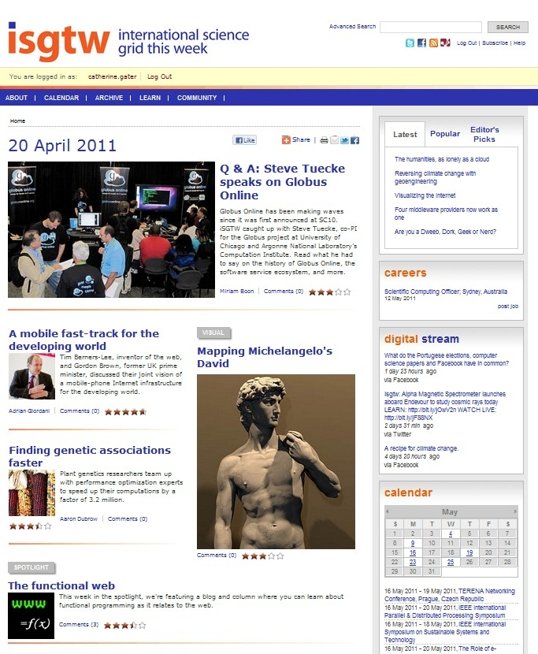
International Science Grid This Week
Produce a weekly electronic newsletter in partnership with the US Editor about grid and e-Infrastructure projects around the world
Expand the coverage of iSGTW to report from geographic regions outside Europe and the US, particularly Asia and Latin America
Expand the coverage to other forms of distributed computing, such as clouds, volunteer grids, high performance computing, networks and data
Over 8000 subscribers worldwide
www.isgtw.org

Slide 15
GridCafé
Keep the website at the cutting edge, developing new areas and exploring interactive 3D environments
Award winning website, produced in 2004 to inform the public about grids
Translated into several languages, including Spanish and French, Chinese version on its way
Over 14,000 visits since September 2010 and 21,000 page views
www.gridcafe.org

Slide 16
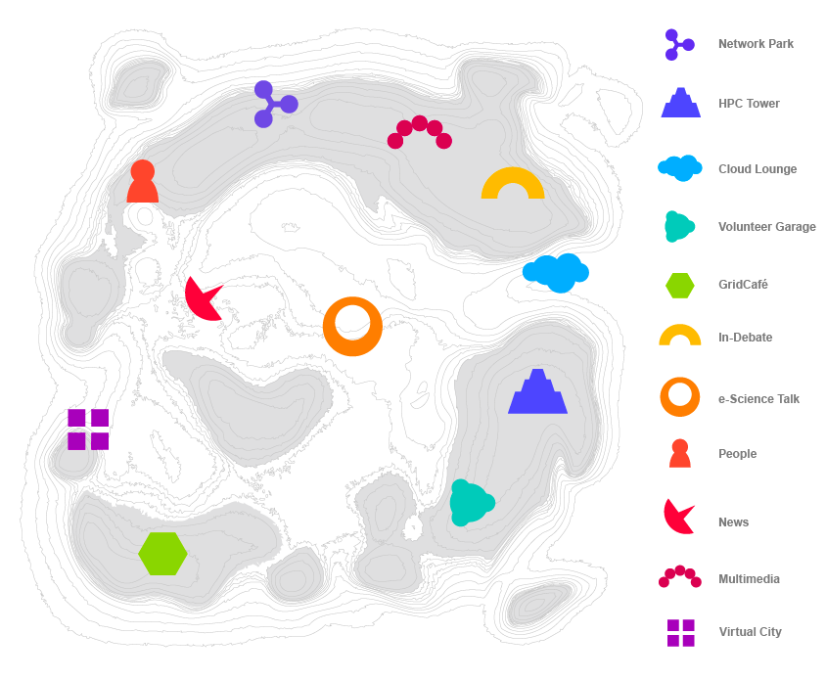
The Virtual e-ScienceCity
Need to go beyond the GridCafé into the e-ScienceCity
Piloting a virtual GridCafé
Build in NewWorldGrid using OpenSim
New 3D GridCafé previewed here today!

Slide 17
Question #2: What about Europe?
http://clayboy.co.uk/2011/05/with-the-greatest-respect-may-i-suggest-you-learn-proper-english
@JackSchofield (AskJack, The Guardian)

Slide 18
Follow us live
Blogging live at www.gridcast.org
Follow us on Twitter at www.twitter.com/e_scitalk
Follow iSGTW on Twitter at www.twitter.com/isgtw (also on Facebook and Nature Networks Forum)
Discussions at the GridCafé forum on http://www.gridcafe.org/SMF/

Slide 19
Twitter competition!
ISGTW is looking for a new name to describe better what we cover: grids, clouds, supercomputing, volunteer computing. Any ideas?
What is e-science? Best description wins!
What's your favourite social media channel?
What's the next big thing in social media?
#SCC2011 #ISGTW

Slide 20
International Science Grid This Week
Weekly newsletter on grid, volunteer, and high performance computing
Jacqui Hayes
European Editor
www.iSGTW.org

Slide 21
5 weekly
elements
3 Features articles
Visual
Spotlight

Slide 22
Lists of the latest stories, most popular, and editor’s pick
Job adverts
Twitter/Facebook/etc feed from us and others
Calendar

Slide 24
A brief history…
“Science Grid This Week” started up in 2006 at Fermilab in US
European editor
It became “International Science Grid This Week”
“iSGTW”
Notes:
Science grid this week started up in 2006 at Fermilab in the US as a weekly newsletter to promote Grid Computing

Slide 25
iSGTW – Say it!

Slide 26
iSGTW – Say it!
What do you think of the name iSGTW? #SCC2011 #ISGTW
COMPETITION:
Can you suggest a new name? #SCC2011 #ISGTW

Slide 27
Our audience
Newsletter stats
Google analytics
Reader’s surveys

Slide 28
Our audience
Number of subscribers:
8,100
Those who read it:
1,300

Slide 29
Our audience

Slide 30
Our audience
2. What is your profession?
Scientist/Researcher |  |  | 40%
IT Professional |  |  | 32%
Other |  |  | 12%
Student |  |  | 5%
Media |  |  | 4-5%
Industry |  |  | 4%
Funding body |  |  | 2%
Total |  |  | 100%

Slide 31
Our audience

Slide 32
Computing
Tier-0 (CERN):
Data recording
Initial data reconstruction
Data distribution
Tier-1 (11 centres):
Permanent storage
Re-processing
Analysis
Tier-2 (~130 centres):
Simulation
End-user analysis

Slide 33
Computing
Grids
Collaborative environment
Distributed resources (political/sociological)
Commodity hardware
(HEP) data management
Complex interfaces (bug not feature)
Communities expected to contribute resources
Supercomputers
Scarce
Low latency interconnects
Applications peer reviewed
Parallel/coupled applications
Also SC grids (DEISA/PRACE, Teragrid/XD)
Clouds
Proprietary (implementation)
Economies of scale in management
Commodity hardware
Pay-as-you-go usage model
Details of physical resources hidden
Simple interfaces
Volunteer computing
Simple mechanism to access millions CPUs
Difficult if (much) data involved
Control of environment ➔ check
Community building – people involved in Science
Potential for huge amounts of real work

Slide 34
A new iSGTW
Relaunched the iSGTW website in January 2011

Slide 35
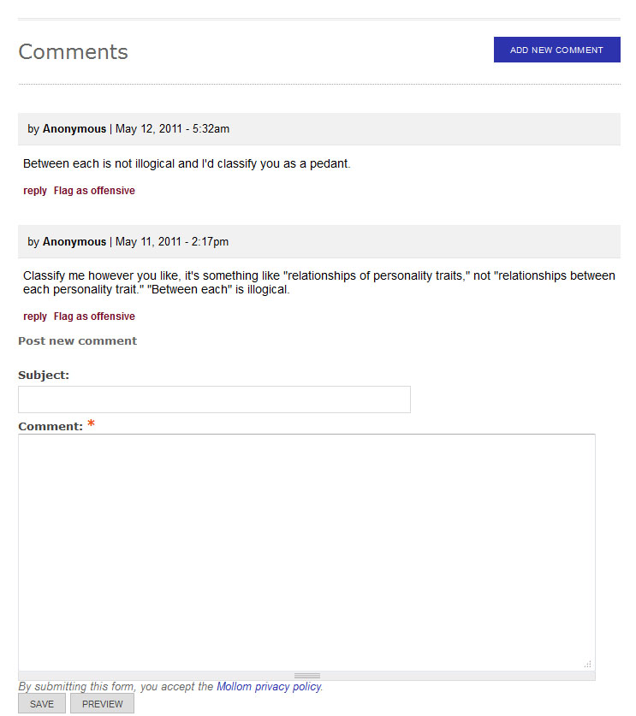
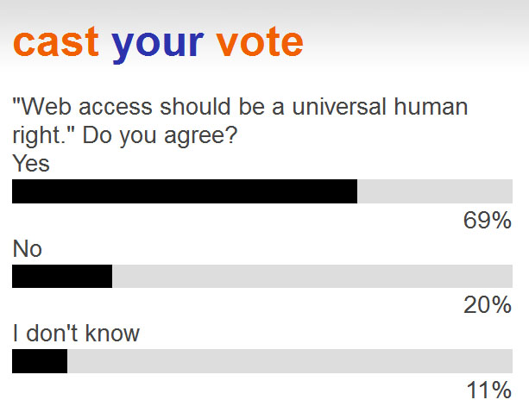
A new iSGTW

Slide 36
Our audience
How do you get subscribers to open their email?
Which interactive elements work best on a website?
What else can you do to increase online participation?
ON TWITTER? #SCC2011 #ISGTW

Slide 37
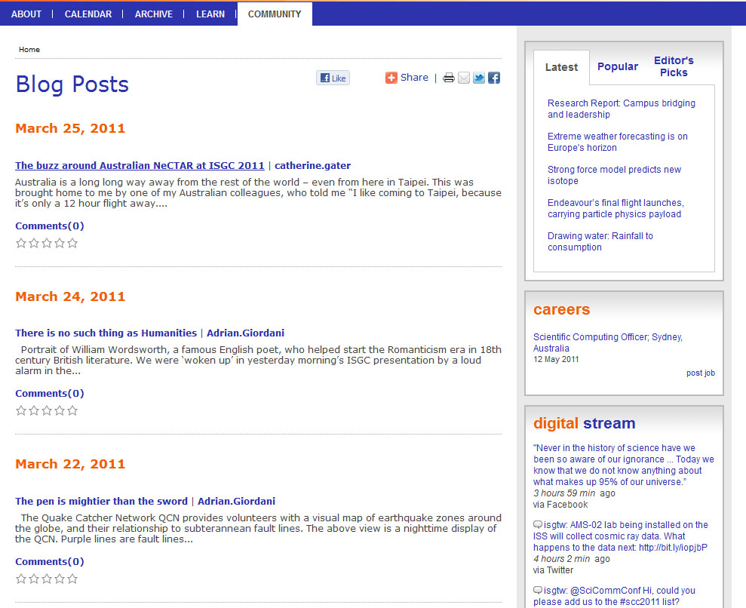
The future

Slide 38
Thank you

Slide 39
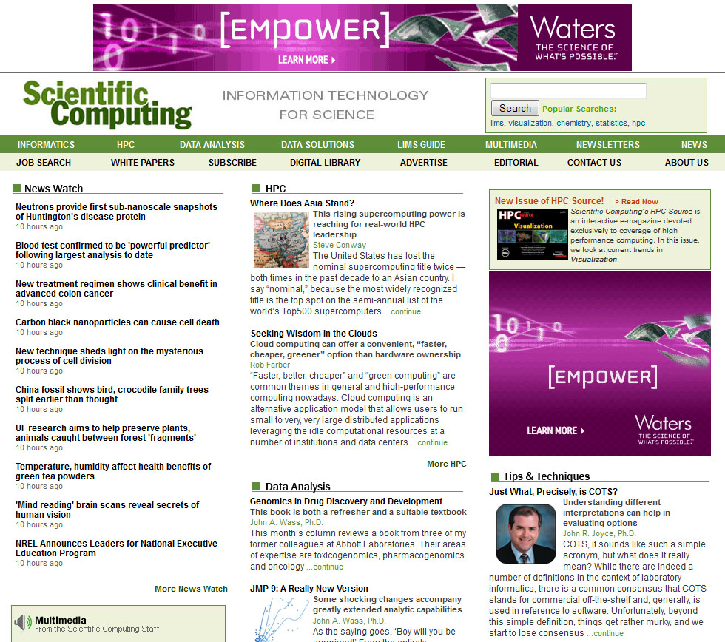
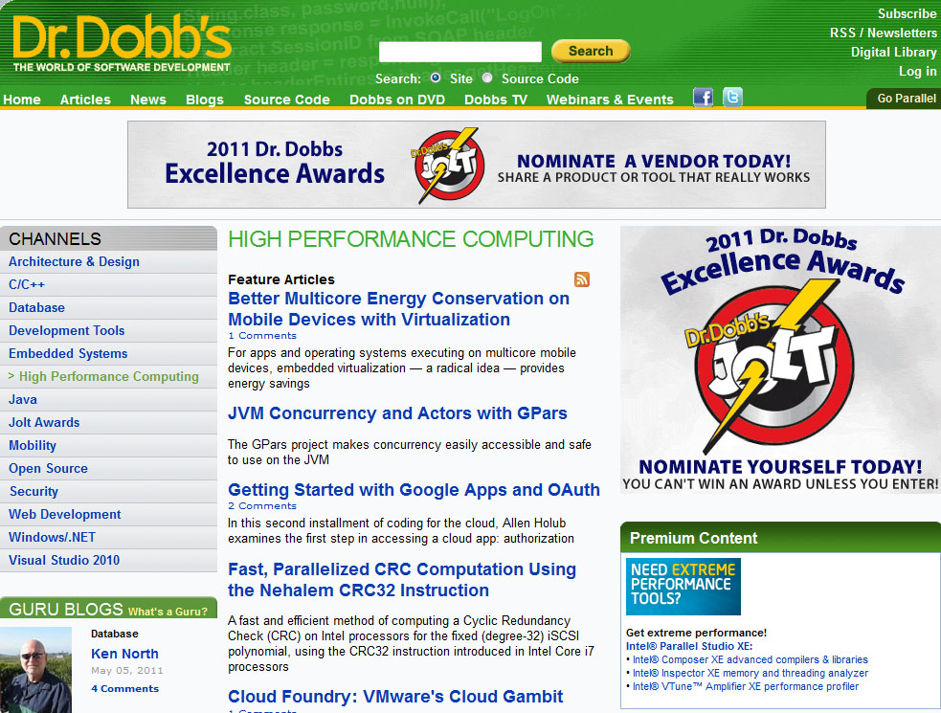
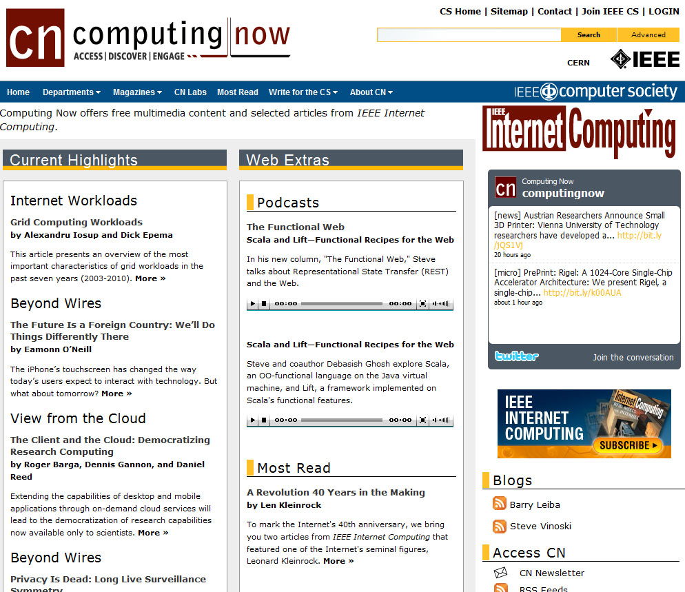
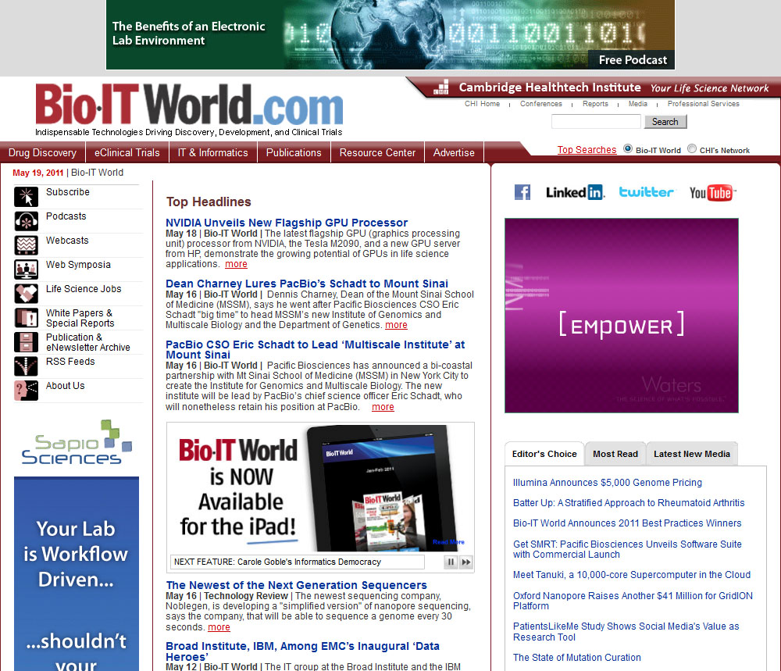
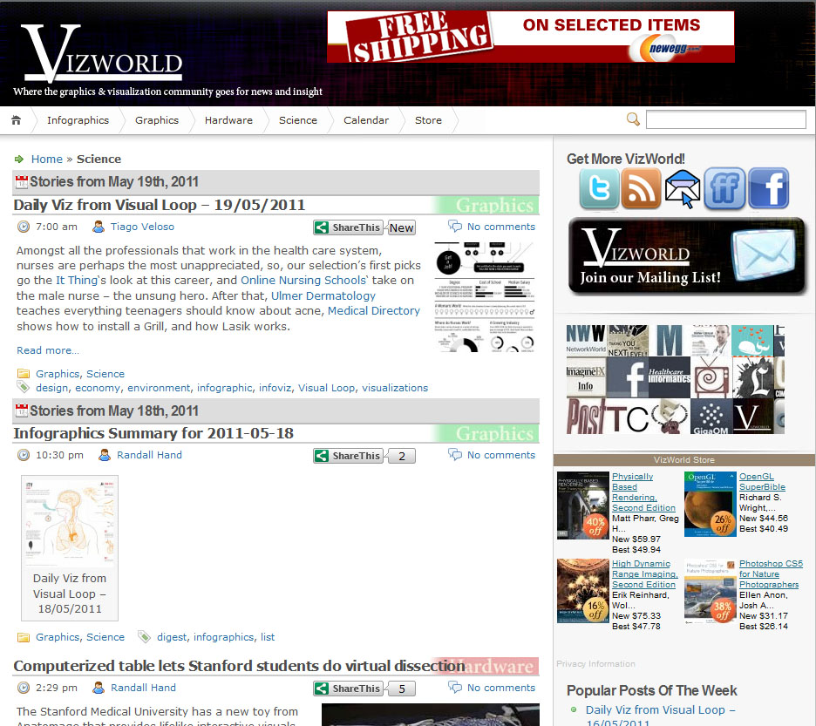
What else is out there?

Slide 40
e-ScienceCity

Slide 41
GridCafé in a virtual world
During the GridTalk project discussion with the EC about the GridCafé and SL...
Study about GridCafé
in a virtual world
Proposal to make an evaluation
using the OpenSim solution

Slide 42
Choice of OpenSim solution
• OpenSource Vs proprietary solution
• Lower price
• Ownership of content
• Technically equivalent to SL
• 3D and scripting tools included : in-world design

Slide 43
Choice of OpenSim solution
VIRTUS
- non profit association
- no “in-world money”
- and content control
Scientific or learning
oriented sims already
in developement
Technical help
from the NWG
team
Team and community of users spirit

Slide 44
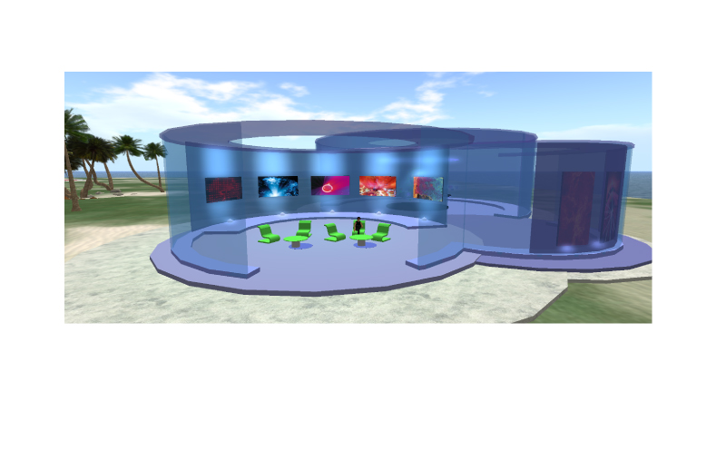
The virtual world of New World Grid
Adaptation of Grid Café content cannot be only
text and images placed on information panels
Need of 3D content, 3D experience, visit, interaction with environment...
But
More things to learn about 3D design and scripting
and longer to create than just “info panel”

Slide 45
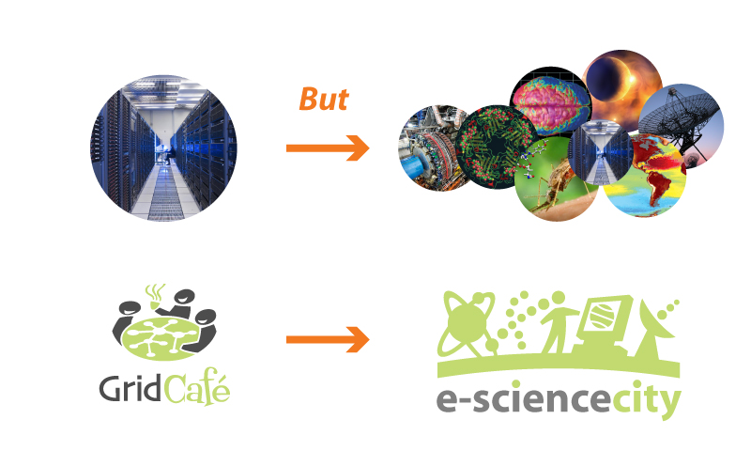
2nd version : e-ScienceCity island
Initialy a simple reconstruction of the web site home page
with some info about grid computing.
Evolution of the project from GridTalk to e-ScienceTalk
Parallel evolution for the web site

Slide 46
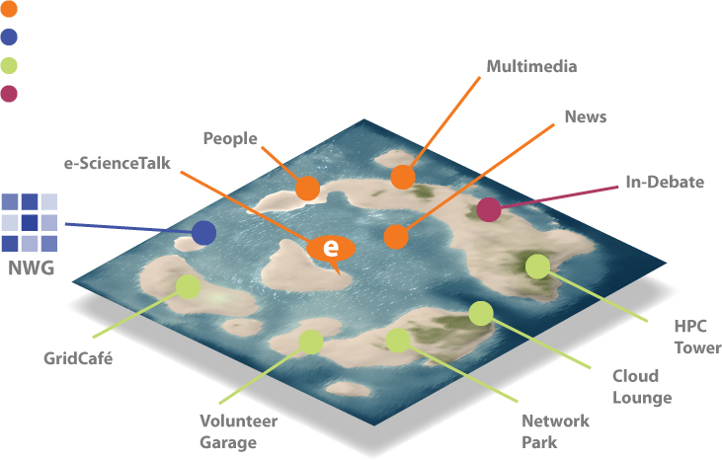
The virtual world of New World Grid
Links with other parts of e-ScienceTalk project
Links with other NWG scientific places
Venues to introduce each subject
Place for meeting or lectures

Slide 47
Parallel evolution for the web site
New logo
that keeps a
strong link with
the GridCafé
but express
the variety
of subjects
Images from
the virtual world
(each section will have its own)
Each section
will have its
corresponding
venue in the
virtual world
A map will be
used for the
navigation within
the web site

Slide 48
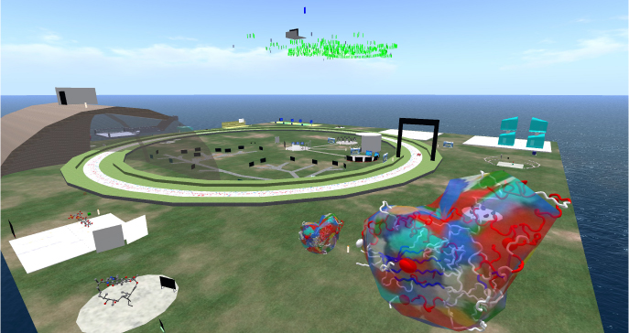
New World Grid tour
Biozone - Genetics and biology

Slide 49
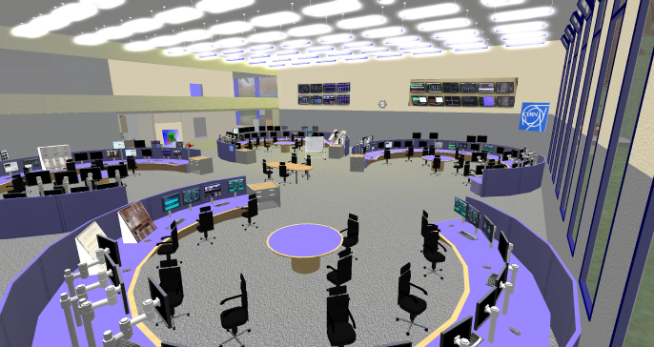
New World Grid tour
CERN Control Centre - LHC control room

Slide 50
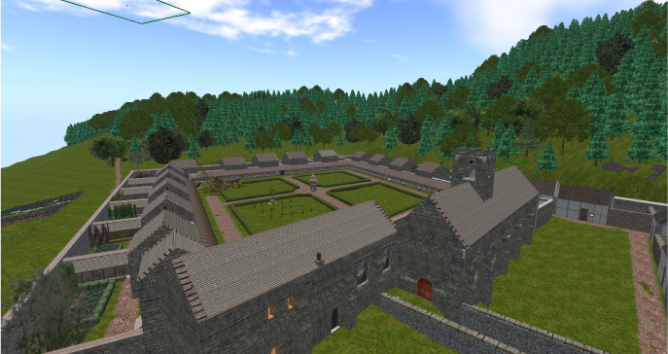
New World Grid tour
The Mont-Grace Priory project

Slide 51
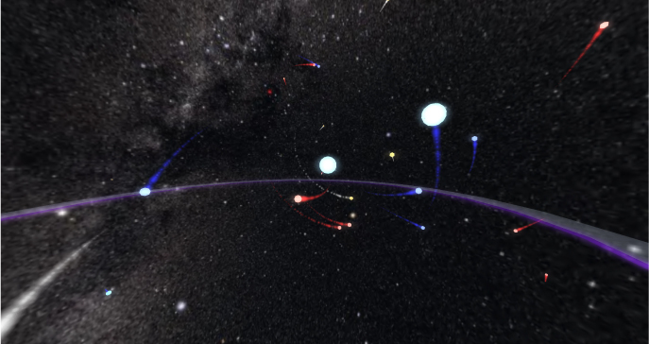
New World Grid tour
New World Innovation

Slide 52
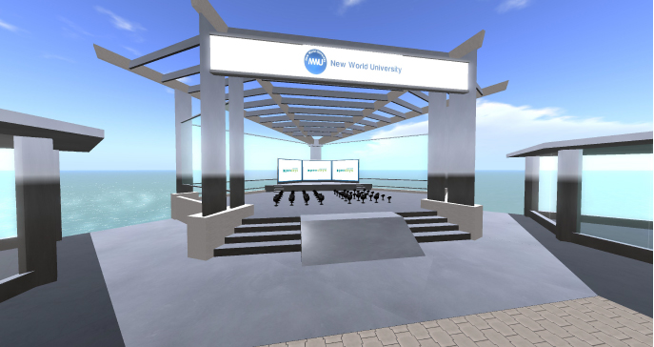
New World Grid tour
The New World University

Slide 53
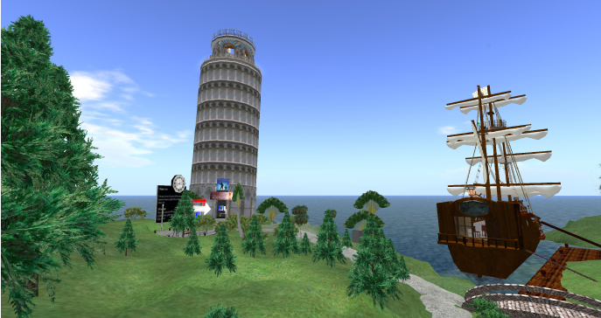
New World Grid tour
The Physics Island

Slide 54
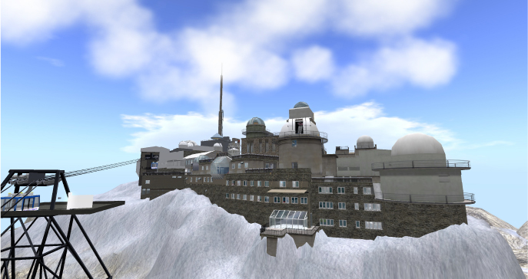
New World Grid tour
Virtual Pic-du-Midi observatory

Slide 55
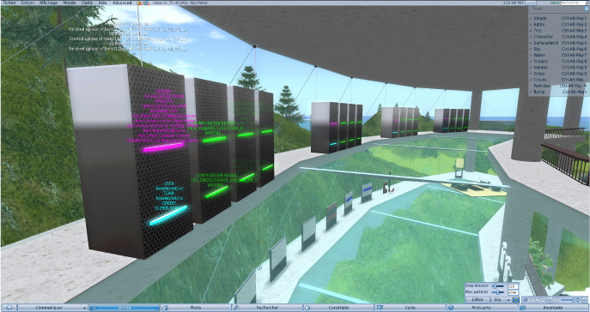
New World Grid tour
VIRTUS - Boinc running on virtual world servers

Slide 56
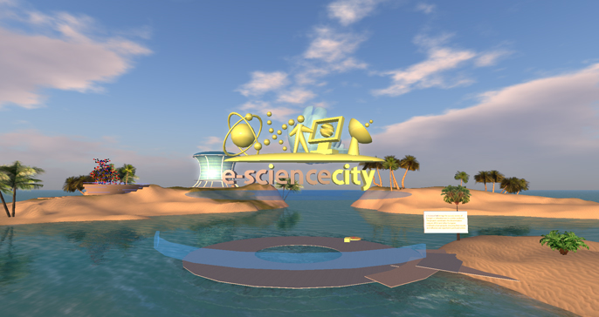
New World Grid tour
e-ScienceCity Island

Slide 57
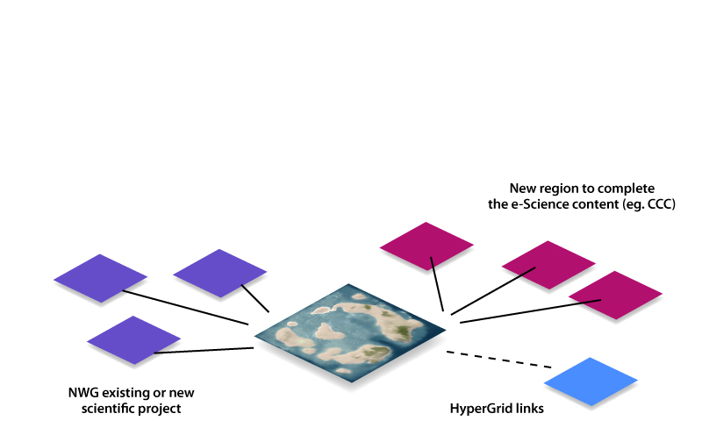
Future development
Promote virtual world for e-science and e-learning
Development of other sims to add content related to e-ScienceCity :
WLCG for grid computing with a virtual visit of Cern Computer Centre
CCC for voluteer computing with presentation of project and participation to the citizen science community - Boinc serveur
Alice experiment sim for high energy physics
Some other projects...

