Slide 1
Training services in the European Grid Infrastructure ecosystem
Gergely Sipos
gergely.sipos@egi.eu
27/April/2012

Slide 2
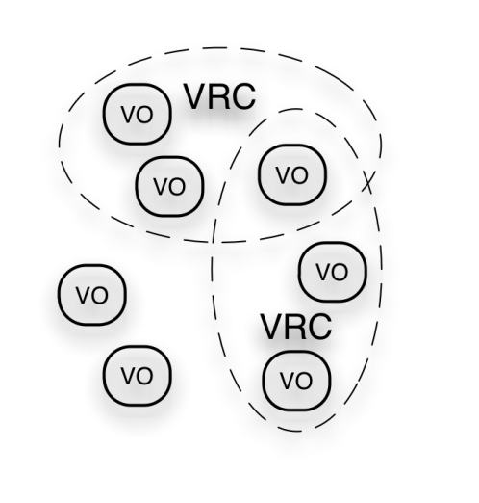
The EGI ecosystem
Training; Training services
User Community
Project: EPIKH
Project: SCI-BUS
Project: Global Excursion
TRANSfoRm
...
Policies + Funding
...
Project: SHIWA
Project: ScalaLife
Project: PRACE-2IP
Training; Training services
Requirements + Feedback
Services + Support
EGI-InSPIRE project
Training; Training services
Service & Resource Providers
Requirements + Feedback
Public Funding Bodies
Policies + Funding
Requirements + Feedback
European Commission
EGI.eu
Technology Providers
National Grid Infrastructures (NGI) AND European Inter-governmental Research Organisations (EIRO)
Open Source Providers
National Research Councils
Strategic Feedback
Technology + Support
Commercial Providers
Policies + Funding

Slide 3
Training services in EGI
By NGIs, EIROs, projects, user communities, technology providers:
Training courses (from few hours to few days)
Training materials, online courses
Training resources (e.g. VOs, sites, certificates)
By EGI.eu, NGI UK, NGI Greece:
Training Marketplace: http://training.egi.eu
Applications Database: http://appdb.egi.eu
Brokering training services between NGIs and user communities

Slide 4
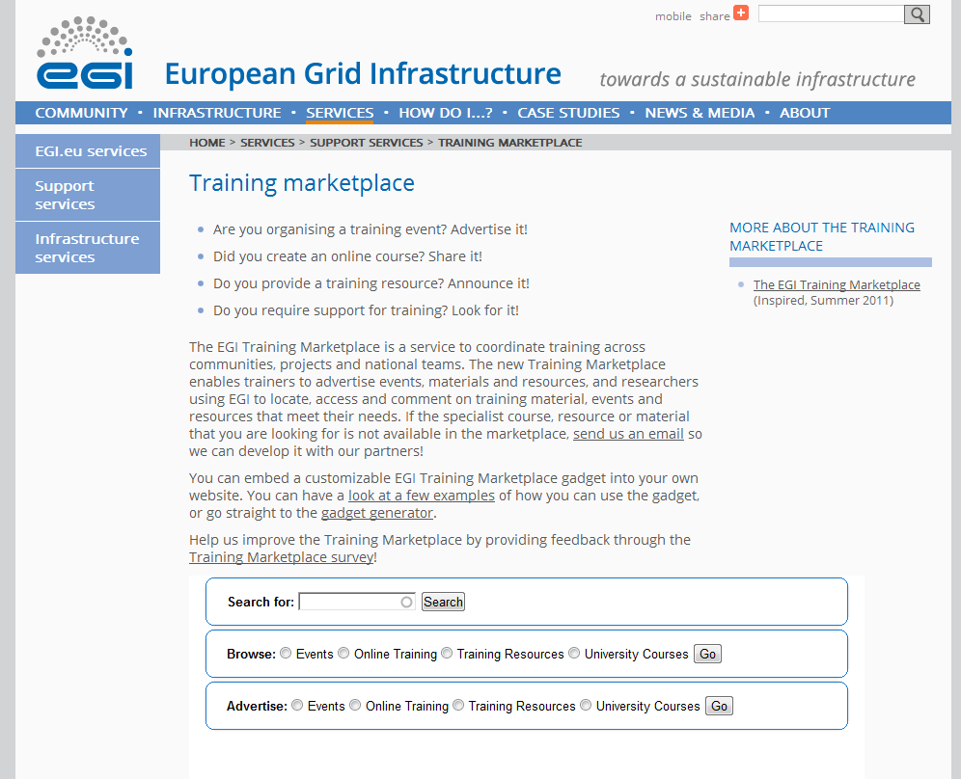
Training Marketplace http://training.egi.eu
Embed into your website with the web gadget!
Search
Browse
Advertise

Slide 5
Training Marketplace Function: search

Slide 6
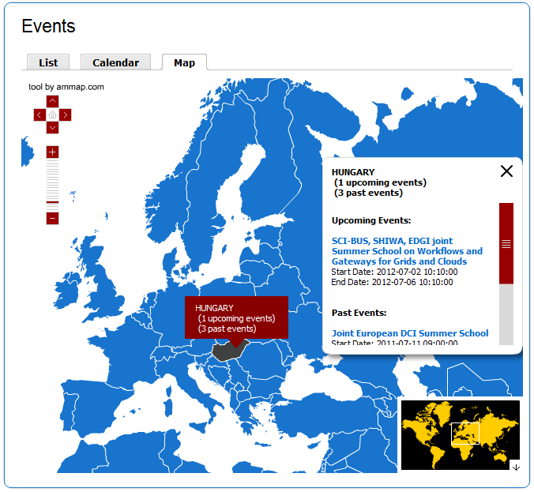
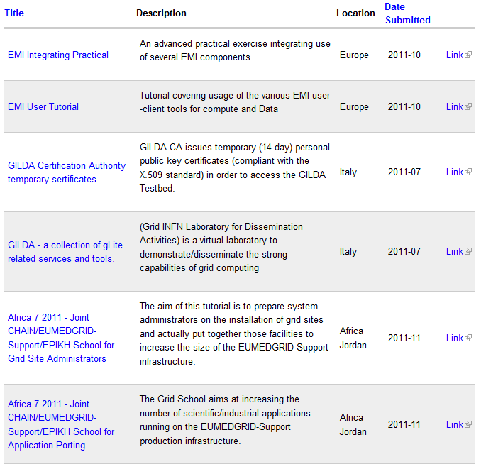
Training Marketplace Function: browse

Slide 7
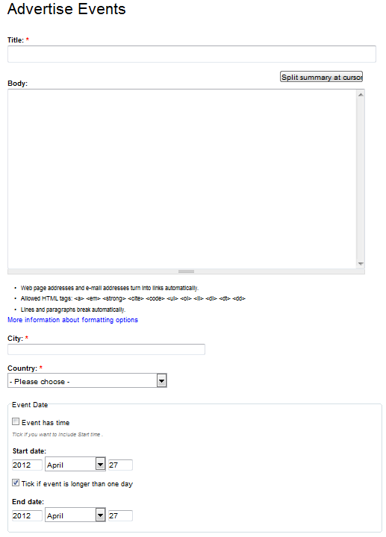
Functions: advertising

Slide 8
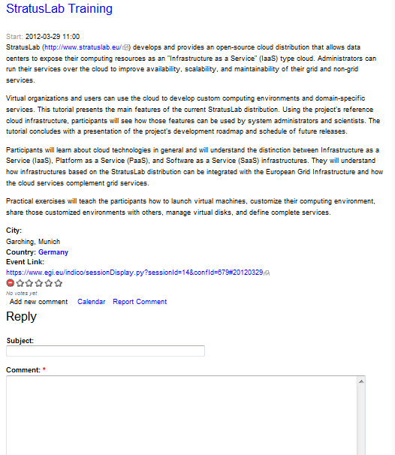
Interaction with trainees: Rating and commenting

Slide 9
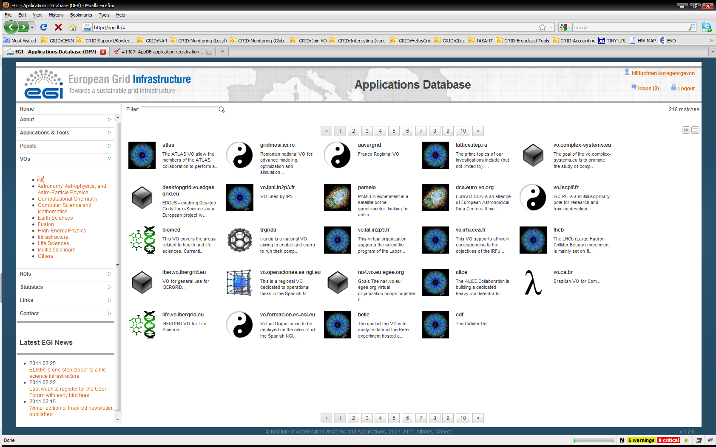
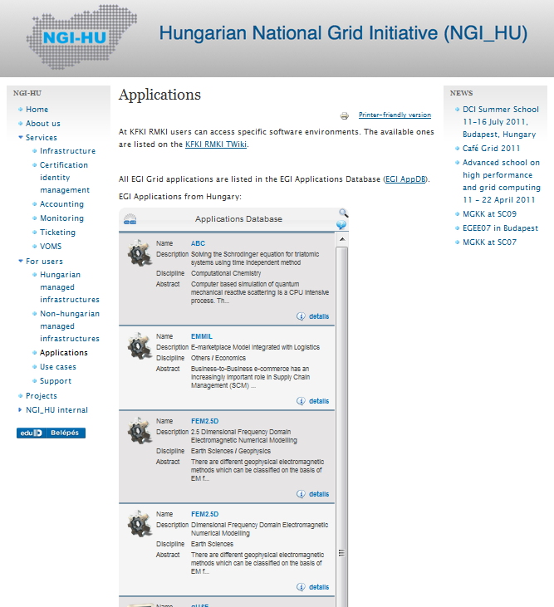
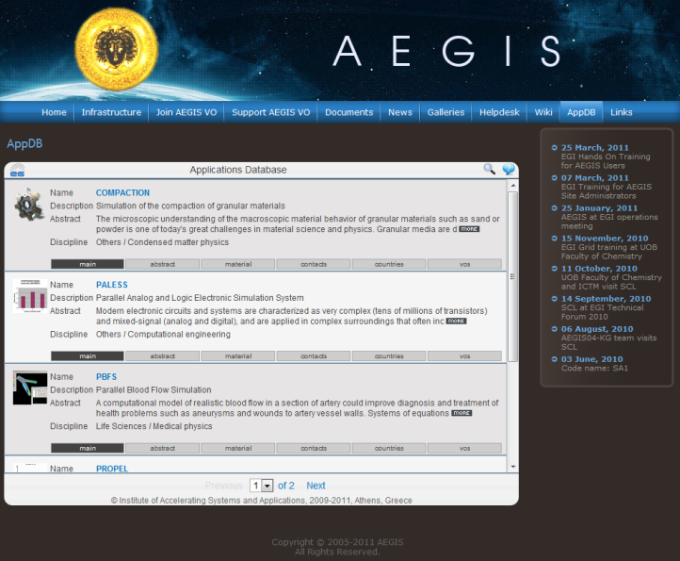
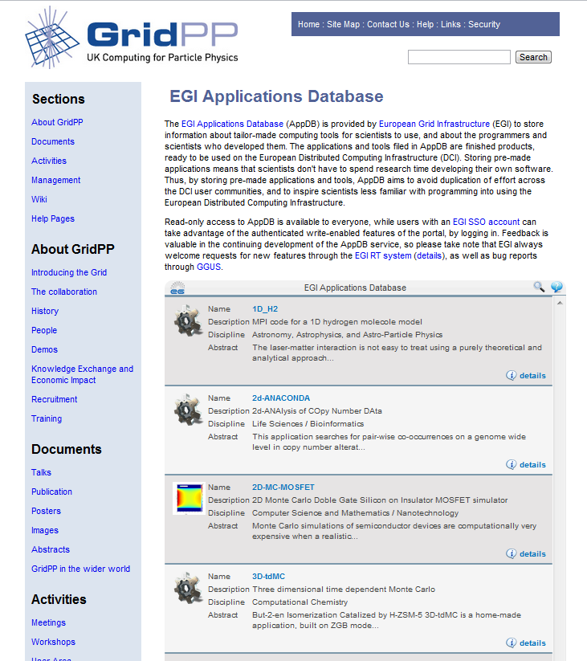
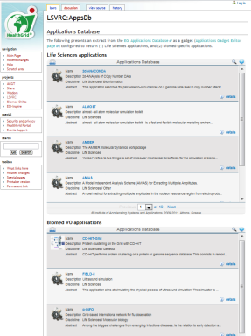
EGI Applications Database
Benefits:
Gives recognition to reusable scientific applications, application developer tools, portals, workflows, etc.
Gives recognition to application developers (people profiles)
Access through web page AND web gadget
Community features such as commenting and ranking
http://appdb.egi.eu

Slide 10
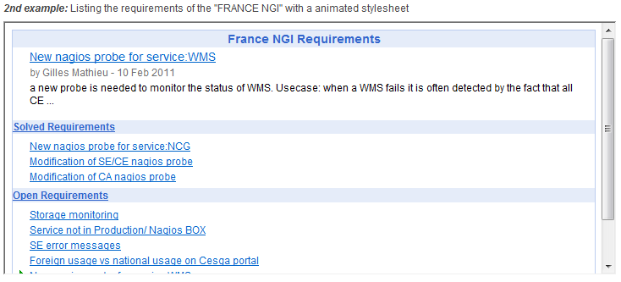
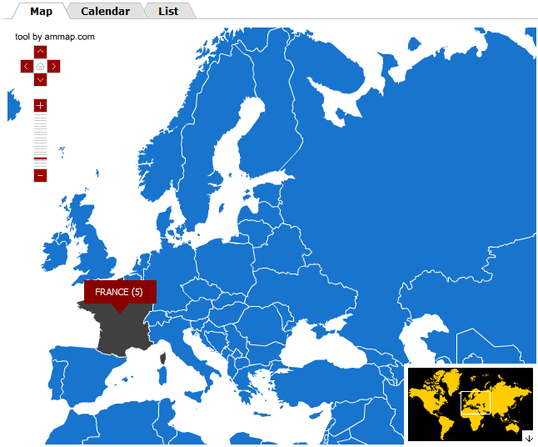
EGI web gadgets
An alternative way of reusing EGI services
Benefits
Customisability
Reusability
Compatibility
Existing gadgets:
Application Database
Training Marketplace
Requirement Tracker
Use and develop gadgets & share them through EGI:
www.egi.eu/user-support/gadgets

Slide 11
Coming soon…
Training Marketplace:
Improved web gadget to provide more flexibility in customising it to NGI websites
AppDB:
Write API for integration with third party registries and portals
New initiatives
Training courses at EGI Technical Forum, September 17-21, Prague:
http://tf2012.egi.eu
EGI Champions – a new support role in NGIs and communities
https://wiki.egi.eu/wiki/VT_EGI_Champions

Slide 12
Summary
Training in EGI consists of
bottom-up activities:
Course delivery, content deliver, resource development
NGIs, user communities
top-down intitiatives:
Training marketplace, Applications Database, Virtual Team projects for specific activities
EGI.eu with its partners
Achievements
Around 130 training-days per year
Around 1000 participant-days per year
Around 20 new training resources per year

Slide 13
Questions?
gergely.sipos@egi.eu

