Slide 1
Setup and deploy Notebooks service
Access to data services
Dissemination level: Public

Slide 2
EGI Notebooks service options
Catch-all / The EGI Applications on Demand (AoD)
Limited resources (computing + storage), sponsored access
Kills notebooks after 1 hour of inactivity
https://notebooks.egi.eu
VO/Community deployment
Compute and storage are typically brokered from your national compute center
Mostly free at point of use for national researchers. Payment may apply for others
Your own instance at your local infrastructure!

Slide 3
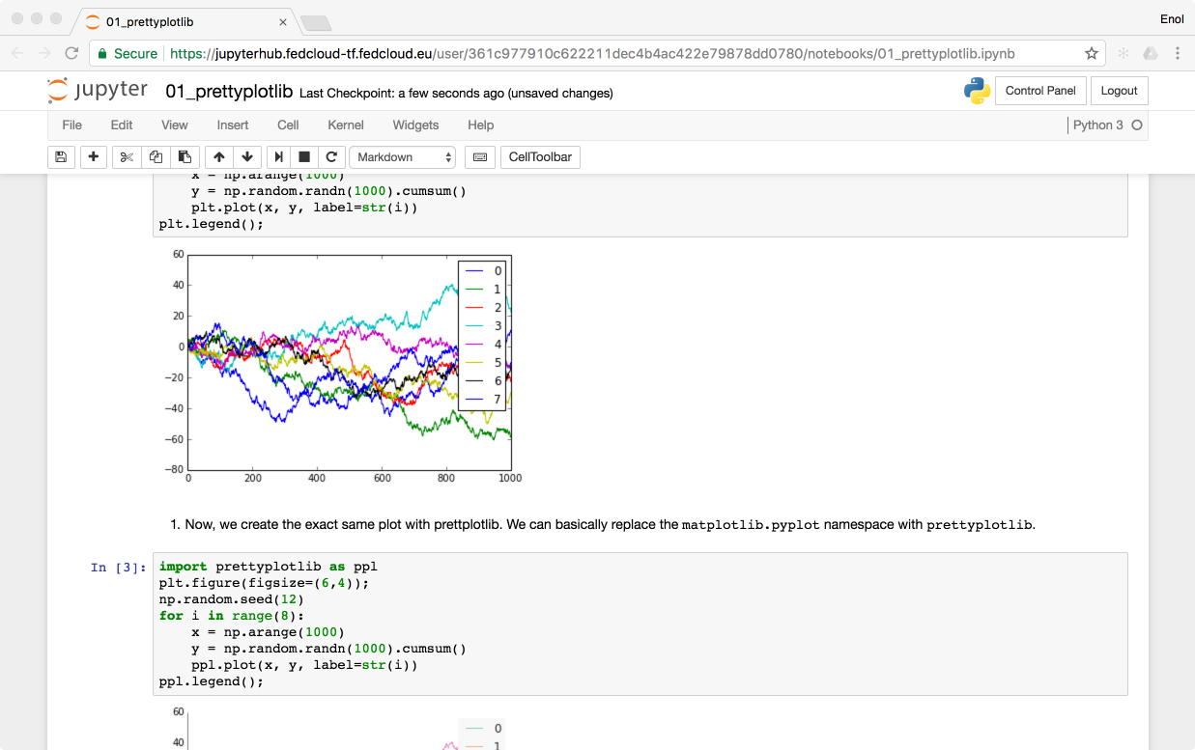
Technology Stack
https://training.notebooks.egi.eu
EGI CheckIn
Kubernetes cluster powered by EGI Cloud Compute
SSL Certificate
Persistent
Storage
Kubernetes
Ingress

Slide 4
Kubernetes (k8s)
Kubernetes is the container orchestration platform where JupyterHub/EGI Notebooks run
Open-source platform for managing containerized workloads and services, that facilitates both declarative configuration and automation.
orchestrates computing, networking, and storage infrastructure on behalf of user workloads
Kubernetes
gives you the ability to deploy and scale Docker containers on-demand
without the overhead of installing, managing and operating the nodes
manages the nodes where to run the containers
automates the deployment, management, scaling, networking, and availability of container-based applications running on that cluster

Slide 5
Getting kubernetes
Commercial ready-to-use k8s
Google Kubernetes Engine (GKE)
Azure Container Service (AKS)
Amazon Elastic Container Service for Kubernetes (Amazon EKS)
…
On premises deployment:
OpenStack Magnum
kubeadm, kubeops
Kubernetes the hard way
EGI Cloud Container Compute
Ansible roles around kubeadm

Slide 6
Helm charts for JupyterHub
Helm is a package manager for Kubernetes
Allows to easily install applications/services easily
Lots of packages available, JupyterHub is one of them!
https://jupyterhub.github.io/helm-chart/
$ cat config.yaml
proxy:
secretToken: <some-secret>
$ helm install jupyterhub/jupyterhub --version=v0.8 --name=jupyterhub \
--namespace=jupyterhub -f config.yaml
$ helm upgrade jupyterhub jupyterhub/jupyterhub --version=v0.9 -f config.yaml

Slide 7
Customising
JupyterHub helm chart is highly adaptable to your needs
What image the users should run
What storage should the users have associated with
What kind of authentication should be used
…
EGI Notebooks is mostly customisation of the JupyterHub helm
Using our notebooks images
With EGI Check-in Authentication
NFS Persistent Volumes

Slide 8
Integrating Notebooks with EUDAT B2DROP

Slide 9
Demo time - deployment

Slide 10
B2DROP
B2DROP offers online storage for researchers
Researchers can collaborate with others and work together on the data.
The data can be shared with external collaborators (B2DROP users or not)
The data can be shared with other platforms, which support the open cloud mesh.
Based on owncloud
Exposes webdav interface for accessing files
Notes:
Researches can synchronise their data across several computers/mobile devices.
* Researchers can organise their work with (shared) calenders and address books.
* Concluded documents can be published directly through B2SHARE.

Slide 11
Integrating Notebooks with EGI Datahub

Slide 12
What do we want to do?
Several of the use cases in EOSC-hub will enable scientific end-users to perform data analysis experiments on large volumes of data, by exploiting a PID-enabled, server-side, and parallel approach.
Users expect easy to use interfaces like Jupyter Notebooks for interacting with the system.
Producing reusable results following FAIR guidelines
Findability, Accessibility, Interoperability, and Reusability.
Notes:
Findability: B2FIND, B2HANDLE and Handle.net
Accessibility: Oneprovider
Interoperability: APIs, standards (OAI-PMH)
Reproducibility: Notebooks, Oneprovider

Slide 13
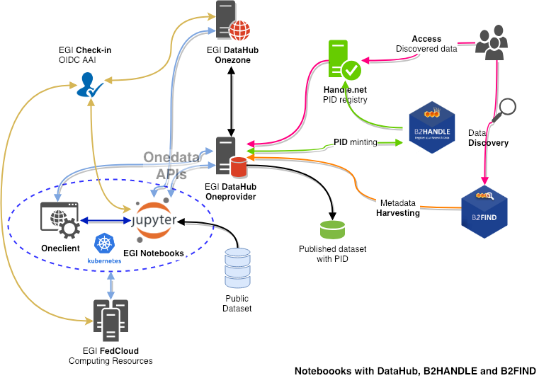
How?
Analysis
Notebooks / JupyterLab
FedCloud resources
Data management
DataHub / Onedata
Space
Onezone
Oneprovider
Oneclient
AAI (OIDC)
Check-in
PID management
B2HANDLE
Handle.net
Cataloguing and discovery
B2FIND
Notes:
A User goes to a Jupyter notebooks service to run an interactive analysis of open data
Notebooks is deployed on a Kubernetes cluster running on EGI FedCloud resources
DataHub used for Data Management
Onedata concepts and components
Space: virtual volume where users organize their data. A space is supported by one or multiple Oneproviders.
Onezone: the federation and authentication service, user for AAI, management and web access.
Oneprovider: a data management component deploy in data centres to expose data and manage transfers
Oneclient: a client application allowing to mount a space locally
Management of publication with PID
Exposition of dataset using OAI-PMH
PID generation by B2HANDLE using Handle.net
DataHub OAI-PMH endpoint is harvested and indexed by B2FIND and can be discovered
Check-in for handling user authentication and authorisation to services with federated AAI
Implementation of AARC’s blueprint
FAIR
Findability: B2FIND, B2HANDLE and Handle.net
Accessibility: Oneprovider
Interoperability: APIs, standards (OAI-PMH)
Reproducibility: Notebooks, Oneprovider

Slide 14
Demonstration flow
Authenticating to DataHub using Check-in: https://datahub.egi.eu
Showing content of space
Authenticating to Notebooks using Check-in: https://cs3.fedcloud-tf.fedcloud.eu
Showing content of mounted space
Running Wind cast analysis notebook
Running PID registration notebook to share and publish notebooks directory
B2FIND cataloguing (data collected on a regular basis): http://eudat7-ingest.dkrz.de/dataset?groups=egidatahub
OAI-PMH metadata in DataHub:
http://datahub.egi.eu/oai_pmh?verb=ListRecords&metadataPrefix=oai_dc
PID in Handle.net registry: http://hdl.handle.net/
PID pointing to shared data publicly accessible in Onedata

Slide 15
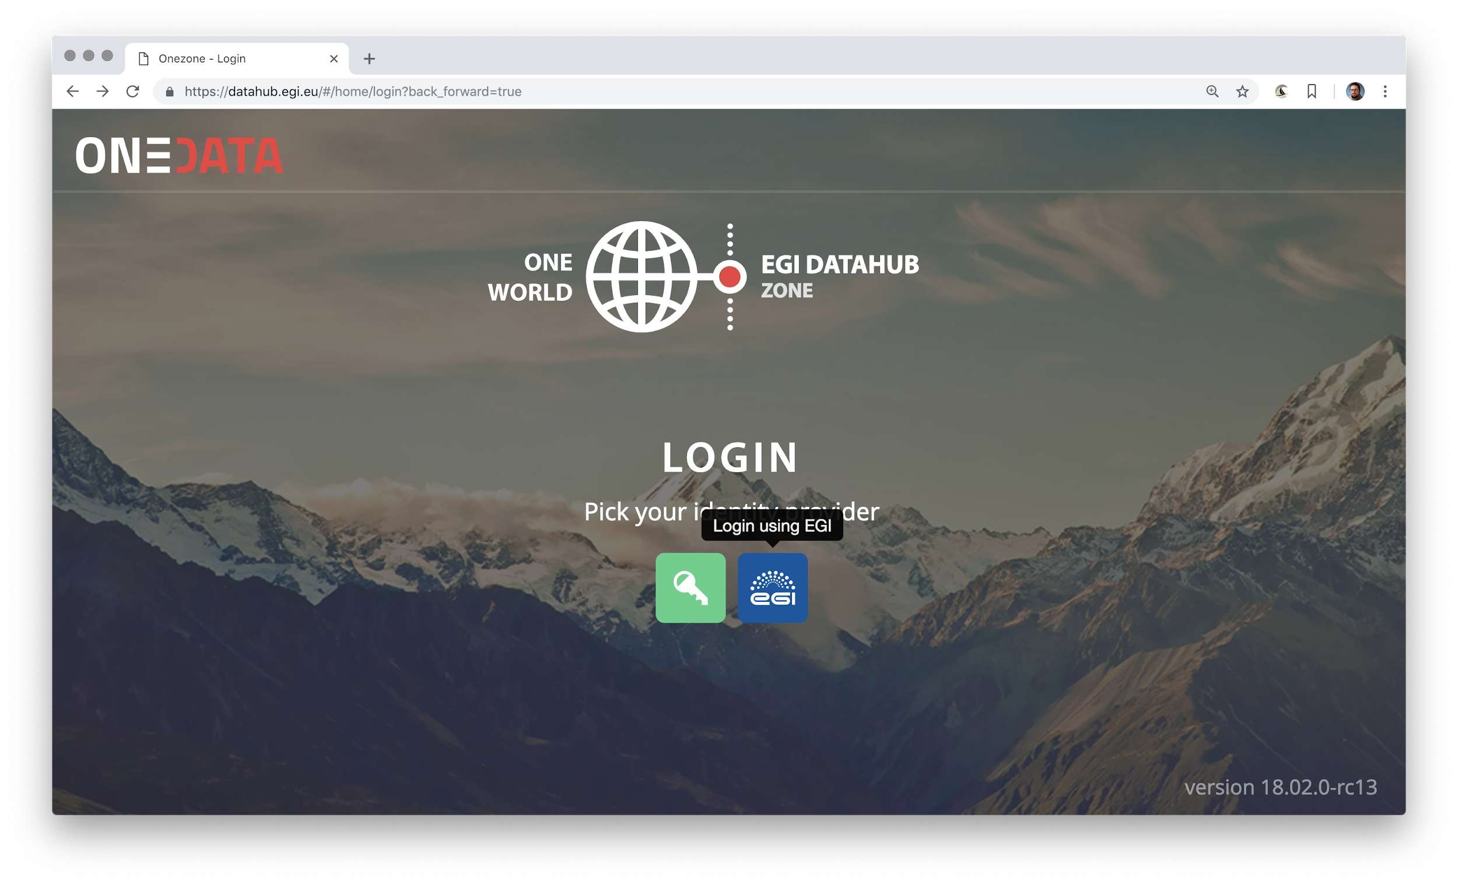
DataHub/Onedata Login with Check-in (OIDC)

Slide 16
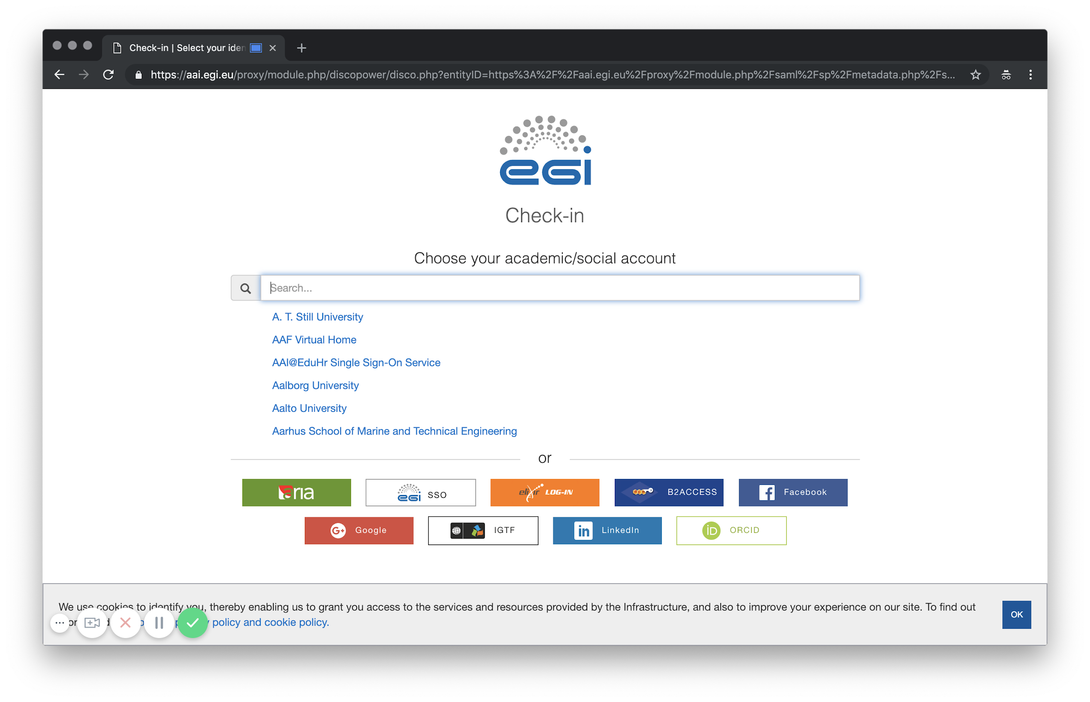
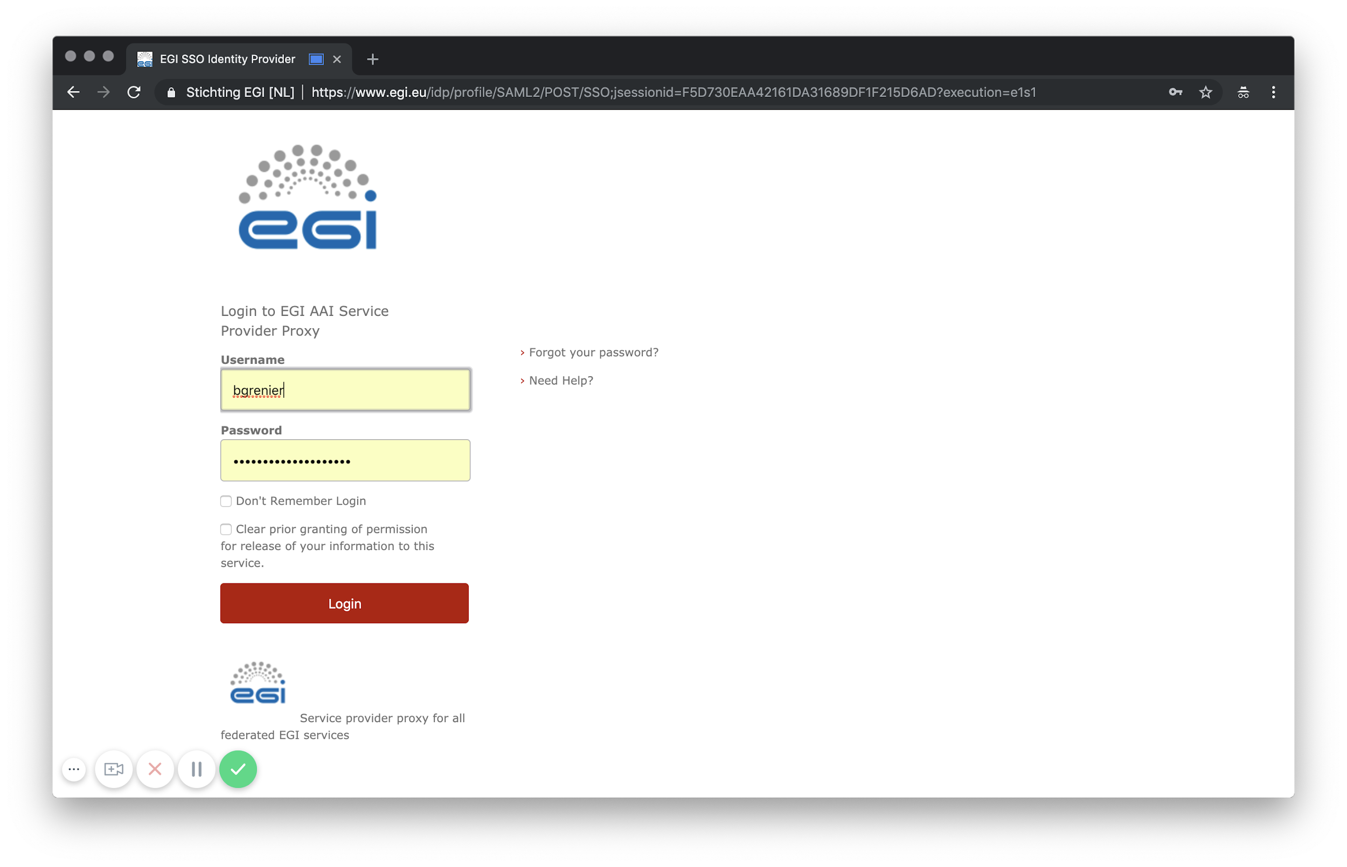
Check-in: IdP Selection and authentication

Slide 17
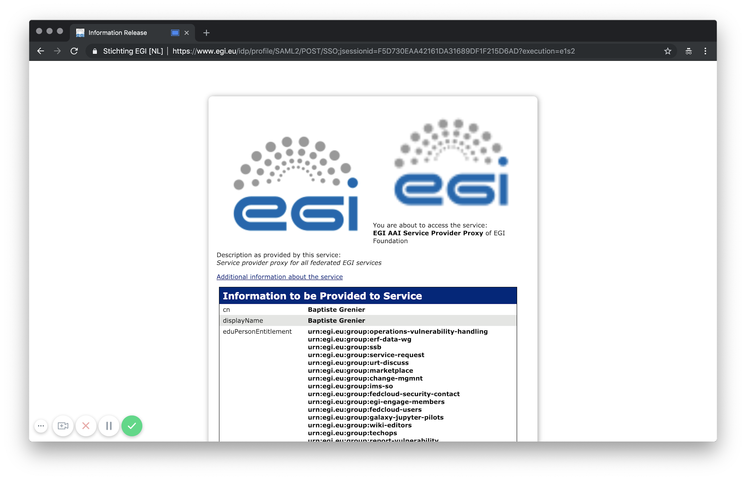
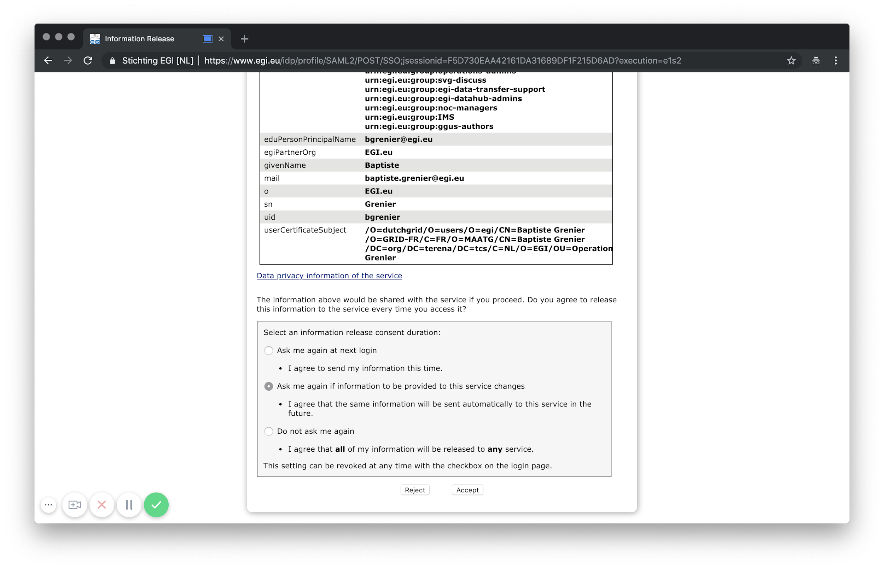
IdP: Information Release consent

Slide 18
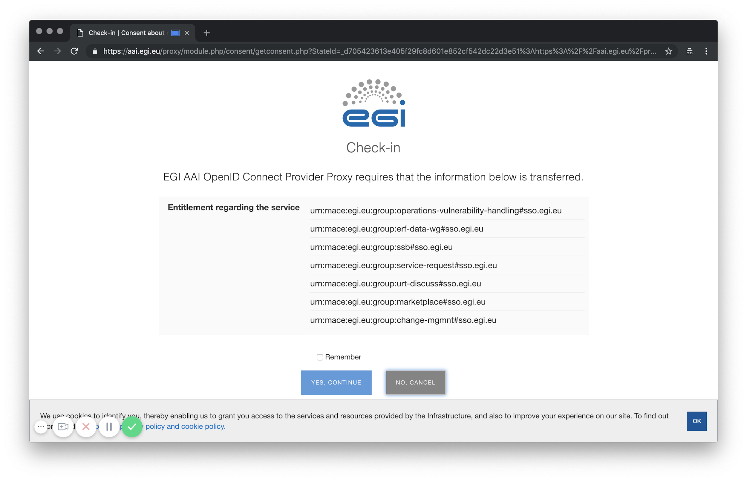
Check-in: entitlements forwarded to the service

Slide 19
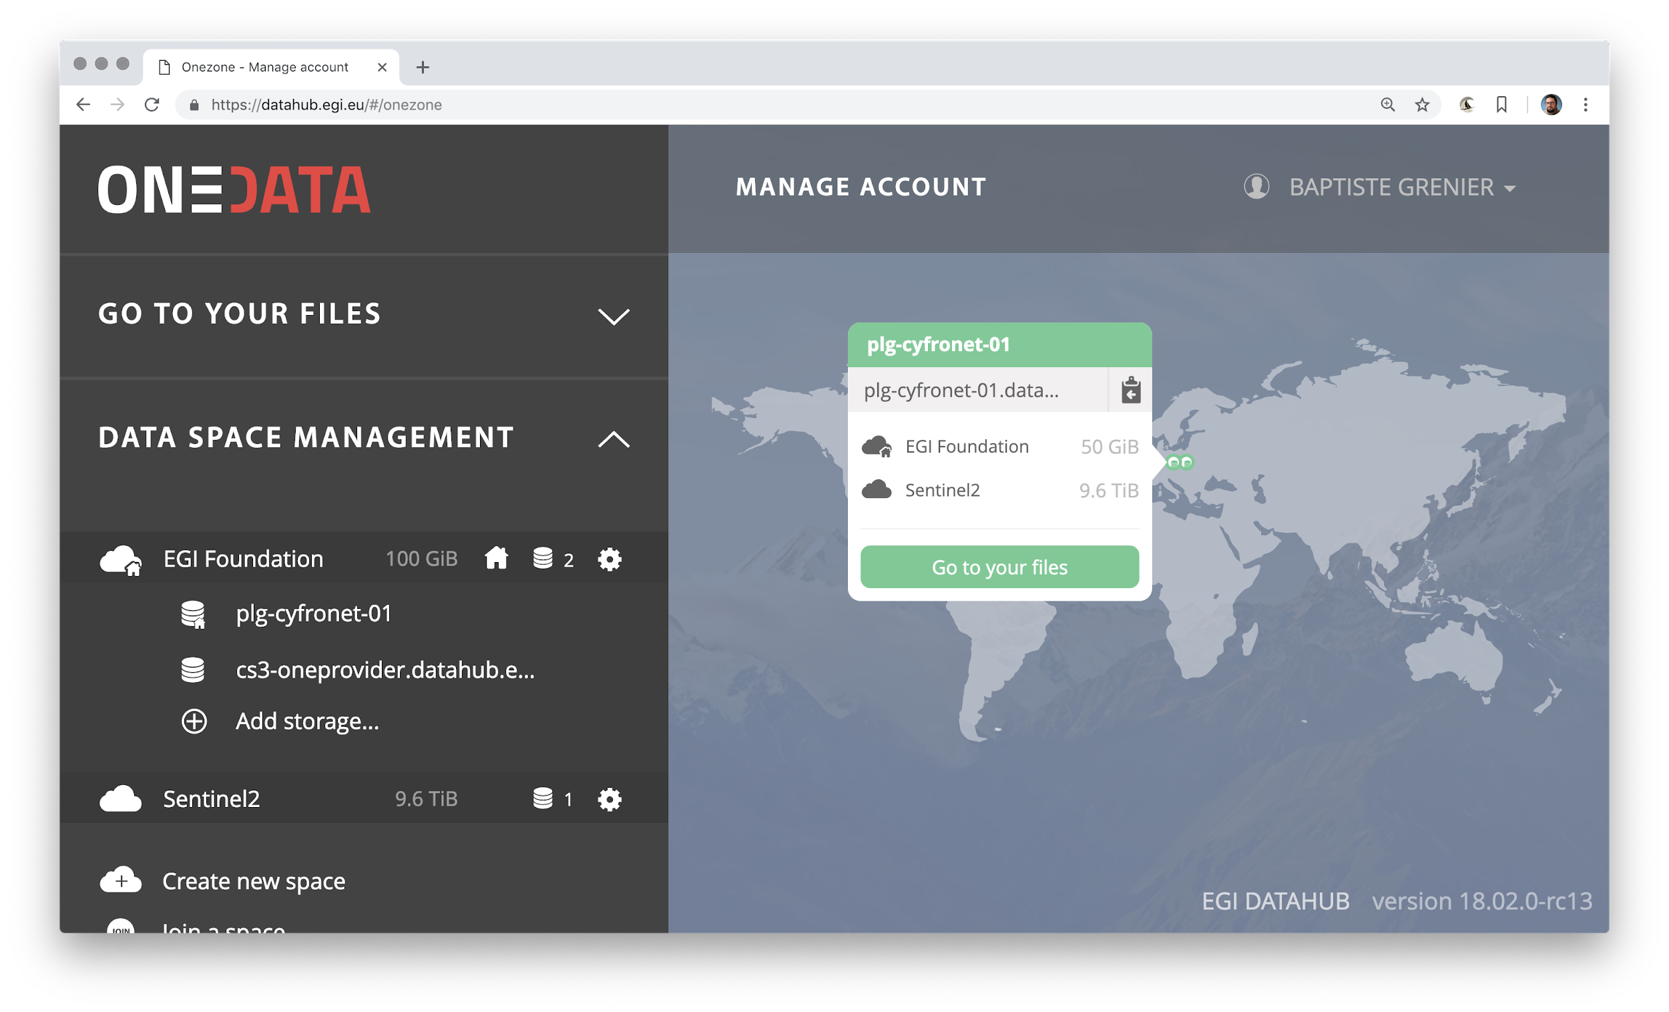
DataHub: displaying spaces and providers

Slide 20
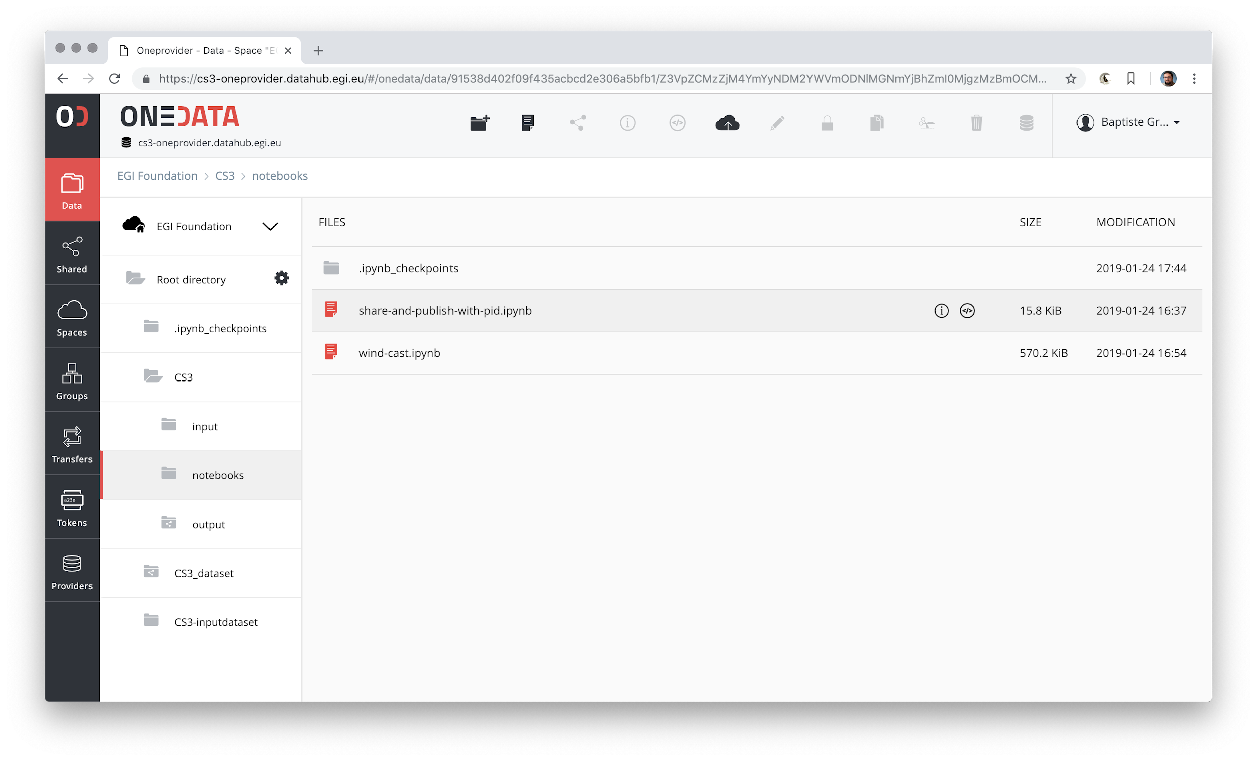
DataHub: user space content

Slide 21
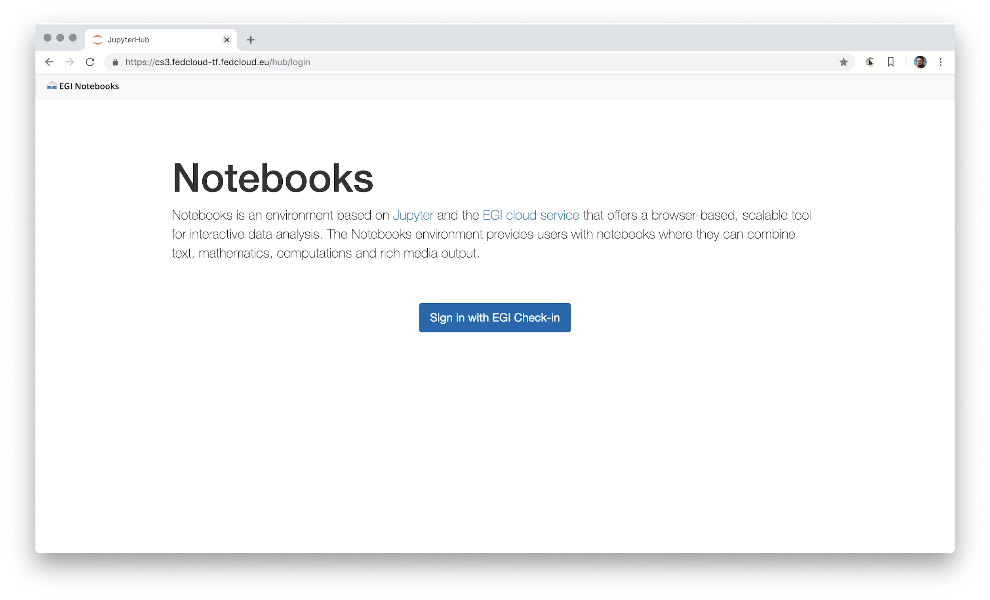
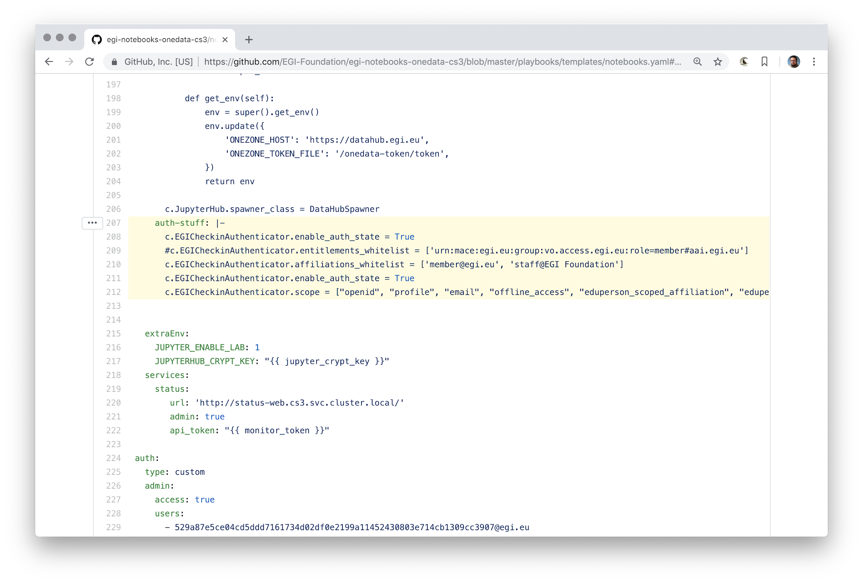
Notebooks: Login with Check-in (OIDC)

Slide 22
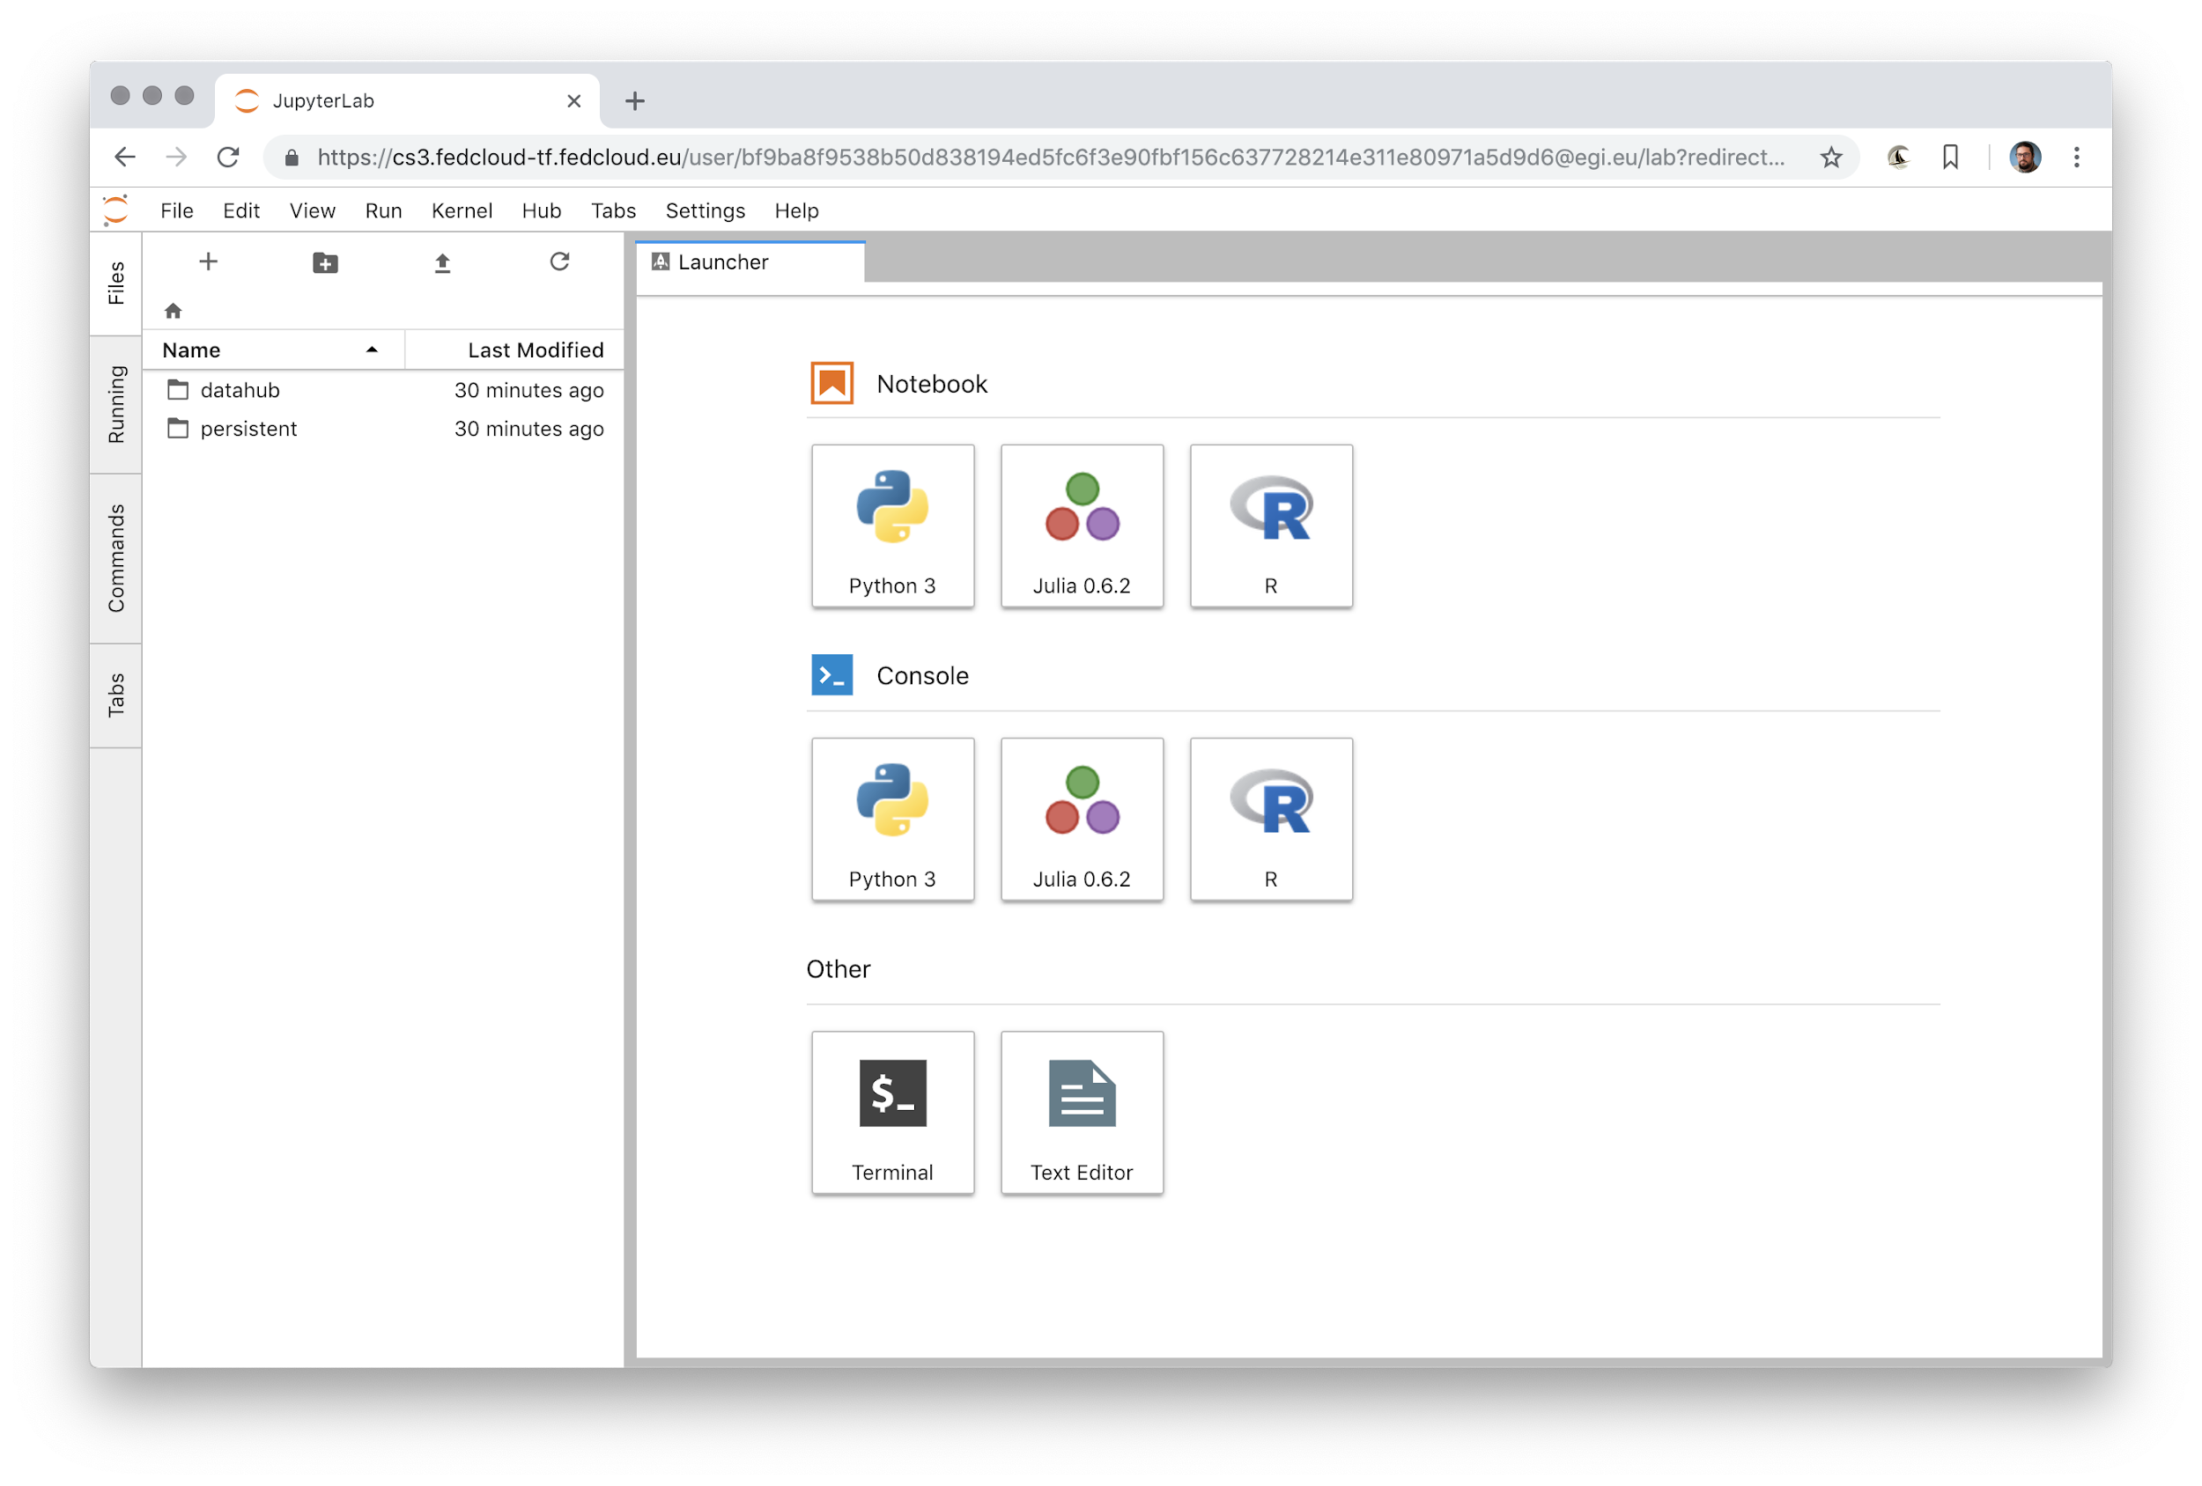
Notebooks: Jupyter Hub env

Slide 23
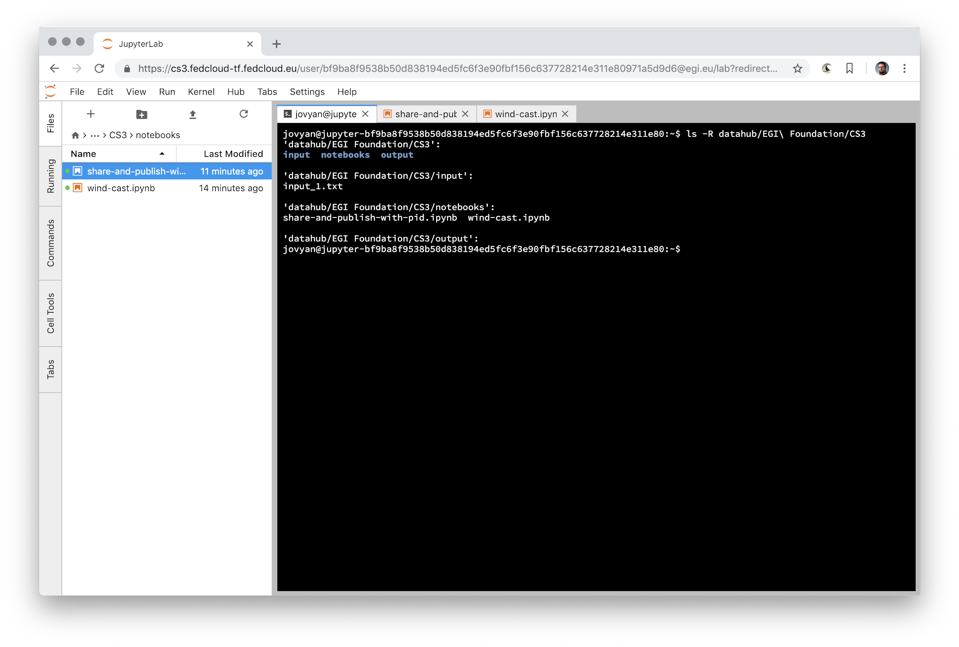
Notebooks: Onedata space mounted locally

Slide 24
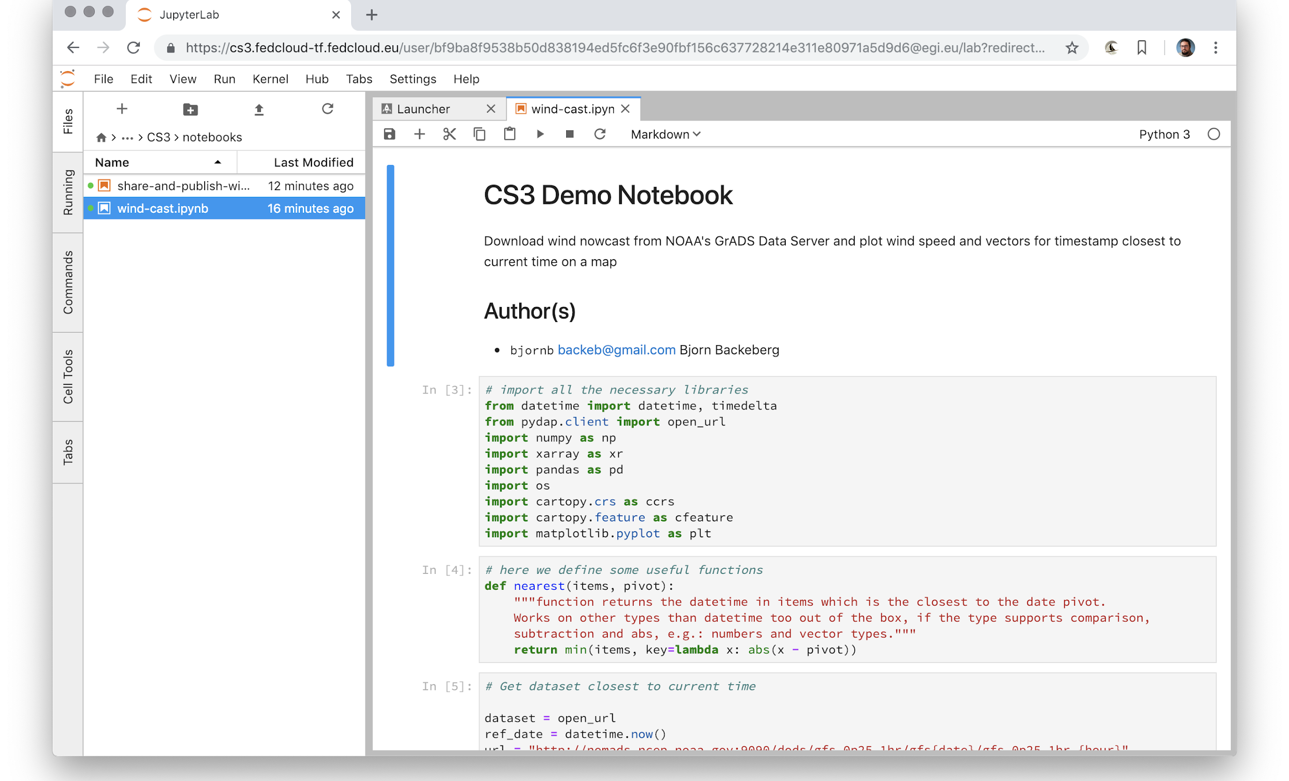
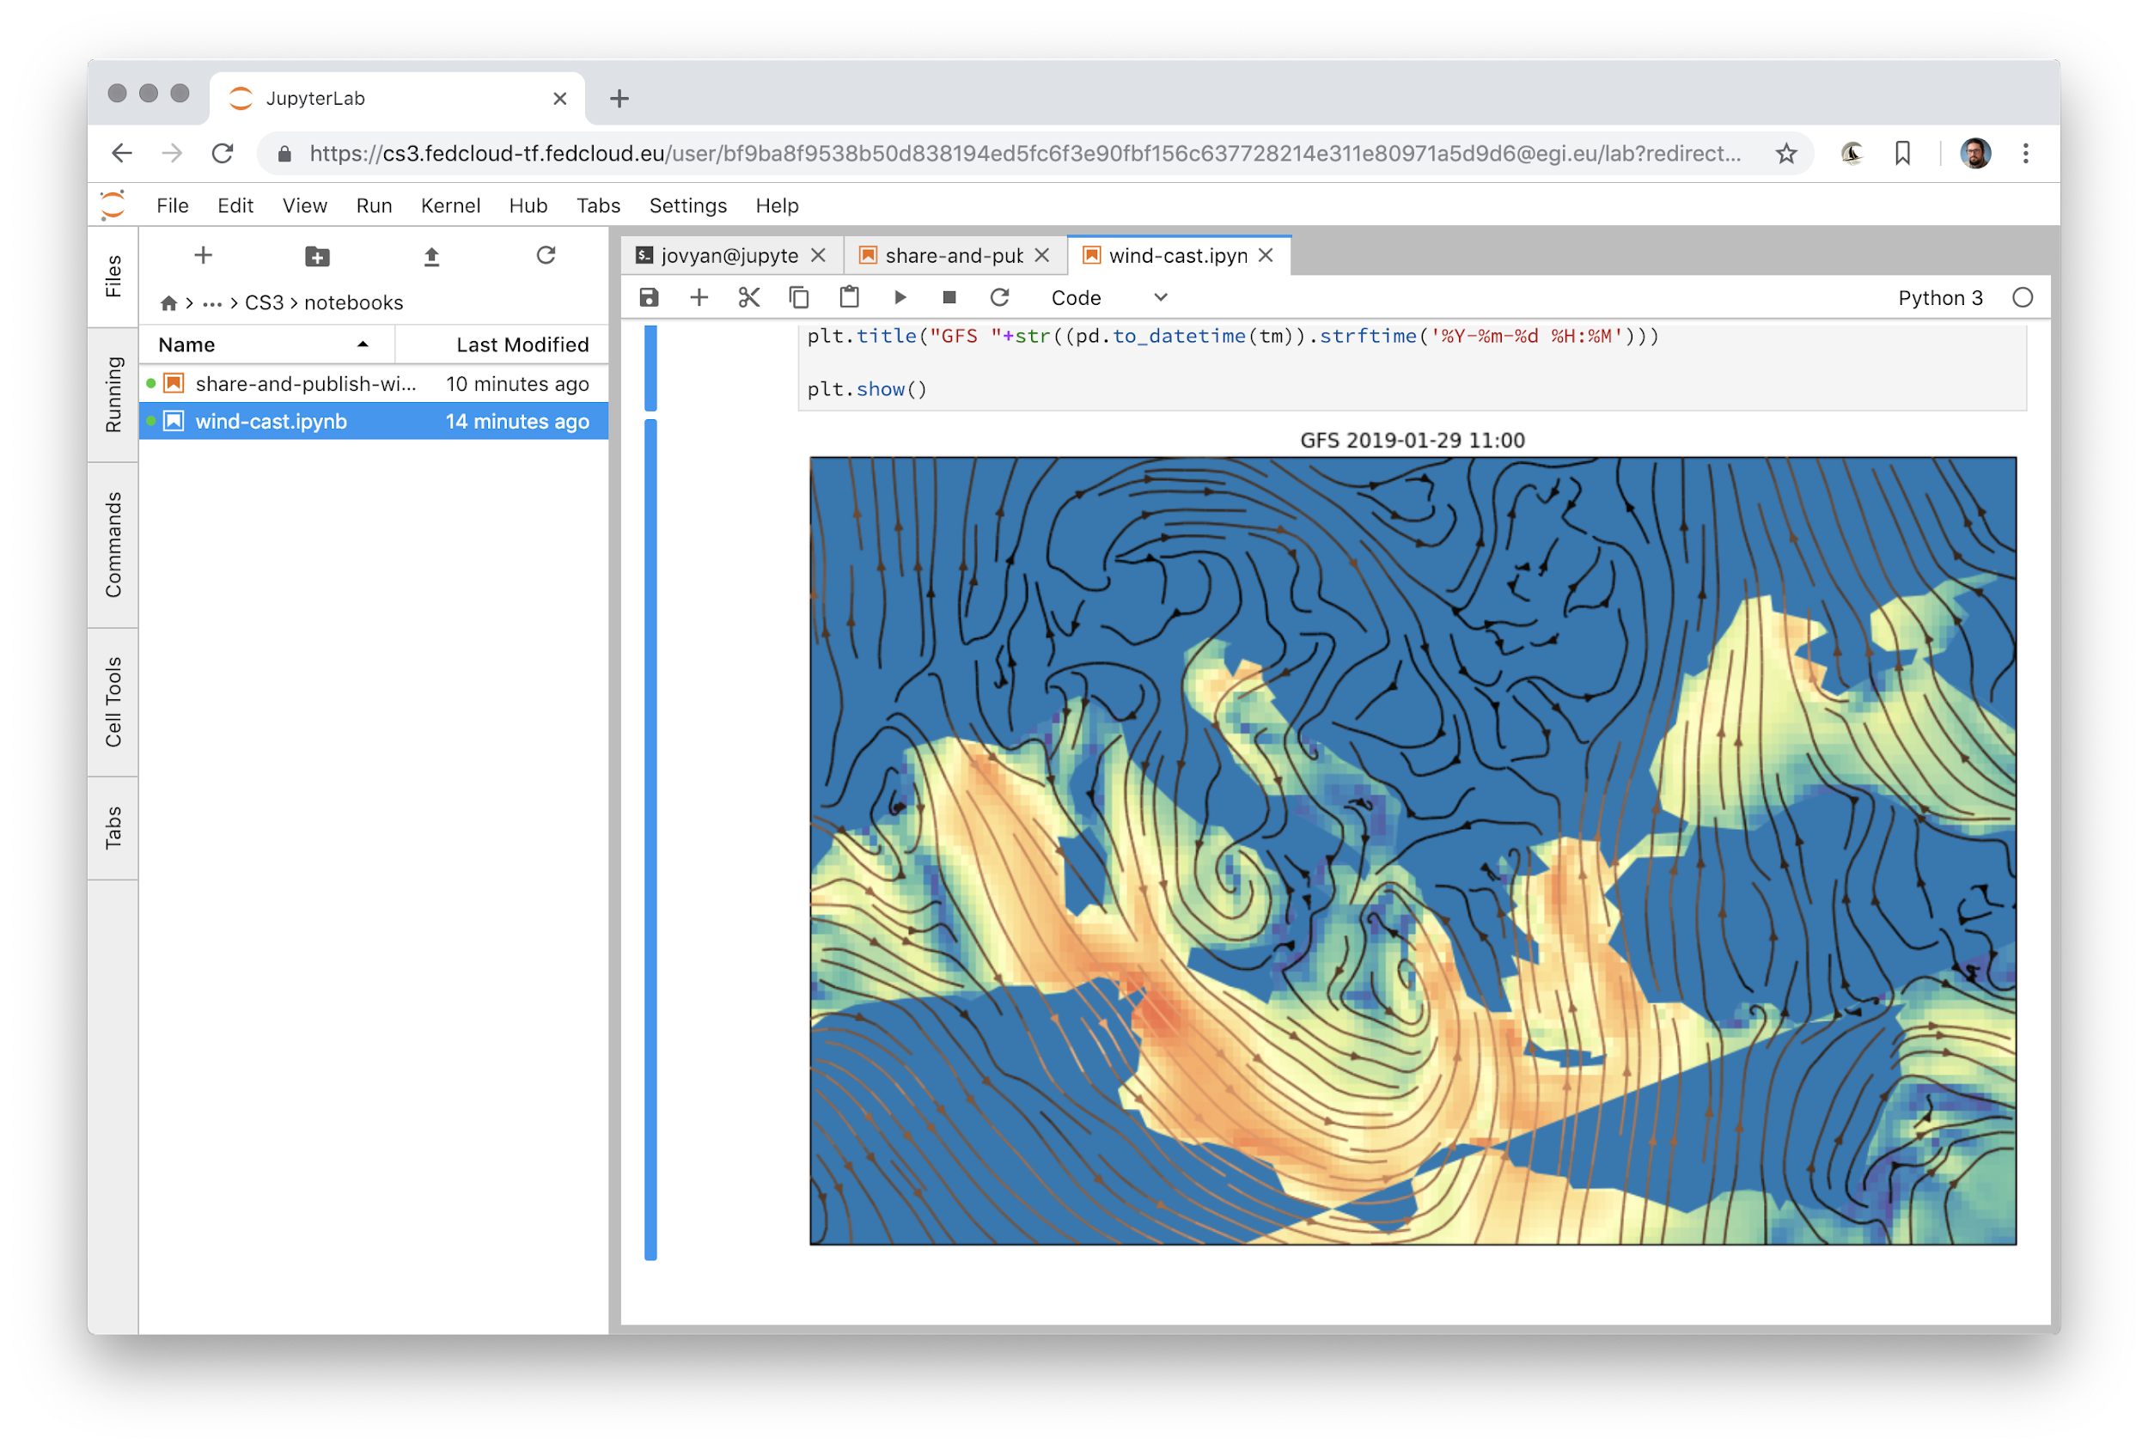
Notebooks: wind casting using public dataset

Slide 25
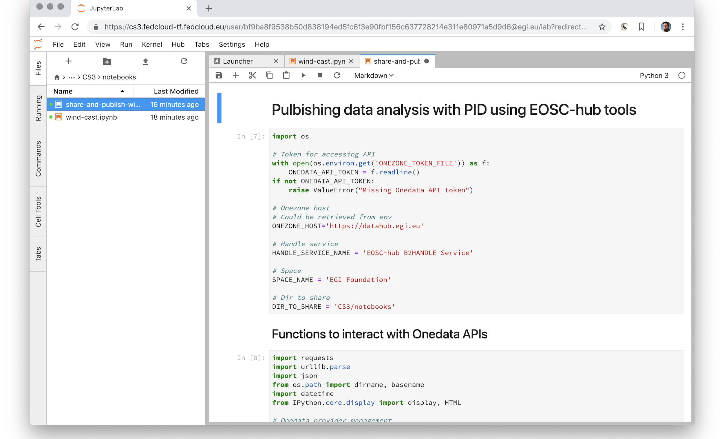
Notebooks: publishing data with PID using APIs

Slide 26
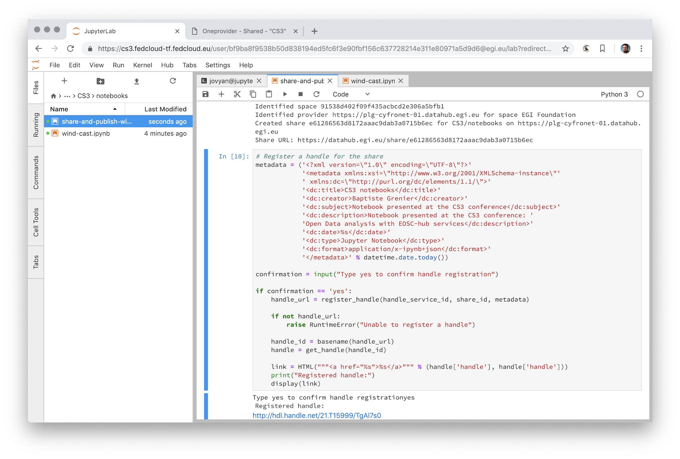
Notebooks: sharing directory, minting PID

Slide 27
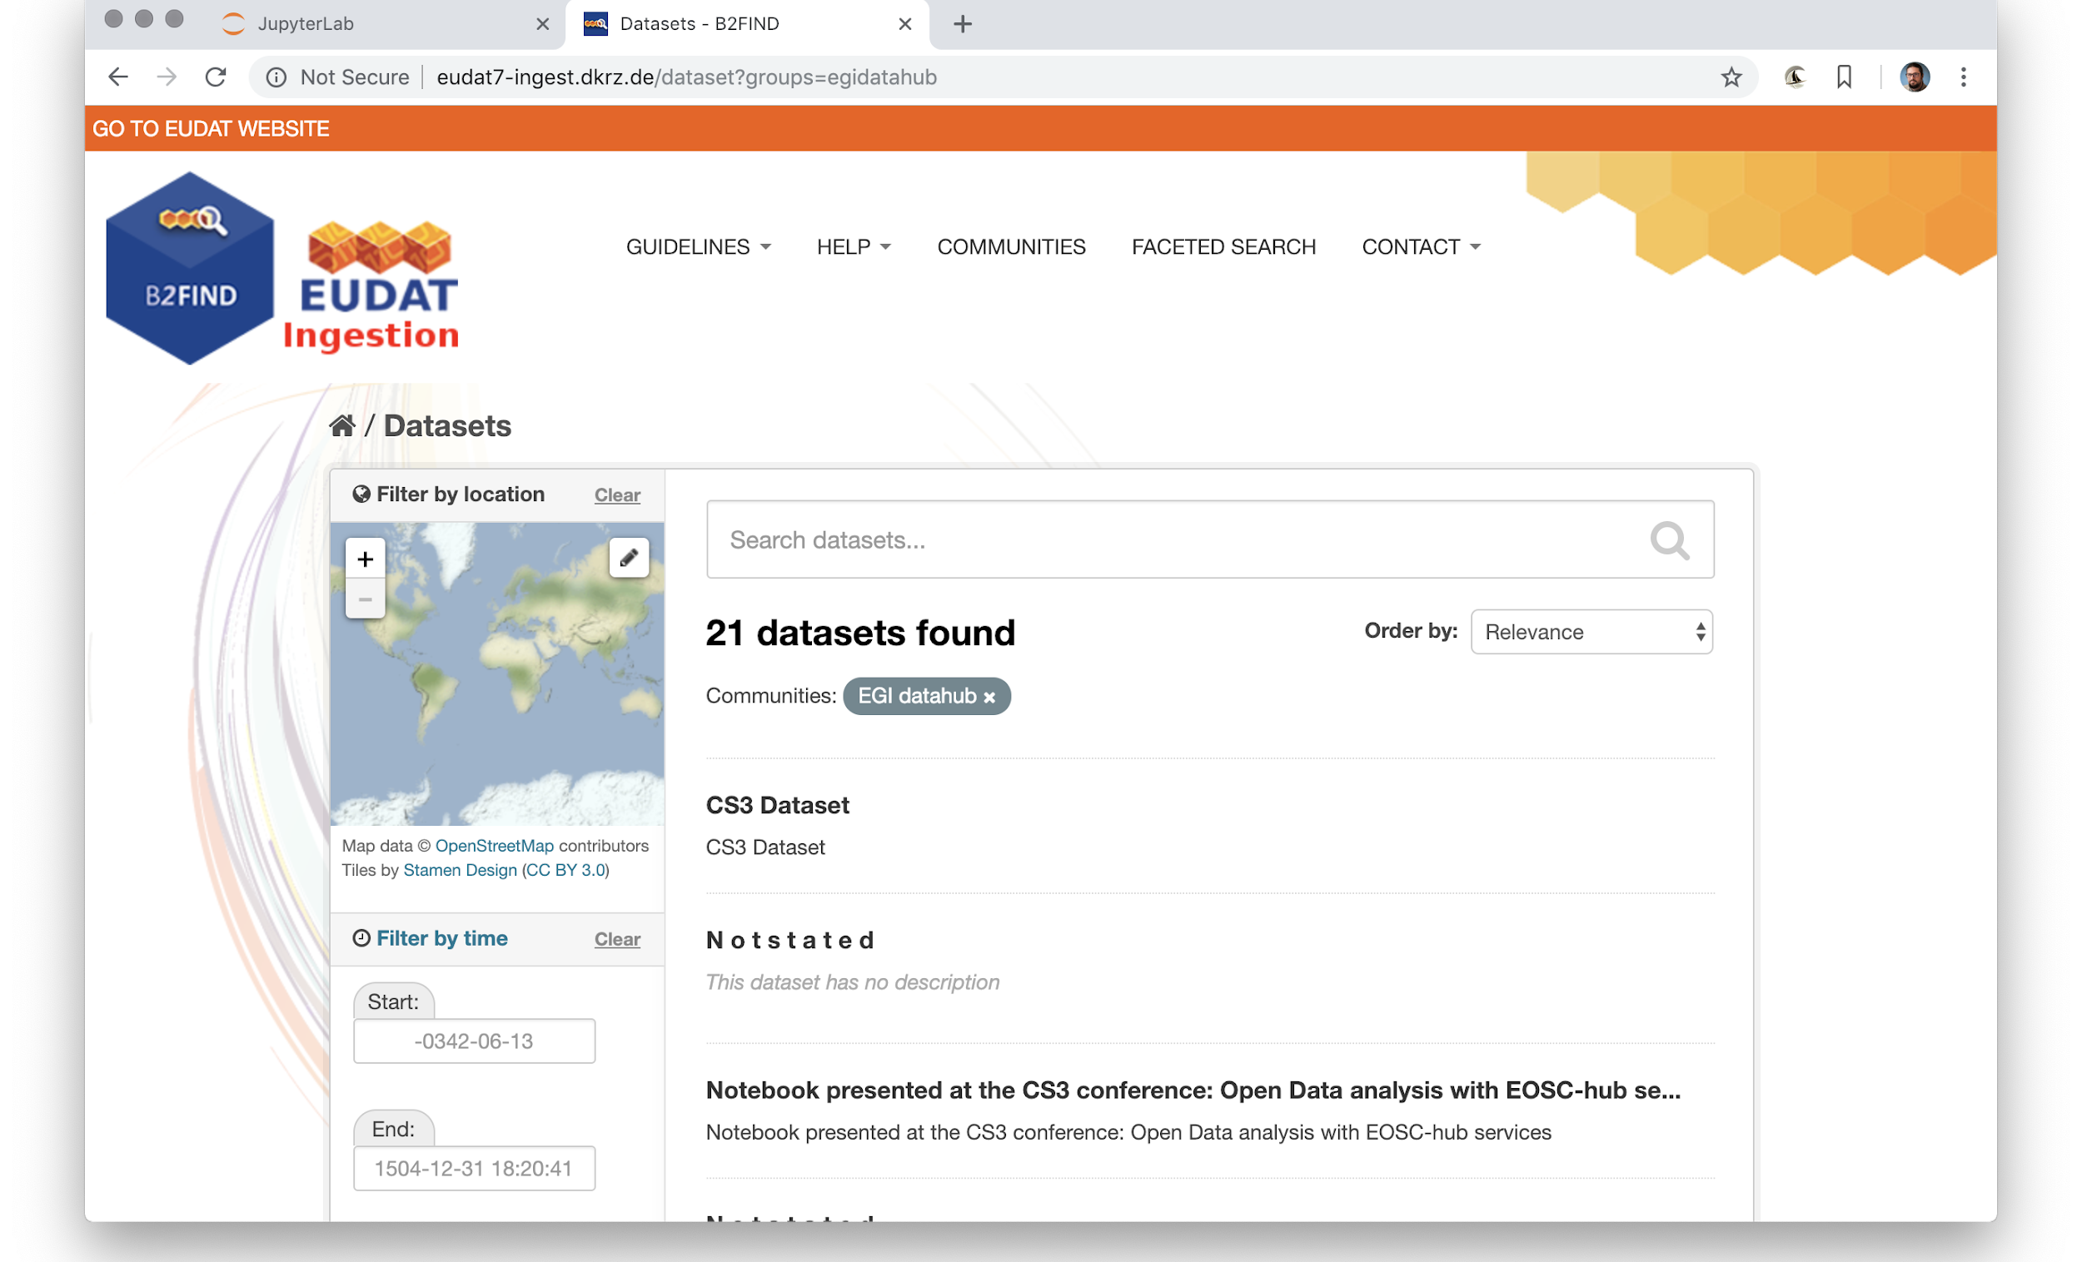
B2FIND: discovery of harvested OAI-PMH metadata

Slide 28
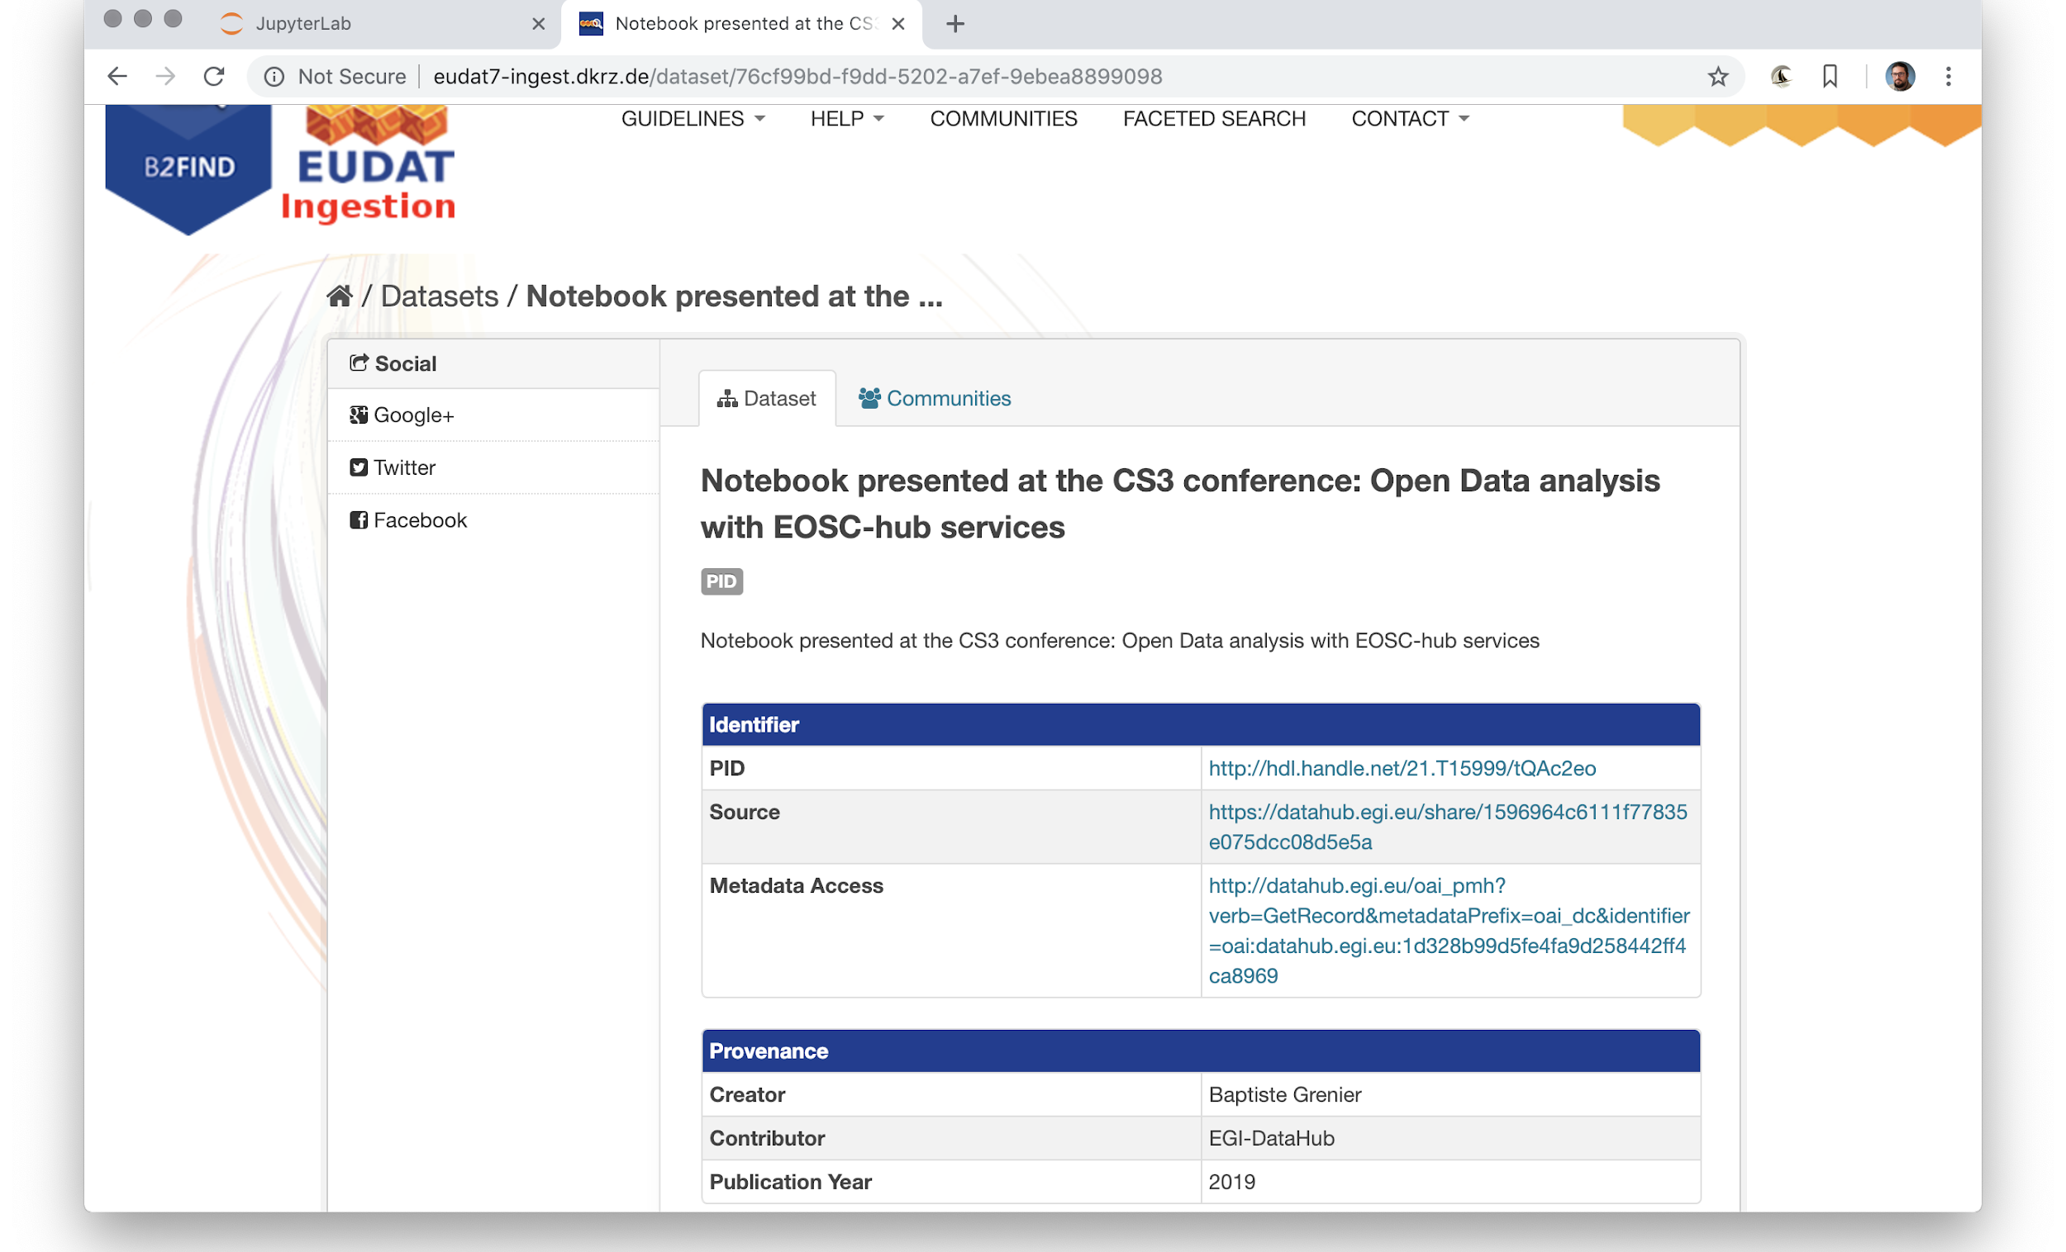
B2FIND: displaying an entry

Slide 29
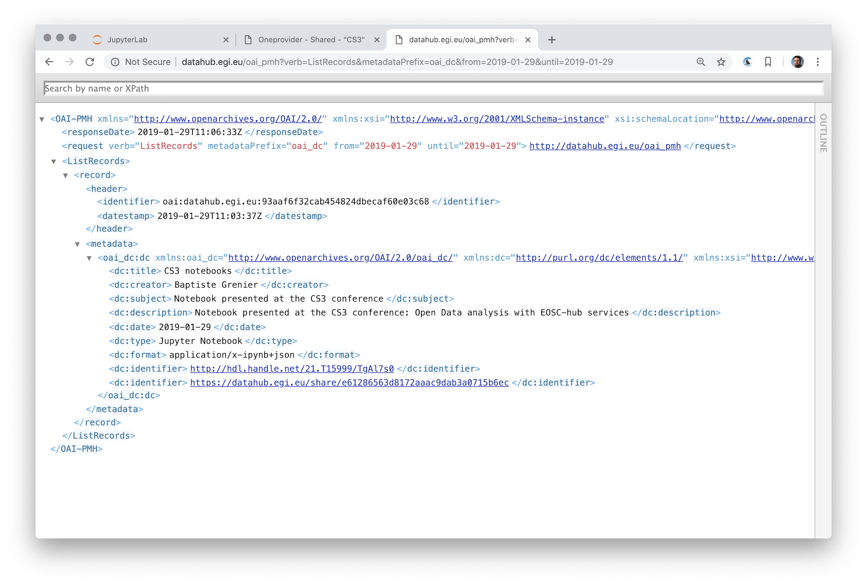
DataHub: Displaying OAI-PMH metadata

Slide 30
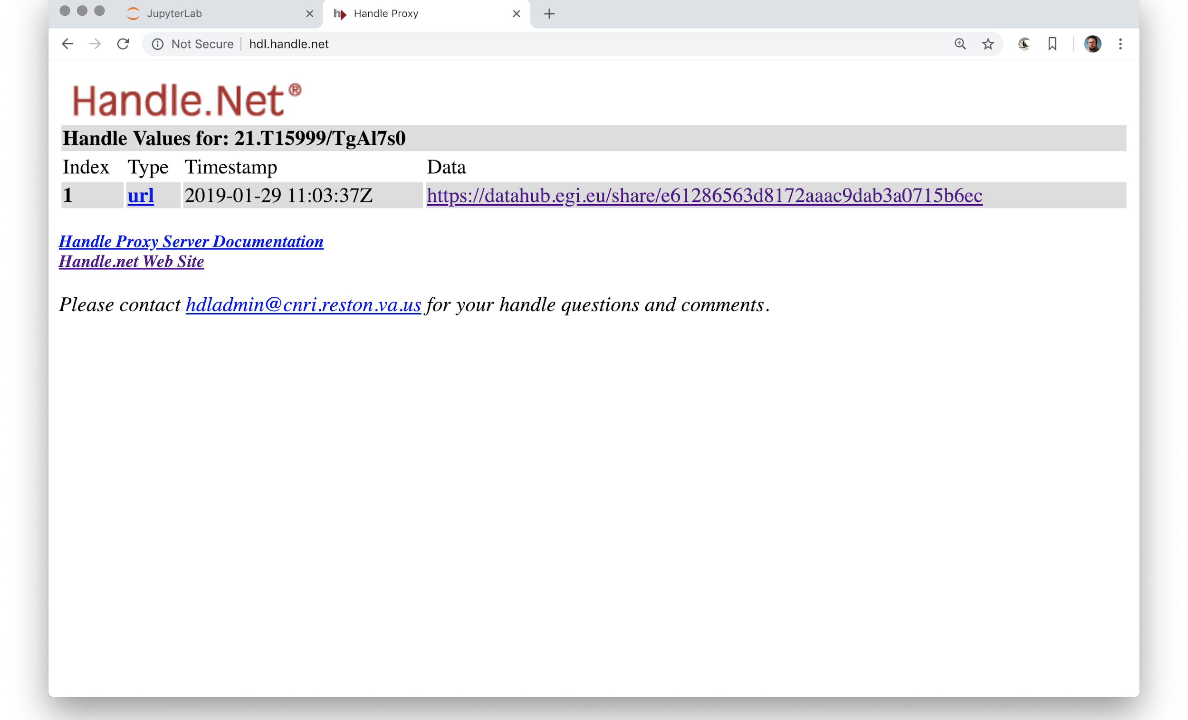
Handle.net: the PID in the registry

Slide 31
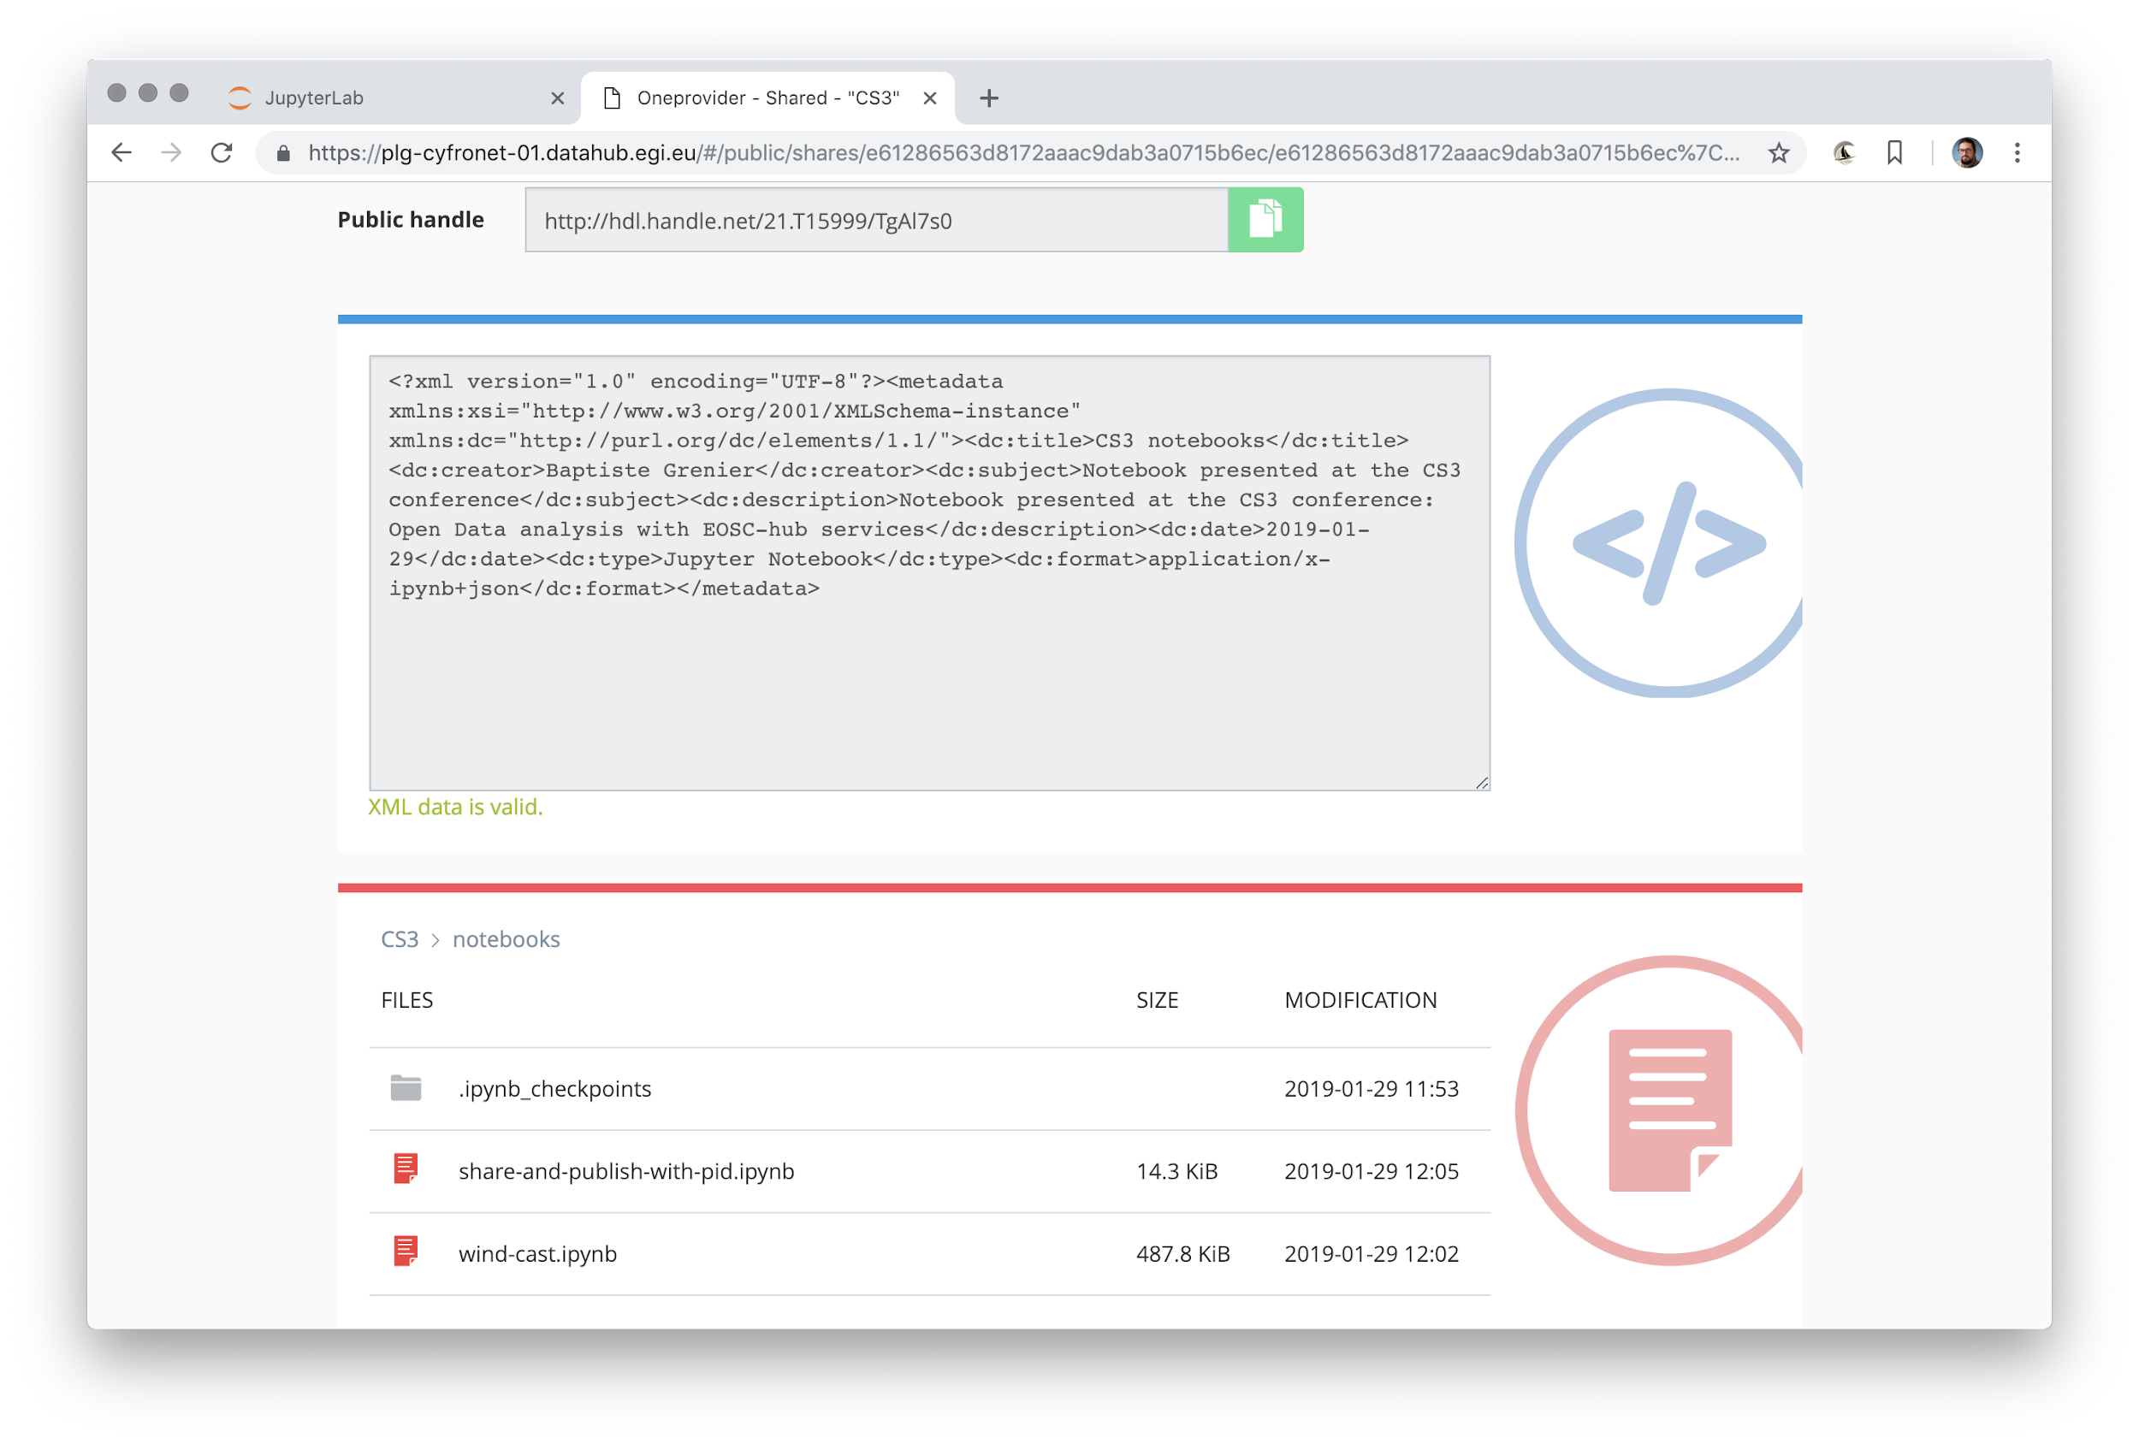
DataHub: the published dataset, from the PID

Slide 32
Links
Onedata
https://onedata.org
EGI DataHub
https://datahub.egi.eu - http://egi-datahub.readthedocs.io/
EGI Notebooks
https://www.egi.eu/services/notebooks/ - https://notebooks.egi.eu/
EGI Check-in
https://www.egi.eu/services/check-in/ - https://wiki.egi.eu/wiki/AAI
B2FIND
https://eudat.eu/services/b2find - http://eudat7-ingest.dkrz.de/
B2HANDLE
https://eudat.eu/services/b2handle - https://hdl.grnet.gr:8001/api/handles

