Slide 1
EGI-EUDAT Integration Activity Pair Data and High-throughput Computing Resource Together
Diego Scardaci, EGI.eu
Matthew Viljoen, EGI.eu
Dejan Vitlacil, KTH
Giuseppe Fiameni, CINECA
Yin Chen, EGI.eu

Slide 2
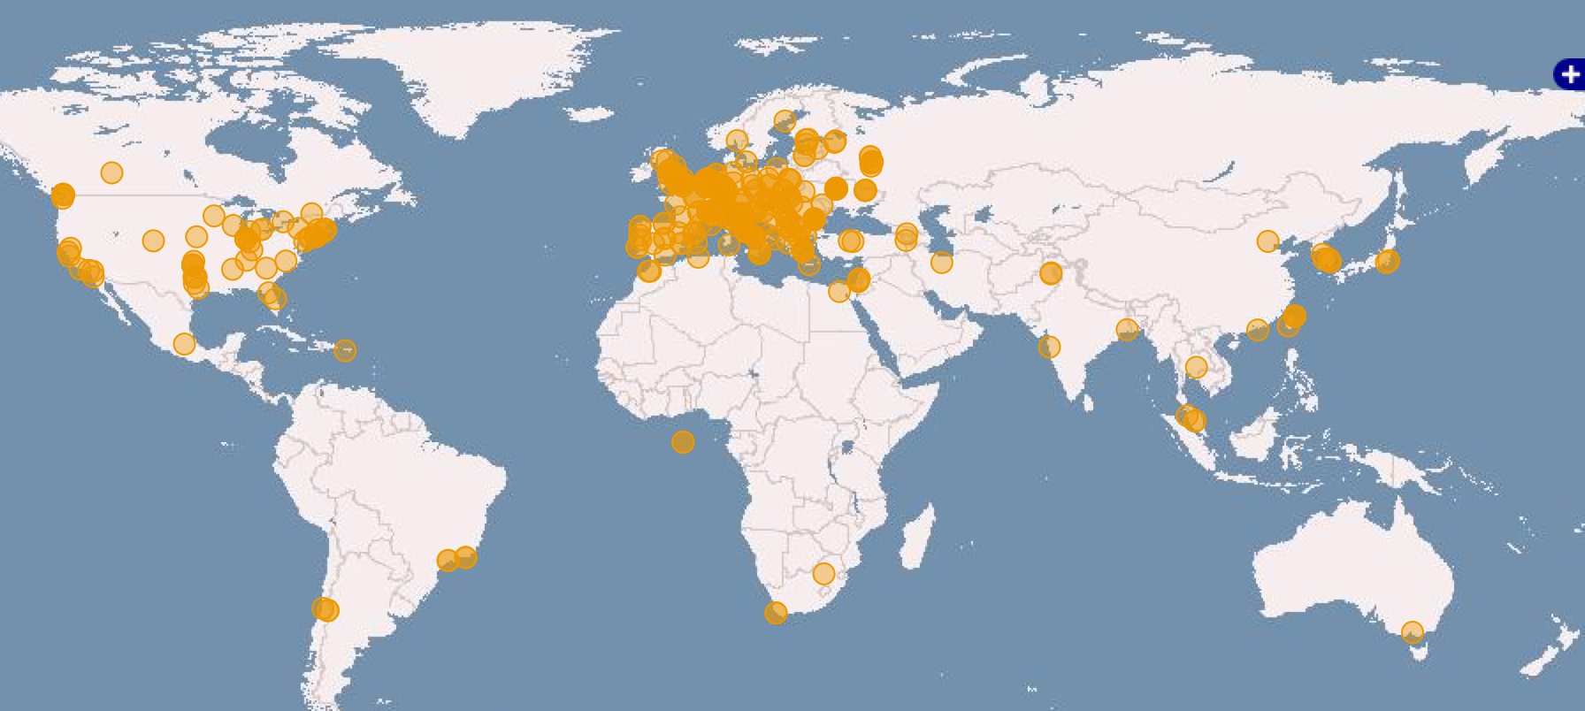
EGI federated infrastructure, QR1 2016
Russia
Ukraine
Canada
58 countries worldwide
EGI: 22 NGIs, CERN, EMBL-EBI
6 Integrated e-Infrastructures
USA
Asia
Pacific
650,000 CPU Cores
+23.6%
500 PB of storage
22 Cloud providers
325 resource providers
46,000 users
+21%
+3,000 research papers
> 780 in 2016
Latin America
Africa
Arabia

Slide 3
HTC installed capacity and consumption
Metric | Per year (hours) | Avg. Per day (hours)
Normalized CPU Time | 21 Billion | 56 Million
Number of jobs | 585 Million | 1.6 Million (+26.4%)
# Running projects/Virtual Organizations
233 (+9%)
# Estimated Users
41,000 (+21%)

Slide 4
Cloud Federation Model
Collaboration Platform
VM image catalogue, Helpdesk
EGI endorsed images
Community Platform
Community Platform
Cloud Realm
Cloud Realm
Cloud Realm
Cloud Realm
EGI Core Infrastructure Platform
AAI, Service Registry, Accounting, Monitoring, Federated Service Management
Cloud Realm
subset of cloud providers exposing homogeneous cloud management interfaces and capabilities which use the the services of the EGI Core Infrastructure Platform for creating a federation
Community Platforms
provide community-specific data, tools and applications and can be supported by one or more realms.

Slide 5
EGI Service Portfolio
Compute
Storage
Data
Security
Operations
Training
Design Phases
Cloud Compute
Data Transfer
Configuration Database
Discovery
Online Storage
Attribute Management
FitSM
Alpha
Cloud
ContainerCompute
Content Distribution
Service Monitoring
Beta
Archive Storage
Training Infrastructure
IdP Proxy
High Throughput
Compute
Federated Data Manager
Production
Helpdesk
Retired
Data Hub
Notes:
Each service can be in a different design phase defines as follows:
discovery: researching users needs, exploring technological or policy constraints;
alpha: prototype available for closed set of users;
beta: service being developed while available for testing publicly;
production: service available in the live environment meeting security/performance requirements;
retired: the service is not anymore offered

Slide 6
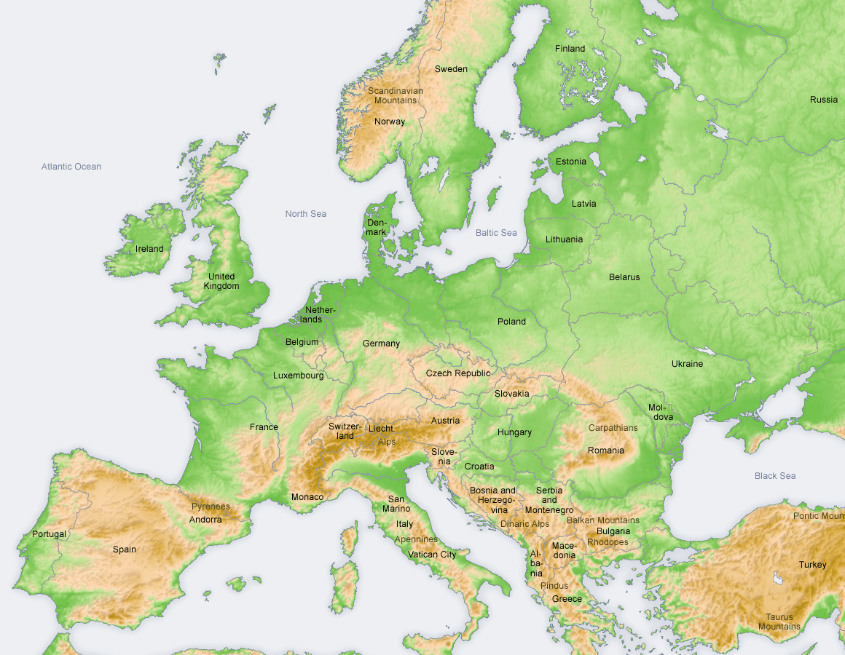
EUDAT is ...
a pan-European initiative building a sustainable cross-disciplinary and cross-national data infrastructure providing a set of shared services for accessing and preserving research data
supporting multiple research communities by working closely with them to deliver technical services as part of the EUDAT Collaborative Data Infrastructure (CDI)
consortium of high performance computing (HPC) / data centres, libraries, scientific communities, data scientists

Slide 7
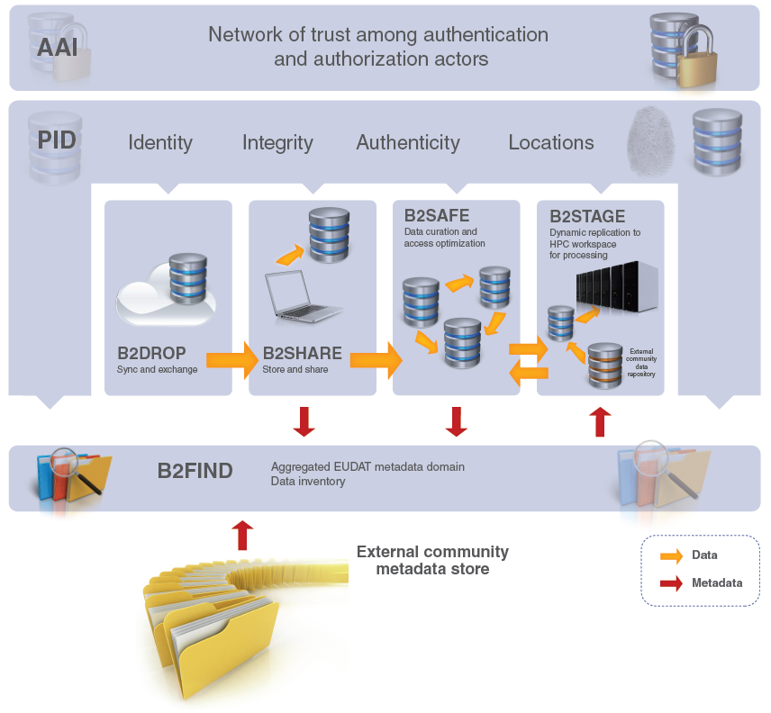
EUDAT B2 Service Suite
B2ACCESS
B2Handle

Slide 8
Motivations
Federated services on EGI + common data services of EUDAT brings together:
Computation on EGI Federated Cloud + HTC
Existing EUDAT services for:
transfer, synching, sharing, preservation of data
Augmentation of services from existing communities using EGI/EUDAT

Slide 9
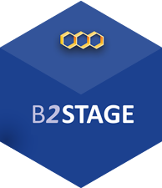
EGI-EUDAT Integration Pilot: Processing in EGI, Long-term storage in EUDAT
Access to EGI and EUDAT services with a single user identity
Data Staging between EGI Federated Cloud and EUDAT services
5. Run analysis
1. Run analysys
4. Retrieve Data
2. Stage output data in B2STAGE
VM
3. Data stored in B2SAFE for Long Term preservation
EGI Federated Cloud
EUDAT services

Slide 14
Next steps
Communities identified for the next steps:
ICOS
EPOS
Now implementing prototypes of their usecases
Challenges
Scaling up from PoC to multiple users (AAI interoperation)
Managing co-existing support systems
Lever future Fedcloud usability improvements

Slide 15
Thank you for your attention
Questions?

