Slide 1
Valorising scientific data with the EGI e-infrastructure
Gergely Sipos
Head of Services, Solutions, Support
EGI Foundation
18 October 2024
Seoul National University

Slide 2
Outline
EGI - Advanced computing for science
EGI contributions to Open Science (via EOSC)
GreenDIGIT - Swarmcastrate
Collaboration with KISTI in Korea

Slide 3
The EGI Federation is an international e-infrastructure
We provide advanced computing and data analytics services for research and innovation
2010 (used to be called European Grid Infrastructure)
From the Large Hadron Collider compute grid…
2024 (Now called simply “EGI”)
….to a multidisciplinary, multi-technology infrastructure

Slide 4
Vision
All researchers have seamless access to services, resources and expertise to collaborate and conduct world-class research and innovation
Why a federation?
Support science at international scale
Build an hyperscale facility for research
Invest nationally, access globally
Bring computing to the data
Mission of the EGI Federation
Deliver open solutions for advanced computing and data analytics in research and innovation
Mission of the EGI Foundation
Enable the EGI Federation to serve international research and innovation together

Slide 5
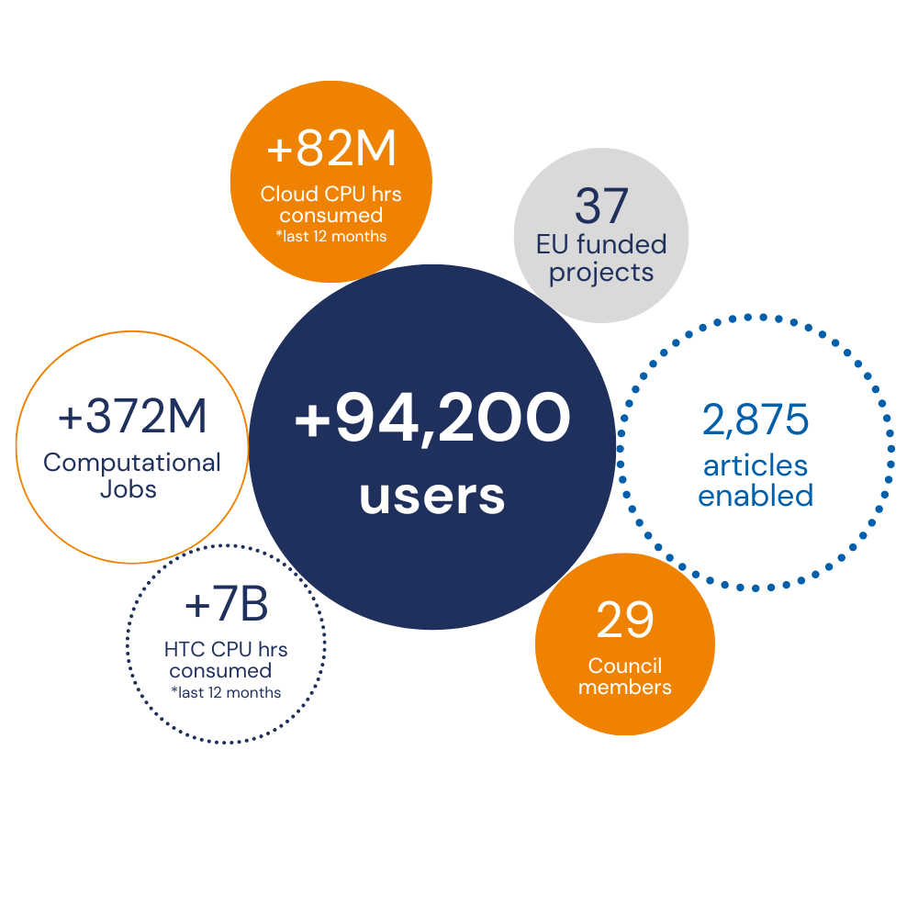
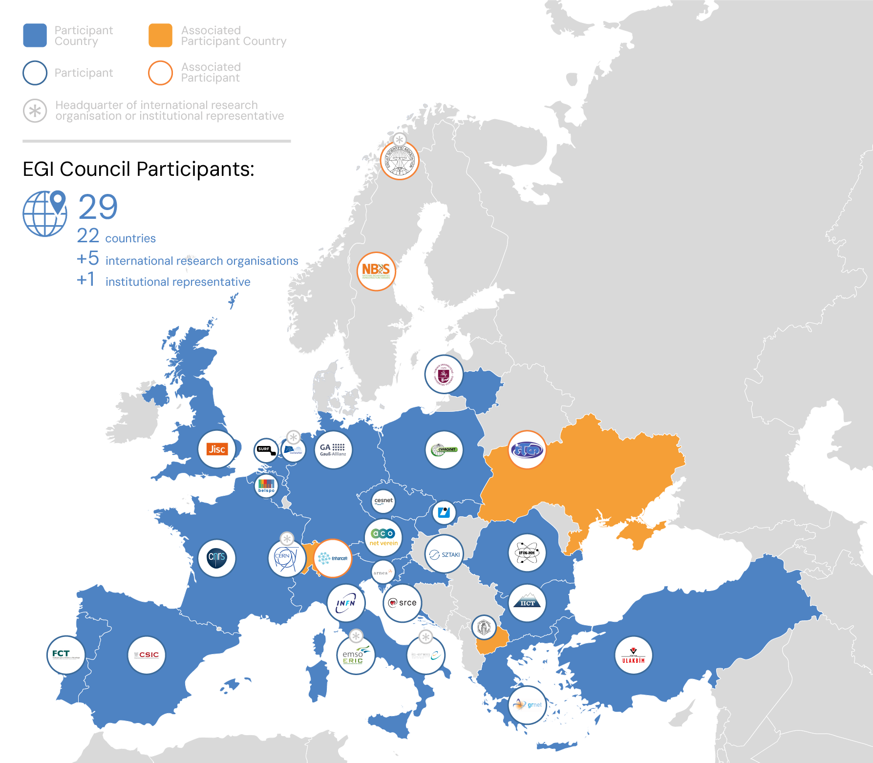
EGI in a Nutshell
Coordinated by the EGI Foundation, a membership organisation
www.egi.eu
EGI Federation
A European flagship digital infrastructure for data-intensive scientific computing
Year 2023 in EGI numbers
Why a federation?
Support at international scale
Build an hyperscale facility
Invest nationally, access globally
Data to compute, Compute to data

Slide 6
EGI services
Services for Research
Services for Federation
Services for Business
Our large-scale computing and data analytics services are helping scientists to accelerate their research.
Our internal services provide tools for coordination of the EGI Federation, improving how we work together.
We help companies to exploit and provide services and resources for compute- and data-intensive research and innovation.
https://www.egi.eu/services/research
Notes:
3 target user groups supported by EGI

Slide 7
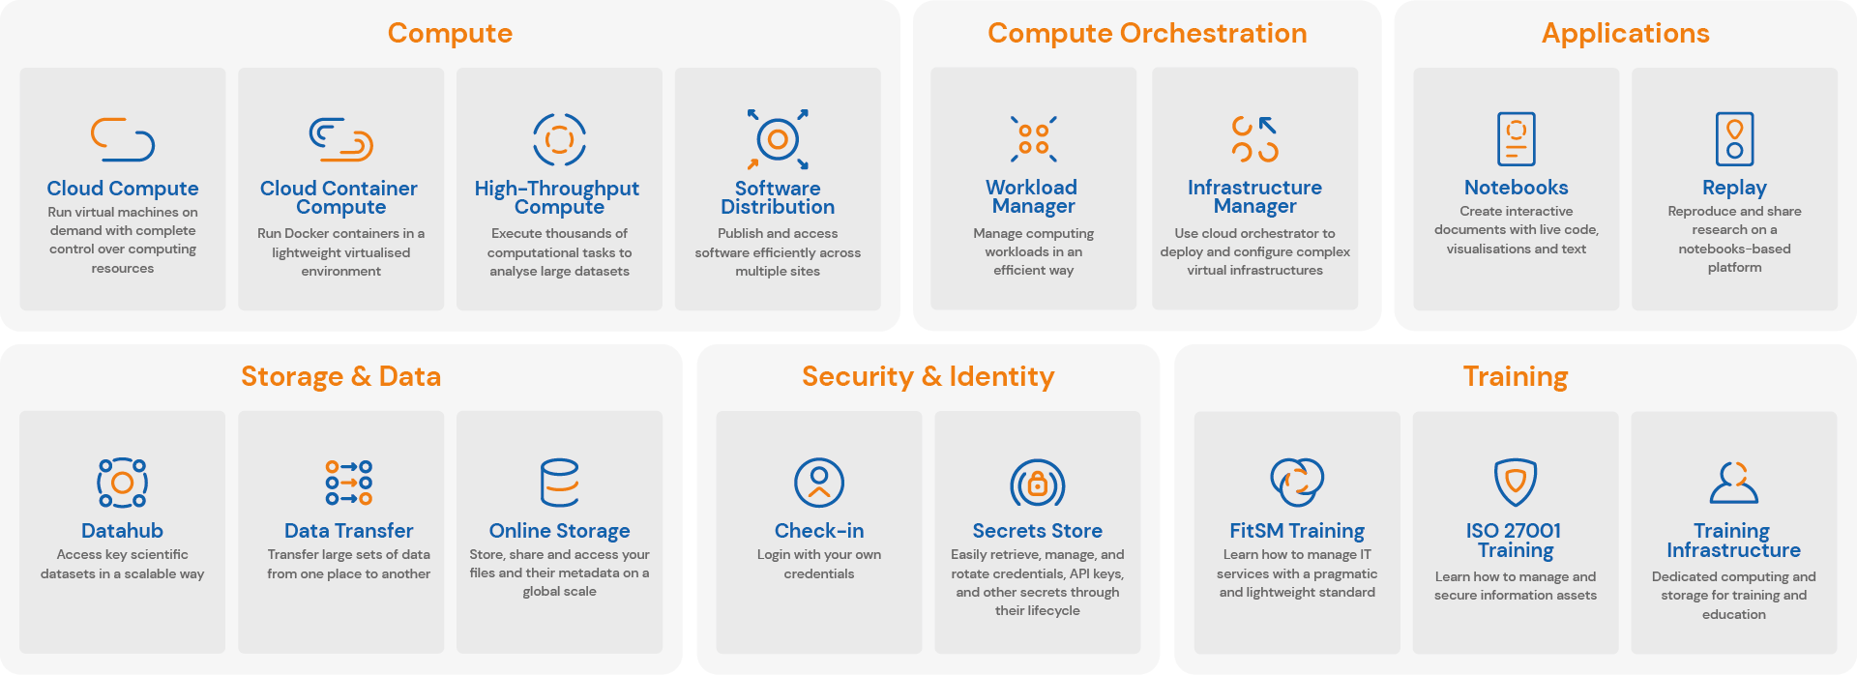
EGI Services for Research
https://www.egi.eu/services/research/
User documentation: https://docs.egi.eu

Slide 8
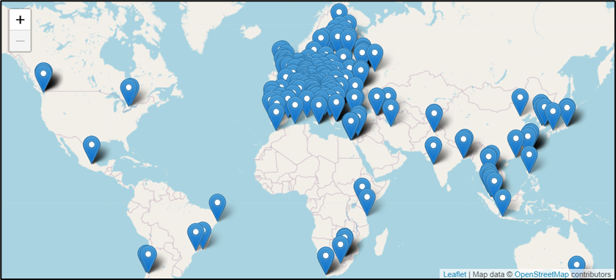
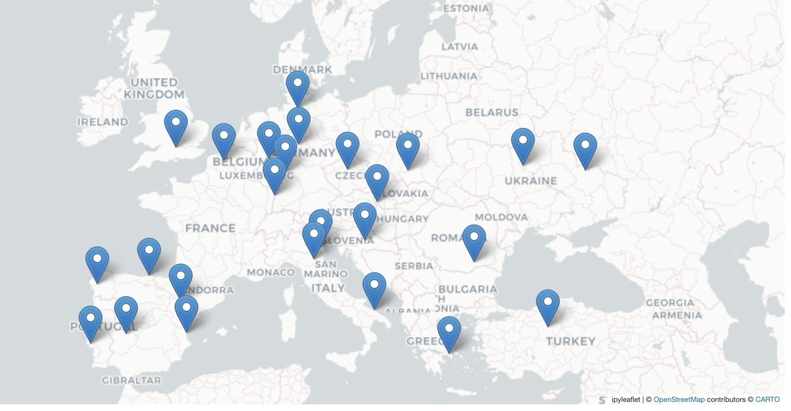
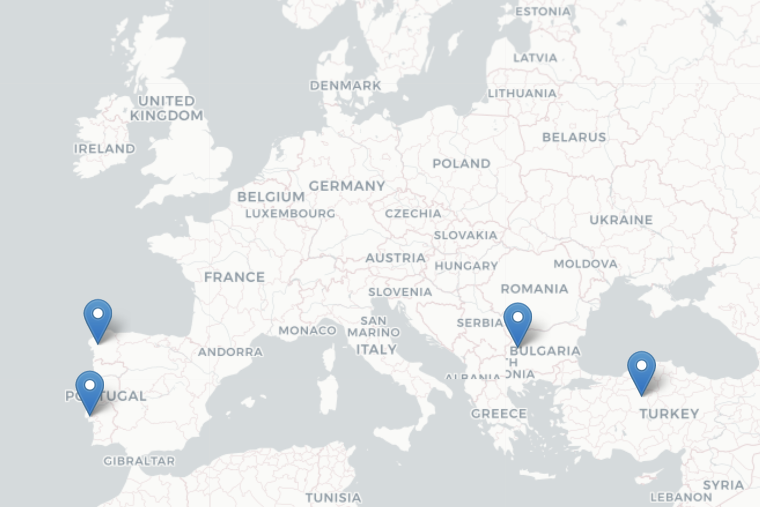
From infrastructure complexity to compute continuum
High Throughput Compute
How to join instructions: https://docs.egi.eu/providers/
How to use instructions: http://docs.egi.eu/users
Benefiting providers
Integrated management capabilities (ISO20k, ISO27k)
Helpdesk, Availability-reliability monitoring, Single Sign-on, Security oversight, etc.
Cloud compute
Since 2015
Benefiting users
High Performance Compute
Harmonised behaviour and access
GUI, API, Command line; Workload and data management, Container, IP addresses, etc.
NEW
HPC federation Working Group: https://confluence.egi.eu/display/EGIBG/Working+Group%3A+HPC+federation

Slide 9
Resource/service allocation in EGI
Projects bootstrap delivery and application/data integration
Sustainability comes from institutional commitments
Type, number, size, cost, availability, etc.
Negotiator
Applic. provider
Instance requirements
Conditions
Storage provider
Cloud provider
HTC provider
Foundation
Community representative
Service Level Agreement
Operation Level Agreement
Training
Support
Federation members
Ensure satisfaction, capture achievements,
record feedback
Ensuring that agreed targets are met
Regular satisfaction interviews
Regular service delivery reports

Slide 10
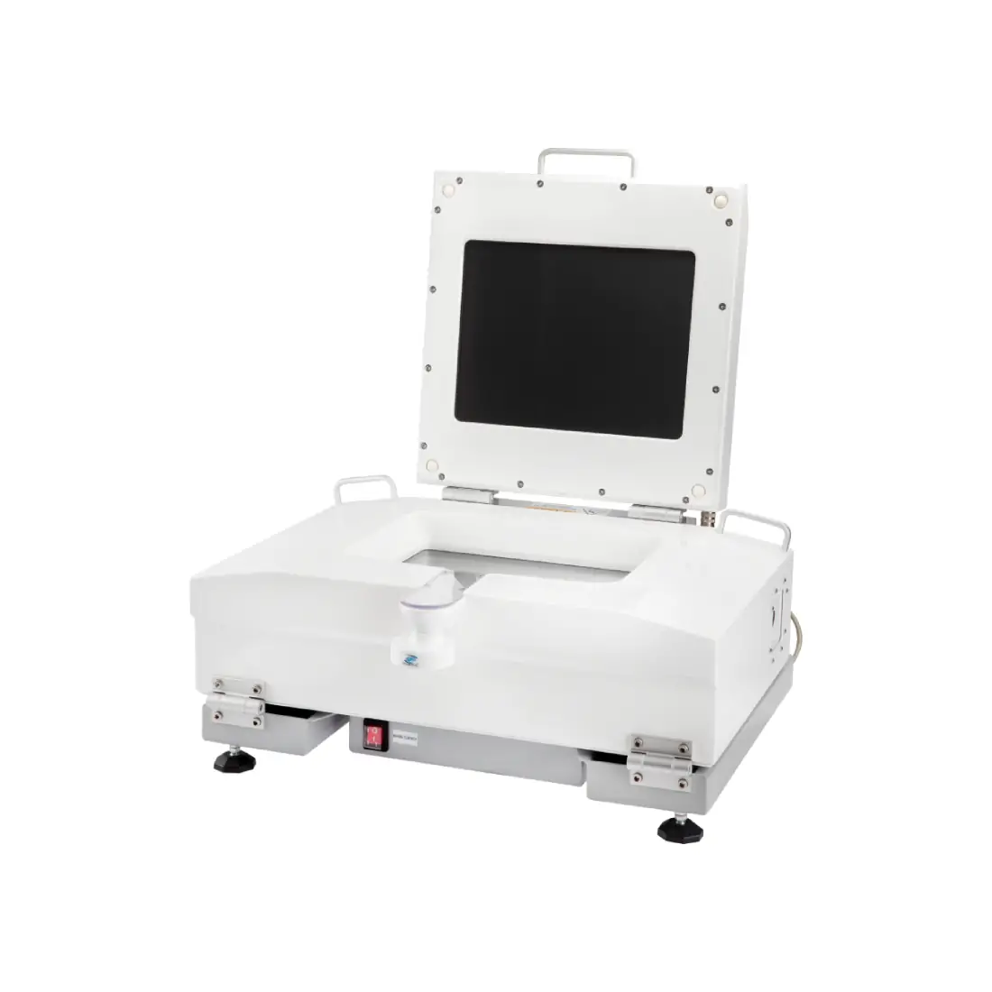
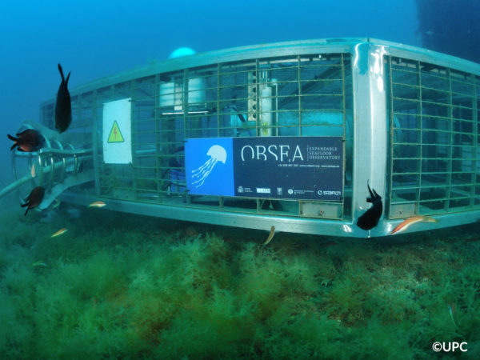
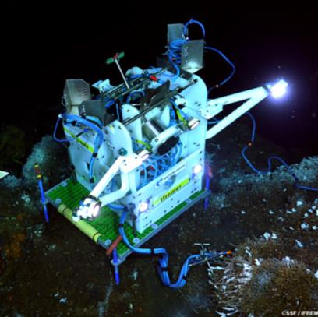
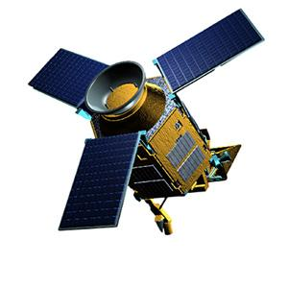
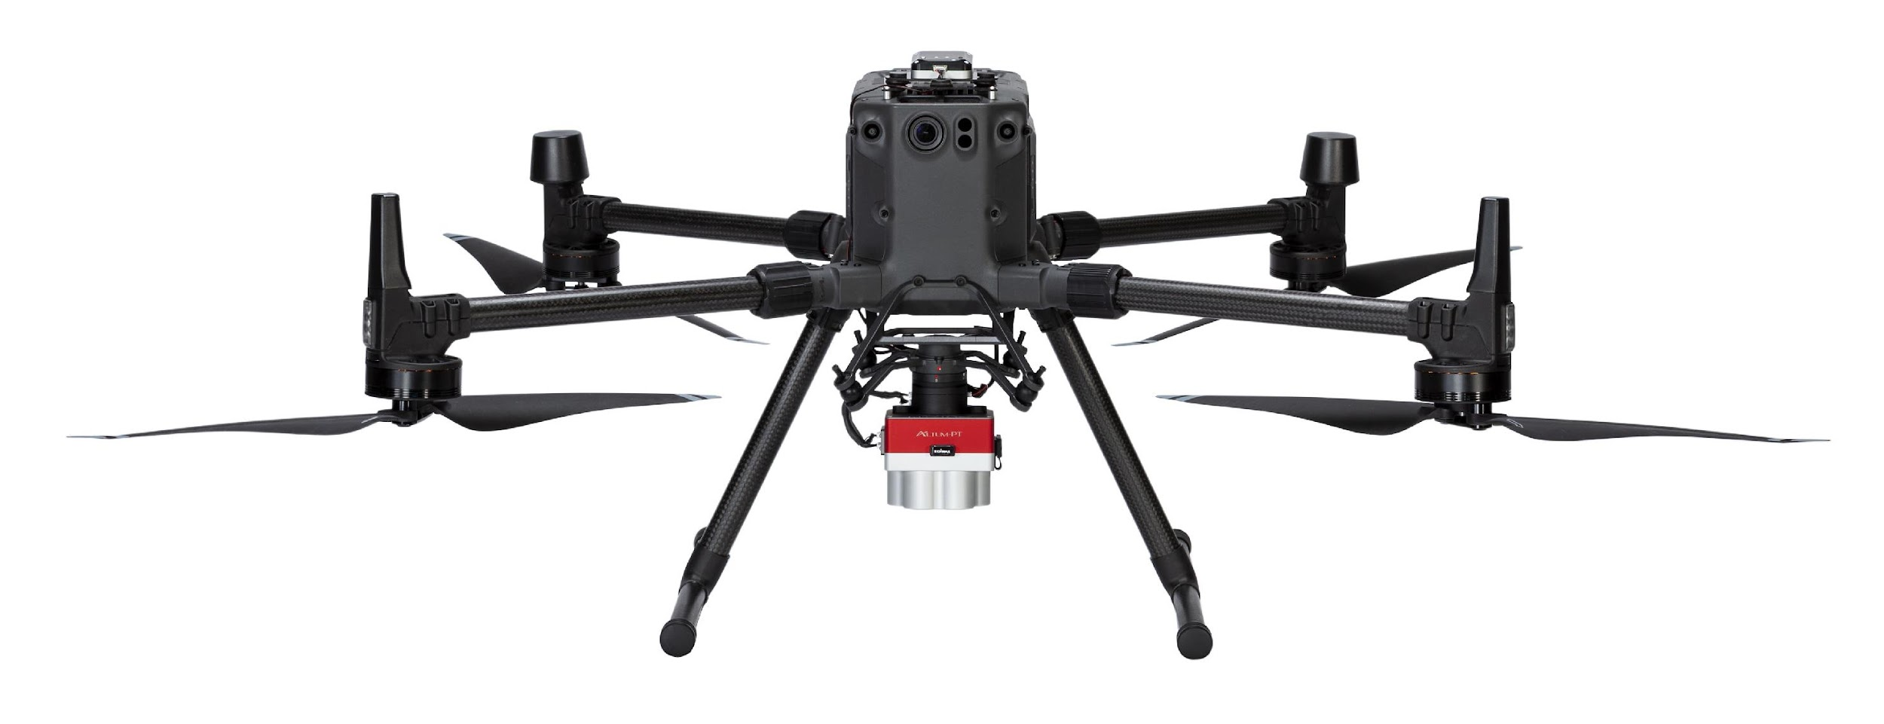
Project example: iMagine (2022-2025)
Challenge: Image data tsunami in aquatic sciences
In Europe, we spent circa 1.4 Billion Euro a year in marine data acquisition (in-situ and remote sensing data)
AI/ML
From DATA to KNOWLEDGE
Underwater cameras
Microscopes
CCTV cameras
Seafloor observatories
Satellites
Drones
VALORISATION
Fish monitoring and classification
Marine litter detection
Oil spill prediction, …
. . .
ACQUISITION
MANAGEMENT
Notes:
Marine environmental management and implementing ocean restoration initiatives require more knowledge and understanding. The implementation requires an increase of our overall knowledge, demanding more science and improved access to observation data and analytical processing. This builds upon national environmental observation and monitoring networks and programs, complemented with EU initiatives such as the Copernicus programme (CMEMS) and EMODnet, and European Research Infrastructures (RIs). Great additional potential in collecting and processing image data using high-performance image analysis tools, including Artificial Intelligence (AI) techniques, and in more sharing of image repositories.

Slide 11
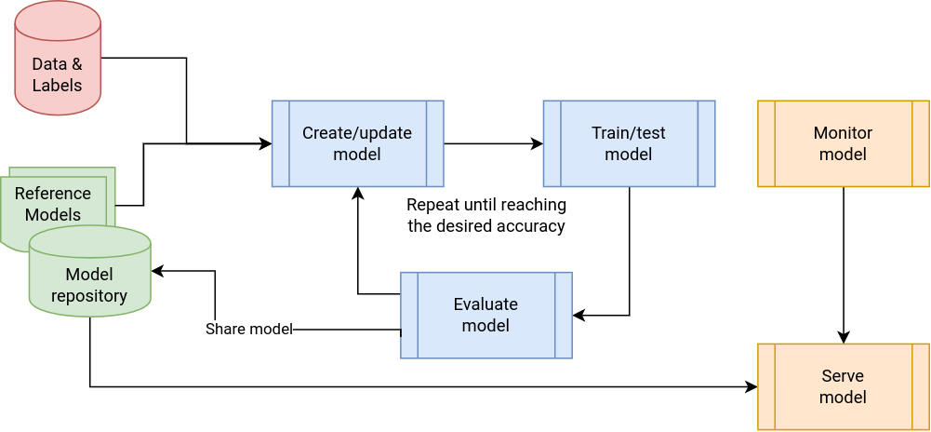
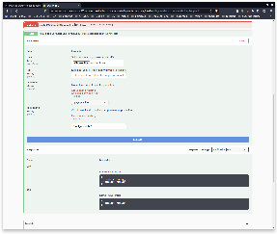
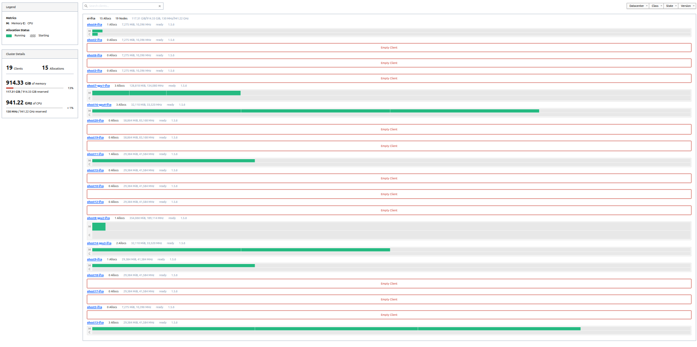
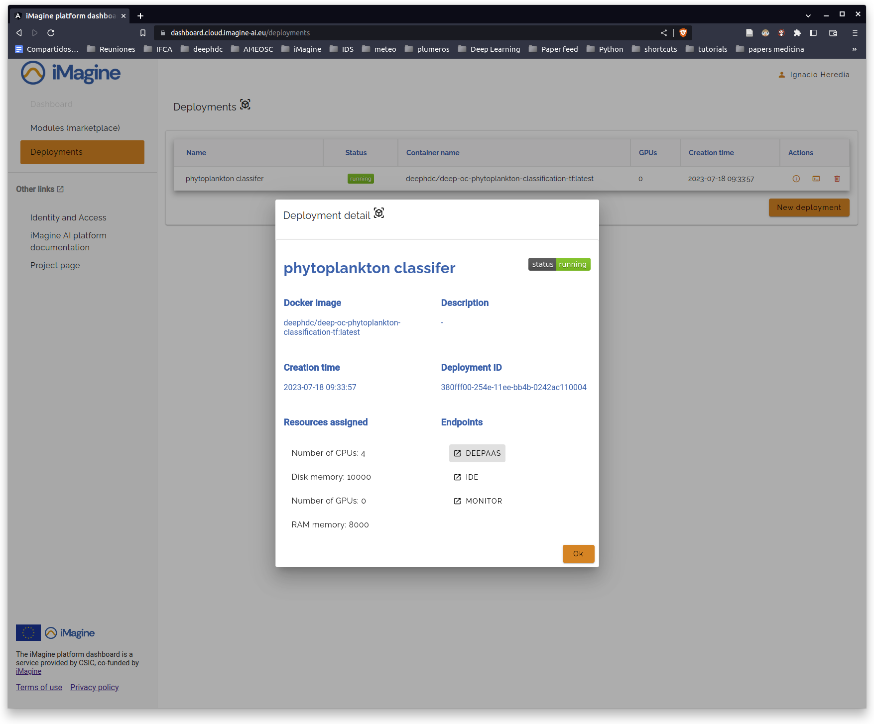
The iMagine Approach
AI/ML Model development, training and delivery
Thematic Services
Competence Centre
CPU intensive
GPU intensive
8 internal use cases &
3 external use cases
Benefitting 10+ Research Infrastructures and linking to
Thematic Services
iMagine AI Platform
Generic, scalable platform for developing and sharing AI/ML applications.
Platform Service
EGI Federated Cloud + Infrastructure Manager + Check-in
Infrastructure
1500 TB-months
132,000 GPU-hours
6,000,000 CPU-hours
OpenStack clouds with GPUs, CPUs, Storage in Spain, Portugal, Turkey & Ireland.

Slide 12
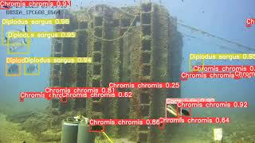

Slide 13
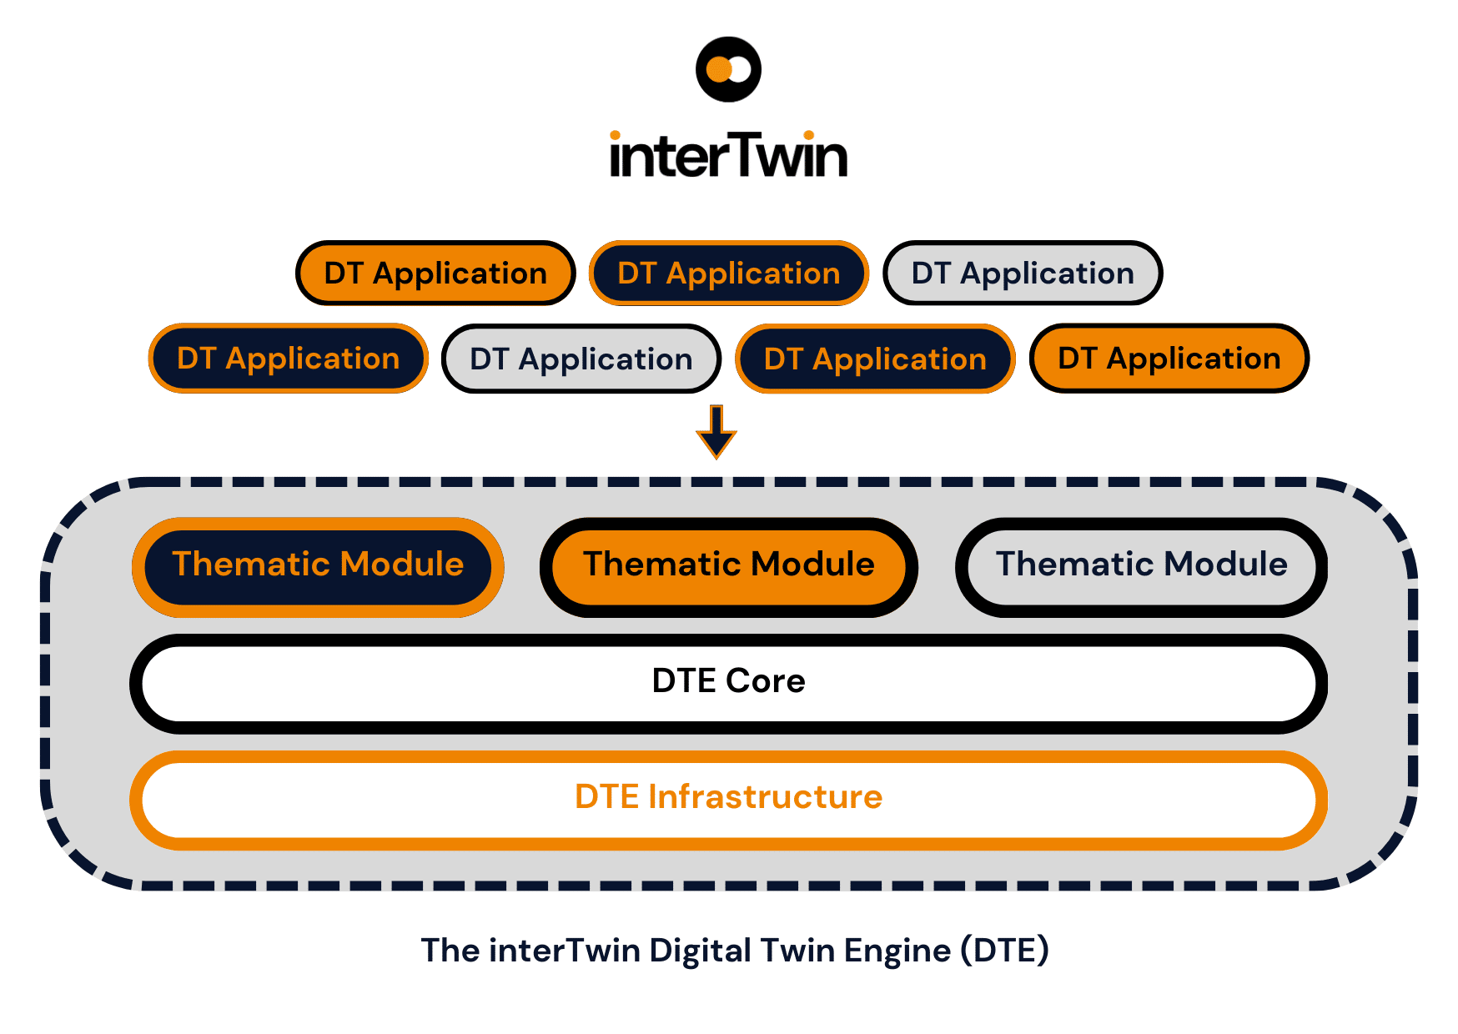
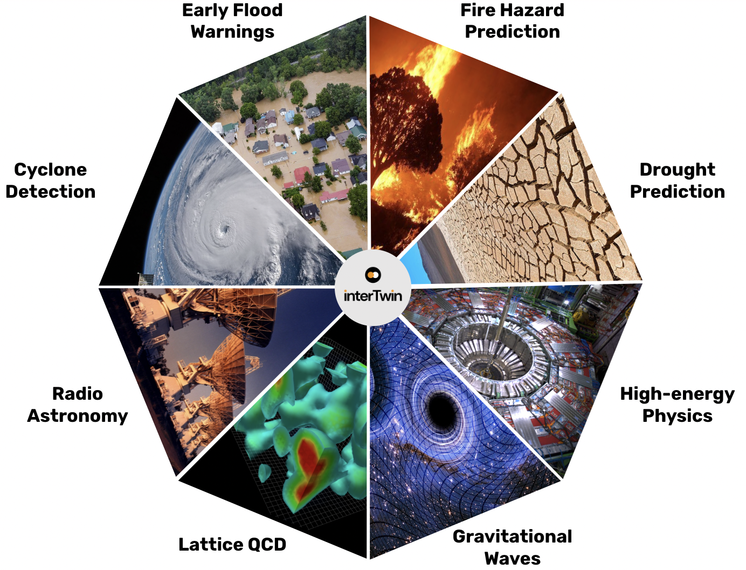
Project example: InterTwin (2022-2025)
interTwin develops a Digital Twin Engine to support the development of Digital Twins for various science domains
WildFire Hazard Map Generation CMCC, CNRS, Univ. of Trento
Early warning for Extreme events Deltares, EURAC, TU Wien
Extreme events impacts CERFACS,
EURAC, Deltares
Tropical Cyclone Detection CMCC, CNRS, Univ. of Trento
‹#›
Workflow Composition
Radio Astronomy Max Planck Society
High Energy Physics CERN, CNRS
EGI Compute, Check-in, Data & Storage services
Lattice QCD CSIC, CNRS, ETHZ
Gravitational Wave - Astrophysics INFN

Slide 14
EGI for EOSC
(EOSC = European Open Science Cloud)

Slide 15
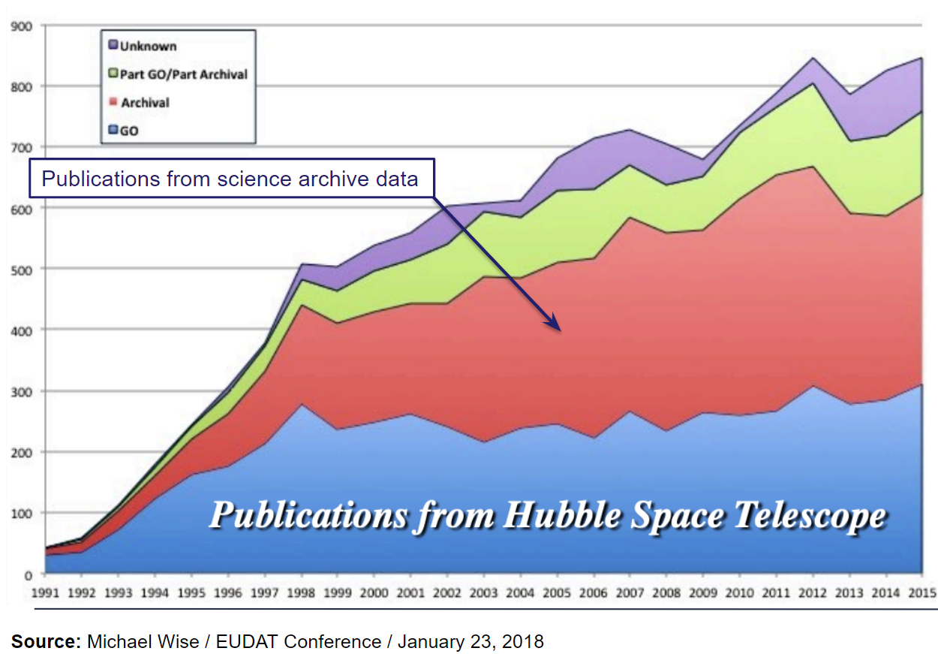
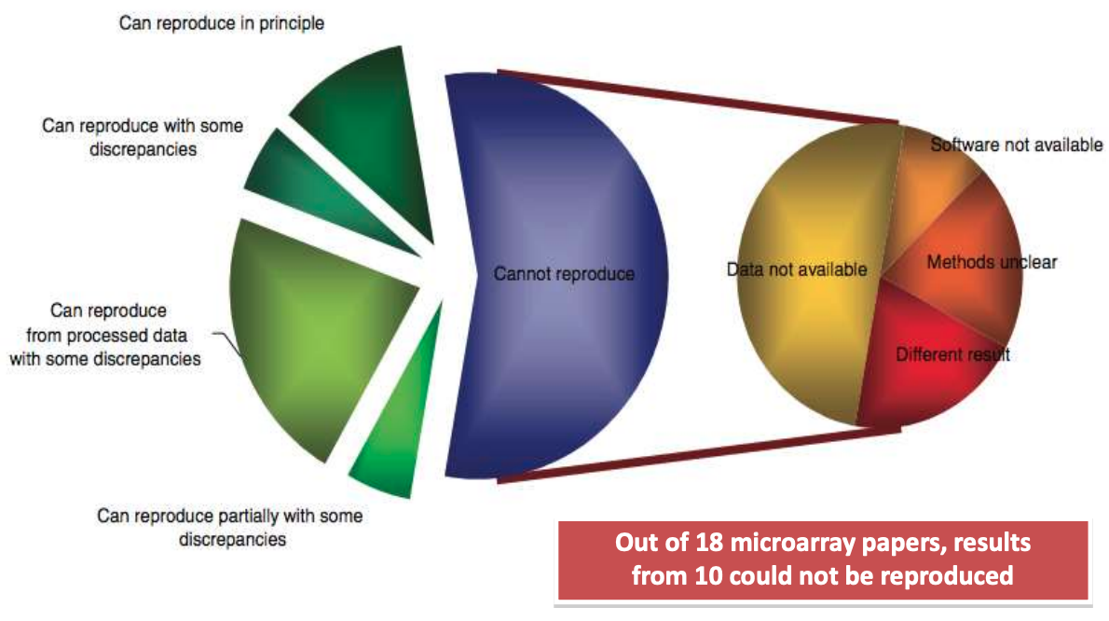
(Some) motivations of open science: increased scientific output, value, transparency, trust
Source: Ioannidis et al., 2009. Repeatability of published microarray gene expression analyses. Nature Genetics 41: 14
See also: Science publishing: The trouble with retractions http://www.nature.com/news/2011/111005/full/478026a.html Bjorn Brembs: Open Access and the looming crisis in science https://theconversation.com/open-access-and-the-looming-crisis-in-science-14950

Slide 16
Since 2018
European Open Science Cloud
Vision: A multi-disciplinary environment where researchers can publish, find and re-use data, tools and services, enabling them to better conduct their work.
Builds on existing infrastructures and services supported by the European Commission, Member States and research communities.
Brings these together in a federated ‘system of systems’
Complemented by: policies, requirements (e.g. Data Management Plans), education, data stewards, incentives
Together making “Open science as the new norm”

Slide 17
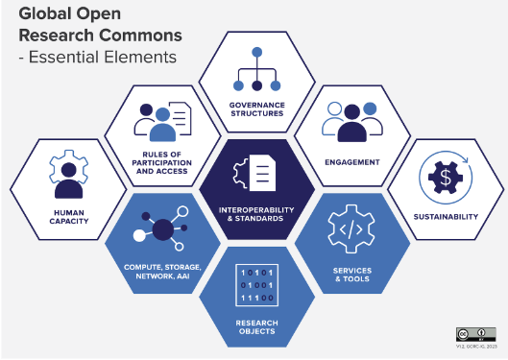
EGI’s look at EOSC: The European Open Research Commons
EOSC Beyond project from Mar 2024
EGI position paper: https://zenodo.org/records/11128540
Collaboration is the hallmark of modern science
The Open Science Commons embodies this vision
The Global Open Research Commons International Model Report, Version 1; Payne,K., Corrie,B., Crawley,F., Harrower,N., Macneil,R., Maxwell,L., Sansone,S.-A., Treloar,A., Woodford, C., Åkerström, W.N.
EOSC Data Commons new project from April 2025

Slide 18
A joint project of multiple EOSC stakeholders
(Started in 2024, coordinated by EGI)
Node-based technical architecture
EOSC Federation Technical Architecture taking into account the introduction of the concept of Node
03
New EOSC Core Services
Next generation of Core Services for the next release of the EOSC EU Node and as reference implementation for other nodes
01
02
Sandbox and integration suite
Testing, validation and integration of EOSC nodes with data spaces

Slide 19
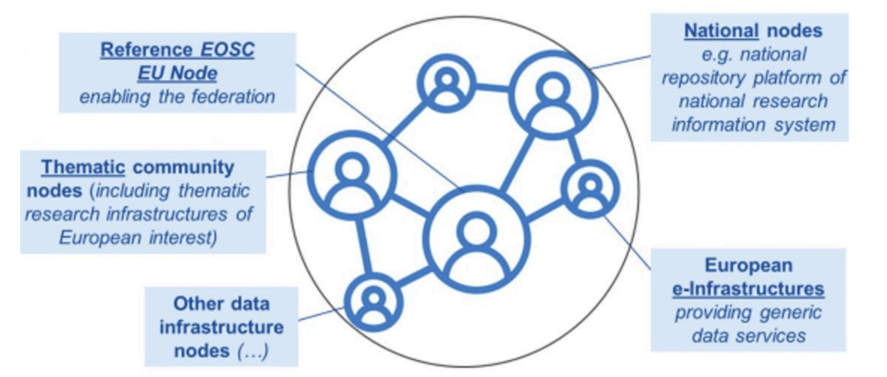
EGI contributions to EOSC
Rules and requirements for all other EOSC Nodes are under development
EGI as federator (Service Management System, …)
LAUNCH AT THE EOSC SYMPOSIUM (21-23 October)
EGI as contributor to user-facing services
(Jupyter Notebooks)
To develop tools for inter-node connections
EOSC as a federation of ‘Nodes’
EGI’s ambition is to contribute as a node
Scalable compute-storage
Generic platforms
Thematic data and services
Ability to take over federation functions

Slide 20
EGI towards Green Computing
The GreenDIGIT project

Slide 21
Factsheet
Objective: Develop solutions to lower the environmental impact of digital Research Infrastructures
March 2024 – February 2027
HORIZON-INFRA-2023-TECH-01-01 - New technologies and solutions for reducing the environmental and climate footprint of RIs
4 Infrastructures in the consortium: EGI, SLICES, SoBigData, EBRAINS
Coordinator: University of Amsterdam (Yuri Demchenko, SLICES)
Technical coordinator: EGI Foundation (Gergely Sipos, EGI)
EC funding: 5,000,000 EUR, 15 partners
All projects funded in the same European Commission call:
→ Accelerators: CNRS, CERN, DESY, ESS, INFN, …
→ Beam sources: ESS, ELI, EMFL
→ Digital services
→ Accelerators: KIT, CERN, DESY, …

Slide 22
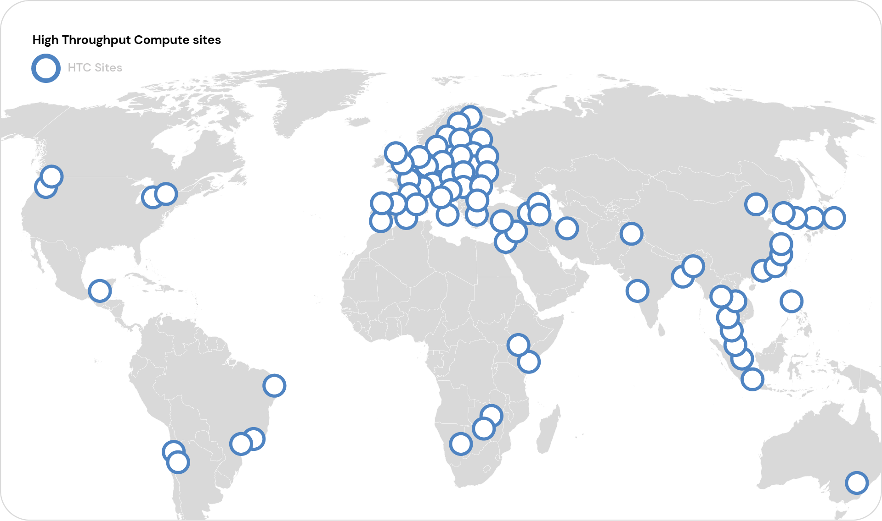
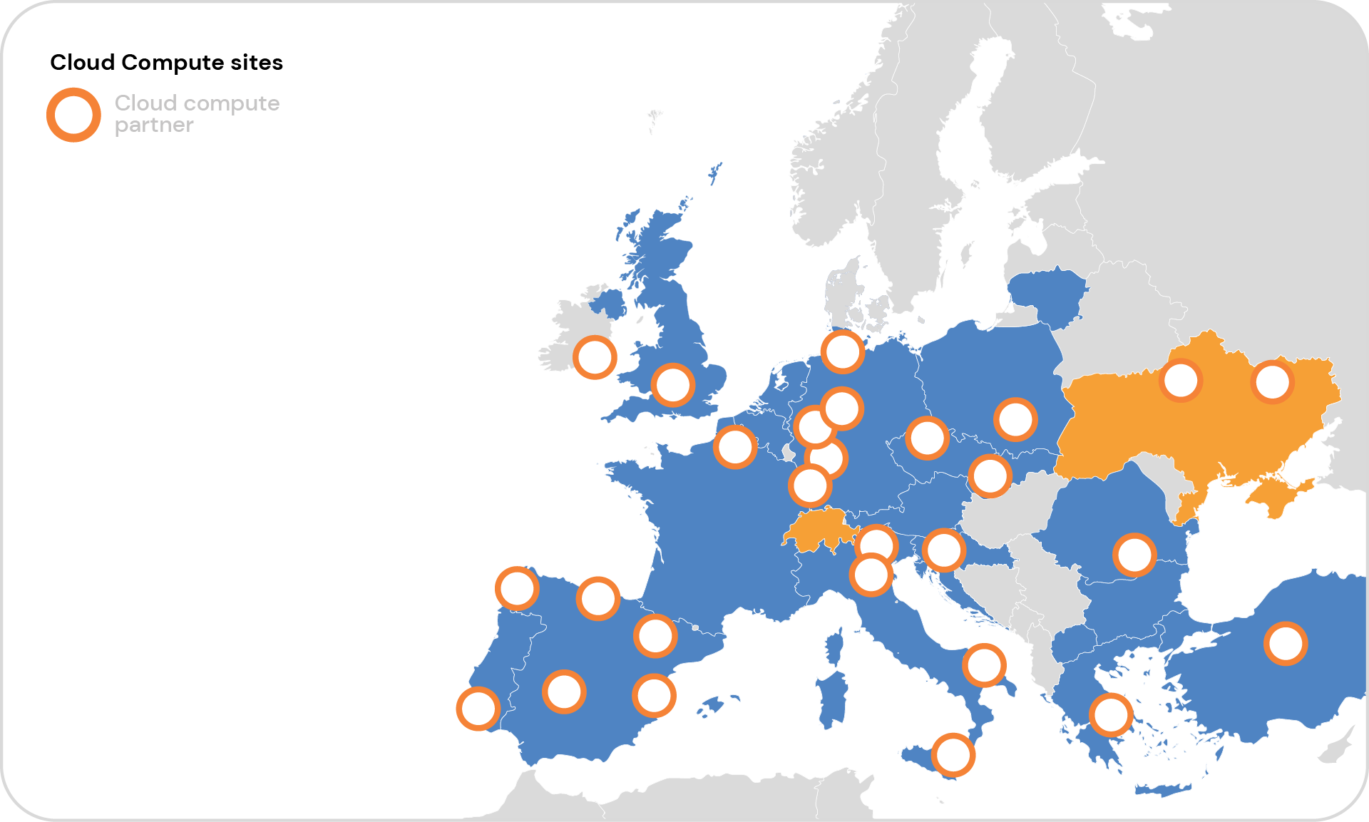
GreenDIGIT - EGI activities
Smart electric grid scheduling solutions (CESNET, CSIC)
High Throughput Compute
PROVIDERS:
Lower env. impact undegraded service quality (sites)
T6.5 (Power-grid)
Good practices
Improvement opportunities (EGI)
T3.1 Landscape survey (Mar-Oct ‘24)
T8.2 (Self-assessment)
T9.1 (Roadmap)
2. Cloud & container compute
T7.1 (Validate)
Connection with Swarmcastrate
Report environmental impact metrics
From 2025
USERS: Lower env. impact, undegraded scientific impact (VO communities)
“Environmental impact aware” workload management (CNRS, CSIC, SZTAKI)
T6.3 (Spec.)
T7.1 (Impl.)
T4.4 (Spec.)
T6.1 (Impl.)
T7.4 (Validate)
3. High Performance Compute

Slide 23
Collaboration with KISTI
Bilateral project March-September 2024

Slide 24
Project scope
In response to this global trend, the Korea Institute of Science and Technology Information (KISTI), under the Ministry of Science and ICT in Korea, is currently undertaking the construction of the Korean Research Data Commons (KRDC) to facilitate the integration of various domestic or institutional research data commons systems. Specifically, starting from 2022, KISTI has been designing and developing the KRDC Framework to implement KRDC and concurrently building strategies for collaboration with advanced global systems such as the European Open Science Cloud (EOSC), with the aim of establishing a global interconnection framework in the future.
To facilitate the aforementioned objectives, EGI, which plays a pivotal role in the EOSC initiative, and KISTI conducted an international collaborative research to establish a methodology for connectivity between EOSC and KRDC, thereby ensuring seamless interoperability and collaboration.

Slide 25
Achievements
Status and technology analysis of EOSC from the KRDC perspective
Compatibility study between the services and protocols of EGI and KRDC
EGI - KRDC interoperability scenarios; Advantage-risk analysis; Demonstrator
Financial and operational considerations for an EOSC-like system in Korea
User-centric assessment of the KRDC system
Possibilities for future KISTI - EGI collaboration

Slide 26
Achievement 3:
EGI - KRDC interoperability demonstrator
Discover
Download
Analyse
(Entry to scientific datasets)
EGI
KRDC
2. Download
3. Analyse

Slide 27
Thank you!
gergely.sipos@egi.eu
contact@egi.eu

