Slide 1
EGI Federated Cloud and Chipster Platform for Bioinformatics Studies
Dr Yin Chen (EGI Foundation), yin.chen@egi.eu
Dr Fotis Psomopoulos (AUTH), fpsom@issel.ee.auth.gr
Remote Experts
Kimmo Mattila (CSC), kimmo.mattila@csc.fi
Giuseppe La Rocca (EGI Foundation), Giuseppe.larocca@egi.eu
Workshop on Grid & Cloud for bioinformatics studies, 15th Dec 2016, CERTH-INAB

Slide 2
Training goals
Learn the concept of cloud computing
Learn the conceptual model of the EGI federated cloud
Obtain skills in using the standard interfaces of the EGI federated cloud
Learn how to deploy bioinformatic applications (Chipster) in the EGI federated cloud
Learn how to become an active user
Workshop on Grid & Cloud for bioinformatics studies, 15th Dec 2016, CERTH-INAB

Slide 3
Outline
Introduction to EGI, & EGI Federated Cloud (25’)
Introduction and access to training infrastructure (20’)
BREAK (15’)
Exercise 1&2 (60’)
Compute management – Setup a Jupyter Notebook
Persistent storage – Add block storage to the Jupyter Notebook
Introduction to contextualisation (5’)
Exercise 3 (60’): Run Chipster in the EGI Federated Cloud
Next steps to become users (10’)
Feedback forms (5’)
Workshop on Grid & Cloud for bioinformatics studies, 15th Dec 2016, CERTH-INAB
Notes:
TODOs:

Slide 4
Introduction to EGI & EGI Federated Cloud
Workshop on Grid & Cloud for bioinformatics studies, 15th Dec 2016, CERTH-INAB

Slide 5
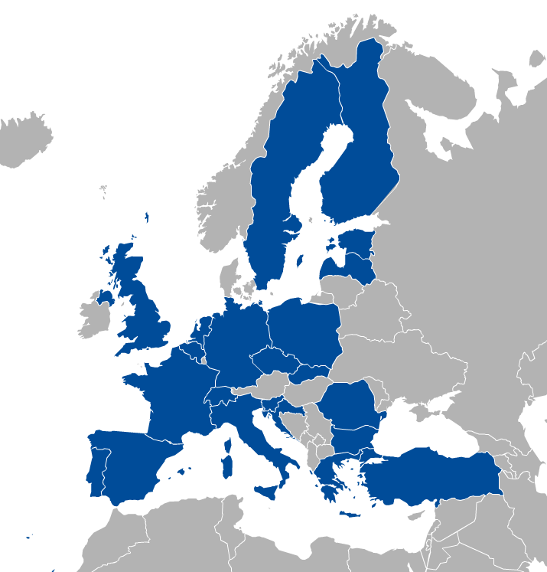
EGI: A sustainable e-infrastructure provider for Open Science
Major national e-Infrastructures: 22 NGIs
EIROs: CERN and EMBL-EBI
EGI Foundation
(ERICs)
https://eduroam.egi.eu/about/
Workshop on Grid & Cloud for bioinformatics studies, 15th Dec 2016, CERTH-INAB

Slide 6
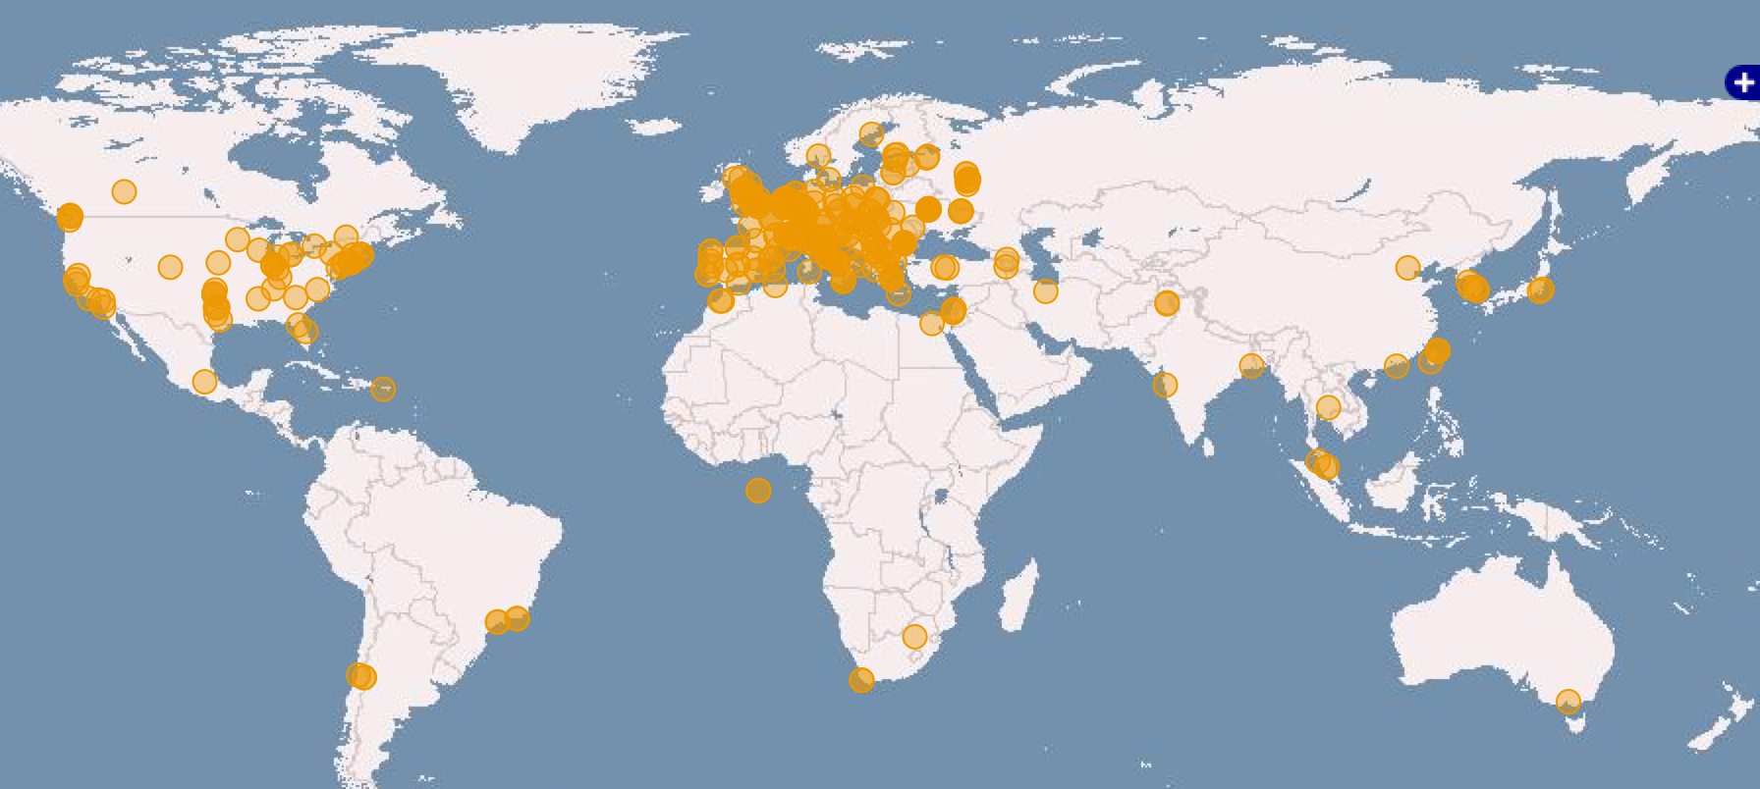
EGI infrastructure today
Russia
Ukraine
Canada
USA
Asia
Pacific
820,000 CPU Cores
560 PB of disk and tape storage
22 Cloud providers
325 resource providers
48,000 users
+4,000 research papers
Latin America
Africa
Arabia
Workshop on Grid & Cloud for bioinformatics studies, 15th Dec 2016, CERTH-INAB

Slide 7
What is Cloud Computing?
Deliver of hosted service over the internet to store, mange and process data (rather than a local server or a personal computer)
Benefits
Virtualisation – Platform-independence; Self-servicing
Scalability – ‘Pay-as-you-go’; Multi-tenant allocation
Predictability – Versioning of VMs and contextualisation scripts
Abstractions – IaaS, PaaS, SaaS
Open source – KVM, OpenStack, OpenNebula, …
VM image
App
App
App
Storage volume
Software Appliance
Virtual Appliance
OS
VM image
Meta data
Cloud management framework
Contextualisation script
Hardware
Virtualized Stack
Workshop on Grid & Cloud for bioinformatics studies, 15th Dec 2016, CERTH-INAB

Slide 8
What is a cloud federation?
Practice of interconnecting cloud service providers
Motivations:
Data locality; Data privacy; Shared investment; Distributed expertise
Multiple cloud sites with some sort of interconnection(s).
Every cloud registered in a single catalogue
Single VM image catalogue for users
Support for the same image format
Automated distribution of VM Images to the federated clouds
Single sign-on for users
Harmonised operational practices
Cloud configurations, integrated monitoring, accounting, etc.
Integrated support model
Ticketing system, consultancy, training
Workshop on Grid & Cloud for bioinformatics studies, 15th Dec 2016, CERTH-INAB

Slide 9
EGI Federated Cloud
Cloud of clouds
Unified user interfaces
Harmonised operational behaviour
Clouds and their interconnections are based on open standards, open technologies
Infrastructure → Access AND technology → Deploy
Workshop on Grid & Cloud for bioinformatics studies, 15th Dec 2016, CERTH-INAB

Slide 10
EGI Federated Cloud
TOPIC OF THIS TUTORIAL
- On every site
OpenStack Nova
- On OS sites
Uniform user interfaces
Harmonised operation
OpenStack
OpenNebula
Cloud registry
Information system
Virt. Machine marketpl.
Usage accounting
Access control
Synnefo
OpenStack
OpenNebula
OpenStack
Workshop on Grid & Cloud for bioinformatics studies, 15th Dec 2016, CERTH-INAB

Slide 11
EGI Federated Cloud
EGI Federated Cloud is a collaboration of communities developing, innovating, operating and using cloud federations for research and education.
Today:
22 providers from 14 NGIs
15 OpenStack
6 OpenNebula
1 Synnefo
~ 6.000 cores in total
Workshop on Grid & Cloud for bioinformatics studies, 15th Dec 2016, CERTH-INAB

Slide 12
How to Access to EGI Federated Cloud? via Virtual Organisations
VO 1 (cloud a, b, c)
VO 2 (cloud b, c, d, e)
VO membership and resource access with X.509 certificates
Generic VOs – e.g. fedcloud.egi.eu → Incubator for new users
Community-specific VOs – e.g. CHIPSTER, Highthroughtputseq, EISCAT, etc. (SLA, OLAs)
Training VO = training.egi.eu → To be used today
Browse VOs at http://operations-portal.egi.eu/vo/search (both grid and cloud)
Workshop on Grid & Cloud for bioinformatics studies, 15th Dec 2016, CERTH-INAB

Slide 13
What is the typical user workflow?
Exercises today
Exercises today
Clouds in your Virtual Organisation (e.g. training.egi.eu)
Application Portal, framework, SaaS, etc..
Visual lookup
OCCI or Nova calls (CMD/API)
VM
VM
VM
OCCI or Nova calls (CMD/API)
VM
VM
VM
Programmatic lookup (API)
VM
Storage
Appliances Marketplace (AppDB)
VM
Virtual/Software Appliances of your Virtual Organisation
VM
VM
VM
VM
VM
VM
VM
VM
VM
Workshop on Grid & Cloud for bioinformatics studies, 15th Dec 2016, CERTH-INAB
Notes:
Remark: The Virtual Appliances Catalogue does not store physically the VMs. It stores only references and metadata about the VMs. The VMs are physically stored elsewhere – e.g. third party HTTP server, EGI Repository

Slide 14
What can the Cloud be used for?
Compute and data intensive workloads
Batch and interactive (e.g. iPython-Jupiter) with scalable and customized environments
Service Hosting
Long-running services (e.g. web server, database, application server, Galaxy server)
Datasets repository
Store and manage large datasets (in a storage volume)
Disposable and testing environments
Host training environments, test applications
Workshop on Grid & Cloud for bioinformatics studies, 15th Dec 2016, CERTH-INAB

Slide 15
A typical usage scenario
Combine usage models in a single application
Scalable Service hosting
Block Storage RAID
Exercise 1
Exercise 2
Web
Server
Data
Server
attach
End User
spawns
mount
Worker
Worker
Worker
analyse
data
Scalable Compute and data processing
Object Storage*
* Object storage (CDMI or other) is not available on every site
Workshop on Grid & Cloud for bioinformatics studies, 15th Dec 2016, CERTH-INAB
Notes:
Spawns: this web server create VM on the fly
RAID: storage system
Service server
Run computation
storage

Slide 16
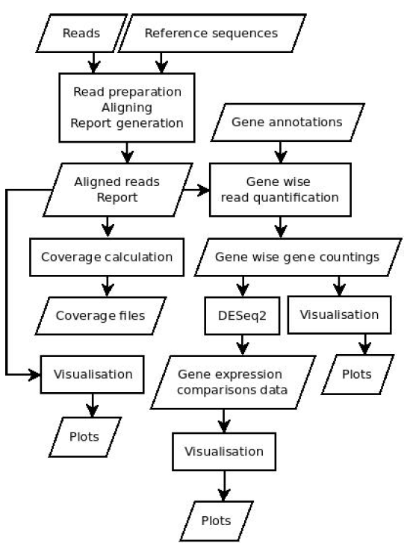
Example: READemption
Pipeline for the computational evaluation of RNA-Seq. data
Usage Model
Computing intensive
Scientific Disciplines
Bioinformatics
Large Memory
Deployment in the FedCloud
VMs with 24 cores, 128 GB of RAM
Block storage up to 3 TB
Source: Konrad U. Förstner
Workshop on Grid & Cloud for bioinformatics studies, 15th Dec 2016, CERTH-INAB

Slide 17
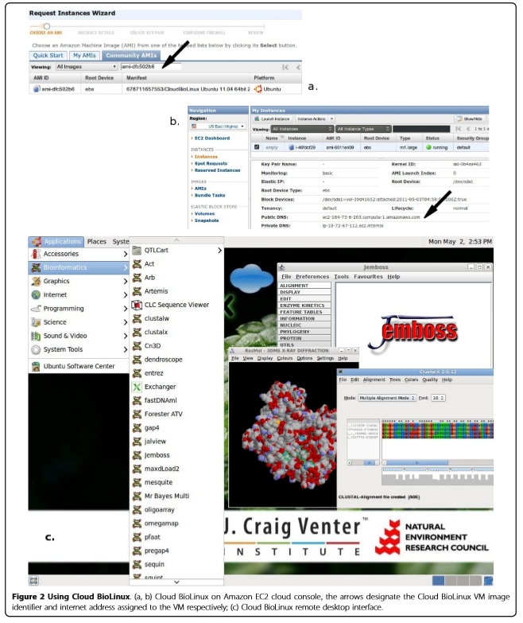
Example:Cloud BioLinux
Publicly accessible VM
Platform for developing bioinformatics infrastructures on the cloud
Quick provision of on-demand infrastructures for HPC in bioinformatics
Pre-configured tools and GUI
Tested on Amazon EC2, Eucalyptus, Okeanos and Virtual box
Workshop on Grid & Cloud for bioinformatics studies, 15th Dec 2016, CERTH-INAB

Slide 18
Example:Taverna
General purpose open source and domain-independent Workflow Management System
Combines distributed web services and local tools into complex analysis pipelines.
Execution takes place either locally or in a grid or cloud environment using the Taverna server
Widely adopted in bioinformatics workflows, typically in the areas of high throughput omics analyses like proteomics, transcriptomics and evidence gathering methods involving text or data mining.
Workshop on Grid & Cloud for bioinformatics studies, 15th Dec 2016, CERTH-INAB

Slide 19
Example:Galaxy
Offers genome analysis resources for cloud computing platforms
Amazon EC2
Virtual Box
Eucalyptus
Okeanos
Freely available and community maintained
software images and
data repositories
Widely adopted in the bioinformatics community
Workshop on Grid & Cloud for bioinformatics studies, 15th Dec 2016, CERTH-INAB

Slide 20
EGI Training infrastructure
Workshop on Grid & Cloud for bioinformatics studies, 15th Dec 2016, CERTH-INAB

Slide 21
training.egi.eu Virtual Organisation
Site | Available capacity in the VO
CESNET (CZ) | 64 vCPUs 110 GB of RAM 1 TB of persistent storage
BIFI (ES) | 50 vCPUs 50 GB of RAM 50 storage volumes 50 public IP addresses
CETA-CIEMAT (ES) | 20 vCPUs 40 GB of RAM 5.4 TB storage 10 public IP addresses
CESNET (OpenNebula)
UI
BIFI (OpenStack)
CETA-CIEMAT (OpenStack)
Trainers join VO with X.509 personal certificates → Generate own proxy for access
Trainees get proxies from trainers. Your proxy is valid for 24 hours
You will need personal certificate from a recognised CA for the long-term – More later!
Workshop on Grid & Cloud for bioinformatics studies, 15th Dec 2016, CERTH-INAB
Notes:
UKIM is closed at the moment
INFN need to update
CETA-CIEMA: some problem

Slide 22
Accessing the training VO
1 account / trainee
1 proxy / account
Ubuntu 14.04 with rOCCI client
Configured by trainers
Login with SSH
UI
OCCI commands
Get IDs of
Cloud endpoint
VA image
Resource template
Access (e.g. SSH, Web)
VM
Block storage
VM Marketplace (AppDB)
http://appdb.egi.eu → Cloud Marketplace
Training.egi.eu VO
Workshop on Grid & Cloud for bioinformatics studies, 15th Dec 2016, CERTH-INAB
Notes:
UI: INFN Catania
Get information from AppDB

Slide 23
OCCI and rOCCI
OCCI (Open Cloud Computing Interface, OGF, 2011)
For VM Management (compute and storage)
Text-based protocol and API focusing on cloud interoperability
rOCCI (OCCI command-line client; r for Ruby)
To be used today
Interacts with the OCCI servers deployed on cloud sites
Supports EGI AAI (X.509 certificates + VOMS)
Available with installer, as VM image, as Docker container or source
jOCCI: Java API for OCCI
Further info: https://wiki.egi.eu/wiki/Federated_Cloud_APIs_and_SDKs
Workshop on Grid & Cloud for bioinformatics studies, 15th Dec 2016, CERTH-INAB

Slide 24
Main commands to be used during Exercises
Command | Explanation
voms-proxy-info | Check the lifetime of your proxy
ssh-keygen | Generate key-pairs for password-less SSH
occi --endpoint A --auth B --action C –resource D | Perform action C on resource D of cloud site A authenticating as B
--action list
--action create
--action describe
--resource compute
--resource storage
cloud site
X.509 proxy
rOCCI quick reference guide: https://gist.github.com/arax/4de4a41fb0fa67719856
Workshop on Grid & Cloud for bioinformatics studies, 15th Dec 2016, CERTH-INAB

Slide 25
Log into the UI
Log into the User Interface
SSH to 90.147.16.130
Username: userX, where X=1,..,39
Password: FedCloudUserX, where X=1,..,39
Check your proxy file
Check the lifetime of your credential
~$ ssh userX@90.147.16.130 –p 4422
~$ echo $X509_USER_PROXY
~$ voms-proxy-info –all
Workshop on Grid & Cloud for bioinformatics studies, 15th Dec 2016, CERTH-INAB

Slide 26
Get ready to access your VMs with SSH
VMs are (normally) accessible through SSH
But password logins are disabled
Instead use key pairs
Create a ssh key to access:
(defaults are ok, can be left without password for the tutorial)
~$ ssh-keygen
Workshop on Grid & Cloud for bioinformatics studies, 15th Dec 2016, CERTH-INAB

Slide 27
BREAK

Slide 28
Exercise 1 & 2: Jupyter Notebook

Slide 29
Jupyter Notebook
Open source, interactive data science and scientific computing across over 40 programming languages.
Notebooks can be shared with others using email, Dropbox, GitHub
Interactive widgets
Favorite tool for the Software and Data Carpentry workshops
Workshop on Grid & Cloud for bioinformatics studies, 15th Dec 2016, CERTH-INAB

Slide 30
Exercise 1 and 2
Managing VMs and block storage:
Start a Jupyter Notebook on an EGI Cloud site
Use persistent storage for Jupyter files
Workshop on Grid & Cloud for bioinformatics studies, 15th Dec 2016, CERTH-INAB
Notes:
Persistent meant the storage will not be deleted after destroy the VM
Create a VM on the cloud
Start VM image of Jupyter Notebook install

Slide 31
Exercise 1: Run a Jupyter Notebook in the EGI Federated Cloud
Workshop on Grid & Cloud for bioinformatics studies, 15th Dec 2016, CERTH-INAB

Slide 32
Exercise 1: Jupyter Notebook setup
What you have to do:
Browse AppDB, find 3 IDs (visual lookup):
ID of the cloud site you want to use
ID of the Jupyter Notebook VM image for that site
ID of the resource template the VM should use (smallest!)
Create VM instance (OCCI call)
Access the Jupyter Notebook from a web browser
Workshop on Grid & Cloud for bioinformatics studies, 15th Dec 2016, CERTH-INAB

Slide 33
Browsing AppDB
DEMO
Go to AppDB:
http://appdb.egi.eu
Cloud MP → Virtual Organizations → training.egi.eu
Choose Jupiter Notebook VA and a specific site
See request on next slide!
VAs and SAs in this VO:
Baseline OS appliances
Minimal OS images
Centos6, Ubuntu 12.04, Ubuntu 14.04
Specific appliances
FedCloud tools: Ubuntu 14.04 with FedCloud clients ready to use
MoinMoin wiki: Ubuntu 14.04 image with MoinMoin installed and configured to run on startup
Jupyter Notebook: Centos6 image with Jupyter Notebook installed
Software appliances
Use contextualization to deliver the functionality
Workshop on Grid & Cloud for bioinformatics studies, 15th Dec 2016, CERTH-INAB

Slide 34
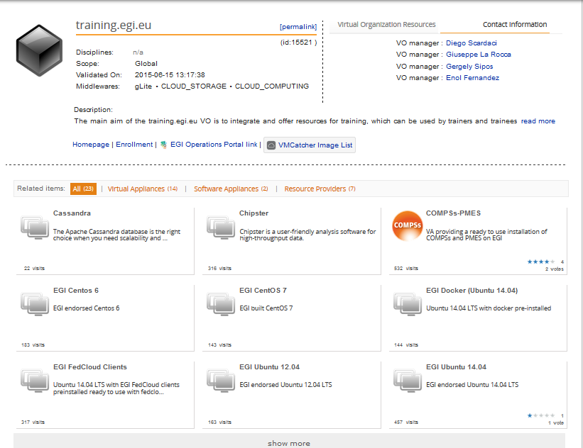
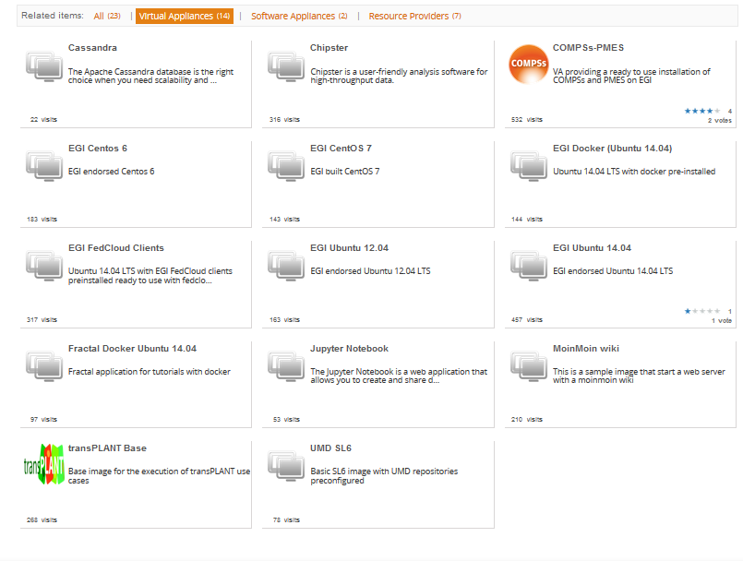
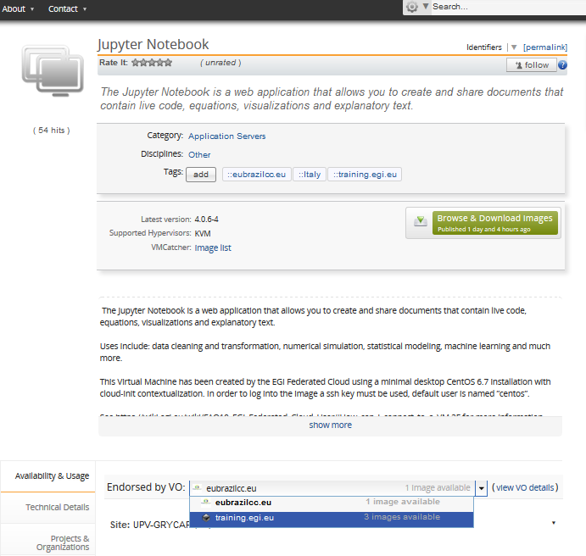
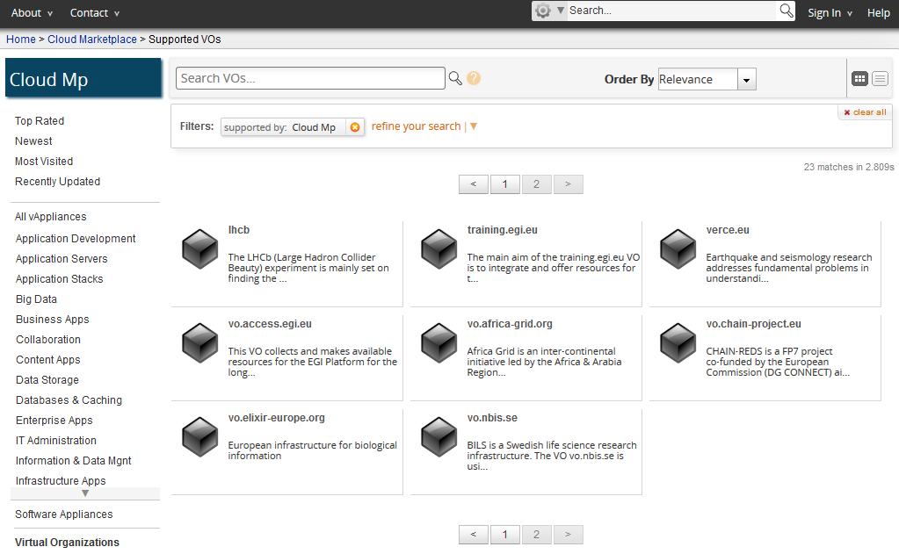
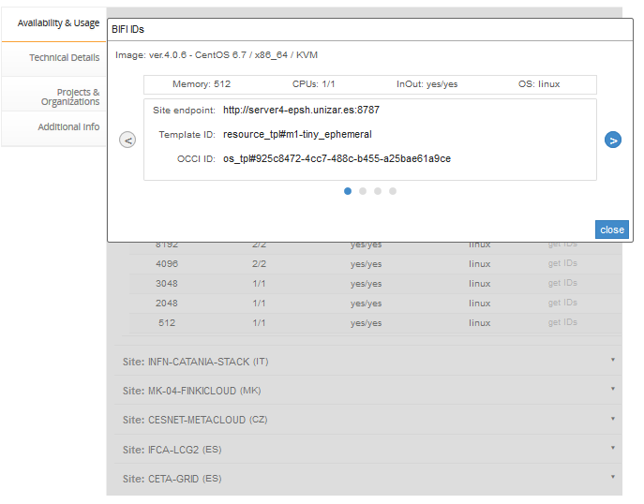
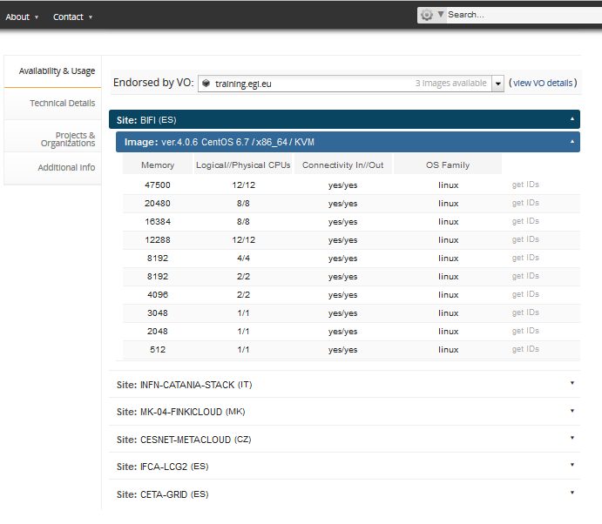
Which cloud
In which size
Which image

Slide 35
TODO - REQUEST
Instantiate VMs based on the smallest resource templates during the whole tutorial
I.e. Use the following Template IDs:
Site | Template name | Template ID
CESNET | Small | http://schema.fedcloud.egi.eu/occi/infrastructure/resource_tpl#small
BIFI | Tiny | resource_tpl#m1-tiny-ephemeral MORE COMPLEX NETWORKING!
Workshop on Grid & Cloud for bioinformatics studies, 15th Dec 2016, CERTH-INAB

Slide 36
Create your first compute appliance
Use Jupyter Notebook VA values from AppDB!
~$ ENDPOINT=<Copy here Site Endpoint information from AppDB>
~$ RESOURCE_TPL=<copy here the Template ID from AppDB>
~$ OS_TPL=<copy here the OCCI ID from AppDB>
~$ occi --endpoint $ENDPOINT \
--auth x509 --voms --user-cred $X509_USER_PROXY \
--action create --resource compute \
--mixin $RESOURCE_TPL --mixin $OS_TPL \
--attribute occi.core.title=“notebook$(date +%s)" \
--context public_key="file:///$HOME/.ssh/id_rsa.pub"
~$ COMPUTE_ID=...
Save the ID in an Env. variable
Workshop on Grid & Cloud for bioinformatics studies, 15th Dec 2016, CERTH-INAB

Slide 37
List and describe your VM instances
~$ occi --endpoint $ENDPOINT \
--auth x509 --voms --user-cred $X509_USER_PROXY \
--action list --resource compute
~$ occi --endpoint $ENDPOINT \
--auth x509 --voms --user-cred $X509_USER_PROXY \
--action describe --resource $COMPUTE_ID
This returns lot of info, including the IP Address of your VM!
occi.networkinterface.address = …
→ It’s not so simple ☹ See next slide!
Workshop on Grid & Cloud for bioinformatics studies, 15th Dec 2016, CERTH-INAB

Slide 38
IF use BIFI
~$ ENDPOINT=https://server4-ciencias.bifi.unizar.es:8787/occi1.1/
~$ occi --endpoint $ENDPOINT \
--auth x509 --voms --user-cred $X509_USER_PROXY \
--action create --resource compute \
--mixin resource_tpl#308bc2b2-1e1e-4af9-a98f-cac76b6ce084 \
-–mixin http://schemas.openstack.org/template/os#3784f4e8-0c96-4f1e-b381-e305f9f8dd87 \
--attribute occi.core.title=“notebook$(date +%s)" \
--context public_key="file:///$HOME/.ssh/id_rsa.pub”
~$ COMPUTE_ID=...

Slide 39
IF use BIFI
~$ ENDPOINT=https://server4-ciencias.bifi.unizar.es:8787/occi1.1/
~$ occi --endpoint $ENDPOINT --action list –resource \
resource_tpl --auth x509 --user-cred \
$X509_USER_PROXY –voms
~$ RESOURCE_TPL=<copy here the Template ID from the list>
~$ occi --endpoint $ENDPOINT --action list –resource \
os_tpl --auth x509 --user-cred \
$X509_USER_PROXY –voms
~$ OS_TPL=<copy here the OCCI ID from the result list>
~$ occi --endpoint $ENDPOINT \
--auth x509 --voms --user-cred $X509_USER_PROXY \
--action create --resource compute \
--mixin $RESOURCE_TPL --mixin $OS_TPL \
--attribute occi.core.title=“notebook$(date +%s)" \
--context public_key="file:///$HOME/.ssh/id_rsa.pub”
~$ COMPUTE_ID=...

Slide 40
If use BIFI
If the VM does not have a public IP (on BIFI endpoint):
~$ occi --endpoint $ENDPOINT \
--auth x509 --voms --user-cred $X509_USER_PROXY \
--action link --resource $COMPUTE_ID \
--link /occi1.1/network/PUBLIC \
-M http://schemas.openstack.org/network/floatingippool#provider
Obtain the IP address from the output of the describe command.
https://server4-ciencias.bifi.unizar.es:8787/occi1.1/networklink/391980c1-42f9-4fdc-b077-59abdb2cf42d_PUBLIC_155.210.133.148
Workshop on Grid & Cloud for bioinformatics studies, 15th Dec 2016, CERTH-INAB

Slide 41
Logging into the appliance
ssh with centos user:
~$ ssh centos@<your vm ip>
Once logged in, check the size of the image:
~wiki $ cat /proc/cpuinfo
~wiki $ cat /proc/meminfo
Workshop on Grid & Cloud for bioinformatics studies, 15th Dec 2016, CERTH-INAB

Slide 42
Start the service
After connecting to the newly launched VM, start the Jupyter notebook as follows:
Jupyter start a web-server (by default listening to port 8888)
Go to your web-browser and type:
https://[public ip]:8888
~$ jupyter notebook
Workshop on Grid & Cloud for bioinformatics studies, 15th Dec 2016, CERTH-INAB

Slide 43
Transfer files
We can transfer input/data files, as well as notebooks from any given location to the current VM.
In our case, let’s take some sample files using wget as follows:
“Real-world” notebook
~$ wget http://grid.ct.infn.it/cron_files/ELIXIR_WS/GeneExpressionHeatmap.ipynb
~$ wget http://grid.ct.infn.it/cron_files/ELIXIR_WS/Data_Cortex_Nuclear.csv
~$ wget http://grid.ct.infn.it/cron_files/ELIXIR_WS/SraRunTable.txt
Corresponding dataset
A dataset for our exercise now
Workshop on Grid & Cloud for bioinformatics studies, 15th Dec 2016, CERTH-INAB

Slide 44
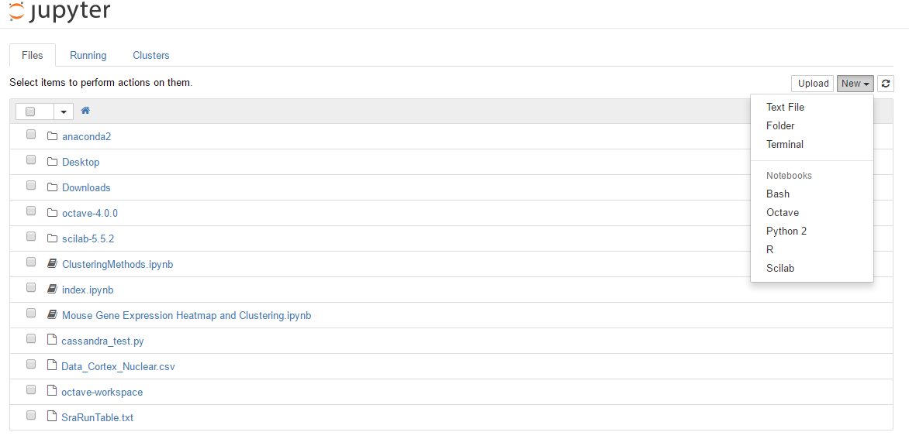
Jupyter’s main page
Select the R kernel for our case
Workshop on Grid & Cloud for bioinformatics studies, 15th Dec 2016, CERTH-INAB

Slide 45
You can also have a terminal case
Useful for basic CLI training.
Workshop on Grid & Cloud for bioinformatics studies, 15th Dec 2016, CERTH-INAB

Slide 46
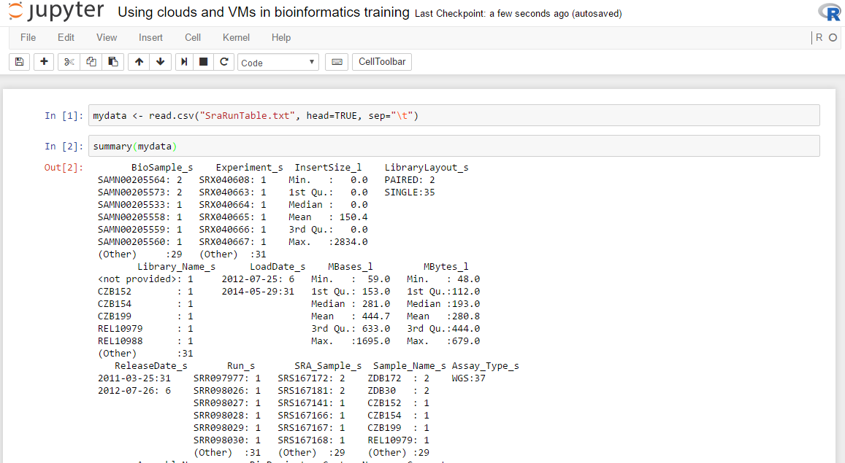
We can show standard downsteam analysis
Each R command is executed within the VM
Results are shown on page
Workshop on Grid & Cloud for bioinformatics studies, 15th Dec 2016, CERTH-INAB

Slide 47
Example case
Let’s run the following commands in the newly created (adapted from the Data Carpentry genomics lesson)
~$ sradata <- read.csv("SraRunTable.txt", head=TRUE,
sep="\t")
~$ summary(sradata)
~$ install.packages("dplyr",
repos='http://cran.us.r-project.org')
~$ library("dplyr")
~$ select(sradata, LibraryLayout_s, LoadDate_s, MBases_l,
Sample_Name_s)
~$ filter(sradata, LibraryLayout_s == "PAIRED")
~$ sradata %>%
select(LibraryLayout_s, LoadDate_s, MBases_l,
Sample_Name_s) %>%
filter(LibraryLayout_s == "PAIRED")
Load data in the notebook
Workshop on Grid & Cloud for bioinformatics studies, 15th Dec 2016, CERTH-INAB

Slide 48
Run entire preset notebooks
One of the key advantages is to allow the re-use of defined notebooks
Open the “Mouse Gene Expression Heatmap and Clustering” notebook
It’s an entire process, with documentation, that can allow specific tasks (the creation of a Gene Expression heatmap in this case)
Workshop on Grid & Cloud for bioinformatics studies, 15th Dec 2016, CERTH-INAB

Slide 49
Exercise 2: Jupyter with persistent storage

Slide 50
Making Jupyter files persistent
When a VM is deleted all its disks are also deleted
If you need persistency for your data you must use a storage volume
Let’s try it with our Jupyter Notebook:
Create a volume
Attach volume to our Jupyter VM
Create FS in the volume and copy the Jupyter files
Detach volume and delete VM
Create new VM with the created volume attached
Mount the volume and check the Jupyter files are still there
Workshop on Grid & Cloud for bioinformatics studies, 15th Dec 2016, CERTH-INAB

Slide 51
Create the volume and describe it
Create a volume
~$ occi --endpoint $ENDPOINT \
--auth x509 --voms --user-cred $X509_USER_PROXY \
--action create --resource storage \
--attribute occi.storage.size="num(1)" \
--attribute occi.core.title=“notebookdata_$(date +%s)"
~$ STORAGE_ID=...
Save the ID in an Env. variable
Describe it
~$ occi --endpoint $ENDPOINT \
--auth x509 --voms --user-cred $X509_USER_PROXY \
--action describe --resource $STORAGE_ID
Workshop on Grid & Cloud for bioinformatics studies, 15th Dec 2016, CERTH-INAB

Slide 52
Attach to VM
~$ occi --endpoint $ENDPOINT \
--auth x509 --voms --user-cred $X509_USER_PROXY \
--action link --resource $COMPUTE_ID \
--link $STORAGE_ID
Workshop on Grid & Cloud for bioinformatics studies, 15th Dec 2016, CERTH-INAB

Slide 53
See attach information
~$ occi --endpoint $ENDPOINT \
--auth x509 --voms --user-cred $X509_USER_PROXY \
--action describe --resource $COMPUTE_ID
[…]
Links:
[[ http://schemas.ogf.org/occi/infrastructure#storagelink ]]
>> location: /storage/link/c17e204e-c96f-40ff-aebe-671351254a5e_1e0162cb-2805-4fe7-8c4e-997a5ddf02ff
occi.core.source = /compute/c17e204e-c96f-40ff-aebe-671351254a5e
occi.core.target = /storage/1e0162cb-2805-4fe7-8c4e-997a5ddf02ff
occi.core.id = /storage/link/c17e204e-c96f-40ff-aebe-671351254a5e_1e0162cb-2805-4fe7-8c4e-997a5ddf02ff
occi.storagelink.deviceid = /dev/vdb
[…]
~$ LINK_ID= =<copy here Link ID>
LINK_ID
We will need this at the VM to manage the volume
Workshop on Grid & Cloud for bioinformatics studies, 15th Dec 2016, CERTH-INAB

Slide 54
TODO Move Jupyter files to new volume
~$ ssh centos@<your jupyter notebook ip>
~$ sudo mkfs.ext3 /dev/vdb
~$ sudo mount /dev/vdb /mnt
~$ sudo su
~$ sudo echo date > /mnt/text_data.txt
~$ sudo ls –la /mnt
~$ exit
Change to root, since /mnt belongs to root
Change back to centos if you want to run Jupyter notebook
Workshop on Grid & Cloud for bioinformatics studies, 15th Dec 2016, CERTH-INAB
Notes:
Mkfs.ext3 -> creates a filesystem in the volume, needed before using it for the first time
Mount /dev/vdb /mnt -> mount the volume in /mnt ; notice /dev/vdb is from the previous describe (see previous slide)
Stop apache2 (web server) to not break things while we change the wiki
Copy all the contents of the wiki to new volume
Umount the volume and mount it again in /org (where the wiki is expecting the data)
Start apache2 again and check wiki

Slide 55
Clean up and stop the VM
Umount the volume
~$ sudo umount /mnt
Detach the volume:
~$ occi --endpoint $ENDPOINT \
--auth x509 --voms --user-cred $X509_USER_PROXY \
--action delete --resource $LINK_ID
Delete VM:
~$ occi --endpoint $ENDPOINT \
--auth x509 --voms --user-cred $X509_USER_PROXY \
--action delete --resource $COMPUTE_ID
Workshop on Grid & Cloud for bioinformatics studies, 15th Dec 2016, CERTH-INAB

Slide 56
Create a new notebook with the volume
~$ occi --endpoint $ENDPOINT \
--auth x509 --voms --user-cred $X509_USER_PROXY \
--action create --resource compute \
--mixin $RESOURCE_TPL --mixin $OS_TPL \
--attribute occi.core.title=“notebook$(date +%s)" \
--link $STORAGE_ID \
--context public_key="file:///$HOME/.ssh/id_rsa.pub"
~$ COMPUTE_ID2=...
Save the ID in an Env. variable
Workshop on Grid & Cloud for bioinformatics studies, 15th Dec 2016, CERTH-INAB
Notes:
This –link will attach the volume as the VM is created, so there is no need to do 2 steps (create + attach)

Slide 57
Use the volume
Login into the VM and mount the volume at /mnt
~$ ssh centos@<your notebook ip>
~$ sudo mount /dev/vdc /mnt
~$ ls –la /mnt
The file created before is still available in the new VM (/mnt)!
Workshop on Grid & Cloud for bioinformatics studies, 15th Dec 2016, CERTH-INAB
Notes:
DO NOT repeat the Mkfs.ext3 this will delete everything in the volume!

Slide 58
Once done, delete your instances
~$ occi --endpoint $ENDPOINT \
--auth x509 --voms --user-cred $X509_USER_PROXY \
--action delete --resource $COMPUTE_ID2
~$ occi --endpoint $ENDPOINT \
--auth x509 --voms --user-cred $X509_USER_PROXY \
--action delete --resource $STORAGE_ID
Workshop on Grid & Cloud for bioinformatics studies, 15th Dec 2016, CERTH-INAB

Slide 59
Contextualisation
VM image
App
App
App
Storage volume
Software Appliance
Virtual Appliance
OS
VM image
Meta data
Cloud management framework
Contextualisation script
Hardware
Virtualized Stack

Slide 60
Contextualization
What?
Contextualization is the process of installing, configuring and preparing software upon boot time on a pre-defined virtual machine image
e.g. hostname, IP address, ssh keys, …
Why?
Configuration not known until instantiation (e.g. data location)
Private Information (e.g. host certs)
Software that changes frequently or under development
Not practical to create a new VM image for every possible configuration
Workshop on Grid & Cloud for bioinformatics studies, 15th Dec 2016, CERTH-INAB

Slide 61
Use with rOCCI CLI
Use --context option to specify
user_data
public_key
EXAMPLE – NO NEED TO EXECUTE
~$ occi --endpoint $ENDPOINT \
--auth x509 --voms --user-cred $X509_USER_PROXY \
--action create --resource compute \
--mixin $RESOURCE_TPL --mixin $OS_TPL \
--attribute occi.core.title="wiki$(date +%s)" \
--context user_data="file:///$PWD/context" \
--context public_key="file:///$HOME/.ssh/id_rsa.pub"
~$ COMPUTE_ID=...
Workshop on Grid & Cloud for bioinformatics studies, 15th Dec 2016, CERTH-INAB

Slide 62
Meta data vs user data
Meta data
User data
Basic predefined information on the VM
VM Identifier
Hostname, IP
User Public Keys
User data is treated as opaque data: Passed to cloud-init.
It is up to cloud-init to interpret it.
cloud-init uses both meta-data and user-data to contextualize the VMs
Workshop on Grid & Cloud for bioinformatics studies, 15th Dec 2016, CERTH-INAB
Notes:
Meta-data used in the previous example to inject the user public key
User data used in the previous example to pass the ‘context’ file to cloud-init

Slide 63
Excercise 3
Running Chipster in EGI Federated Cloud

Slide 64
Chipster: http://chipster.csc.fi
Open source platform for data analysis
Provides an easy access to over 340 analysis tools
No programming or command line experience required
What can I do with Chipster?
analyze and integrate high-throughput data
visualize data efficiently
share analysis sessions
save and share automatic workflows
Workshop on Grid & Cloud for bioinformatics studies, 15th Dec 2016, CERTH-INAB

Slide 65
Analysis tools
140 NGS tools for
RNA-seq
miRNA-seq
exome/genome-seq
ChIP-seq
FAIRE-seq
MeDIP-seq
CNA-seq
Metagenomics (16S rRNA)
60 tools for sequence analysis
BLAST, EMBOSS, MAFFT, Phylip
140 microarray tools for
gene expression
miRNA expression
protein expression
aCGH
SNP
integration of different data
Workshop on Grid & Cloud for bioinformatics studies, 15th Dec 2016, CERTH-INAB
Notes:
TODOs:
65

Slide 66
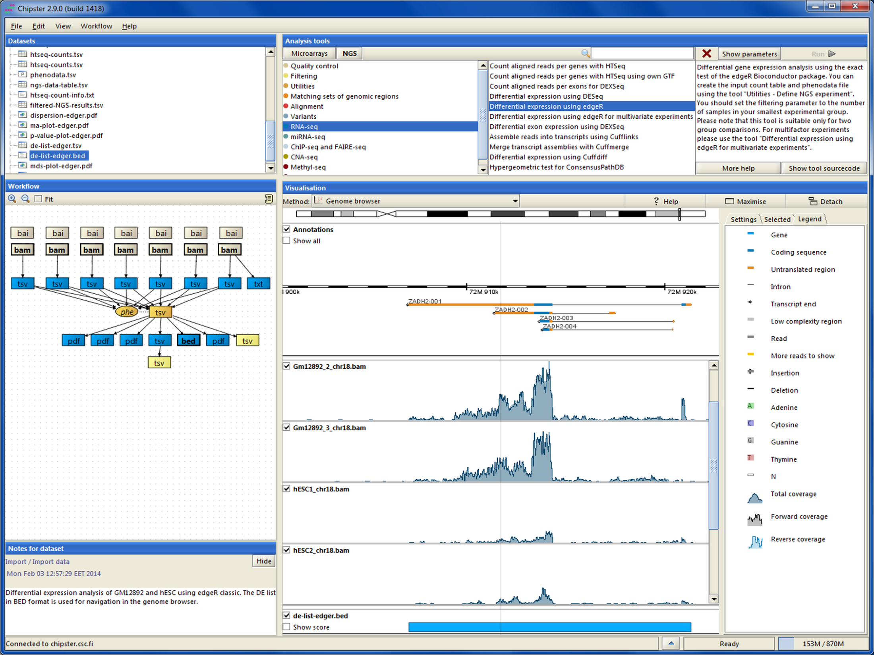
Chipster client
Workshop on Grid & Cloud for bioinformatics studies, 15th Dec 2016, CERTH-INAB

Slide 67
Chipster
Chipster id free, open source software
CSC hosts a Chipster server for researchers working in Finland
If you are not working in Finland you must purchase account to CSC or use some other Chipster server
Workshop on Grid & Cloud for bioinformatics studies, 15th Dec 2016, CERTH-INAB
Notes:
67

Slide 68
Chipster in EGI Federated Cloud
EGI Federated Cloud
Chipster VM
Web browser
( Chipster client+ JavaWS)
Chipster
server
Users
Data
OCCI
SSH
CVMFS mount
Tools
(200 GB)
Tools needed:
- Certificate
- VO membership
- rOCCI
- Mac OSX or Linux
Local Chipster
manager
Workshop on Grid & Cloud for bioinformatics studies, 15th Dec 2016, CERTH-INAB
Notes:
Remark: The Virtual Appliances Catalogue does not store physically the VMs. It stores only references and metadata about the VMs. The VMs are physically stored elsewhere – e.g. third party HTTP server, EGI Repository
68

Slide 69
Launching Chipster in EGI Federated cloud
Create a contextualization script that contains commands to create the required directories and CVMFS linking ( about 50 lines)
Create a data volume
Select VM-flavor and operating system template and launch the virtual machine
Set a public IP address
Connect to the new VM and restart chipster server
Workshop on Grid & Cloud for bioinformatics studies, 15th Dec 2016, CERTH-INAB

Slide 70
Launching Chipster in EGI Federated cloud
... or use FedCloud_chipster_manager
./FedCloud_chipster_manager -launch -key your_cloud_key
Tasks available in FedCloud_chipster_manager
launch a chipster server
delete a chipster server
list chipster servers in current VO
check status of chipster servers in current VO
restart a Chipster server
add chipster user accounts to the server
Workshop on Grid & Cloud for bioinformatics studies, 15th Dec 2016, CERTH-INAB

Slide 71
Using Chipster in EGI Federated Cloud
When the server is running, end users can access the server using port 8081
https://[ip.address.of.the.VM]:/8081
The manager of the server can open a terminal connetion to the server:
ssh -i keyfile ubuntu@[ip.address.of.the.VM]
Instructions for managing your Chipster server can be found from the Chipster technical manual:
https://github.com/chipster/chipster/wiki/TechnicalManual
Workshop on Grid & Cloud for bioinformatics studies, 15th Dec 2016, CERTH-INAB

Slide 72
Next steps

Slide 73
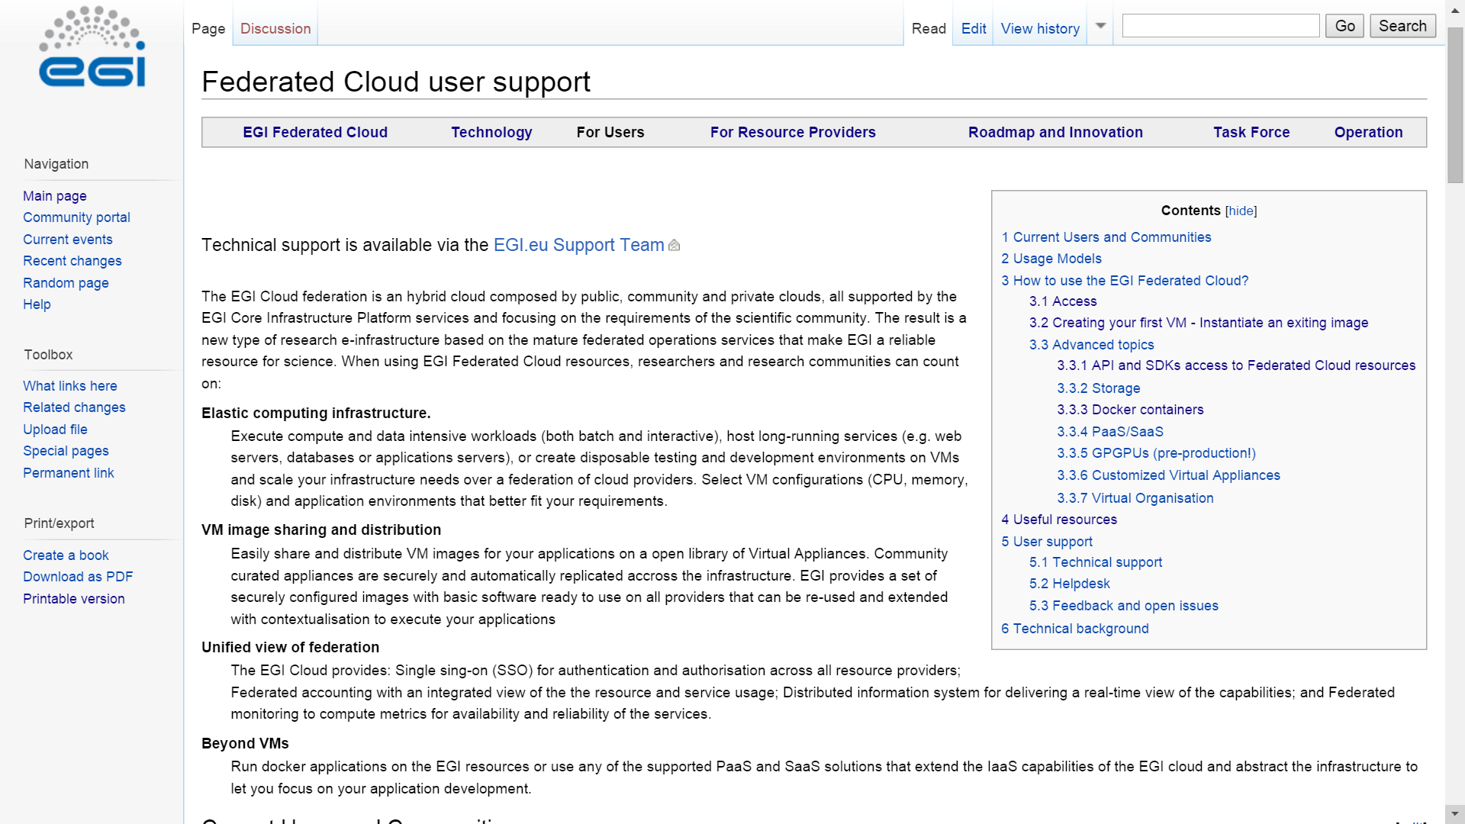
Main resource
EGI Federated Cloud Documentations and Guides:
https://wiki.egi.eu/wiki/Federated_Cloud_user_support
Workshop on Grid & Cloud for bioinformatics studies, 15th Dec 2016, CERTH-INAB

Slide 74
Getting access to the FedCloud
Your steplist:
Obtain certificate from
National CA (face-to-face identity check) http://www.igtf.net
OR
Terena Certificate Service: (online) https://www.digicert.com/sso
Register at the VO
fedcloud.egi.eu is a good starting point
Other VOs: http://operations-portal.egi.eu/vo/search
VO manager authorizes You
Membership DB updated
Identity replicated to resource within 1 day
Interact with the resources
rOCCI
API
High-level tool
Obtain certificate: Once Renew certificate: Annually
You
CA
Join VO: Once
VIRTUAL ORGANISATION
Use resources
VO manager
Register
Membership service
User database
Cloud sites
DB replication (once a day)
Workshop on Grid & Cloud for bioinformatics studies, 15th Dec 2016, CERTH-INAB

Slide 75
Support services
Dedicated technical consultancy for any user or community:
support@egi.eu
F2F/Web Meetings
Identify suitable setup
Technical integration
Continuous tracking and support
Periodic meetings
Fedcloud.egi.eu VO
Resources for prototyping
Allocate technical experts
Define milestones
Usable for 2x6 months
Enabled on all sites
Doc
Step by step guides
Secure, up-to-date
Migration to production
Identifying committed resource providers
EGI VM Images
Contextualisation
Examples
Tutorials – CMD line, API
Main OS versions
Support for VO setup
SLAs, OLAs
Docker
Workshop on Grid & Cloud for bioinformatics studies, 15th Dec 2016, CERTH-INAB

Slide 76
PLEASE FILL IN THE FEEDBACK FORMS! https://www.surveymonkey.com/r/3ZYGXQ2

