Slide 1
Federated Cloud Task Force
Use cases and requirements
Steve Brewer
EGI.eu Chief Community Officer
Steve.brewer@egi.eu
Content: courtesy of Newhouse, Sipos and others at EGI.eu

Slide 2
VRCs
The impact of Virtual Research Communities on EGI's services and infrastructure
VRC model adopted a year and a half ago:
A flexible organisations of scientists and researchers who had a common area of academic interest for which having a single voice to communicate their needs would benefit their research in terms of e-Infrastructure.

Slide 3
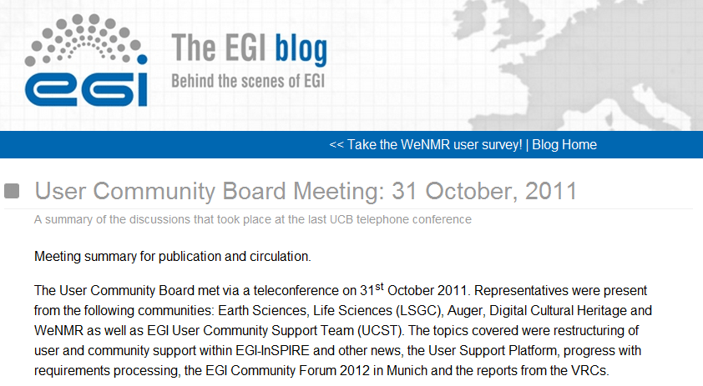
User Community Board
Meets monthly, typically by telephone
Larger public meetings at EGI forums
Reports from meetings published on blog

Slide 4
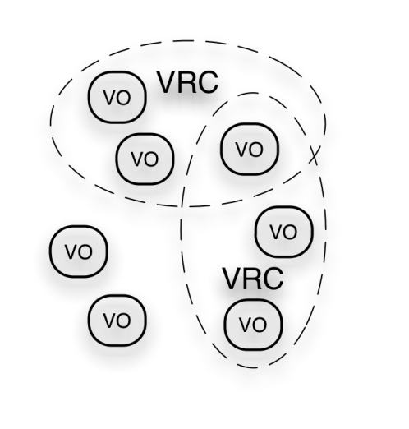
Virtual Research Community model
VO: a group of researchers and developers accessing EGI
HUC: a “heavy”, experienced user group. (often with multiple VOs)
VRC: a multi-national research collaboration with a joint workplan with EGI
Benefits of a VRC:
Defined communication channels: named contact points between VRC & EGI
Confirmed links to NGIs: partnership with sustainable national entities
UCB membership: involvement in the prioritisation of requirements
Dissemination: sharing of news, breakthroughs, best practice and innovation
EGI.eu
EGI Helpdesk
NGI
User Community
Training
User Community Board
Virtuli-sation
HUC
SoftwareServices
Applic. support
Other Helpdesk
Diss. & marketing
User Community Board
VRC representatives: Life Sciences Grid Community; WeNMR Structural Biology
HUC representatives: Astronomy & Astrophysics, Earth Sciences, Computational Chemistry, Arts & Humanities, Hydrometeorology
http://www.egi.eu/user-support/vrc_gateways/

Slide 5
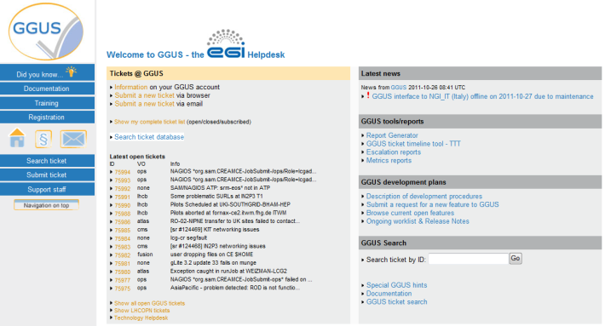
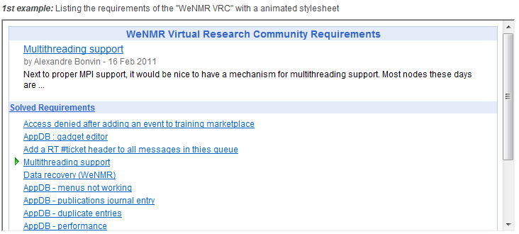
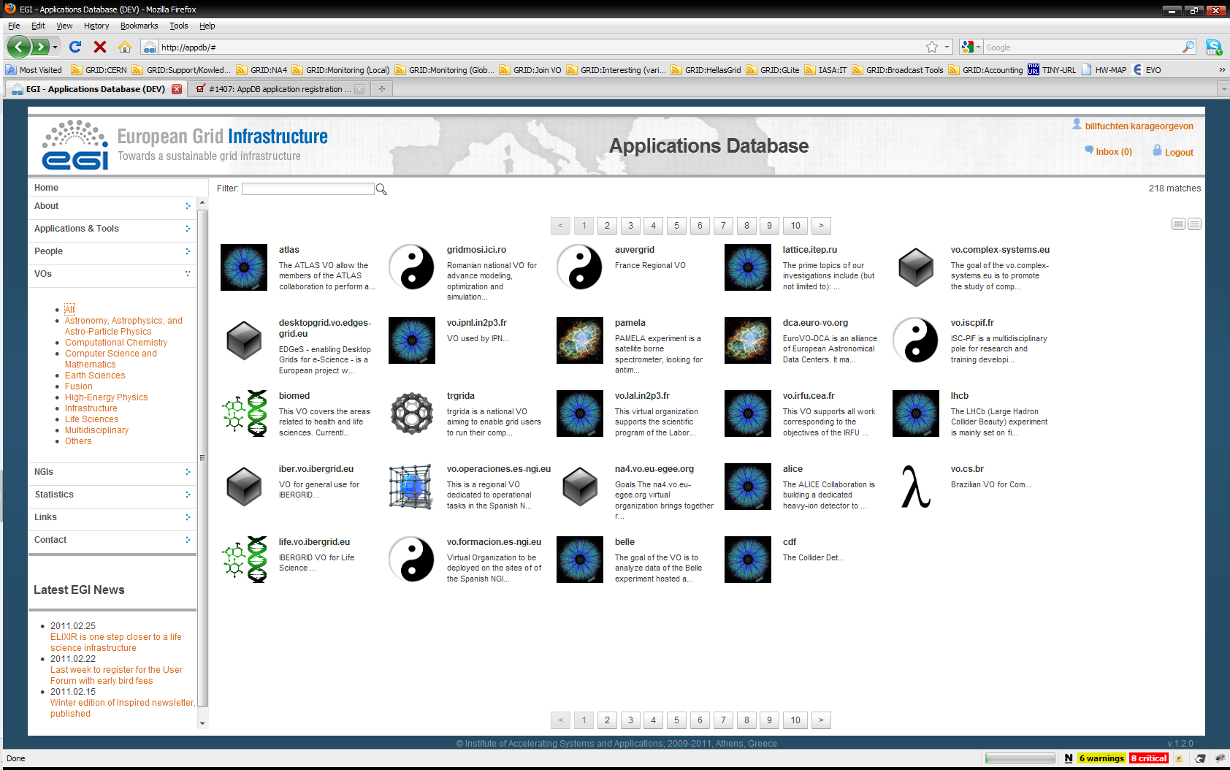
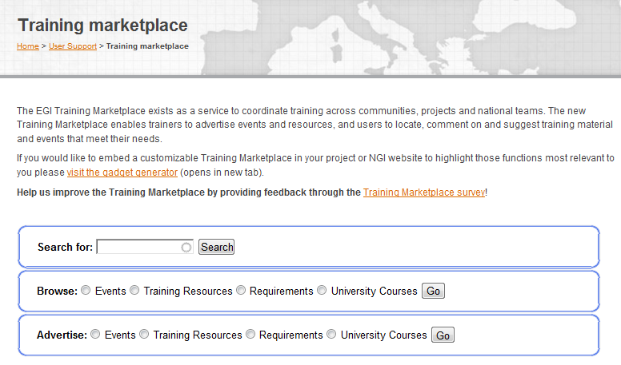
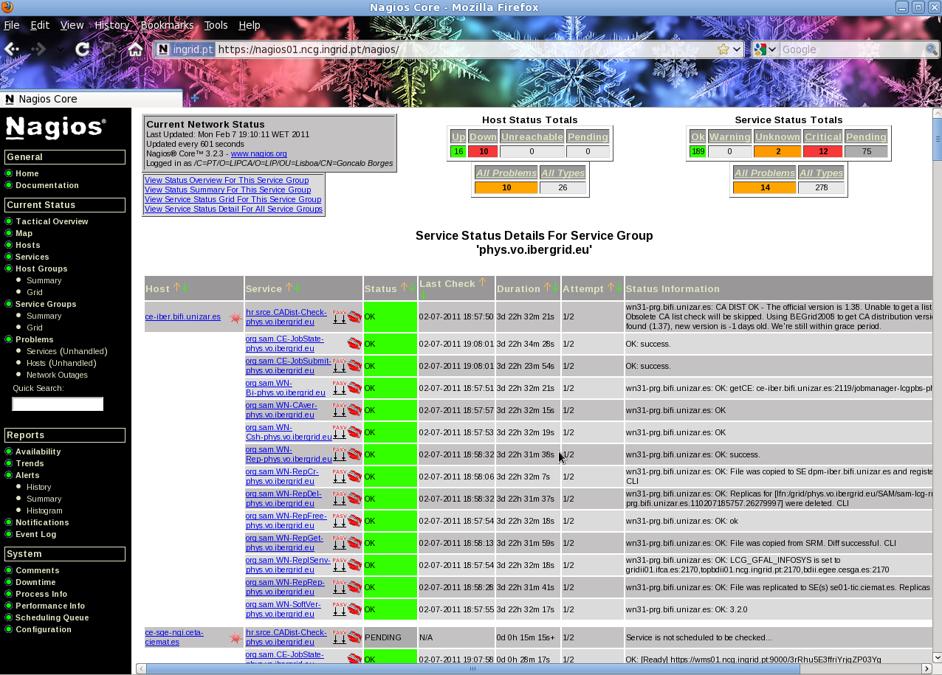
Software services www.egi.eu
Helpdesk
To deal with bugs, downtimes, etc.
Requirements tracker
Request changes to EGI services or provide solutions for others
Applications Database
Ready-to-use scientific applications including specialist applications
Tools for scientific programmers (workflow systems, frameworks, portals, etc.)
Training marketplace
Search, browse and request training resources (events, materials, etc.)
Virtual Organisation services
Monitor EGI sites and software services from your perspective
EGI web gadgets
Customise and embed EGI software services into your website!
Go to www.egi.eu/user-support/gadgets

Slide 6
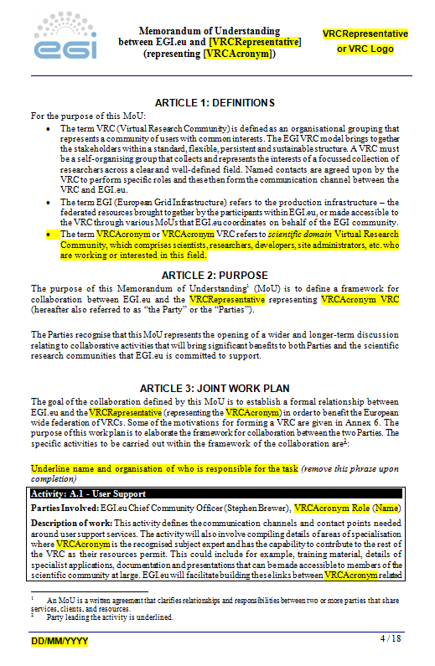
How to get involved as a VRC?
A VRC is
an organisational grouping that represents a community of users with common interests
a self-organising group that collects the interests of a focussed collection of researchers across a clear and well-defined field
A VRC isn’t
a hierarchical structure with a single leader
a layer that separates researchers from EGI services
the exclusive contact point from a research field
VRC Memorandum of Understanding
Defines the framework of collaboration with EGI.eu and the VRC representative
Template is available at https://documents.egi.eu/document/205
See LSGC MoU and the WeNMR MoU as examples

Slide 7
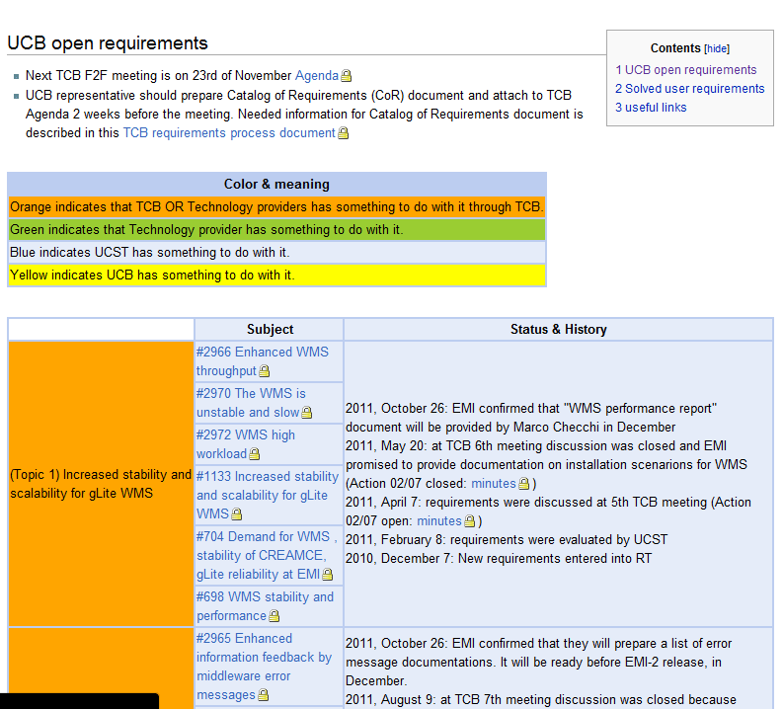
UCB Requirements
https://wiki.egi.eu/wiki/Track_User_Support_Requirements
Requirements captured from users and communities
Requirements investigated and analysed by User Community Support Team and TCB etc.
UCB involved in monitoring and endorsing process
Many resolved requirements

Slide 8
Requirements
The following have been discussed and pursued at TCB:
Increased stability and scalability for gLite WMS
Better (more verbose and informative) error messages
Fix known bugs before adding new features
Coherency of command line commands, parameters and APIs
Better feedback about jobs, automated resubmission of jobs that are stuck on sites
Coherency of storages and catalogue
Stability and scalability of data management services
TCB: Technology Coordination Board

Slide 9
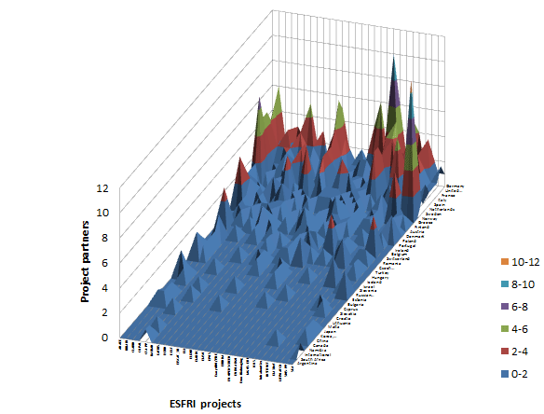
ESFRI project support
ESFRI: European Strategy Forum on Research Infrastructures
Aims of ESFRI:
develop scientific integration in Europe
strengthen Europe’s international outreach
competitive and open access to high quality Research Infrastructures
attracts the best researchers from around the world

Slide 10
Forum Workshops
Workshops for users and communities:
opportunities to further investigate identified requirements
Identify and share experiences & best practices
At Lyon Technical Forum the following ran:
Data management
NGI roadshow model – experiences and needs
VRC reports and presentations
Portal technologies: portlets, widgets and gadgets

Slide 11
Evolution of EGI…
...towards a virtualised pan-European e-infrastructure
Supporting services encapsulated into Virtual Machines
Virtualisation layer enables the integration of resources, monitoring, accounting and change notification
No ‘big-bang’ migration
Gradual change transparent to the end-user
Virtual Research Communities
Software
Central Services
Domain Services
Community Services
Virtualised services
Platforms
Current middleware (gLite, ARC, UNICORE, dCACHE, Globus)
Infrastructure
Virtualisation layer
NGI
NGI
EIRO
NGI
NGI
Related activities:
https://wiki.egi.eu/wiki/EGI_Virtualisation_Activities

Slide 12
Community Forum 2012
Munich: 26-30 March 2012
In conjunction with: EMI 2nd Technical Conference
Call for participation out under following tracks:
Users and communities
Software services for users and communities
Middleware services
Operational services and infrastructure
Coordination and Communication
Federated Cloud
talk, Presentation
or
workshop?
See www.egi.eu for details

