Slide 1
European Community Engagement within EGI
Gergely Sipos gergely.sipos@egi.eu
Customer and Technical Outreach Manager, EGI.eu
Nordic e-Infrastructure Conference 2017, Umėa, Sweden
Permalink to slides: https://documents.egi.eu/document/3126

Slide 2
Outline
EGI: Stakeholders, services
Engagement
Target groups
How?
Facilitating reuse
Conclusions

Slide 3
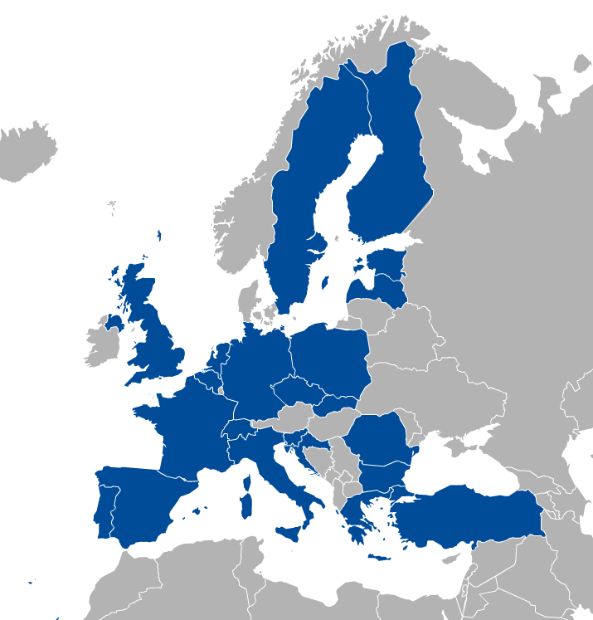
EGI stakeholders
NGIs
Council membership
Prime focus on national level
Activities sustained from local funding
Partners
Countries (quasi-NGIs) in Europe
Regional e-infrastructures outside of Europe
Software & service developer projects
EGI.eu Foundation
Coordinator of the whole federation
Engagement with multi-national communities
Baseline activities sustained from fees
New developments & areas funded from projects
EGI.eu in Amsterdam

Slide 4
EGI Service Catalogue
Compute
High-Throughput Compute
Execute thousands of computational tasks to analyse large datasets
→ Aka. ‘Grid computing’
Cloud Compute
Run virtual machines on demand with complete control over computing resources
Cloud Container Compute
Run Docker containers in a lightweight virtualised environment
Storage and Data
Online Storage
Store, share and access your files and their metadata on a global scale
Archive Storage
Back-up your data for the long term and future use in a secure environment
Data Transfer
Transfer large sets of data from one place to another
Training
FitSM training
Learn how to manage IT services with a pragmatic and lightweight standard
Training infrastructure
Dedicated computing and storage for training and education

Slide 5
EGI Service Catalogue
with New Developments
Compute
High-Throughput Compute
Execute thousands of computational tasks to analyse large datasets
→ Aka. ‘Grid computing’
Applications on Demand
Access scalable scientific applications ‘as services’
Cloud Compute
Run virtual machines on demand with complete control over computing resources
Cloud Container Compute
Run Docker containers in a lightweight virtualised environment
Storage and Data
DataHub
Online Storage
Store, share and access your files and their metadata on a global scale
Access key scientific datasets scalably
Archive Storage
Back-up your data for the long term and future use in a secure environment
Data Transfer
Transfer large sets of data from one place to another
Security
Training
CheckIn
FitSM training
Learn how to manage IT services with a pragmatic and lightweight standard
Handle transparent Single Sign-On from multiple, heterogeneous identity providers
Training infrastructure
Dedicated computing and storage for training and education

Slide 6
EGI Services for Participants
Operations
Coordination
Accounting Track and report the usage of your services
Helpdesk Handle EGI service requests and incidents for distributed support teams
Operations Tools Integrate resources and operations
Collaboration and Community Management Tools Coordinate activities to ensure seamless operations
Configuration Database Manage the configuration information of federated e­-infrastructure
Service Monitoring Monitor EGI services and provide operational and business insights
Validated Software and Repository Manage high-quality software releases
Communications Share your successes at a larger scale
ITSM Coordination Ensures professional service management for EGI IT services
Community Coordination A joint approach to user engagement
Operations Coordination and Support Coordinate activities to ensure seamless operations
Security Coordination Enhance local security for a safer global infrastructure
Project Management and Planning A joint approach to planning and management
Strategy and Policy Development Define common strategies and policies in Europe and worldwide
Technical Coordination Progress and innovation through collaboration
Security
Attribute Management: Manage community membership and expose trusted information

Slide 7
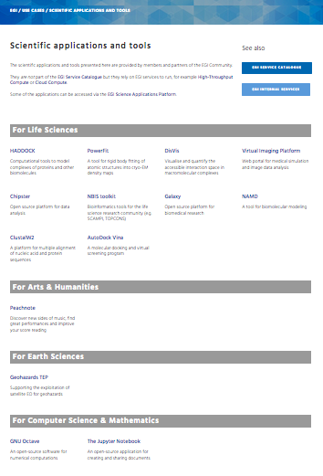
Thematic services from EGI partners
https://www.egi.eu/use-cases/scientific-applications-tools/

Slide 8
User engagement – Target groups
Size of individual groups
WLCG
CTA
ELIXIR
INSTRUCT
KM3Net
EPOS
EISCAT_3D
BBMRI
DARIAH
LifeWatch
EMSO
ICOS
ELI
VIRGO
SKA
Pierre Auger
CORBEL
ENVRIplus
…
144 global, 99 national ‘Virtual Organisation’
PeachNote
CEBA Galaxy eLab
Semiconductor design
Main-belt comets
Quantum pysics studies
Virtual imaging (LS)
Bovine tuberculosis spread
Convergent evol. in genomes
Geography evolution
Seafloor seismic waves
3D liver maps with MRI
Metabolic rate modelling
Genome alignment
Tapeworms infection on fish
…
VRE projects
WeNMR
VERCE
AgINFRAplus
LSGC
SuperSites Exploitation
Environmental sci.
neuGRID
…
gnublia
CloudSME
Terradue
TEISS
SixSq
Agroknow
UBERCLOUD
FAO
Engineering
Sinergise
EcoHydros
BDVA
…
ESFRIs, FET flagships
Multinational communities
Industry, SMEs
‘Long tail’

Slide 9
Self-servicing vs. Engagement projects
Website
User guides, Documentations, Request form
‘Catch-all’ services
Based on corporate SLA
E.g. Applications On Demand Service
NGIs to support national groups/projects
Engagement strategy
go.egi.eu/engagementstrategy
Engagement board
Customised, dedicated services
Pro-active outreach
Service planning
Builds on ‘Competence Centres’

Slide 10
Engaging with structured communities From opportunities to operational setups
Opportunity
Customer support case
Operation
User story (business case)
National partners
Potential EGI services
Business programme
NGI interest
Engagement board (NEW!)
→ Cost-value-interest analysis
Form “Competence Centre”
Detailed technical requirements
Co-design workshops
Sw. devel. &integration
Tests, formal evaluations
SLA – OLAs
Service satisfaction review interviews (3/6/12 months)
Improvement suggestions
Publications, users
Capacity plan updates
Helpdesk; Complaints
Business development
Customer relationship management
Service Level Management

Slide 11
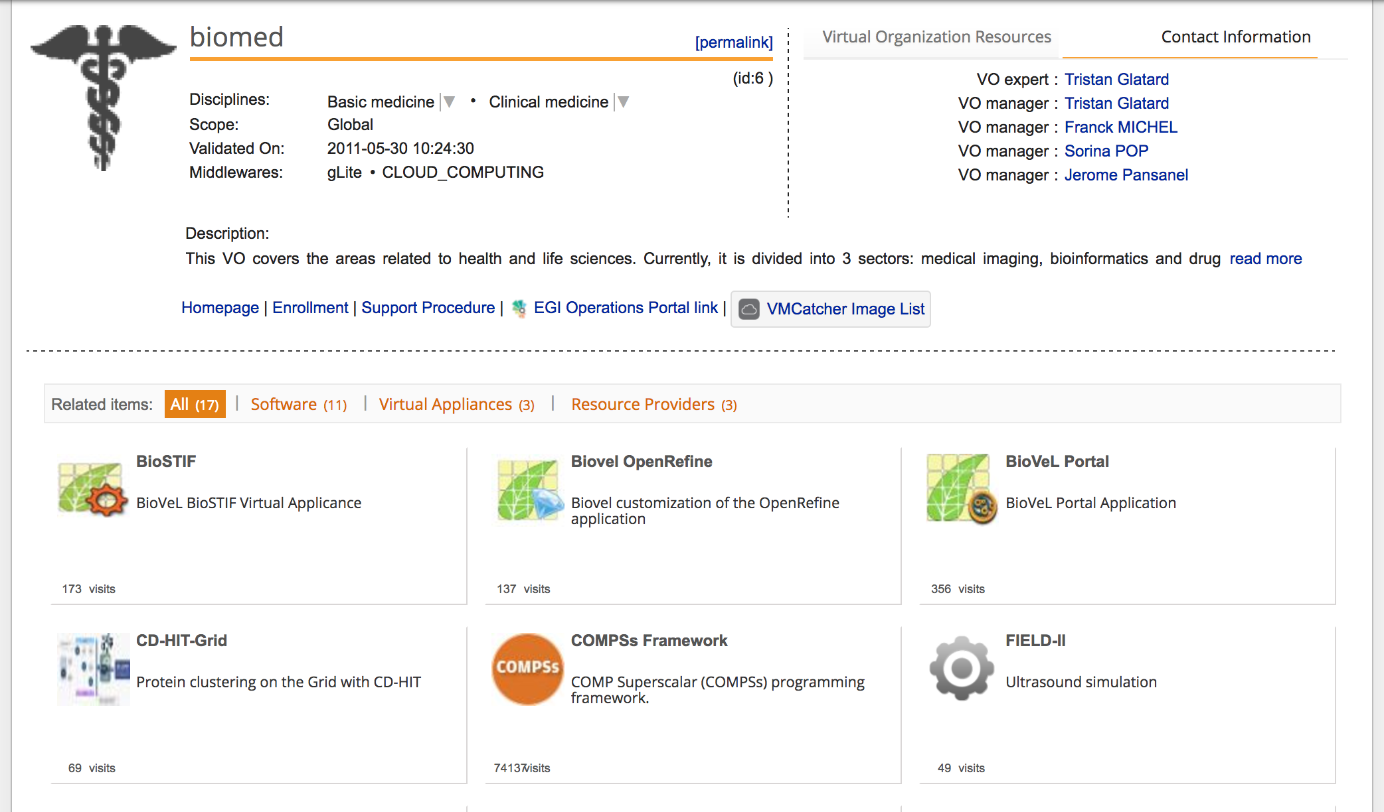
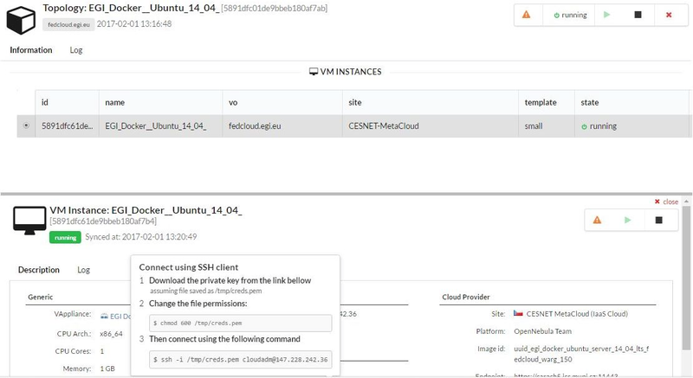
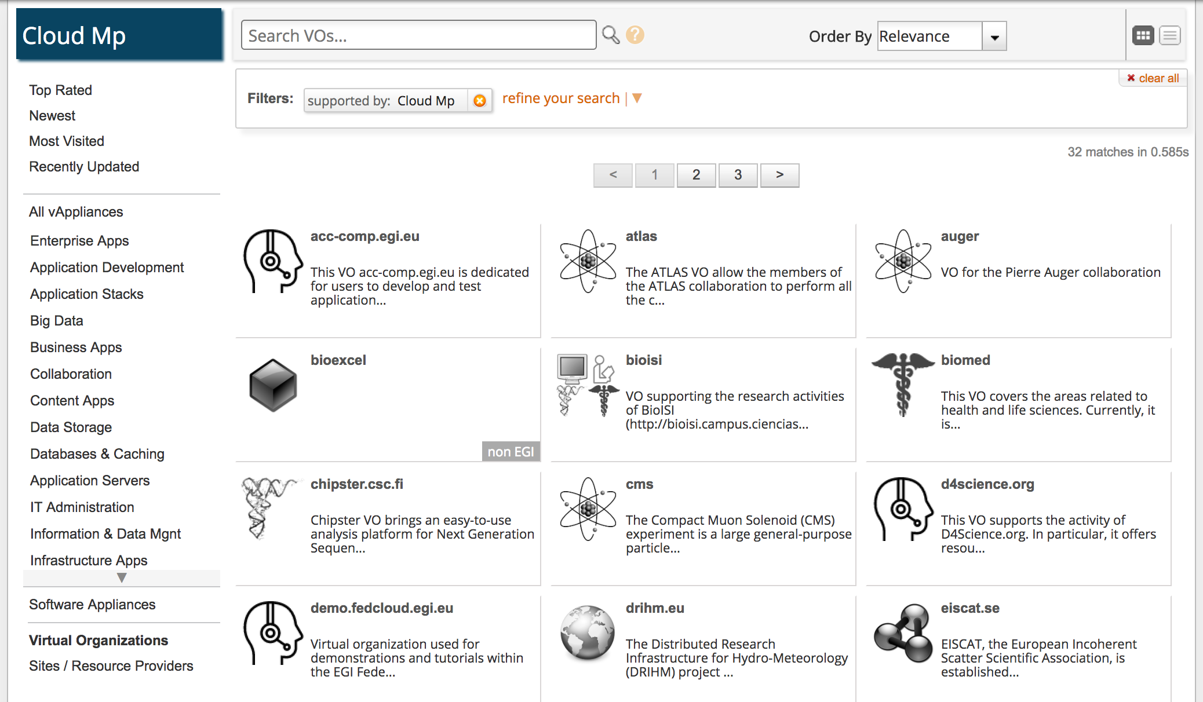
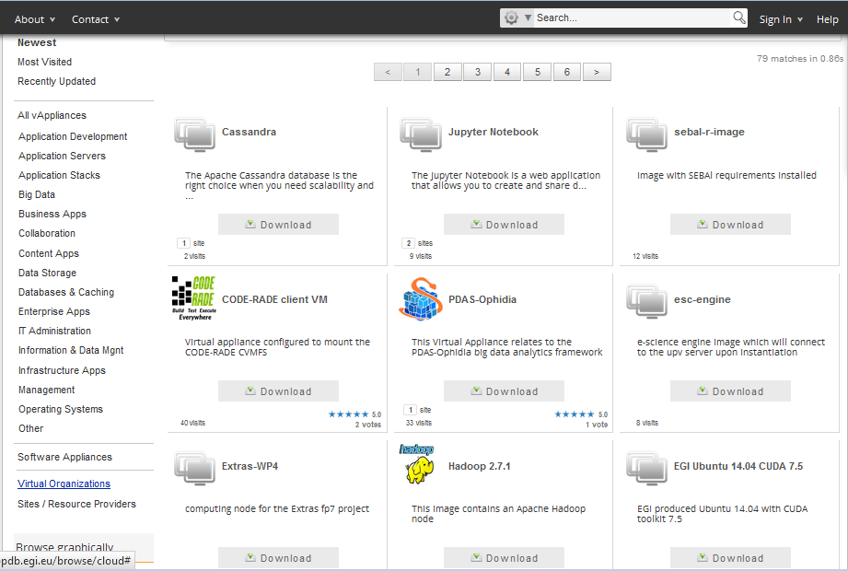
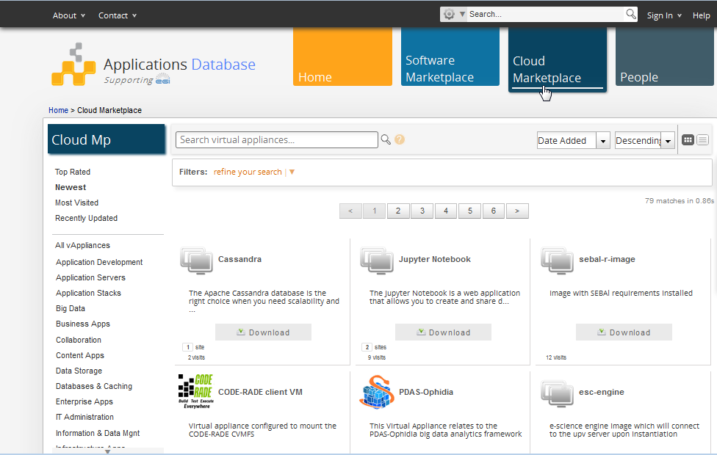
Facilitating reuse 1: AppDB (http://appdb.egi.eu)
VM Management Dashboard – NEW!

Slide 12
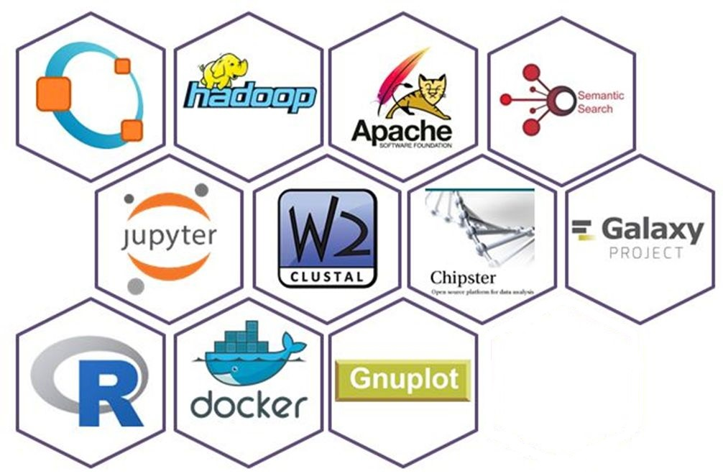
Facilitating reuse 2: Applications on demand service
Open for users: http://access.egi.eu
Open for providers:
Add new applications
Add gateways
Add cloud, HTC, storage
Join the support team
User Registration Portal (URP)
2. Approval
User
1. Request
User DB
User support team
3. Generate user account
4. Application use
8. Scientific papers
Applications hosted in VRE gateways
5. Obtain proxy
Infra. certificate
OpenAIRE
6. Access cloud/HTC/storage
Support team monitors user activity
EGI Accounting system
7. Accounting records
access.egi.eu resource pool

Slide 13
Conclusions
Growing EGI service portfolio
Self-servicing for the long-tail
Simple tools, high quality documentations are crucial
Pro-active outreach towards RIs
Co-design workshop, distributed support teams are crucial
Online tools that facilitate application reuse
AppDB, Applications on Demand Service
Engagement opportunity offered by EOSC
Challenges
Lack of ‘single point of contact’ within some NGIs – or for the Nordic
Diversity of member states (for both e-Infra and RIs)

