Slide 1
Addressing the big data challenges through a federated Research Data Cloud
Tiziana Ferrari/EGI.eu
EGI-Engage Technical Coordinator

Slide 2
Outline
The big data challenges
Brain research
Solid earth science
Astronomy
The cloud approach
opportunities and limits
EGI Cloud Federation approach
Vision

Slide 3
The big data challenges from EGI-Engage and the work of the EGI technical user support team

Slide 4
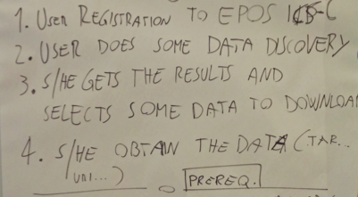
Extracting knowledge from data
The repeated pattern
for access to research data

Slide 5
The data access and processing challenge
Integration of research data from multiple repositories worldwide
Increasing demand to compute the data where the reference datasets are located and to make use of large storage and computing facilities (free-at-point-of-use, pay-as-you-go, etc.)
High performance I/O requirements (e.g. visualization)
Data cannot leave the hosting organizations in some cases
Data recalling from tape and transfer to local campus computing facilities or the cloud of choice can be unfeasible because of size → Users waste time on data exploitation rather than local procurement of data and computing, rather than data exploitation
User workload generated by data analysis jobs can cause scale problems at campus infrastructures

Slide 6
User stories 1/3 Human Brain Project/Neuroinformatics

Slide 7
Human Brain Project
Accelerate our understanding of the human brain by integrating global neuroscience knowledge and data into supercomputer-based models and simulations.
Six collaborative ICT platforms to engage research communities:
Neuroinformatics, Brain Simulation, High Performance Computing, Medical Informatics, High Performance Computing, Neuromorphic Computing and Neurorobotics
HBP Neuroinformatics Platform
Deliver multi-level brain atlases
Enable the analysis and integration of many different types of data into common semantic and spatial coordinate frameworks

Slide 8
HBP/Neuroinformatics infrastructure needs
Brain Research Facilities
Providing large amounts of image stacks or volumetric data produced daily at brain research sites around the world
Active Repository Centres
Data centres having respective storage solutions plus capacity for data processing and hosting visualization services
Metadata Brain Centre
Maintain the central HBP metadata repository

Slide 9
Human Brain Project use cases in the EGI Cloud Federation (1/2)
Remote interactive multi-resolution visualization of large volumetric datasets
Active repository combining large data storage with computational services for accessing and viewing large volume datasets
Requirements:
multi-terabyte storage capacity (1 image from 1-10TB)
compute node with fast I/O bandwidth (min a GB/s) to storage device
High performance internet connectivity for web services
A standardized AAI
Web client for interactive 2D/3D viewing using WebGL and/or OpenLayers.

Slide 10
Human Brain Project use cases in the EGI Cloud Federation (2/2)
Feature extraction and analysis of large volumetric datasets
Automated reconstruction of neuron morphology
Requirements:
the active repository
deployment of Vaa3D, a service that can include any type of neuron reconstruction algorithm
a multiprocessor compute node with high speed access to the storage device.
Datasets are provided by HBP organizations, Allen Institute/US, Monash University/Australia and others → data providers distributed worldwide

Slide 11
User stories 2/3 European Plate Observing System (EPOS)

Slide 12
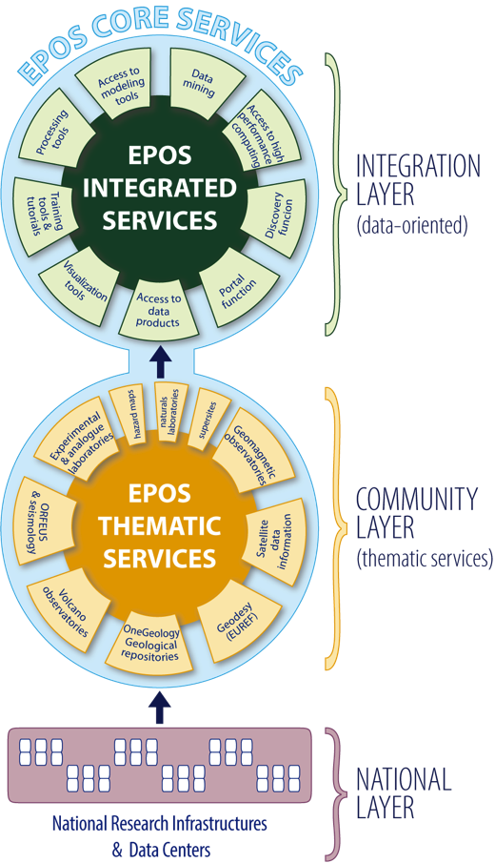
EPOS objectives
Promote and make possible innovative approaches on solid Earth Sciences:
enabling scientists to make use of multidisciplinary data
Metadata catalog in the EPOS Central HUB (ICS-C)
Distributed Services (ICS-D):
provide resources, including processing
Community Layer (Thematic Core Services – TCSs):
pan European e-Infrastructures of a single discipline
data and services for EPOS Central Hub
get data from national Research Infrastructures (RIs)

Slide 13
User story
Discover and connect to data repositories (access and download)
Use processing and modeling tools from EPOS for each thematic service area
Central Hub (for orchestration)
Distributed facilities computation, visualization etc., could be provided by a third party (e.g. EGI for computation)

Slide 14
EPOS-EGI use cases
Provide a computational infrastructure for
TCS seismology: compare synthetic seismograms generated from HPC simulations with real observations (MISFIT application)
TCS Satellite Data (in future from Copernicus): Earth surface displacement maps with geographical parameters

Slide 15
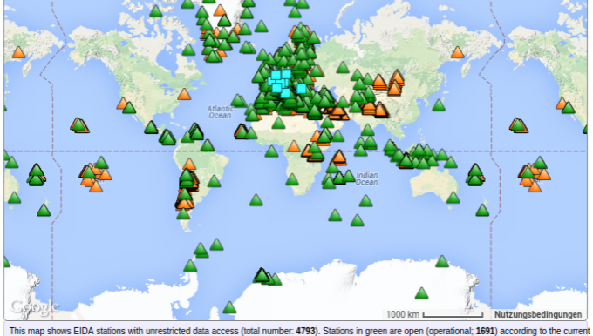
EPOS/Seismology
Data archive: EIDA
a distributed data centre archiving archive seismic waveform data and related metadata for geosciences research communities
350 TB, from more than 130 seismic sensor networks across Europe and more than 4500 stations
Users requiring transparent and integrated access
Archiving organizations needing credit for the invested resources and sustainability
Notes:
Courtesy of Javier Quinteros, Helmhotz Centre Potsdam

Slide 16
EPOS/Satellite data 1/2
Systematic and on-demand generation of EO products on wide areas on Earth from satellite radar data (SAR): Earth surface displacement maps and geophysical parameters retrieval
Retrieval and processing of data
Management of large satellite data archives
Data access is free but needs authenticated access, (data must be managed by European data custodians)
150 MB to 10 GB of input data, 1 new acquisition every 12 days
Long processing times, adaptation of algorithms to gain efficiency
10-100 processing nodes per area, > 10 Gb/s connectivity
High speed connectivity between archives and computing facility

Slide 17
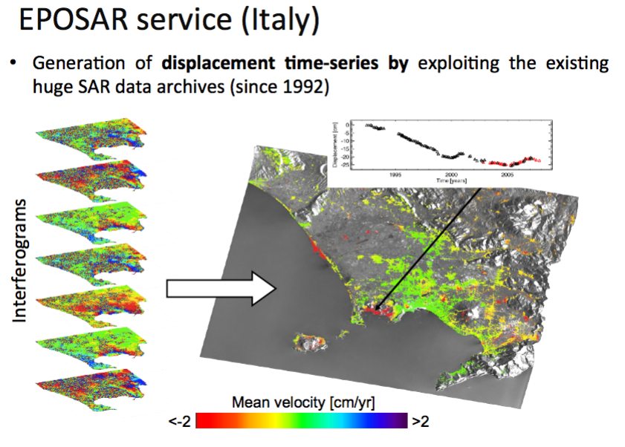
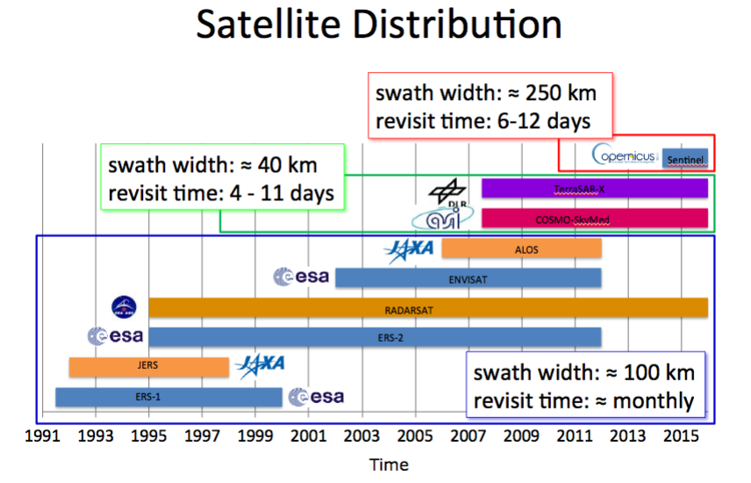
EPOS/Satellite data 2/2
Notes:
Courtesy of F. Casu, M. Manunta/CNR Italy

Slide 18
User stories The LOFAR radio-telescope

Slide 19
LOFAR
LOFAR telescope
array of simple omni-directional antennas making radio pictures of the sky, a Wide Area Sensor Network for geophysical research and studies in precision agriculture
7000 antennas arranged in clusters
Observational data:
More than 19 PB, + 3 PB/year of reduced data, data is open as of March 2015
up to 650 TB/day
Pathfinder for SKA
Notes:
R. F. Pizzo/ASTRON

Slide 20
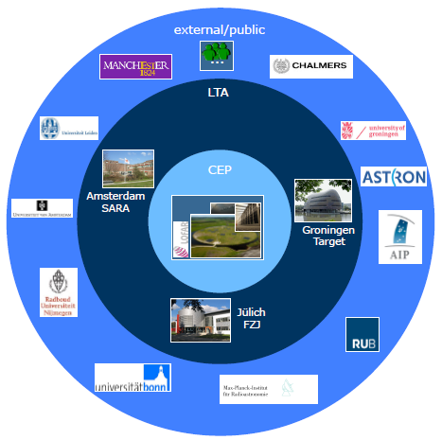
LOFAR use cases in the EGI Federated Cloud
LOFAR Long Term Archive (LTA)
Distributed information system created to store and process the large LOFAR data volumes
Collaboration plans: caching of LOFAR data in the EGI Cloud Federation to reduce time to recollect from tape and provide on demand batch processing (HTC) and execution of calibration pipelines

Slide 21
Other use cases
ELIXIR (Ensembl, Refseq, NR/NT, UniProtKB, PDB)
INSTRUCT
Euro-BioImaging
EISCAT-3D
Freshwater and marine resource conservation
Agrifood

Slide 22
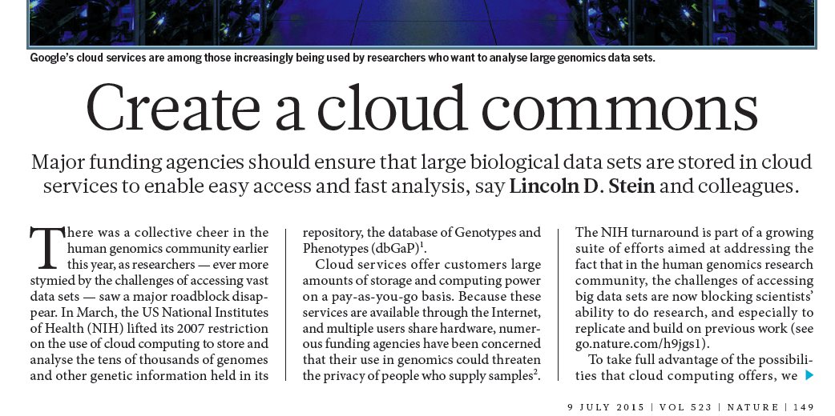
The Cloud approach
When cloud computing and storage can or cannot help for faster data analysis

Slide 23
The pros
Possibility to scale up in house computing and storage facilities and cope with variable user-generated load
Elasticity – vertical and horizontal
Provide an environment to run custom community tools and applications
Foster the creation of community of codes
Run on-demand batch processing (HTC)

Slide 24
What cloud CANNOT solve alone 1/3
Data analysis is not any faster if computing is not co-located with data
Need of data peering agreements to replicate major data sets worldwide → data distribution agreements and data peering points (data hubs) on cloud
HPC and HTC facilities co-located with data repositories
Community tools are needed for knowledge extraction
Need of a community platforms for sharing of open source scientific code and the development of communities of code

Slide 25
What cloud CANNOT solve alone 2/3
Research data is inherently distributed
Data portability must be ensured across different cloud providers → open cloud standards
Research data discovery
Data needs to be pre-staged → large on-line storage capacity and brokering compute to data (commercial providers give data for free, but charge for local storage, data still needs to be retrieved locally)
Data privacy rules need controlled access
Access control managed by or in agreement with the data providers, even in case of open research data
Federation to join up public, community and private clouds
Commercial and publicly funded ones
International data peering points

Slide 26
What cloud CANNOT solve alone 3/3
No separation between data, cloud compute, HTC, HPC and high speed connectivity
Cross-border procurement to avoid silos and the creation of disjoint research infrastructures
Coordinated investment to cope with scale and create an economy of scales
Role of funding agencies, data custodians, cloud providers and researchers in a “data commons” environment → need of governance and coordinated procurement

Slide 27
The EGI Cloud Federation Approach

Slide 28
What is a cloud federation?
Practice of interconnecting cloud service providers
Some motivations:
Data size – too large to move
Data privacy – not allowed to move
Shared investment – cannot afford at a single site
Distributed expertise – Knowledge is available at multiple sites; need to develop knowledge from multiple organizations

Slide 29
How to build a cloud federation
Multiple cloud sites with interconnection(s)
How are we implementing this in EGI?
Every cloud registered in a single catalogue
Single library of applications from/to users
Support for the same image format
Automated replication of VM Images to clouds
Single sign-on for users → X509 certificates from IGTF, eduGAIN in the future
Shared operational practices → EGI Operations tools and processes
Harmonised configuration, shared monitoring, accounting, etc.
Same user support model → Helpdesk, Network of support teams, Tutorials, etc.
Ticketing system, consultancy, training
The model can be extended to federate worldwide
NeCTAR/Australia, CANFAR, …

Slide 30
EGI Federated cloud
Development started in 2011
Production operations since May 2014
Currently:
21 providers from 14 NGIs
6.000 cores in total
700k VMs, 9M CPUh in last 12 months

Slide 31
Architecture of the EGI Federated Cloud
Manage instances
Uniform interfaces and behaviour
Share & endorse VM images (OVF)
Image replication
Cloud Site
(OpenStack)
Cloud Site
(OpenNebula)
Cloud Site
(Synnefo)
Cloud Providers
Service registry
Information system
Accounting
Monitoring
AAI (VOs)
Endorsed VM images
Operation services
Appliances Marketplace (AppDB)
EGI Core Platform

Slide 32
A Vision for the Open Science Cloud

Slide 33
“O” as “Open”
Data driven research relies on data, tools and applications
Create a platform for sharing of data, tools and applications
Communities of code
Discover and certify open source scientific software
Instantiate tools in a on-demand fashion on cloud
Commoning the data
The Data Commons are an ensemble open research data, tools, applications, virtual laboratories and the related knowhow that the researchers can freely share in a common space, which federates the data and hosts the computing and tools needed to extract knowledge from the data.

Slide 34
Federation of research systems
Federate research data that is made available for reuse through a network of large data hubs connected by a high speed communications facility and offering HTC, HPC and cloud computing facilities
more than a cloud, a federation of research systems
Data + computing
International peering agreements with data custodians
Agencies contributing to the funding of the data hubs and their international federation

Slide 35
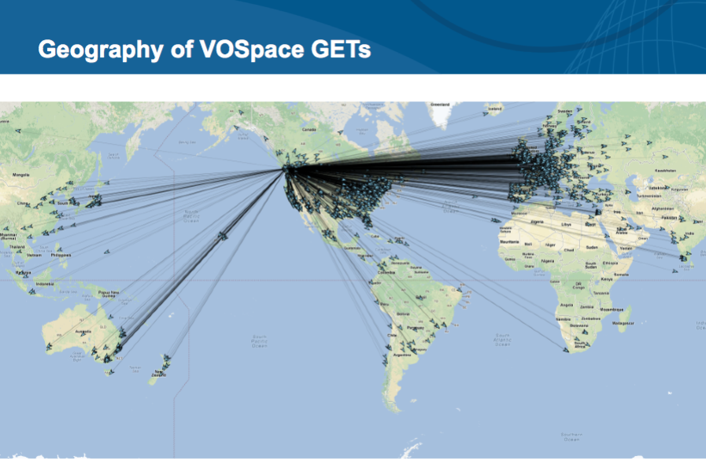
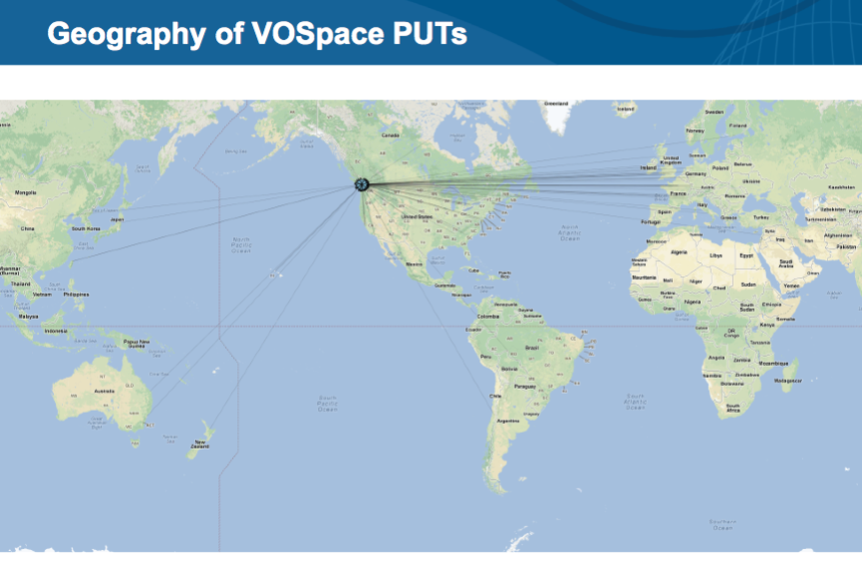
Federating international cloud infrastructures – the CANFAR/EGI collaboration
Replicate datasets for analysis in different world time zones (Canada and Europe)
Combining data for source detection and cross-matching
Involves:
Authentication, Data discovery and programmatic access
Data-location-aware virtual clusters
Storing results in a project data space
Collaborative analysis with science team
Notes:
Courtesy of S. Gaudet

Slide 36
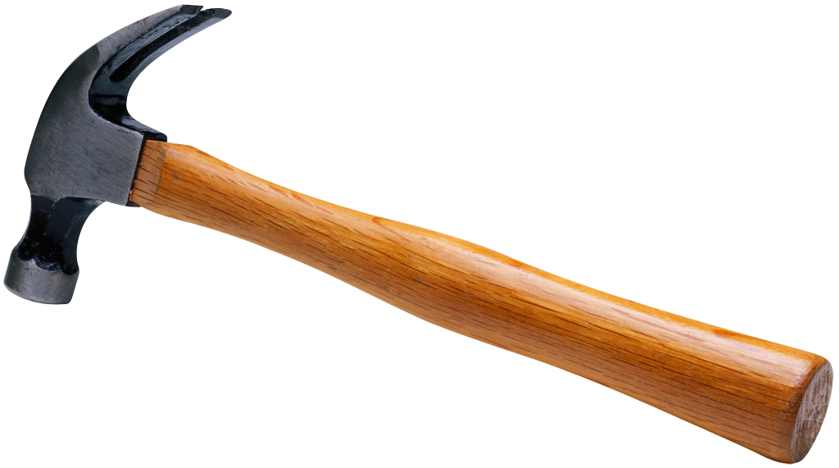
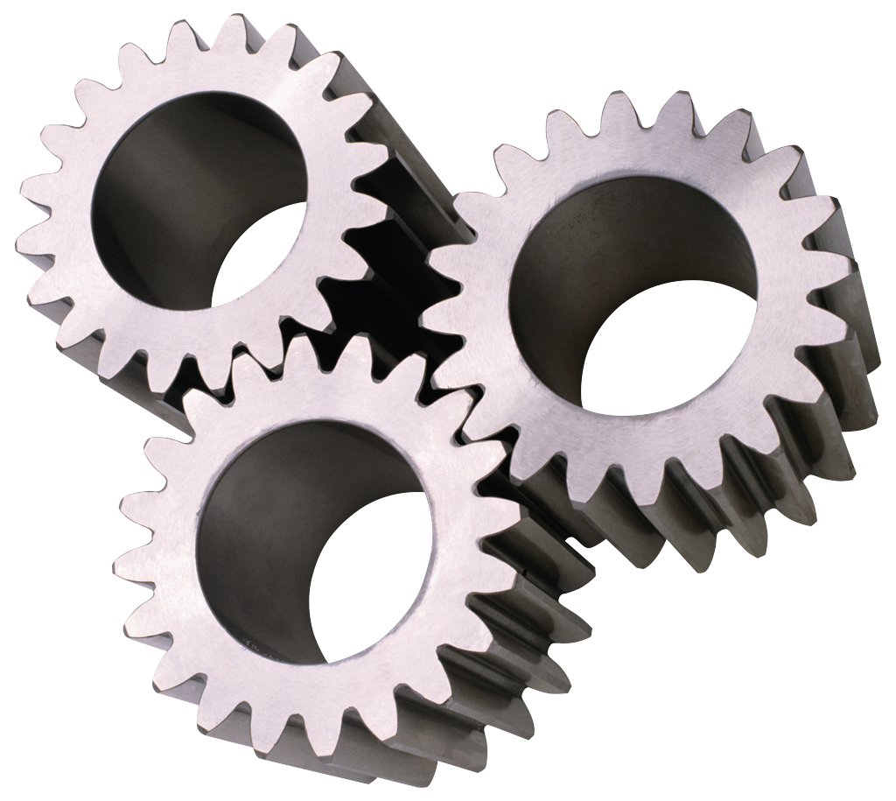
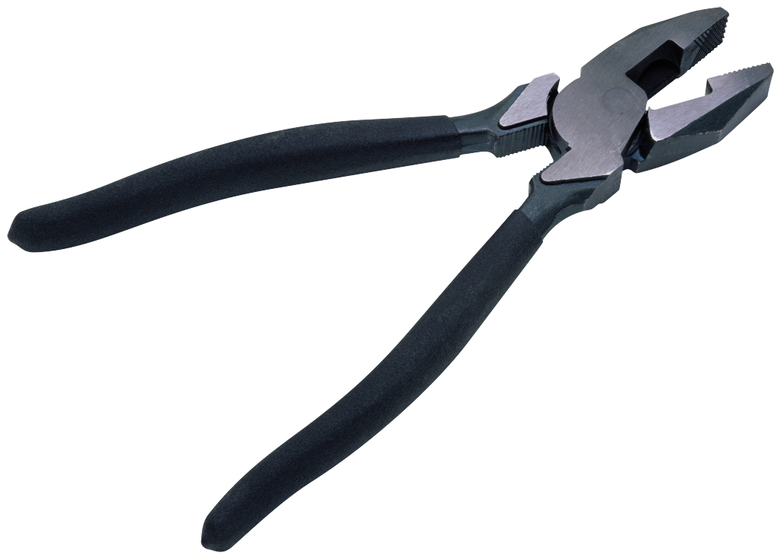
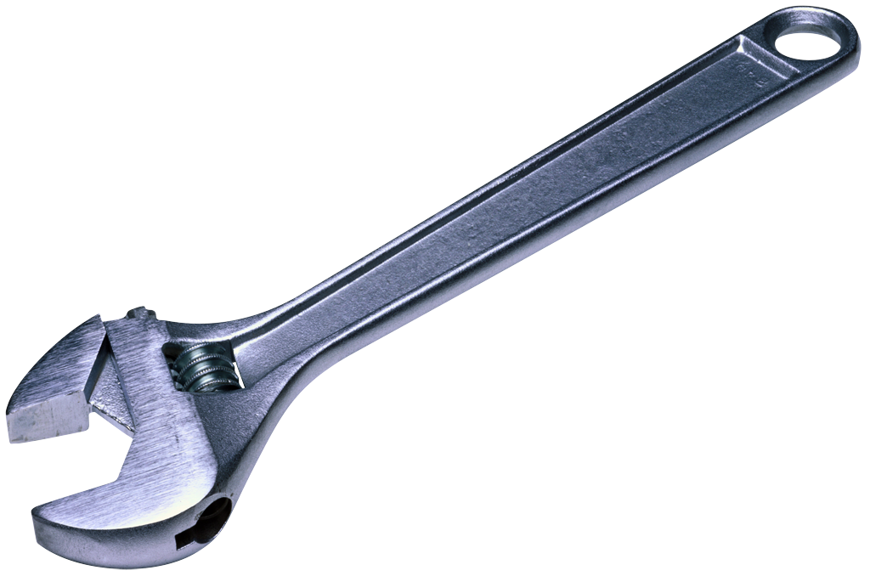
Research Data Cloud
Open Science Marketplace
Community platforms
Training marketplace
E-Infrastructure
Service marketplace
Data Commons Hubs:
Multidisciplinary data, community Applications, Tools, HPC/HTC and cloud services
Data
marketplace
Applications and cloud service registry
Data
Data
Data Commons Hub
Data Commons Hub
Research
Data Cloud
Data
Data
Data Commons Hub
Data Commons Hub

Slide 37
Research Data Cloud
An window opportunity for Europe to
to develop a leadership worldwide capitalizing on and expanding
existing projects
RI-e-Infrastructure cooperation efforts
International e-Infrastructure coordination activities
Develop a market of research data and use this for innovation

