Slide 1
Updates about the European Open Science Cloud from the EOSC-hub project
Gergely Sipos EGI Foundation
Member of CORBEL e-Infrastructure Board
Slides available at http://go.egi.eu/corbel2018
Dissemination level: Public

Slide 2
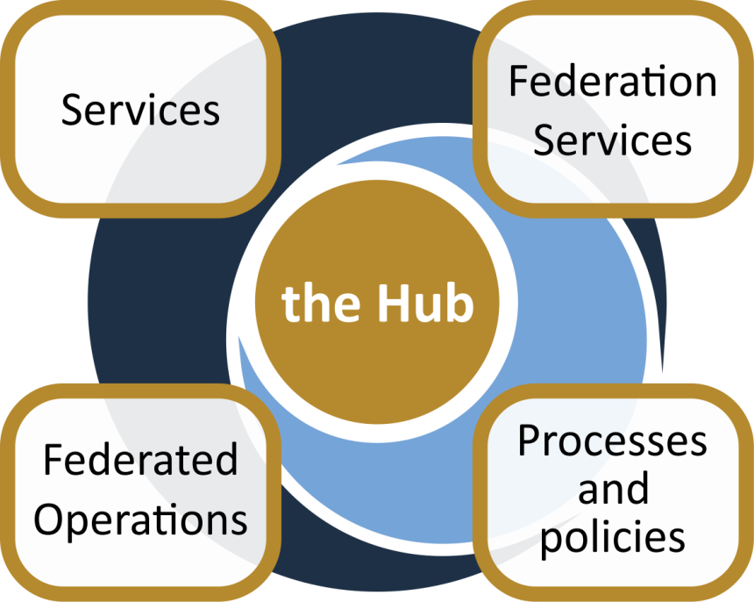
The project creates EOSC Hub:
a federated integration and management system for EOSC
Baseline services (storage, compute, connectivity)…
Data
Applications & tools
Support: Training, consultants
From the consortium AND from external contributors
Marketplace
AAI
Accounting
Monitoring
…
Security regulations,
Compliance to standards,
Terms of use,
FAIR implementation guidelines
…
Lightweight certification of providers
SLA negotiation
Customer Relationship Management
…
Based on FitSM

Slide 3
EOSC-hub: services & service areas today
Request access via https://eosc-hub.eu/catalogue
Compute
EGI High-Throughput Compute
EGI Cloud Compute
EGI Cloud Container Compute
Data Management & Storage
B2Handle
B2Find
B2Drop
B2Safe
B2Stage
CVMFS
EGI Datahub
EGI Online Storage
eTDR
Services for sensitive Data
Thematic Services
ECAS
DARIAH Science Gateway
OPENCoastIS
GEOSS
EO Pillar
WeNMR Suite
DODAS
LifeWatch Services
CLARIN CMI
Professional Services
FitSM Training
Data Management Planning
Platforms
EGI Workload Manager
IM (Infrastructure Manager)
PaaS Orchestrator
Research Data
LOFAR
EPOS-Orfeus
…
Identity & Security
EGI Check-in
B2Access
IAM
Aggregators
Applications Database
Repository of Validated Software
Slides from yesterday at Medical Infrastructures User Forum
http://go.egi.eu/miuf
Note: work in progress, mapping to services areas being reassessed

Slide 4
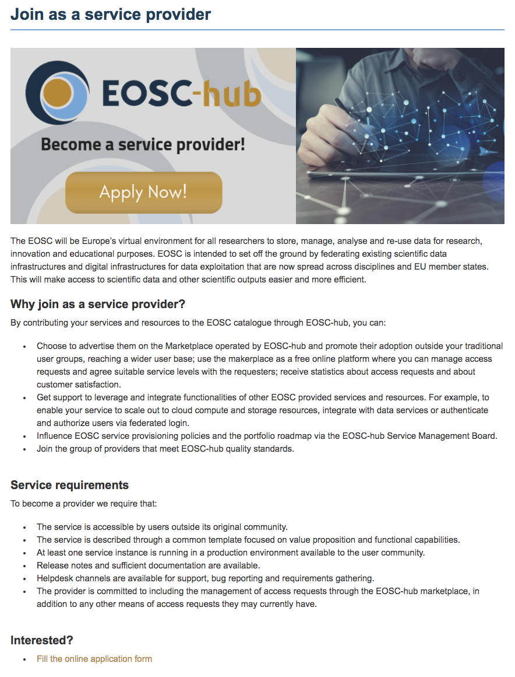
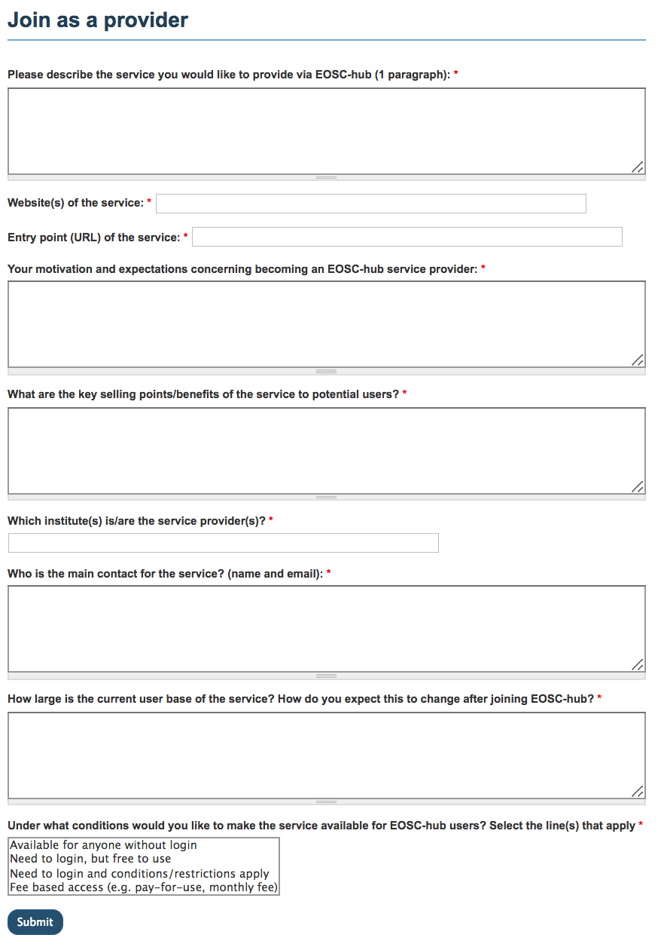
Become a service provider https://www.eosc-hub.eu/join-as-service-provider

Slide 5
EOSC-hub makes services and data F.A.I.R.
Findable → Harmonised service descriptions; Catalogue (→EOSC-Portal); PID service (B2HANDLE); Software and VM catalogue (AppDB), …
Accessible → Marketplace; Federated login across services; Harmonised access policies; …
Interoperable → Portable and scalable compute and storage; Orchestrators; Growing, community-defined standards; …
Reusable → Training & documentation; Long-term preservation service (B2SAFE)

Slide 6
EOSC-hub makes services reliable
Service validation (when entering the catalogue)
Aligned service management practices (based on FitSM processes)
Service monitoring with configurable test probes (based on ARGO)
Operations security (distributed Software Vulnerability Group)
Helpdesk reaching distributed service operators

Slide 7
Participate in EOSC-hub
Users & customers
EOSC-hub website
EOSC-hub marketplace
Services without authentication
Services requiring access control
Integration (optional)
Science community providers (from EOSC-hub and beyond)
EOSC-hub service catalogue
Thematic services
EOSC-hub common services
Basic infrastructure
Compute and storage
Federation Services
AAI, Accounting, Monitoring, Operations, Security
Added value services
Compute, data, software management, curation & preservation
Open Collaboration Services
Application/software repository, Configuration management, Marketplace
E-infrastructure providers (from EOSC-hub and beyond)
Notes:
Explain that users and service providers can participate in EOSC either as a service provider in offering a (thematic) service to researchers, to the end user. But services providers can also participate in EOSC as user or customer of services and resources provided via EOSC. The constrains under which a service is offered or can be used must be clear and can differ. The constrains under which a service is offered can differ because of community, national constrains or can depend on different requirements, for example the amount of resources requested.
A customer assembles a service (instance) for a group of users he/she represents.
Users use already configured service instances.
Thematic services can choose whether or not to be present in the Marketplace. If they opt out from the Marketplace then users will be redirected to them from the EOSC-hub website.

Slide 8
Growing the service catalogue through partnerships
INFRAEOSC-04:
Life and medical sciences
Neutron & photon physics
Social Sciences and Humanities
Environmental Sciences
Astro- and astro-particle physics
INFRAEOSC-02: New innovative services
INFRAEOSC-05(b): National services
INFRAEOSC-01: Commercial services
Research infrastructures (ERICs)

Slide 9
Technology Readiness Level (TRL)
TRL - Method of gauging the maturity of technology/service, used by EC
TRL Level | Description
1 | Basic principles observed
2 | Technology concept formulated
3 | Experimental proof of concept
4 | Technology validated in lab
5 | Technology validated in relevant environment
6 | Technology demonstrated in relevant environment
7 | System prototype demonstration in operational environment
8 | System complete and qualified
9 | Actual system proven in operational environment
TRL8 & 9 – considered Production Level within EOSC-hub:
past development and PoC/pilot/pre-production stages
evident to users which functionalities are present
users’ reasonable expectation of stability are met
Notes:
EC definition of the Technology Readiness Levels. The TRL levels are linked to the different phases within Service Development process.

Slide 10
Cross-coordination across EOSC initiatives
Areas:
Offering groups of services
Service validation and provisioning
User support (online guides and technical helpdesk)
Training for users (service-specific training & DMP)
Outreach and onboarding of users
EOSC-hub: collaboration framework for EOSC consortia targeting specific stakeholder groups (e.g. disciplinary groups / national groups / commercial entities)

Slide 11
EOSC Stakeholders Forum
Vienna, 21-22/Nov
https://eoscpilot.eu/events/second-eosc-stakeholders-forum
EOSC Launch event
Vienna, 23/Nov/2018
Slides available at http://go.egi.eu/corbel

